Slide 1



Web storages

Slide 2

TABLE OF CONTENTS
Cookies
Local Storage
HTML5 Storage
Storage support
Drawbacks to using local Storage
Storage and methods
Storage and listeners
Local Storage security risks
HTTP headers to enhance security

Slide 3
Local Storage
Cookies
HTTP is stateless protocol
Cookies manage state maintenance
Cookies are key/value pairs used by websites to store state information on the browser
Stored client side for tracking user
Cookies are transmitted in clear text (security issue)
HTTP/1.1 200 OK
Content-type: text/html
Set-Cookie: foo=10 Set-Cookie: bar=20; Expires=Fri, 30 Sep 2011 11:48:00 GMT
... rest of the response
GET /index.html HTTP/1.1 Host: www.example.com

Slide 4
Local Storage
Cookie attributes
Name: Specifies the name of the cookie
Value: Specifies the value of the cookie
Secure: Specifies whether or not the cookie should only be transmitted over a secure HTTPS connection. TRUE indicates that the cookie will only be set if a secure connection exists. Default is FALSE
Domain: Specifies the domain name of the cookie. To make the cookie available on all subdomains of example.com, set the domain to “example.com”. Setting it to www.example.com will make the cookie only available in the www subdomain
Path: Specifies the server path of the cookie. If set to “/”, the cookie will be available within the entire domain. If set to “/php/”, the cookie will only be available within the php directory and all sub-directories of php. The default value is the current directory that the cookie is being set in
HTTPOnly: If set to TRUE the cookie will be accessible only through the HTTP protocol (the cookie will not be accessible by scripting languages). This setting can help to reduce identity theft through XSS attacks. Default is FALSE
Expires: Specifies when the cookie expires. The value: time ()+86400*30, will set the cookie to expire in 30 days. If this parameter is omitted or set to 0, the cookie will expire at the end of the session (when the browser closes). Default is 0

Slide 5
Local Storage
Cookie types
Session cookie
Persistent cookie
Secure cookie
Http-only cookie
Same-site cookie (Strict, Lax, None)

Slide 6
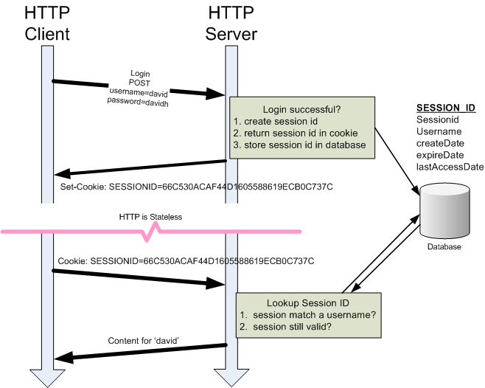
Local Storage
Session cookies

Slide 7
Local Storage
Pros and Cons
Cookie Pros:
scalability: all the data is stored in the browser so each request can go through a load balancer to different webservers and you have all the information needed to fullfill the request;
they can be accessed via javascript on the browser;
not being on the server they will survive server restarts;
RESTful: requests don't depend on server state
Cookie Cons:
storage is limited to 80 KB (20 cookies, 4 KB each)
secure cookies are not easy to implement: take a look at the paper A secure cookie protocol

Slide 8
Local Storage
Local Storage
Local Storage
A client application natively supports the storage of the data
Ini file
XML file
Registry
Etc.
In case of Web Applications so far there were almost only Cookies on the client side
Small size (4 kb)
With each request there content is sent
Not encrypted by default
Which we might need
High storage need on client side
Persistence should happen when reloading the site
Sending data to server is not necessary
Solution before HTML5
Internet Explorer – userData
64 kb is enough for everything
Flash 6 – Flash Cookies
100 KB – today already1 MB – 10 Mb
Google Gears
SQLite – embedded SQL database

Slide 9
HTLM5 Storage
HTML 5 Storage
HTML5 Storage
Current names in industry:
Web Storage
Local Storage
DOM Storage
Key / Value double storage
Data persists even if navigating from the site
We close the page
We close the browser
Does not send it back to the web server (only manually)
What is the size of the web storage ?
5 MB / Domain
If exceeding, we might permit further storage places (10 Mb) in case of certain browsers
Please note that only simple data are stored in text formats
What happens if we exceed 5 Mb?
Throw exception- QUATA_EXCEEDED_ERR
Might I ask for more storage place?
No!
Can be set in case of Opera

Slide 10
Drawbacks to using local Storage
Drawbacks to using local Storage
Are there any drawbacks to using local Storage instead of Cookies?
Usability
You user will not know if you are using localstorage or cookie so there is no difference for then. (If you disable cookies the localStorage will not work either)
Performance
Performance between the two is not a factor for choosing one, you can't notice any big difference.
sessionStorage
Here is a storage but only for this session, if you close this window the session will be lost and the data will be lost too, its like a session variable on any back-end language.
localStorage
Doesn't depend on session, if you add a data to the local storage that will be available to any window, and will exists until that is deleted by the user or the program.

Slide 11
Storage and functions
Storage and functions
Storage
The key can be only the string
Value is anything supported by JavaScript
String
Boolan
Integer
Float
Data will stored as string
Function
Storage
setItem();
Request
getItem();
var foo = localStorage.getItem("bar");
// ...
localStorage.setItem("bar", foo);
var foo = localStorage["bar"];
// ...
localStorage["bar"] = foo;
Remove of data
Remove of one data
removeItem();
Remove of more data
Clear();

Slide 12
Storage and listeners
Monitoring storage - Events
If we insert or remove elements, we might subscribe to events
if (window.addEventListener) {
window.addEventListener
("storage", handle_storage, false);
}
else {
window.attachEvent
("onstorage",handle_storage);
};
function handle_storage(e) {
if (!e) {
e = window.event;
}
}
Where is it phisically stored?
Windows – Internet Explorer
C:\Users\{UserName}\AppData\LocalLow\Microsoft\Internet Explorer\DOMStore\
In XML file!

Slide 13
Local Storage security risks
Local Storage security risks
Also known as Offline Storage, Web Storage. Underlying storage mechanism may vary from one user agent to the next. In other words, any authentication your application requires can be bypassed by a user with local privileges to the machine on which the data is stored. Therefore, it's recommended not to store any sensitive information in local storage.
Use the object sessionStorage instead of localStorage if persistent storage is not needed. sessionStorage object is available only to that window/tab until the window is closed.
A single Cross Site Scripting can be used to steal all the data in these objects, so again it's recommended not to store sensitive information in local storage.
A single Cross Site Scripting can be used to load malicious data into these objects too, so don't consider objects in these to be trusted.
Pay extra attention to “localStorage.getItem” and “setItem” calls implemented in HTML5 page. It helps in detecting when developers build solutions that put sensitive information in local storage, which is a bad practice.
Do not store session identifiers in local storage as the data is always accesible by JavaScript. Cookies can mitigate this risk using the httpOnly flag.
There is no way to restrict the visibility of an object to a specific path like with the attribute path of HTTP Cookies, every object is shared within an origin and protected with the Same Origin Policy. Avoid host multiple applications on the same origin, all of them would share the same localStorage object, use different subdomains instead.

Slide 14
HTTP headers to enhance security
X-Frame-Options
This header can be used to prevent ClickJacking in modern browsers.
Use the same-origin attribute to allow being framed from urls of the same origin or deny to block all. Example: X-Frame-Options: DENY
X-XSS-Protection
Enable XSS filter (only works for Reflected XSS).
Example: X-XSS-Protection: 1; mode=block
Strict Transport Security
Force every browser request to be sent over TLS/SSL (this can prevent SSL strip attacks).
Use includeSubDomains.
Example: Strict-Transport-Security: max-age=8640000; includeSubDomains
Content Security Policy
Policy to define a set of content restrictions for web resources which aims to mitigate web application vulnerabilities such as Cross Site Scripting.
Example: X-Content-Security-Policy: allow 'self'; img-src *; object-src media.example.com; script-src js.example.com
Origin
Sent by CORS/WebSockets requests.
There is a proposal to use this header to mitigate CSRF attacks, but is not yet implemented by vendors for this purpose.

