Slide 1
Introduction to Azure Kubernetes Service (AKS)
Attila Balogh-Biro

Slide 2
Agenda
Containerization overview
Kubernetes Overview
AKS Overview & Architecture
Interacting with the cluster
AKS Features

Slide 3
About Me
15+ years in the industry
Java and DevOps enthusiast
Microsoft Certified Trainer

Slide 4
Containerization overview
Provides isolation at kernel level (sandboxing)
Package your application and its dependencies
Built around Linux features like namespaces, cgroups etc.
Different implementation (Docker, Cri-o, Containerd)

Slide 5
Kubernetes overview
Kubernetes is an Open source container orchestration system
Focused around:
Scheduling
Scaling
Lifecycle management
Resilience and self-healing

Slide 6
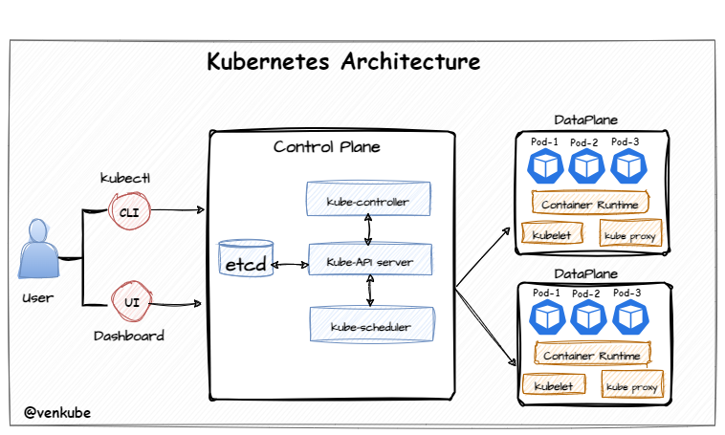
Kubernetes Architecture

Slide 7
But how to use?
Declarative resource management
Everything is a resource (object)
Pods (Single & Multi-Container pods)
Controllers:
Deployment / Replication Controller / Replicaset
StatefulSet
DaemonSet
Services:
ClusterIP / NodePort / Load Balancer

Slide 8
But how to use?
Persistent Volumes
Persistent Volume Claims
Storage classes

Slide 9
AKS Overview
Managed Kubernetes Service
Control plane managed by Azure, worker nodes are managed by customers
Reduces setup and operational complexity for production workloads

Slide 10
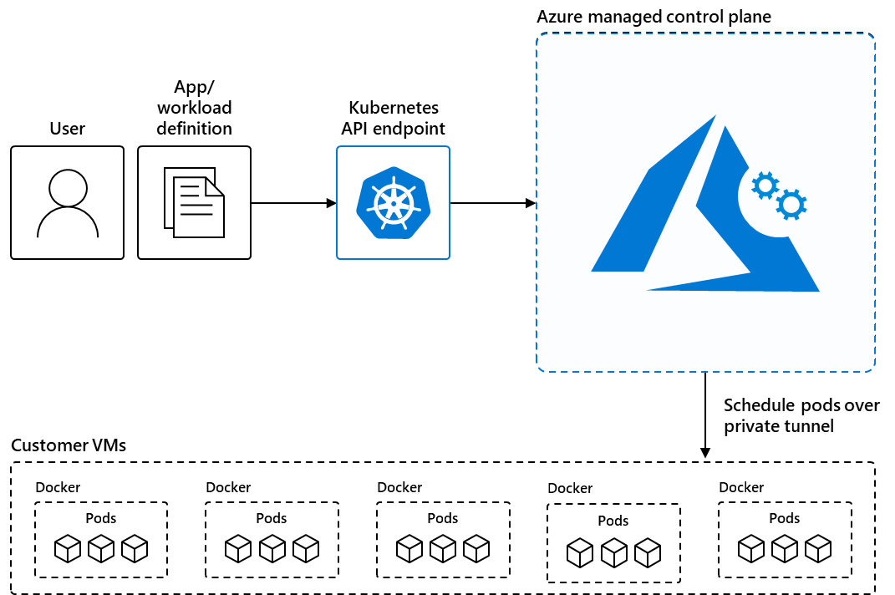
AKS architecture

Slide 11
AKS benefits
Identity and access management, Microsoft Entra ID integration
Logging and monitoring
Prebuilt cluster configurations for Kubernetes with smart defaults
Storage volume support (Azure Disk, Files, NetApp files)
Easy to use development tool integration (Helm, Visual Studio extension, built-in Istio support)
Autoscaling, multiple node types, GPU support etc.
Virtual Node/kubelet support

Slide 12
AKS benefits
CNCF certified Kubernetes implementation
Compliant with SOC, ISO, PCI DSS, HIPAA etc.

Slide 13
Container solutions in Azure
Container solution | Resource type
Azure Kubernetes Service | Managed Kubernetes
Azure Red Hat OpenShift | Managed Kubernetes
Azure Container Instances | Managed Docker container instances (serverless)
Azure Container Apps | Managed Kubernetes (serverless)

Slide 14
Thank you!

