Slide 1
Unsupervised image vectorisation
Attila Kun

Slide 2

Vectorisation
Abstract language (example: SVG)
Usefulness:
Scale agnostic rendering
Dimensionality reduction

Slide 3
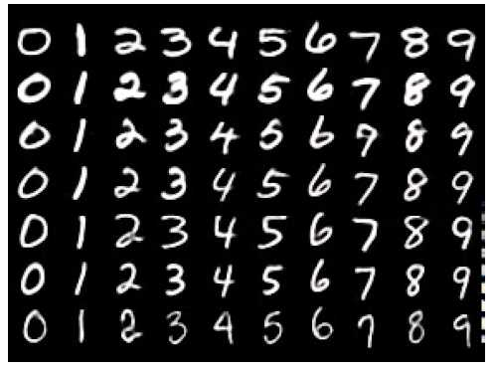
MNIST database
Collected from Census Bureau employees
70,000 images

Slide 4
Goals
Vectorise MNIST digits using fix number of lines
Use no labels
Make use of deep learning as opposed to classical techniques
  PyTorch (automatic differentiation, stochastic gradient descent)
  Rust

Slide 5
3 approaches
Traditional autoencoder
Variational autoencoder
Likelihood-free inference

Slide 6
Traditional autoencoder
Input
Output
Hidden code
Bottleneck layer
Compresses information

Slide 7

Differentiable renderer
Line1
Renderer
Line2
LineN
Heat map
Continuous function
Soft renderer

Slide 8
Differentiable renderer

Slide 9
Differentiable renderer
exp(-α*d^2)
d
Repeat for every pixel on GPU

Slide 10
Modified autoencoder
Input
Output
Renderer
Network learns how to produce useful inputs
Well defined interface
Inputs are the inferred vectors

Slide 11
Training
Whole architecture is differentiable
We can optimise using stochastic gradient descent
Source of randomness: minibatch training

Slide 12

Results
Original MNIST
Vectorised output
Pro: fast training
Con: weak results, cumbersome soft rendering implementation
Learns something but not great. How to improve?

Slide 13
Variational autoencoder
Generative model:
rz
Hidden code
z∼ p(z)
θ
p(z|x)?
Approximate the posterior using q(z|x) parameterised by φ
rz
x∼ p(x|z)
Generated sample

Slide 14
Variational autoencoder
In the image vectorisation context:
p(z): Vectors
p(x|z): Generated images
p(z|x) ≈ q(z|x): Inferred vectors of an image. Finding this is our goal.
p(x|z), q(z|x) are neural networks
p(z) is multivariate standard normal

Slide 15

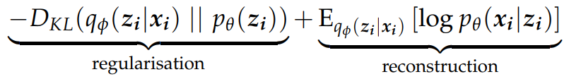
Variational lower bound
If the lower bound is maximal w.r.t. θ and φ, then q(z|x)=p(z|x)

Slide 16
Implementing p(x|z)
How to turn vectors into an image?
We need a renderer

Slide 17
Non-differentiable renderer
Differentiable programming is annoying
Non-differentiable programming is more general
Solutions:
1. Approximating gradients with a neural network
2. Native implementation (Rust) => big speedup

Slide 18
Putting it together
Approximate renderer + variational objective
Training via stochastic gradient descent

Slide 19






Results

Slide 20




Sampling from prior
Regularised
Unregularised

Slide 21
Likelihood free inference
Variational autoencoders use fully specified distributions
Sometimes we can only sample from an implicit distribution

Slide 22
Implicit distributions
Generative model
Inference model
rz
rz
Hidden code
p(z)
q(z|x)
Inferred hidden code
θ
φ
rz
rz
p(x|z)
Empirical sample
Generated sample
d(x)

Slide 23
Discriminator
Train a discriminator that can tell the difference between pairs
Generative model
Inference model
z∼p(z)
x ∼ p(x|z)
z∼q(z|x)
x ∼ d(x)
VS

Slide 24
Problems
Mode collapse
Complication: approximate rendering
Possible solution: Different objective (Wasserstein)

Slide 25
Summary
Traditional autoencoder (differentiable renderer) 😐
Variational autoencoder (non-differentiable renderer) 🙂
Likelihood-free variational inference 🙁
Conclusion:
Classical techniques might be still better
More complicated approaches like SPIRAL would give better results at the cost of higher complexity

Slide 26
Thank you. Questions?

