Slide 1

Claude Code
Mastering Anthropic's Agentic Coding Tool
Attila Budai
For Intermediate-to-Senior Developers • 2026

Slide 2
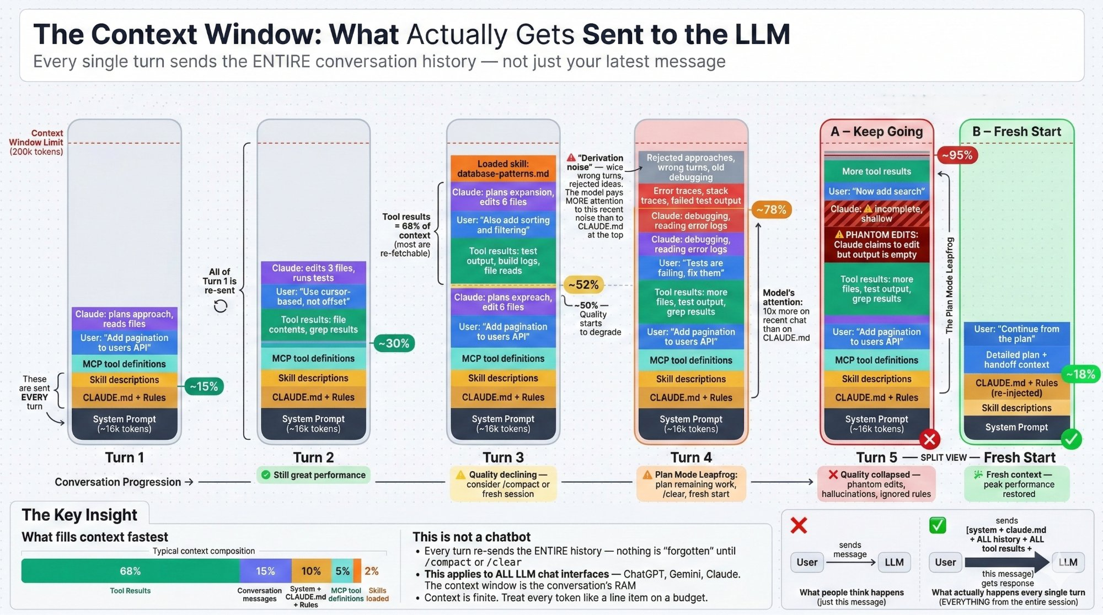
The Context Window — What Actually Gets Sent

Slide 3

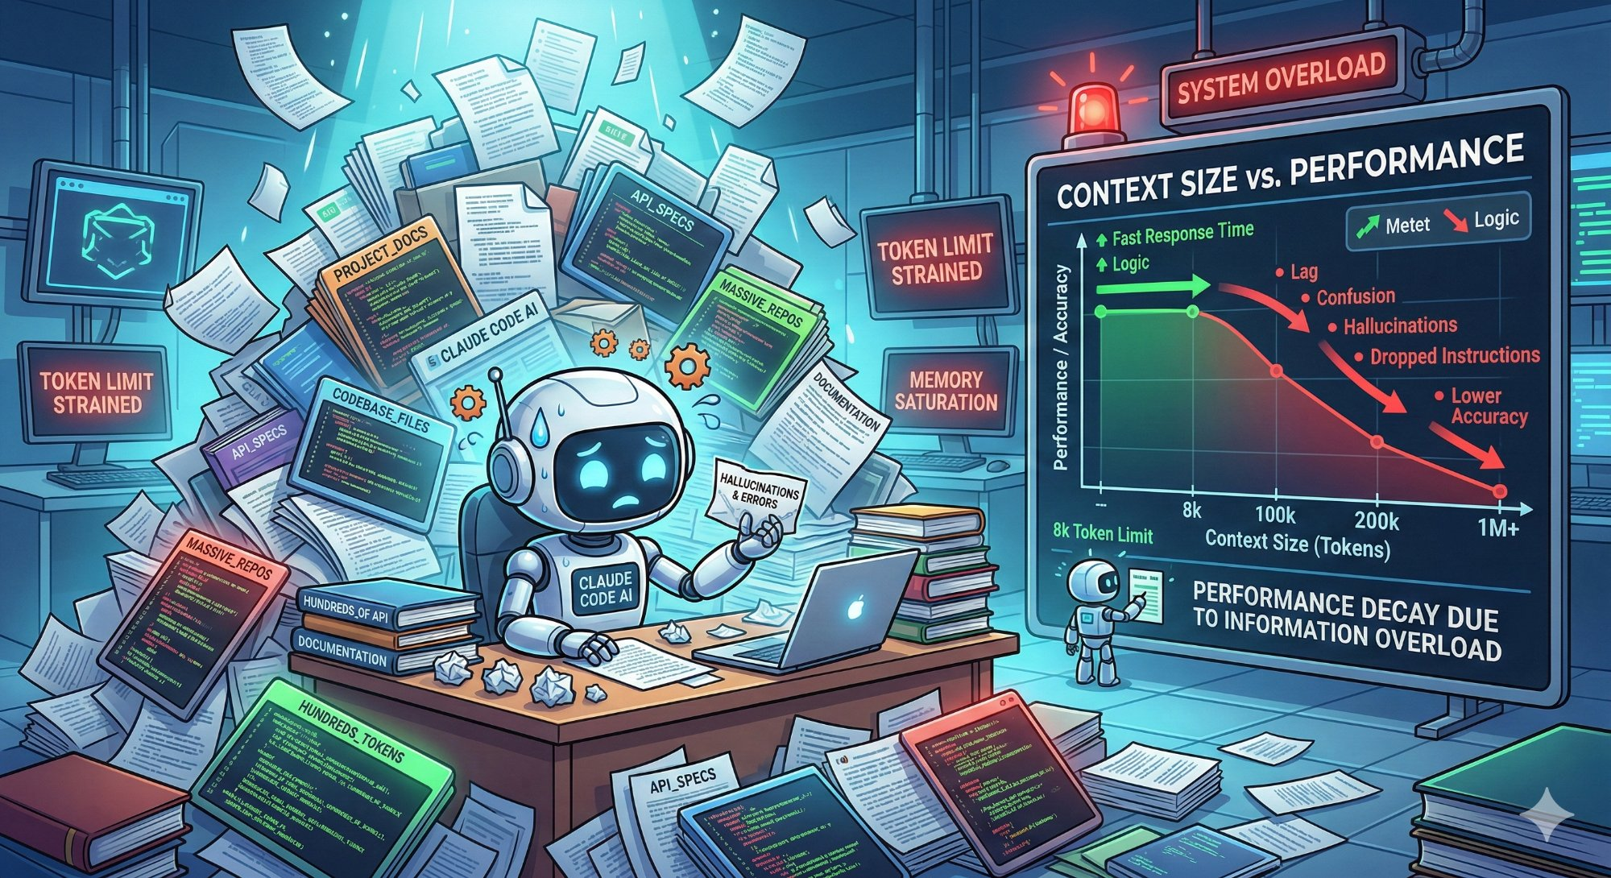
Context Handling — The #1 Operational Skill
~50%
Peak performance
context usage
~30 min
Quality degrades at
70-100k tokens
22–38%
Auto-compact overhead
of context window
up to 66%
MCP idle consumption
of context
Three context problems: Ordering (recency bias) • Saturation (needle-in-haystack) • Decay (stale info)

Slide 4





What is Claude Code?
Anthropic's official agentic coding tool. Started as a CLI, now available across terminal, IDE, desktop app, browser, and mobile. It understands your codebase, reads/writes files, executes commands, and works autonomously — all through natural language.
What makes it agentic?
Agentic = autonomous goal pursuit through a Plan → Act → Observe → Iterate loop
Plan
→
Act
→
Observe
→
Iterate
Breaks the goal into steps, identifies risks
Uses tools — file edits, shell, git, MCP
Reads results — test output, errors, file state
Adjusts the plan based on what it observed
Why context matters here: Every iteration of this loop generates tool results that fill the context window. A complex task may run 50+ cycles. Managing context is managing the quality of the agentic loop.

Slide 5











The Claude Code Dictionary
CLAUDE.md
Subagent
Project config file injected into every conversation. Your "constitution" — rules, routing, conventions.
A child Claude session with its own context window and tools. Delegated work returns only a summary.
Skills
Commands
Markdown files in .claude/skills/ loaded on demand. Expert knowledge for specific tasks (e.g. database migrations).
Markdown files in .claude/commands/ — custom workflows invoked with /slash syntax.
Hooks
Agents
Shell scripts that run before/after Claude acts. Mandatory enforcement — Claude cannot skip them.
Specialists in .claude/agents/ — run in separate context with specific roles (e.g. code-reviewer).
Rules
Worktrees
Files in .claude/rules/ always loaded into context. Modular laws for testing, security, code style.
Git feature: multiple working copies of a repo. Enables parallel Claude sessions on separate branches.
MCP
Memory
Model Context Protocol — standard for connecting external tools (databases, APIs, services) to Claude.
Claude's cross-session learnings. Persists between conversations, separate from CLAUDE.md.

Slide 6




MCP — Model Context Protocol
MCP is an open standard (created by Anthropic) that lets Claude connect to external tools and data sources through a unified protocol. Think of it as USB-C for AI — one standard connector for databases, APIs, file systems, web services, and more.
How It Works
Claude (Client)
→
MCP Server
→
External Service
Claude Code acts as the MCP client. It discovers available tools from connected servers.
A lightweight process that exposes tools, resources, and prompts via the MCP protocol.
The actual data source — PostgreSQL, GitHub, Jira, Slack, filesystem, custom APIs.
Context cost: Each MCP server's tool definitions consume tokens just by being registered — up to 66% of context. Install only what you need, toggle OFF when not in use.

Slide 7


Subagents & Delegation
A subagent is a child Claude session that runs in its own context window with its own tools and model. The parent delegates a task, the subagent works independently, and only a summary comes back — keeping the parent's context clean.
"Do it myself" — Execute
"Delegate" — Subagent
Uses the main context window
Gets its own fresh context window
All tool results stay in context
Has its own tools and can be a different model
Context fills up with every action
Only a summary returns to parent
Best for: small, focused tasks
Best for: large tasks, parallel work, specialists
Define reusable specialists in .claude/agents/ — e.g. code-reviewer.md, security-agent.md — each with its own role and instructions

Slide 8



Slash Commands & Daily Workflow
/compact
/init
Summarize conversation and free context. Use when context is getting heavy (~50%+). Claude creates a summary and starts fresh from it.
Initialize CLAUDE.md for your project. Claude analyzes your codebase and generates an initial constitution with conventions and routing.
/clear
/review
Hard reset — wipe entire context and start a brand new session. More aggressive than /compact; no summary carried over.
Trigger a code review workflow. Claude examines recent changes, checks against project rules, and provides structured feedback.
/teleport
/your-command
Transfer your current session from one surface to another. Start on claude.ai/code (mobile), continue in terminal. Carries context across.
Custom commands from .claude/commands/ — define your own workflows in markdown and invoke them by name.

Slide 9

The Claude Product Family
Claude Chat
Claude Code
(Web)
Claude Code
(CLI/Desktop)
claude.ai (Chat)
claude.ai/code
Terminal / Desktop / IDE
Interface
Interface
Interface
Browser chat
Browser coding UI
Terminal + IDE panels
File Access
File Access
File Access
Upload only
GitHub repo connect
Full local filesystem
Shell
Shell
Shell
No shell access
Cloud sandbox
Full local shell
Persistence
Persistence
Persistence
Conversation history
Project memory
CLAUDE.md, hooks, skills
Best For
Best For
Best For
Questions, writing,
analysis
Plan, implement,
create PRs
Plan, implement,
test, commit

Slide 10

Claude Code vs Cursor vs Windsurf
Feature | Claude Code (CLI) | Claude Code (Web) | Cursor | Windsurf
Interface | Terminal / Desktop / IDE | Browser | VS Code fork | VS Code fork
Model | Claude only | Claude only | Multi-model | Multi-model
Agent mode | Core architecture | Core architecture | Added in 2.0 (Oct 2025) | Added (Cascade)
Context control | Full (selective loading) | Partial | Partial (silent truncation) | Minimal (loads all rules)
Git integration | Deep (worktrees, diffs) | GitHub PRs/branches | Basic | Basic
Extensibility | CLAUDE.md, hooks, MCP | CLAUDE.md (limited) | .cursorrules | Rules
Parallel work | Git worktrees (3-100) | Browser sessions | Single workspace | Single workspace
Mobile access | No | Yes | No | No
Context autonomy matters: Claude Code gives you full control over what enters context. Cursor silently truncates for cost/performance. Windsurf loads everything every time.

Slide 11


Competitive Edge — Head to Head
Where Claude Code Wins
Where Cursor / Windsurf Win
Full autonomy — plan, implement, test, commit
Visual feedback: inline diffs & live previews
Multi-surface (terminal, IDE, desktop, web, mobile)
Lower learning curve: familiar IDE UX
Parallel execution with git worktrees (3–100 agents)
Faster tab completion for small edits
Deep enforcement: hooks, skills, subagents
Multi-model: switch GPT, Claude, Gemini per-request
Terminal-native: SSH, tmux, headless servers
CI/CD: GitHub Actions, GitLab, Slack integration

Slide 12


The Three Permission Modes
Toggle with Shift+Tab during a session
Normal
Auto-Accept
Plan Mode
Asks permission for each tool use
Approves all actions automatically
Can explore but not modify
Best for: Learning, sensitive work
Best for: Trusted tasks, experienced users
Best for: Architecture, planning, research
What Requires Permission
File reads — usually auto-allowed
Shell commands — approval (risky always ask)
File writes — requires approval in Normal mode
Git commits/pushes — always ask

Slide 13


settings.json — Configuration Guide
File Locations & Precedence
Key Settings
Scope | Path | Shared?
Managed | /etc/claude-code/settings.json | System-wide
User | ~/.claude/settings.json | No
Project | .claude/settings.json | Yes (git)
Local | .claude/settings.local.json | No (gitignored)
{
"model": "opus",
"permissions": {
"allow": ["Bash(npm run *)"],
"deny": ["Read(.env)"],
"defaultMode": "acceptEdits"
},
"hooks": { ... },
"sandbox": { ... },
"env": { "KEY": "value" }
}
Precedence: Managed > CLI args > Local > Shared > User
Arrays (like permissions.allow) merge across scopes
Pro tip: Use project-level .claude/settings.json for team-shared conventions, and .claude/settings.local.json for personal overrides. Managed settings (enterprise) cannot be overridden.

Slide 14
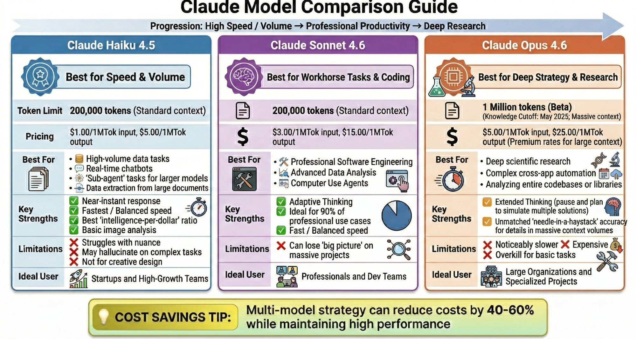
Claude Model Comparison Guide

Slide 15
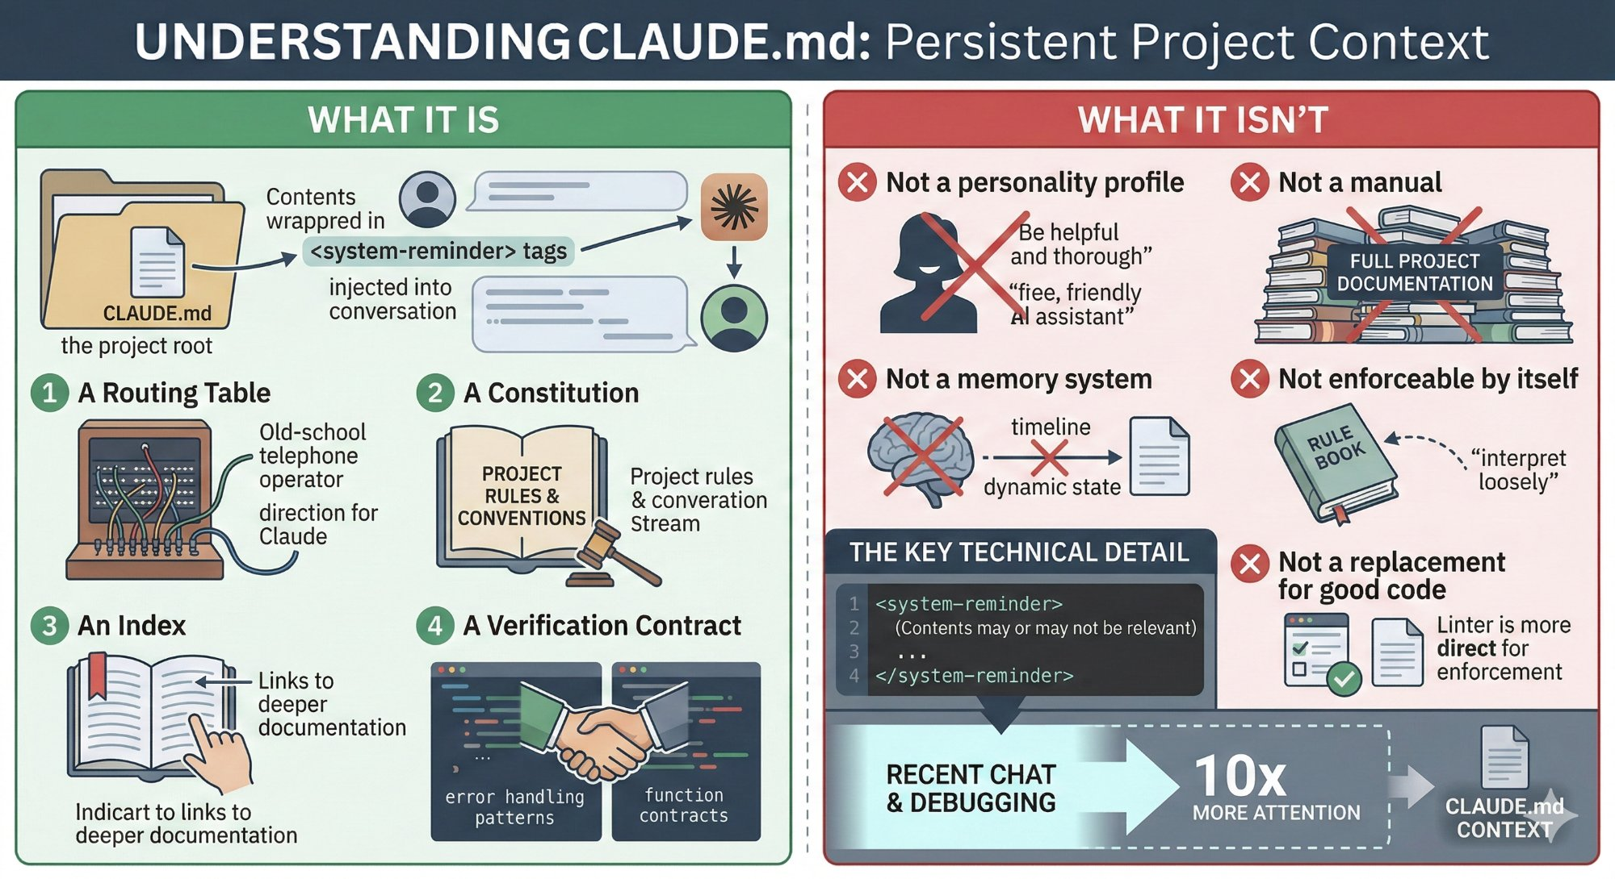
CLAUDE.md — Persistent Project Context

Slide 16
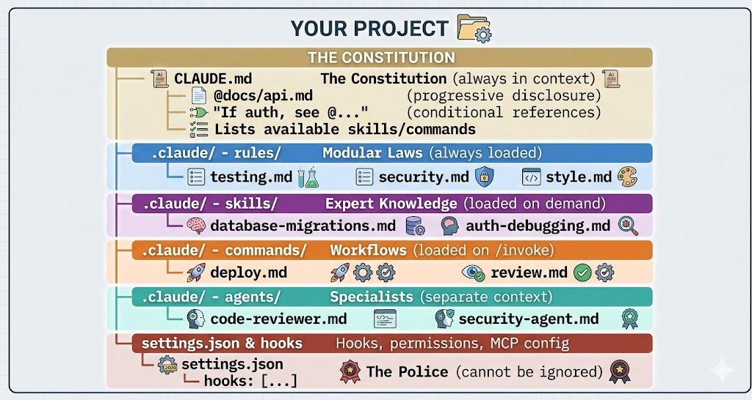
Project Configuration Hierarchy
CLAUDE.md = Constitution (advisory) • Skills = SOPs (optional) • Hooks = Police (mandatory)

Slide 17

Plan Mode — Think Before You Act
What Plan Mode CAN Do
What Plan Mode CANNOT Do
Explore the codebase (read files, search, grep)
Modify files
Design implementation approaches
Run shell commands
Create detailed implementation plans
Make any changes to your project
Analyze architecture & dependencies
Execute git operations
The IDE + CLI Hybrid Workflow
Claude Code
(CLI/IDE)
Cursor /
Native IDE
Terminal
Web /
Mobile
Multi-file changes, refactoring, features, debugging
Quick edits, inline autocomplete, visual navigation
Parallel worktree sessions, background agents
Long-running tasks, reviewing on the go

Slide 18


Hooks — The Enforcement Layer
Shell scripts that execute outside Claude's decision loop. Claude cannot ignore, interpret, or skip them.
PreToolUse
PostToolUse
Stop
Validates before action.
Can block the action entirely.
Checks after action.
Can trigger corrections.
Verifies final response.
Last quality gate before output.
Example: PreToolUse hook in settings.json
"hooks": {
"PreToolUse": [{
"matcher": "Write",
"command": "bash -c '
if echo "$TOOL_INPUT" |
grep -q "production"; then
echo "BLOCK: No writes to prod!"
exit 1
fi'"
}]
}
CLAUDE.md = Constitution
Advisory
Skills = SOPs
Optional
Hooks = Police
Mandatory

Slide 19
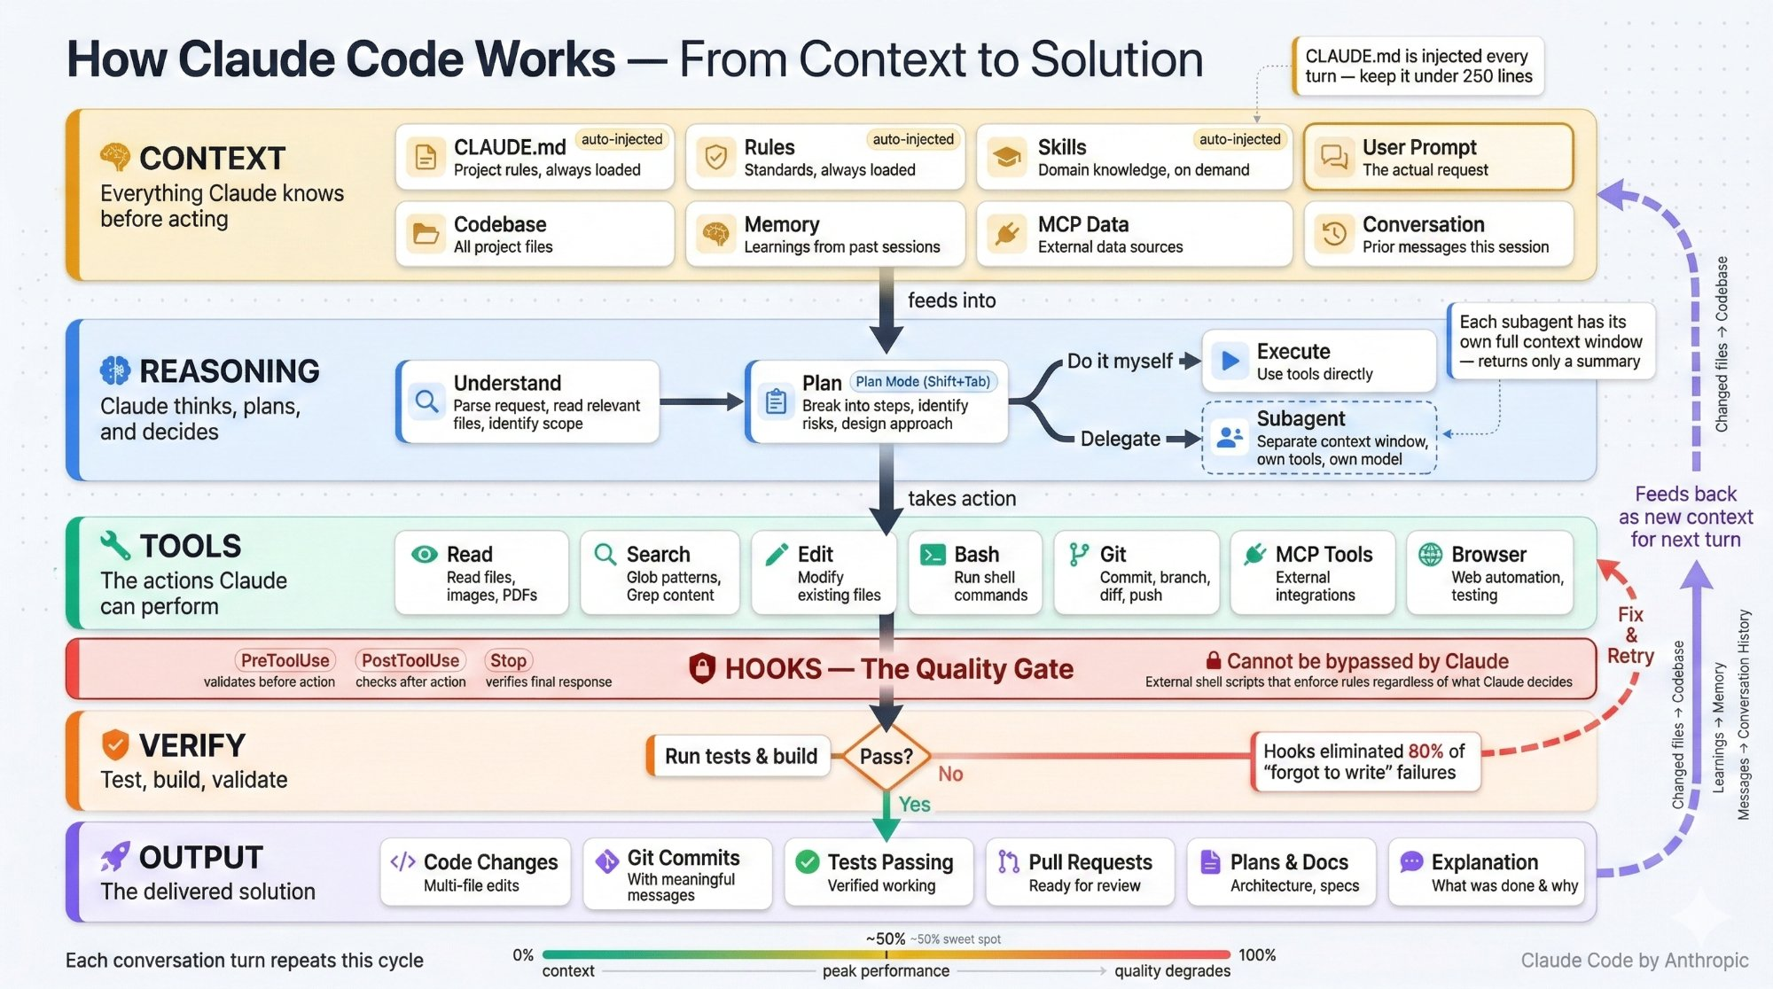
Putting It All Together — How Claude Code Works

Slide 20

Key Takeaways
Context management is the #1 skill — keep it fresh, use /compact and /clear
Claude Code is agentic-first — it plans, implements, tests, and commits autonomously
MCP connects external tools but costs context — toggle servers on/off deliberately
Subagents keep your context clean — delegate large tasks, get back summaries
CLAUDE.md is your constitution; Hooks are your police — use both
Use the right mode: Normal for safety, Auto-Accept for flow, Plan for architecture
Combine CLI + IDE for best results — they complement, not compete
Attila Budai • Questions? • Deep-dives available on hooks, subagents, and parallel workflows

