Slide 1
JavaScript, ES6,
DOM, Event Handling
Zoltan Tar
Nyíregyháza – 2026/03/03

Slide 2
Agenda
01
JavaScript, ES6
02
DOM, DOM Manipulation
03
Event Handling

Slide 3
JavaScript
What is JavaScript?
Basics: types, functions, classes

Slide 4









What is JavaScript?
JavaScript
High level interpreted programming / scripting language
Prototype based
Functional oriented with possibility of OO usage
Synchronous
Loosely / dynamically typed
Originally designed for browsers, but now it’s used in many other aspects
Standard: ECMAScript
Widely used version: ES2015 / ES6
Current version: ES2025 / v16
ES.Next: dynamic name for the next version under development

Slide 5
JavaScript – types
JavaScript
Basic types:
undefined
null
Boolean
Number
BigInt
String
Symbol
Structural types:
Object
Array, Map, Set, WeakMap, WeakSet etc
Function (callable object)
Variables
var: old-fashioned way of create a function scoped variable
let: block scope variable, the value can be changed
const: block scope variable, cannot be changed
Globals: window or global (environment dependent)
Functions
Anonymous function
Named function
Inner function (‘nesting’)
Immediately Invoked Function Expression (IIFE)
Arrow function
Objects
Key-value pairs
Prototype, Constructor (more on prototypes: MDN)
JSON
https://developer.mozilla.org/en-US/docs/Web/JavaScript/Data_structures

Slide 6

JSON
JavaScript
JavaScript Object Notation
A lightweight data interchange format
Readable to humans
Easily processed by programs
Subset of JavaScript (object notation)
MIME type: application/json
Can contain:
Number
String
Boolean
Array
Null
Object
{
"id": 1,
"name": "Json Statham",
"hasGun": true, "movies": [
"Crank",
"The Transporter"
],
"killedBy": null
}

Slide 7
Scopes
JavaScript
Global* Scope: anything that is declared outside any block or function
*window (browsers) / global (headless browsers or Node)
Function Scope: each function has their own scope
Block Scope (ES6): variables declared with let and const are block scoped (block: any code within curly braces)
Function & Global
Block scope
1.
var a = 42;
try {
var a = 90;
} catch (err) {
console.log(err);
}
console.log(a);
2.
const a = 42;
try {
const a = 90;
} catch (err) {
console.log(err);
}
console.log(a);
3.
const a = 42;
try {
a = 90;
} catch (err) {
console.log(err);
}
console.log(a);
4.
let a = 42;
try {
let a = 90;
} catch (err) {
console.log(err);
}
console.log(a);
5.
let a = 42;
try {
a = 90;
} catch (err) {
console.log(err);
}
console.log(a);
* hoisting

Slide 8
Functions
JavaScript
Function declaration
function myFunction(param1, param2) {...}
Function expression (anonymous, IIFE)
const myFunction = function(param1, param2) {...};
Shorthand method definition
const collection = { myFunction: function(param1, param2) {...}, };
Arrow function
const myFunction = () => {...};
Generator function
Returns a generator object
Can be exited and re-entered
Save context across re-entrances
Function as object instance
const numberA = "numberA"; const numberB = "numberB"; const sumFunction = new Function( numberA,
numberB,
"return numberA + numberB„
); sumFunction(10, 15); // => 25
Functions are first-class citizens of JavaScript – can be:
passed as an argument
returned
assigned to a variable
The number of arguments passed to a function depends on the caller (not the declaration)
Highly depends on context from where it’s called:
„this” does not mean the same thing as in Java
(Re-)Define scope with:
Call
Apply
Bind
https://developer.mozilla.org/en-US/docs/Web/JavaScript/Reference/Functions

Slide 9
Arrays
JavaScript
Definitions:
const array = [];
const array2 = new Array();
Traversing
for (let i=0; i<array.length; i++) {
console.log(array[i]);
}
for (let i in array) {...}
for (let i of array) {console.log(i);} array.forEach((item, index) => {
console.log(`${index}: ${item}`);
});
Notable methods:
filter: find multiple matching items
find: find the first matching item (=> findLast)
forEach: traversing
includes: does it contain? (for primitives)
map: transform
reduce: reduce the array to a single value
some: has at least one match (=> every)
The most likely used structured types after functions
Iterable object
Stores a collection of multiple items under a single variable name
Has members for performing common array operations
Not primitive: resource type
Resizable and can contain a mix of different data types (not suggested – use typed arrays)
Elements must be accessed using nonnegative integers
Zero indexed
Array-copy:
shallow copy (spread operator)
Deep clone (structuredClone)
https://developer.mozilla.org/en-US/docs/Web/JavaScript/Reference/Global_Objects/Array

Slide 10
Classes
JavaScript
class Computer {
constructor(name) {
this.name = name;
this.portable = false;
}
describe = () => {
console.log(this.name);
return ` It's ${this.name} – ${this.portable ? "portable" : "standard"} computer`;
};
}
class Notebook extends Computer {
constructor(name) {
super(name);
this.portable = true;
}
}
const notebook = new Notebook("HP G8");
notebook.describe();
Template for creating objects
Before ES6: house of horror
ES6: class expression
Constructor
Only „public” elements can be defined (no restriction definition)
Prototype:
JS implements prototype-based inheritance
Mechanism by which JS objects inherit features from one another
Chain: every objects has a prototype, which can also have a (different) one
obj.__proto__, Func.prototype
https://developer.mozilla.org/en-US/docs/Learn/JavaScript/Objects/Object_prototypes
https://developer.mozilla.org/en-US/docs/Web/JavaScript/Reference/Classes

Slide 11
Function definitions
Different types and ways to define a function

Slide 12
Type of functions
Function definitions
Definition types
Declaration
function myFunction(param1, param2) {...}
Expression
const myFunction = function(param1, param2) {...};
const myFunction = () => {...}; // arrow
setTimeout(function() {...}); // callback
(() => {...})(); // IIFE
const obj = { myFunction: function() {...} }; //method
Constructor
const myFunction = new Function(
'a',
'b',
'return a + b'
);
Regular function
Can return anything
Always runs to completion after invocation
Async functions
Always returns a Promise
Let us use the await operator
Generator functions *
Returns a Generator object
Let us use the yield operator
Async generator functions *
Returns an AsyncGenerator object
Both await and yield can be used
https://developer.mozilla.org/en-US/docs/Web/JavaScript/Reference/Functions
* Just mentioned, not part of the training

Slide 13
Functional programming
Lisp: Everything is a function
JavaScript: hold my beer

Slide 14
Main concepts
Functional programming
Pure functions
Always product the same output for the same arguments irrespective of anything else
No side effects (e.g. do not modify arguments, local/global variables or input/output streams)
Gain: deterministic and easy to debug
Recursion
No for or while loops
Iterations are implemented through recursion
Referential transparency
Using constants – no changes after defined
New value means new variable
Eliminates the chances of side-effects
First-Class Functions
Functions are first-class variable
Can be passed to other functions as parameters
Can be returned from functions or stored in data structures
Higher order Functions
Functions that take other functions as arguments
Can return functions
Immutability
A variable is always constant – cannot be modified after initialized
Helps maintaining the state throughout the runtime

Slide 15
Pros and cons
Functional programming
Advantages
Pure functions are easier to understand
No state changes
No dependency – only the given input
One produced output – the return value
Treating functions as values and pass them to others makes code more readable and easily understandable
Easy testing and debugging
One input – one output principle
No changes on input, no hidden output
It can be used to implement concurrency/parallelism as pure functions don’t change variables or any other data outside of their context
Lazy evaluation
Evaluate when needed
Store results if needed more than once
Disadvantages
Sometimes writing pure functions can reduce readability of code
Writing programs in recursive style instead of using loops can be intimidating
Combining pure functions with the rest of the application and I/O operations can be difficult
Immutable values and recursion can lead to decrease in performance

Slide 16
Impure functions
Functional programming
Pure functions
let x = 0;
function addImpure(a) {
x += a;
return x;
}
console.log(addImpure(2));
console.log(x);
let x = 0;
function add(a, b) {
return a + b;
}
console.log(add(x, 2));
console.log(x);
Multiple problems:
External dependency
Unpredictable outcome
Mutation
Not reusable

Slide 17
Mutability
Functional programming
Immutability
const x = [1, 2, 3];
x.push(4);
x.push(5);
console.log(x); // [1, 2, 3, 4, 5]
const firstName = ‘Bob’;
firstName.concat(’ Ross’);
console.log(firstName); // ‘Bob’
const fullName = firstName.concat(’ Ross’);
console.log(firstName); // ‘Bob’ console.log(fullName); // ‘Bob Ross’

Slide 18
Shared state
Functional Programming
Avoiding shared state
let counter = 0;
function incrementCounter() {
counter++;
return counter;
}
console.log(incrementCounter()); // 1
console.log(incrementCounter()); // 2
function increment(n) {
return n + 1;
}
let count = 0;
console.log(increment(count)); // 1
count = increment(count); // count = 1
console.log(increment(count)); // 2

Slide 19
First-class citizens
Functional programming
// Assign a function to a variable
const add = (x, y) => x + y;
const sum = add;
console.log(sum(1, 2)); // 3
// Pass a function as an argument
const callFunc = (fn, ...x) => fn(...x);
console.log(callFunc(add, 2, 3)); // 5
// Return a function from a function
function createCounter() {
const count = 0;
return function() {
return count++;
};
}
const counter = createCounter();
console.log(counter()); // 0
console.log(counter()); // 1
Functions should be treated like any other data type:
Assigned to variables
Passed as arguments to other functions
Returned as values from other functions

Slide 20
Higher-order functions
Functional programming
In function programming functions can be used as arguments to other functions or returned as the result of a function.
This allows for powerful abstractions, such as functional composition and currying
// A higher order function
function operateOn(operation, x, y) {
return operation(x, y);
}
// returns sum of two arguments
function add(x, y) {
return x + y;
}
// returns product of two arguments
function multiply(x, y) {
return x * y;
}
console.log(operateOn(add, 2, 3)); // 5
console.log(operateOn(multiply, 2, 3)); // 6

Slide 21
Lazy evaluation
Functional programming
In function programming the evaluation of an expression is delayed until its value is needed, this is known as lazy evaluation.
This can be useful to improve performance and save memory usage.
// A generator function – infinite sequence
function* naturalNumbers() {
let n = 1;
while (true) {
yield n++;
}
}
const numbers = naturalNumbers();
console.log(numbers.next().value); // 1
console.log(numbers.next().value); // 2
console.log(numbers.next().value); // 3

Slide 22
Arrays
How to handle arrays in JavaScript?

Slide 23
New winds
Arrays
Using built-in methods instead of traditional cycles
Benefits:
Compatible with functional paradigm
Keeps the original array without any modifications
Easy to understand what the goal is
More concise and readable code
Usually faster than traditional loops
Similar syntax and approach
Drawbacks:
None – once tried and never put it aside
List of commonly used methods
forEach – simple traversing
map – transform
filter – remove elements
reduce - accumulate
Other goodies:
some – has at least one element that pass the test
every – all elements match with the test
find – find one element
includes – is in the array (only for primitives)

Slide 24
Simple traversing
Arrays
const arr = [1, 2, 3, 4, 5];
for (let i=0; i < arr.length; i++) {
console.log(arr[i]);
}
for (let i in arr) {
console.log(arr[i]);
}
for (let element of arr) {
console.log(element);
}
let i=0;
while(i < arr.length) {
console.log(arr[i++]);
}
const arr = [1, 2, 3, 4, 5];
arr.forEach((item, index) => {
console.log(`${index}: ${item}`);
});

Slide 25
Transformations
Arrays
const arr = [1, 2, 3, 4, 5];
const double = [];
for (let i=0; i < arr.length; i++) {
double.push(numbers[i] * 2);
}
console.log(double); // [2, 4, 6, 8, 10]
const arr = [1, 2, 3, 4, 5];
const double = arr.map((item) => item * 2);
console.log(double);

Slide 26
Filtering
Arrays
const numbers = [1, 2, 3, 4, 5];
const evenNumbers = [];
for (let i = 0; i < numbers.length; i++) {
if (numbers[i] % 2 === 0) {
evenNumbers.push(numbers[i]);
}
}
console.log(evenNumbers); // [2, 4]
const numbers = [1, 2, 3, 4, 5];
const evens = numbers.filter(
(item) => item % 2 === 0
);
console.log(evens);

Slide 27
Accumulating
Arrays
const numbers = [1, 2, 3, 4, 5];
let total = 0;
for (let i = 0; i < numbers.length; i++) {
total += numbers[i];
}
console.log(total); // 15
const numbers = [1, 2, 3, 4, 5];
const total = numbers.reduce(
(subTotal, item) => subTotal + item,
0
);
console.log(total);

Slide 28
Document Object Model
HTML, CSS and JavaScript combined

Slide 29
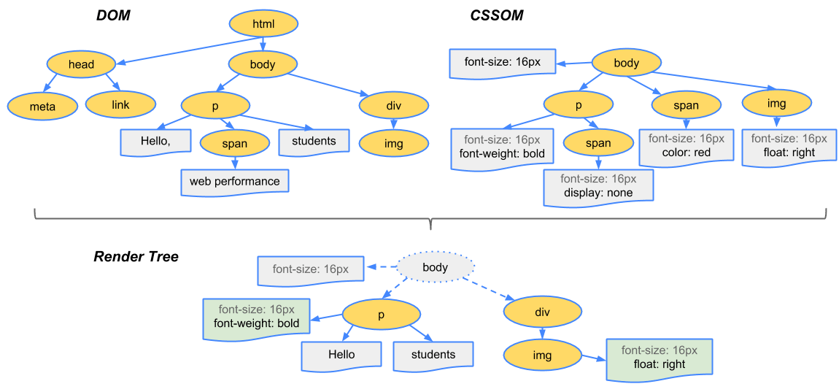
What is DOM?
Document Object Model
Programming interface for HTML and XML documents
Has its own structure
Defacto standard: tree data model
API provides us a way to access and modify the DOM elements
HTML: non-standard XML
Related: CSSOM (CSS Object Model)
Needed for rendering the page
HTML page: combined DOM & CSSOM

Slide 30
JavaScript & DOM
Document Object Model
JS main purpose: add functionality to a website
Add the possibility to react on different events:
Mouse (over, hover)
Keyboard events (key pressed)
Form and Input events (submit data or value changes)
DOM manipulation
Create, remove or update nodes in the DOM dynamically
Access elements and modify attributes
Root element: window.document
And more:
Single Page Applications
Web applications
Access elements:
document.getElementById
document.querySelector
document.querySelectorAll
Events:
element.addEventListener("click", callbackFn)
element.removeEventListener("click", callbackFn)
Content manipulation:
element.innerHtml
document.createElement
document.createTextNode
node.appendChild

Slide 31
SCRIPT tag
Document Object Model
Default loading: synchronous
When browser met a script tag it loads the file and execute it
During this the rendering is stoped
Asynchronous:
Async attribute
Download in the background at a low priority (same in defer)
Can interrupt page rendering to execute
Executes as soon as possible without particular order
Defer attribute
Won’t interrupt page rendering to execute
Executes in sequence just before the DOMContentLoaded event
Suggested method
Move every SCRIPT tag at the end of the BODY
Benefits:
The whole page is rendered when the browser loads the script
Already visible page for the user
Separated logic from display mode

Slide 32
Create HTML with JavaScript
Document Object Model
<main id="app">
<header class="page-head">
<h1>Hello world</h1>
<p>a little description here</p>
</header>
</main>
const app = document.createElement('main');
app.setAttribute('id', 'app');
const pageTitle = document.createElement('h1');
pageTitle.innerText = 'Hello world';
const description = document.createElement('p');
description.appendChild( document.createTextNode('a little description here') );
const header = document.createElement('header');
header.classList.add('page-head');
header.appendChild(pageTitle);
header.appendChild(description);
app.appendChild(header);
document.body.appendChild(app);

Slide 33
Event handling
Document Object Model
<div id="app">
<input name="content" />
<button class="button">Click here</button>
<ul class="list"></ul>
<p>0</p>
</div>
const list = document.querySelector('#app .list');
const addElement = () => { const input = document.querySelector( "input[name='content']" ); const element = document.createElement('li');
element.innerText = input.value.trim();
list.appendChild(element);
document.querySelector('#app p').innerText = list.children.length; };
const button = document.querySelector('.button');
button.addEventListener('click', addElement);

Slide 34
Callbacks & Promises

Slide 35
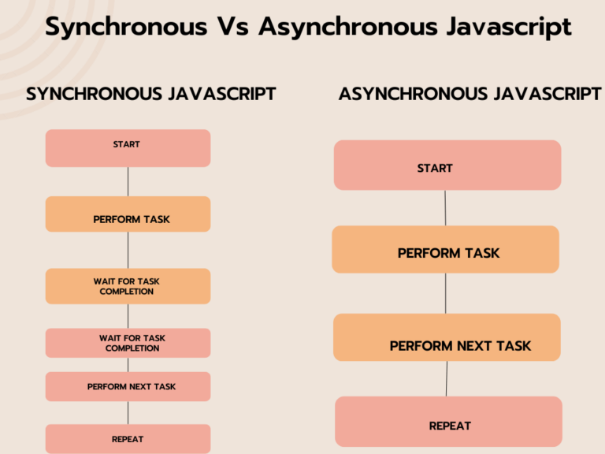
Asynchronous JavaScript in a nutshell
Callbacks & Promises
Asynchronous programming is a way for a computer program to handle multiple tasks simultaneously rather than executing them one after the other
Allows a program to continue working on other tasks while waiting for external events
Improve performance and responsiveness
Events (wait for user to click…?)
Timers (e.g. do nothing for X seconds…?)
HTTP requests (e.g. XHR or Fetch – block everything till data arrives…?)
JS is single-threaded – it carries out async operations via callback queue and event loop
JS is synchronous and has a single call stack
Code is executed in last-in first out (LIFO)
https://semaphoreci.com/blog/asynchronous-javascript
https://www.freecodecamp.org/news/asynchronous-programming-in-javascript/

Slide 36
JavaScript concurrency model
Callbacks & Promises
JavaScript has a concurrency model based on „event loop”
Three main parts: heap, stack and message queue.
At some time during the event loop, the JS runtime starts processing the messages on the message queue
Event handlers, XMLHttpRequest and timers can push messages to the message queue
Each message has a callback associated with it, which will be invoked upon processing.
https://medium.com/sessionstack-blog/how-javascript-works-event-loop-and-the-rise-of-async-programming-5-ways-to-better-coding-with-2f077c4438b5

Slide 37
Asynchronous functions
Callbacks & Promises
const printNumber = (num) => {
setTimeout(() => {
console.log("Your number is: ", num);
}, Math.floor(Math.random() * 100) + 1);
};
const countToThree = () => {
printNumber(1);
printNumber(2);
printNumber(3);
};
countToThree(); // What is the result of this? Why?

Slide 38
Callbacks
Callbacks & Promises
const printNumber = (num, callBackFn) => {
setTimeout(() => {
console.log("Your number is: ", num);
callBackFn();
}, Math.floor(Math.random() * 100) + 1);
};
const countToThree = () => {
printNumber(1, () => {
printNumber(2, () => {
printNumber(3, () => {});
});
});
};
countToThree(); // Is this better?
Functions are first class citizens in JavaScript
That means we can use them as function parameters
A callback is basically a function that is passed to another function
The first function will call the callback
So let’s see our printNumber function with callbacks

Slide 39
The Promise
Callbacks & Promises
A promise is an object representing the eventual completion or failure of an asynchronous operation.
A Promise is in one of these states:
pending: initial state, neither fulfilled nor rejected.
resolved: meaning that the operation completed successfully.
rejected: meaning that the operation failed.
Until ES6 JavaScript did not have native implementation for promises
Pre ES6, the concept Promise was more like a design pattern, if you wanted to use it you had to use third-party libraries like jQuery or Q, frameworks that had the implementation (like AngularJS) or implement it yourself.
https://developer.mozilla.org/en-US/docs/Web/JavaScript/Reference/Global_Objects/Promise

Slide 40
The Promise object
Callbacks & Promises
With the standardization of ECMAScript2015 (more commonly known as ES6), native support for promises was introduced for JavaScript
The promise constructor takes a function with two functions as parameters for happy and sad cases – this function is called the executor
The executor is called immediately (even before creating the new promise object), does some asynchronous work then calls resolve if everything went fine, or reject if some error occurred.
The Promise prototype has the well known then, catch and finally methods for handling the result of the Promise
const proxy = new Promise(
(resolve, reject) => {}
);

Slide 41
How to work with promises?
Callbacks & Promises
In async calls you have to work with data you don’t have yet – so: Simple variable assignment is not working!
You have to WAIT until the data arrives – it can be done via the THEN method
It’s also possible an error occurs and it has to be handled too – never forget it, a promise has to be accepted or rejected within a time
You can store data within promises too e.g. no other request has to be sent out which can increase performance
JS Decorator for promise: async + await pairing
const proxy = new Promise(
(resolve, reject) => {}
);
proxy
.then((param) => {
console.log("done", param);
})
.catch((error) => {
console.error("error", error);
});
(async () => {
try {
const param = await proxy;
console.log("done", param);
} catch (error) {
console.error("error", error);
}
})();

Slide 42
Counting with Promises
Callbacks & Promises
const printNumber = (num) =>
new Promise((resolve, reject) => {
setTimeout(() => {
console.log("Your number:", num);
resolve();
}, Math.floor(Math.random() * 100) + 1);
});
const countToThree = () => {
printNumber(1)
.then(() => printNumber(2))
.then(() => printNumber(3));
};
countToThree();
const countToThree = async () => {
await printNumber(1);
await printNumber(2);
await printNumber(3);
};
/** We successfully created a promise chain that will print the numbers in order */

Slide 43
Sync the async
Callbacks & Promises
const printNumber = (num) =>
new Promise((resolve, reject) => {
const wait = Math.floor(Math.random() * 100) + 1;
setTimeout(() => {
console.log("Your number:", num);
resolve({ wait, num });
}, wait);
});
const count = () => {
return Promise.all([
printNumber(1), printNumber(2), printNumber(3)
]);
};
(async () => {
try {
const [number1, number2, number3] = await count();
console.log(
"all done",
{ number1, number2, number3 }
);
} catch (error) {
console.error("error", error);
}
})();
What the actual …? Why …?
A little multi-threaded thinking is needed
E.g. transactions (database or multiple requests)
We want to know when all the async methods are finished, failed or just settled (-> Promise.allSettled)
We want the fastest result (-> Promise.race)
How to stop the unstoppable?
-> don’t – just accept it and move on

Slide 44
Fetch API
Execute requests from client side to a server

Slide 45
The Fetch API
AJAX & Fetch API
(async () => {
const response = await fetch("/api/cart", {
method: "POST",
headers: {
"Content-Type": "application/json",
},
body: JSON.stringify({
productId: 5,
quantity: 1,
userId: 1,
}),
});
if (response.status === 200) {
const { quantity } = await response.json();
ShoppingCart.updateQuantity(quantity);
} else {
throw new Error("Unexpected error");
}
})();
The Fetch API provides a JavaScript interface to create HTTP requests.
Follows the Promise pattern solution
Standard way to request data from server and handle the responses
Example:
(async function() {
const res = await fetch("https://yesno.wtf/api");
const data = await res.json();
console.dir(data);
return data;
})();
https://developer.mozilla.org/en-US/docs/Web/API/Fetch_API

Slide 46
Thank you!
For more information, contact
Zoltan Tar
Software Engineer
zoltan_tar@epam.com
EPAM Debrecen
Tüzér street 4.
HU-4028 Debrecen

