Slide 1

Cambell Prince
Cambell Prince 6th December 2013

Slide 2
What are we doing?
Register and Setup
Introduction
AngularJS: What is it?
Models and Scope (MV VM)
Controllers and Directives
Routes and Views
Services

Slide 3
Registration
Please sign-in and pay (100 Baht)
Make sure you put in your lunch order
  This needs to be in by 9:30

Slide 4
Installation and Setup
This course is hands on, your setup needs to work. Make sure you have:
  Eclipse (our setup, not your own)
  Virtualbox (debian7 import)
  Chrome
  Gitextensions and clone:
    https://github.com/cambell-prince/ng-training-101.git
    To c:\src\sil\ng-training-101
Ask Chris, Robin, Ira, Tim for help

Slide 5
What are we doing?
Register and Setup
Introduction
AngularJS: What is it?
Models and Scope (MV VM)
Controllers and Directives
Routes and Views
Services

Slide 6

Introduction
Hands on
Building a real app
  Well, almost real :-)
We're not hiding the complexity
Mentors are in the room

Slide 7
What are we doing?
Register and Setup
Introduction
AngularJS: What is it?
Models and Scope (MV VM)
Controllers and Directives
Routes and Views
Services

Slide 8
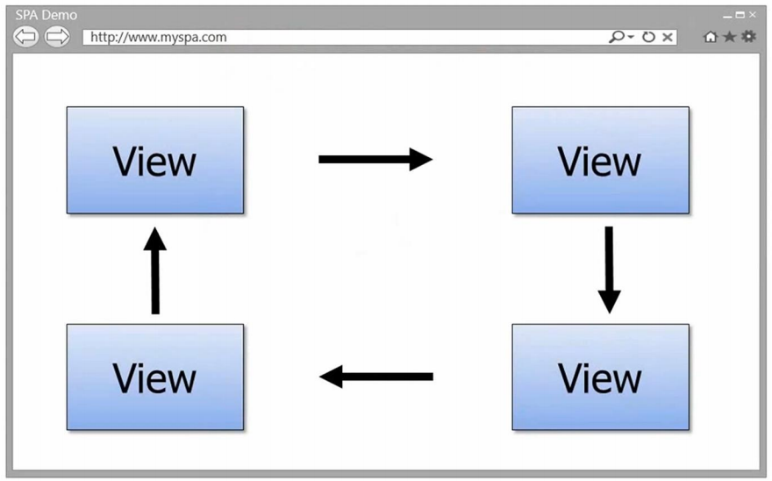
Introduction: What is Angular?

Slide 9

Introduction: SPA Challenges
DOM Manipulation
Routing
Data binding
View loading
Module dependencies
Object modeling

Slide 10

Introduction: SPA Challenges

Slide 11
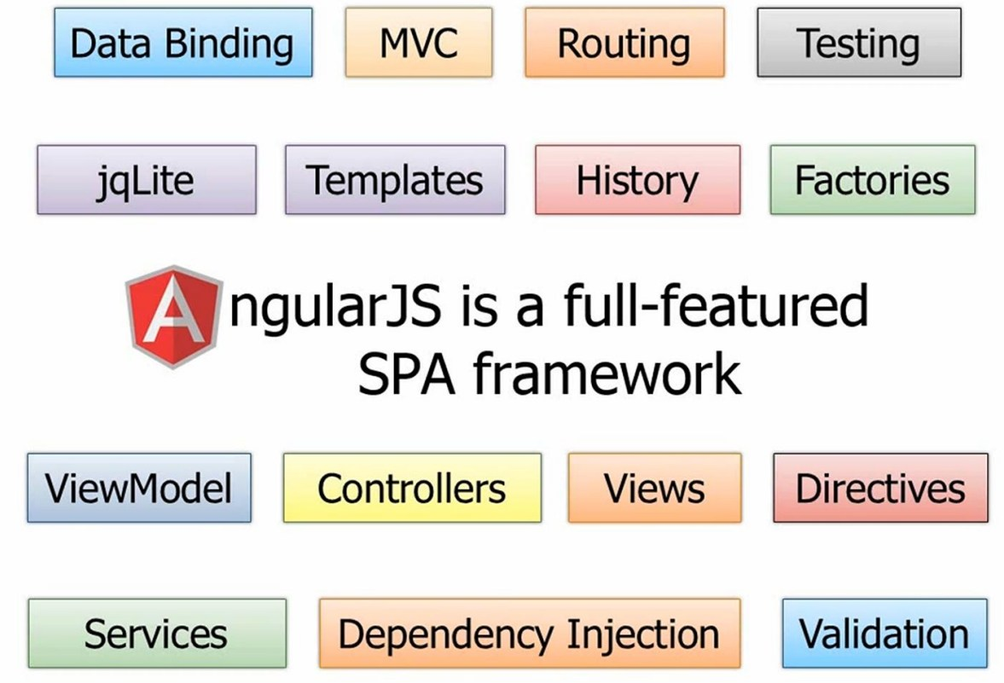

Slide 12
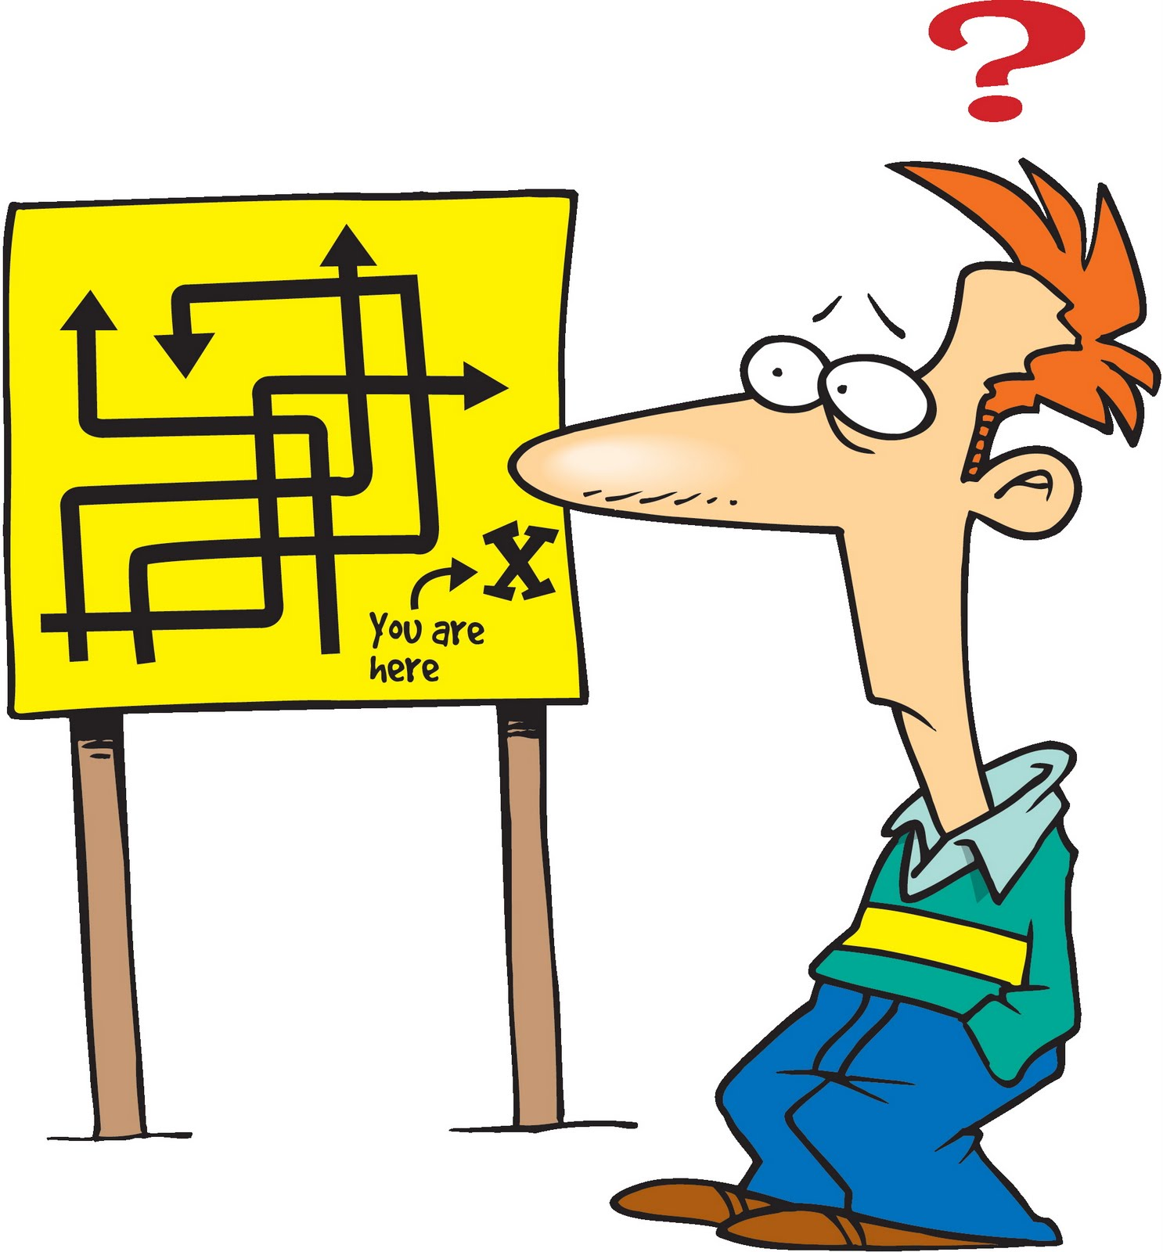
Angular
Scope
Controller
Directives
Routes
Transclusion
Compile / Link
??? ??? ???

Slide 13
Angular
Teaches HTML new tricks

Slide 14
What are we doing?
Register and Setup
Introduction
AngularJS: What is it?
Models and Scope (MV VM)
Controllers and Directives
Routes and Views
Services

Slide 15
Coding Step 1
Two way data binding with ng-model

Slide 16
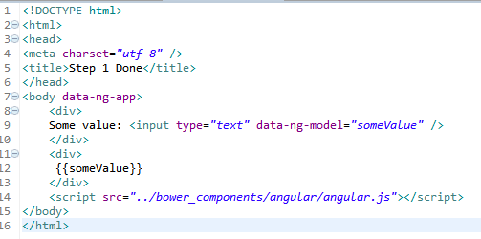
Syntax
Directive
Directive
Expression

Slide 17
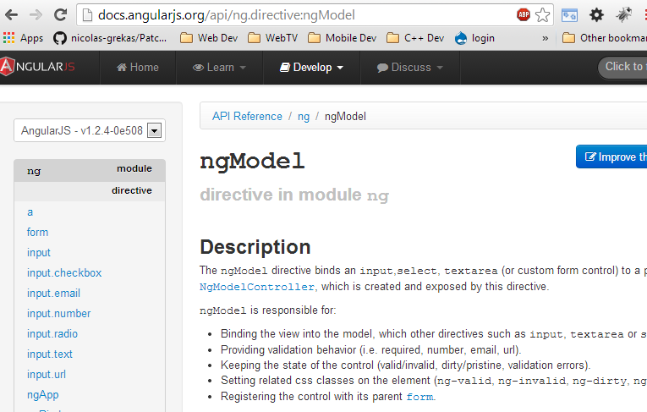
Documentation

Slide 18
BREAK

Slide 19
What are we doing?
Register and Setup
Introduction
AngularJS: What is it?
Models and Scope (MV VM)
Controllers and Directives
Routes and Views
Services

Slide 20
Coding Step 2
Adding a Controller in Javascript

Slide 21
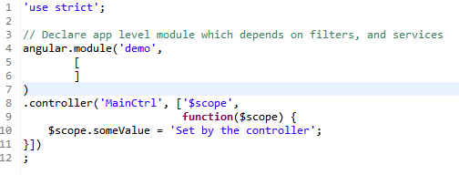
Controller

Slide 22
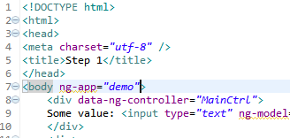
Controller in the View

Slide 23

Debugging Javascript
Chrome dev tools
  Ctrl+shift+i
Demo Step 2

Slide 24
What are we doing?
Register and Setup
Introduction
AngularJS: What is it?
Models and Scope (MV VM)
Controllers and Directives
Routes and Views
Services

Slide 25
First: About Bootstrap
Provides css that looks good by default
  http://getbootstrap.com/2.3.2/
Scaffolding; the layout grid
Base CSS; text, buttons, labels, inputs, forms
Don't use the components with angular
  Use the angular-ui bootstrap components
  http://angular-ui.github.io/bootstrap/

Slide 26
Coding Step 3
Adding Routes and Views and Bootstrap

Slide 27
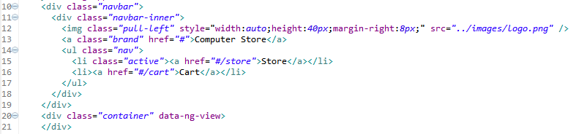
Route: Main View
From bootstrap navbar
  http://getbootstrap.com/2.3.2/components.html#navbar
  Add img for logo with pull-left class
Ng-view to contain the views as determined by the route

Slide 28
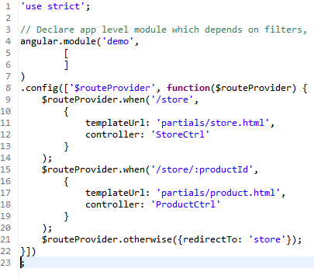
Route: Setting the Routes

Slide 29
Bootstrap
Keep your site looking good enough by default
  Use bootstrap markup, then override the styles to suit the graphics design you want.
Do this as you go
  You will not come back and fix it up later.
  Really, it just doesn't happen.

Slide 30
Dependencies
Modules are defined with their dependencies
Controllers and Services are defined with their dependencies
Angular can automatically determine dependencies from function arguments
  But don't do that. Causes problems with minification.
  Best practice. Declare your dependencies.

Slide 31
LUNCH

Slide 32
What are we doing?
Register and Setup
Introduction
AngularJS: What is it?
Models and Scope (MV VM)
Controllers and Directives
Routes and Views
Services

Slide 33
Coding Step 4
Adding Services and Views
The ng-repeat directive

Slide 34

Services: Let's get some data!
Services provide an abstraction of 'data provider', hiding the implementation details from the application.
Code from the application should always presume 'async'.

Slide 35
Services: Let's get some data!
'services.js' provides a fake data store. Normally you would implement with $http or $resource angular services for REST data sources.
Json-rpc is also an option.
  Data Transfer Object (DTO) for a composite of models.

Slide 36
Services: Let's get some data!
The controller calls the service to get the model data.
The model data is then set into the $scope (the VM)
The view renders
Excercise:
  store.html and store.js
  product.html and product.js

Slide 37
Coding Step 5
Adding the Shopping Cart
The ng-repeat directive

Slide 38
Adding the Shopping Cart
?

Slide 39
Future Features
Fix the navbar, it doesn't set the active property on the current route.
Add a row for total to the cart and a checkout button.
Add 'items in cart count' into navbar.
Add 'reset cart' button.

Slide 40
Real Word Workflow
Package Managers:
  Bower (javascript)
  Composer (php)
  NPM (node; server side javascript)
DVCS
  Git
  Mercurial
Tests
  Karma; unit tests and end to end tests

Slide 41
Real Word Workflow
Build
  Grunt current best practice
  Ant what we currently use
Continuous Integration (CI)
  Team City
  Jenkins

Slide 42
END
Evaluation Please
http://goo.gl/TGW7Ge

