Slide 1


Title: Actor Threat Profiling
Presented By:
Attiq Ahmed Afsar Husnain Ahmed
Industrial Supervisor: Academic Supervisor:
Dr. Nabeel Ahmed Awan Dr. Musadaq Mansoor
Cydea Tech. (Pvt.) Ltd. Assistant Professor

Slide 2
Agenda
Functional and Non-Functional requirements
Current Working
Project Timeline
List of the Features
Recap (Problem Statement & Objectives)
Project Scope and Business Objectives

Slide 3
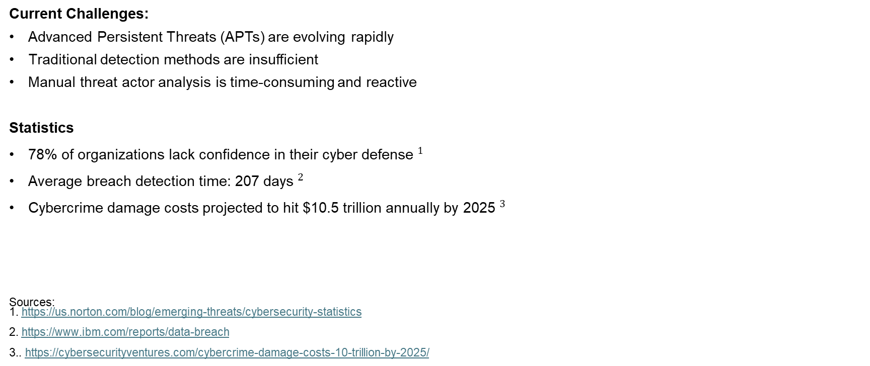
Problem Statement
Current Challenges:
Advanced Persistent Threats (APTs) are evolving rapidly
Traditional detection methods are insufficient
Manual threat actor analysis is time-consuming and reactive
Statistics
${\text{78\% }\text{of} \text{organizations} \text{lack} \text{confidence} \text{in} \text{their} \text{cyber} \text{defense} }^{1}$
${\text{Average} \text{breach} \text{detection} \text{time}\text{: 207 }\text{days} }^{2}$
${\text{Cybercrime} \text{damage} \text{costs} \text{projected} \text{to} \text{hit}\text{ \$10.5 }\text{trillion} \text{annually} \text{by}\text{ 2025 }}^{3}$
Sources: 1. https://us.norton.com/blog/emerging-threats/cybersecurity-statistics
2. https://www.ibm.com/reports/data-breach
3.. https://cybersecurityventures.com/cybercrime-damage-costs-10-trillion-by-2025/
Impact:
Prolonged unauthorized access
Data breaches
Financial losses
Reputational damage
Notes:
Problem statement explained with stat and also explain the impacts at the last
What is APT?
An Advanced Persistent Threat (APT) is when skilled hackers break into a computer system and stay there for a long time without being noticed.
Advanced means they use clever techniques to get in.
Persistent means they keep trying to stay hidden and keep access.
Threat means they can steal information or cause problems for the organization.
So, APTs are serious attacks where hackers quietly work to achieve their goals over time.

Slide 4
Objectives
To Develop an automated pipeline for extracting APT-related data from various web sources.
Design algorithms to identify threat actor names and identities from unstructured data.
Build a comprehensive knowledge graph

Slide 5
Project Scope
Data Collection: Gather data from Mitre Att&ck, threat reports, and cyber forums etc.
Threat Actor Profiling: Identify actors and their TTPs.
Knowledge Graph: Build relationships between actors, tactics, and targets.
Automation: Automate data collection and analysis.
Limitations: Excludes real-time monitoring and full UI development.

Slide 6
Business Objectives
Cybercrime cost analysis (Cybersecurity Ventures)
Aspect | Details | Statistics
Growing Cybersecurity Market | Increasing investments in cybersecurity and threat intelligence solutions. | Global cybersecurity market projected to grow from $173.5B (2022) to $266.2B (2027) at 8.9% CAGR.
Global Impact | System’s threat intelligence library benefits businesses, governments, and cybersecurity teams worldwide. | Cybercrime costs expected to reach $10.5T annually by 2025, up from $3T in 2015.
Integration Potential | Opportunities for integration with existing security platforms to enhance current systems. | Over 30% of professionals report a lack of actionable intelligence; this solution fills the gap.
Sources: Cybersecurity market projection (Fortune Business Insights)
APT Detection Market CAGR and Trends (Verified Market Research)
Notes:
CAGR: compound annual growth rate

Slide 7
List of the Features
Automated Data Collection:
Collects APT data from multiple sources (e.g., threat intelligence platforms, blogs, forums).
Threat Actor Profiling:
Identifies and profiles threat actors from unstructured data.
Knowledge Graph:
A comprehensive, queryable graph mapping relationships between threat actors, their identities, targets, and attack patterns.

Slide 8
Functional & Non-Functional Requirements
Functional Requirements
Non-Functional Requirements
Automated Data Extraction: Collects APT data from web sources.
Unstructured Data Analysis: Identifies threat actors and TTPs
Knowledge Graph Construction: Builds relationships between threat actors, TTPs, and victims
User Interface for Querying/Reporting: Interface for querying the graph and generating reports
Security: Encrypt sensitive data
to follow industry best practices.
Usability: Simple, intuitive UI for easy navigation
Scalability: Can handle increasing data volume without performance loss
Maintainability: Codebase must be modular and easy to update

Slide 9
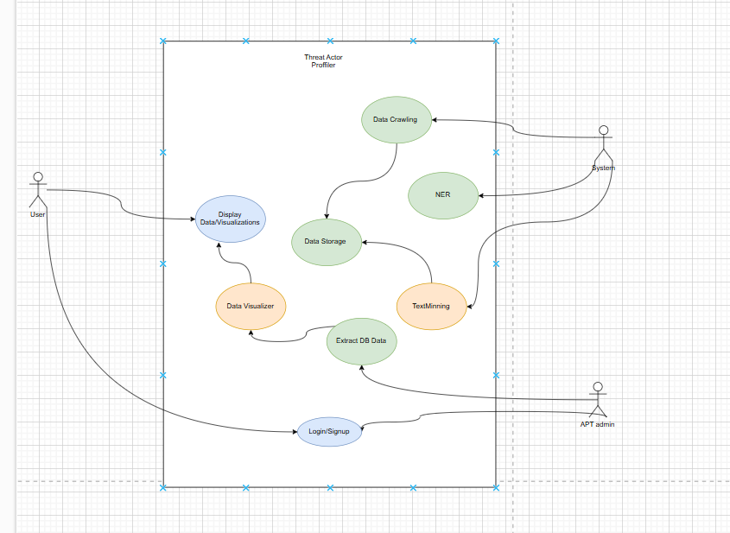
Use Case Diagram

Slide 10
U1:Data Crawling
Title | Automated Data Extraction
Actor | System
Description | Gathers APT-related data from multiple publicly available sources like MITRE Attack and cyber forums.
Steps | 1. Identify sources. 2. Extract data using web crawling or APIs. 3. Preprocess and format the data for storage.
Preconditions | Access to web sources and APIs. Proper permissions to access and extract data from the sources.
Postconditions | APT-related data is extracted and ready for storage and analysis.

Slide 11
U2:Data Storage
Title | Centralized Data Repository
Actor | System
Description | Stores collected data in a structured format for efficient access and analysis.
Steps | 1. Receive preprocessed data from the crawling module. 2. Organize and store data in a database or knowledge graph. 3. Ensure data integrity and security.
Preconditions | Preprocessed data is available.
Postconditions | Data is securely stored and organized for further modules like NER and visualization.

Slide 12
U3:NER (Named Entity Recognition)
Title | Entity Identification
Actor | System
Description | Extracts key entities such as threat actor names, tactics, techniques, and procedures (TTPs) from unstructured text.
Steps | 1. Fetch stored data. 2. Apply NLP models to extract entities. 3. Map identified entities to predefined categories.
Preconditions | Data must be available in a text format. Pre-trained NLP models for entity recognition.
Postconditions | Key entities are identified and structured for inclusion in the knowledge graph.

Slide 13
U3:Text Mining
Title | Data Analysis and Insights
Actor | System
Description | Analyzes extracted data to identify patterns, relationships, and insights about APTs and threat actors.
Steps | 1. Retrieve entity-extracted data. 2. Apply algorithms to find patterns or anomalies. 3. Generate insights for further visualization.
Preconditions | Data must be processed by the NER module. Availability of text mining algorithms or frameworks.
Postconditions | Insights and patterns are available for visualization or reporting.

Slide 14
U3:Data Visualizer
Title | Interactive Visualization
Actor | APT admin
Description | Provides an intuitive and visual representation of relationships between threat actors, tactics, and organizations.
Steps | 1. Retrieve insights and data from text mining. 2. Build a knowledge graph or other visual formats. 3. Display data via dashboards or visual tools.
Preconditions | Insights and data must be structured. Tools or frameworks for data visualization must be available.
Postconditions | A user-friendly visualization of the knowledge graph and other related insights is displayed.

Slide 15
U3:Display Data/Visualizations
Title | User Interface Layer
Actor | User
Description | Allows users to view the visualized data, including threat actor profiles, relationships, and other insights.
Steps | 1. Fetch visualized data or graphs. 2. Render the data in an interactive interface. 3. Provide tools for filtering, searching, or exploring the data.
Preconditions | Visualized data is prepared by the Data Visualizer module.
Postconditions | Users can interact with and understand the APT-related data easily.

Slide 16
U3:Login/Signup
Title | User Authentication
Actor | User, APT admin
Description | Handles user authentication and authorization to access the system’s features.
Steps | 1. Allow users to register with credentials. 2. Authenticate user logins. 3. Grant access based on roles (e.g., Admin, User).
Preconditions | Users must have a valid email or account credentials. System must support secure authentication (e.g., encryption, password hashing).
Postconditions | Users are authenticated and have role-based access to system features.

Slide 17
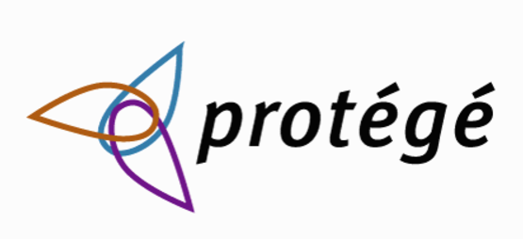
Current Working
Working on the Graph Ontology:
Tool: Protégé
Classes/Nodes : (Groups, Techniques, Software's used etc.)
Object Type Properties: (Relationship between the classes)
Data Type Properties: (Domain, Range datatypes)
Notes:
Components of TTPs
Tactics:
Definition: The why behind an attack—the overarching goals or objectives the attacker wants to achieve.
Examples:
Initial Access: Gaining entry into a target's system.
Exfiltration: Stealing sensitive data.
Persistence: Maintaining long-term access to a system.
Techniques:
Definition: The how—specific methods or actions used by attackers to achieve their tactical objectives.
Examples:
Phishing: Sending fake emails to trick users into revealing sensitive information.
Credential Dumping: Extracting password hashes from a compromised system.
Lateral Movement: Moving between systems within a network.
Procedures:
Definition: The specific implementation or detailed steps of a technique, tailored to the attacker's tools, expertise, or preferences.
Examples:
A phishing attack using a cloned website with a login form.
Using Mimikatz to extract passwords during credential dumping.
Importance of TTPs in Cybersecurity
Threat Actor Profiling:
Helps identify and attribute attacks to specific groups by analyzing their unique patterns and behavior.
Example: Advanced Persistent Threat (APT) groups often have distinct TTPs.
Incident Response:
Enables security teams to detect, respond to, and mitigate threats effectively by recognizing familiar tactics or techniques.
Threat Intelligence:
Provides insights into emerging attack methods, allowing organizations to update defenses proactively.
Frameworks:
TTPs are the foundation of cybersecurity frameworks like MITRE ATT&CK, which categorizes and maps TTPs for various threat actors.
Example: TTPs in an APT Attack
LevelExampleTacticInitial AccessTechniqueSpear Phishing EmailProcedureSending emails with malicious Word documents that execute a macro to install malware.Relationship Between TTPs and Knowledge Graphs
In your Threat Actor Profiler project, TTPs will play a critical role in identifying and mapping relationships between:
Threat Actors (e.g., APT29),
Techniques they use (e.g., Spear Phishing),
Tactics they pursue (e.g., Initial Access),
Victim Organizations they target.
This mapping helps to visually and semantically represent the behavior of threat actors, enabling better analysis and understanding of cyber threats.

Slide 18
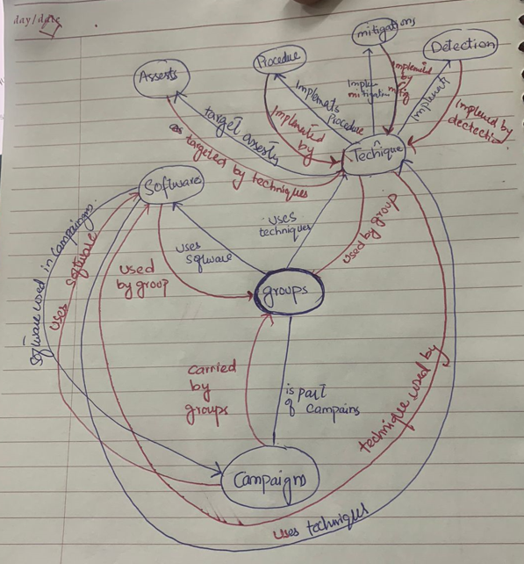
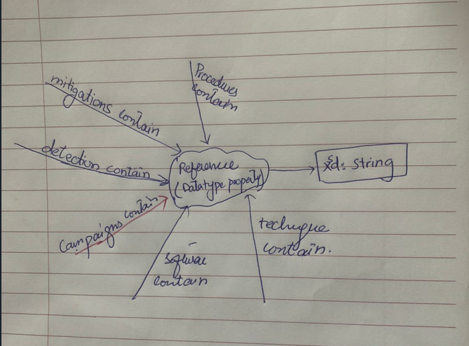

Slide 19
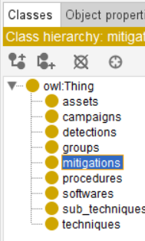
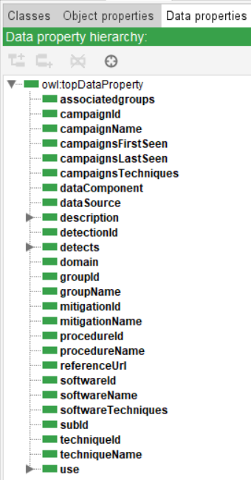
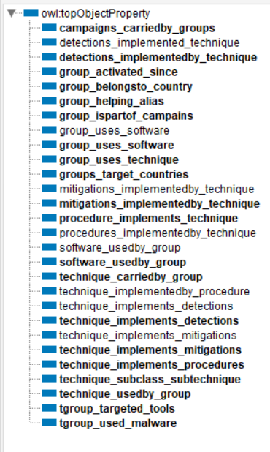
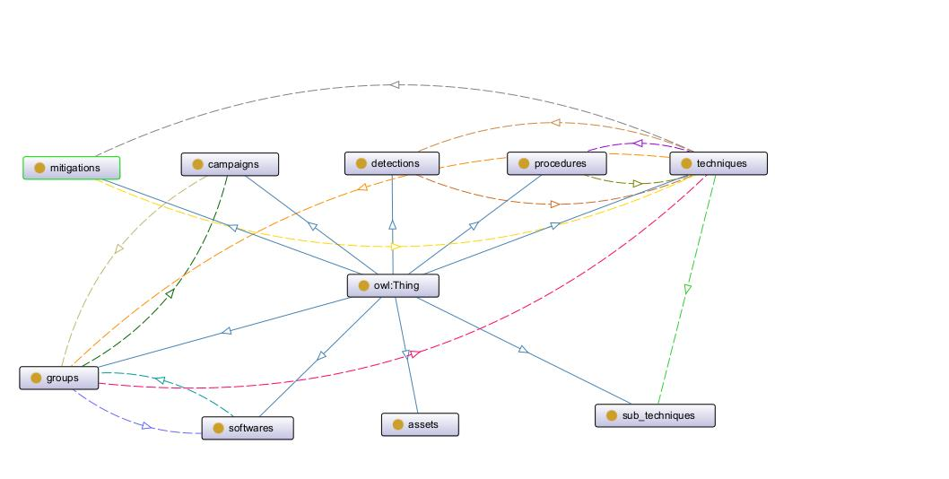

Slide 20

Cont’d
2. Data Crawling:
Website: https://attack.mitre.org/
The MITRE ATT&CK framework provides a detailed collection of cyberattack methods that help in understanding and profiling threat actors.
Tool: Scrapy
The tool automates the process of extracting detailed information about various APT techniques, tactics, and associated actors from the website

Slide 21
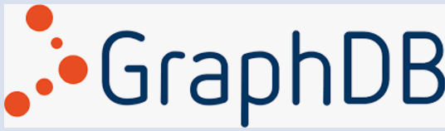
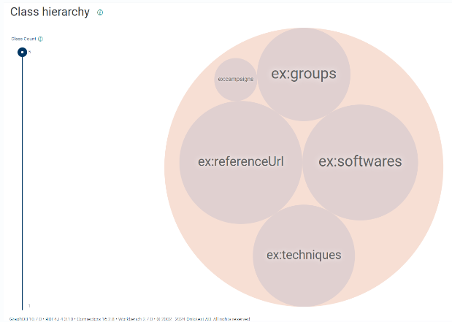
Cont’d…
3. Working on the Graph DB:
Tool: Graph DB
Next Step: Data Insertion and Extraction ( Done in next 2 weeks)

Slide 22
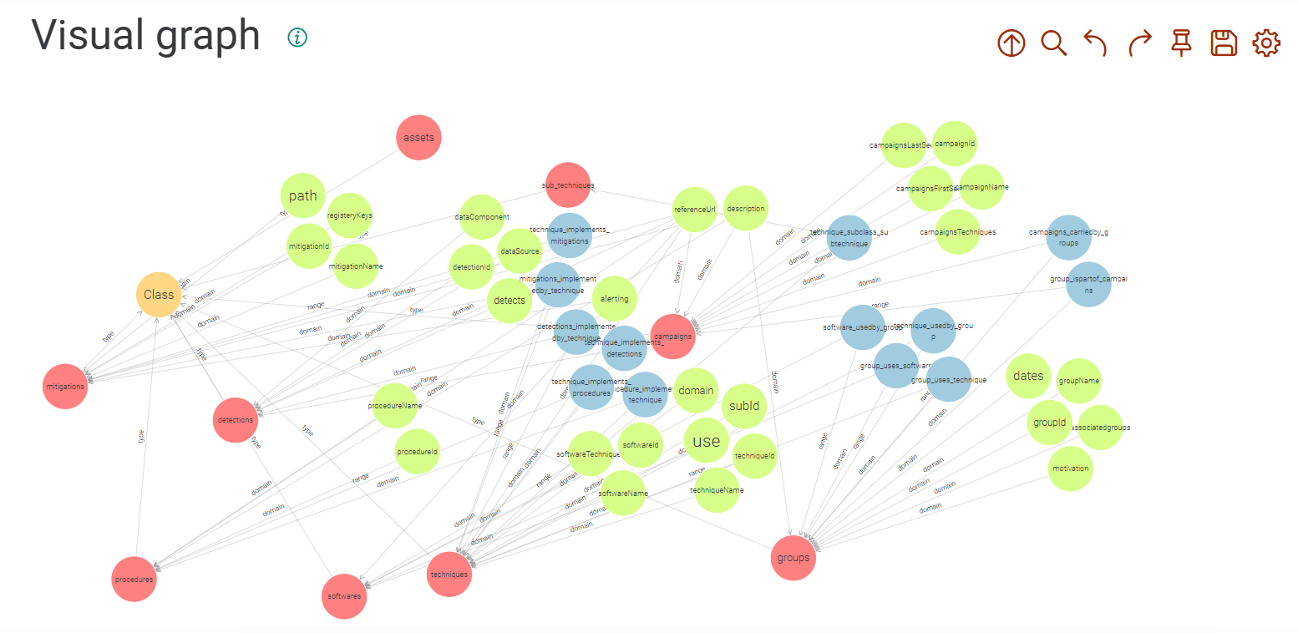

Slide 23
Project TimeLine
FYP-1 | FYP-2
Requirements gathering and system architecture design. Initial data extraction pipeline development. Development of profiling algorithms. Knowledge graph schema design. Apt Data Extraction | NER (Named Entity Recognition) Implementation of Text Mining and machine learning models. Integration of all system components. Final testing, debugging, and UI development.

Slide 24

Thank you

