Slide 1
CSC 334 – Parallel and Distributed Computing
Instructor: Dr. M. Hasan Jamal
Lecture# 01: Introduction

Slide 2
Motivating Parallelism
Traditionally, software has been written for serial computation:
To be run on a single computer having a single Central Processing Unit (CPU);
A problem is broken into a discrete series of instructions that are executed sequentially.
Only one instruction may execute at any moment in time.
Performance is achieved by executing instructions concurrently through multitasking
Uniprocessors are fast but:
Some problems require too much computation
Some problems use too much data
Some problems have too many parameters to explore
“For example:
Weather simulations
Gaming
Web servers
Code breaking

Slide 3
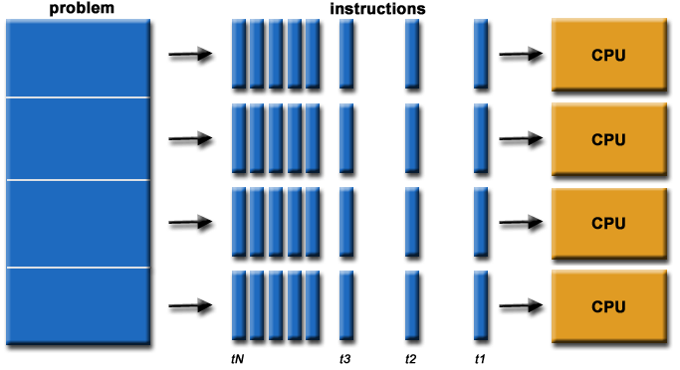
Motivating Parallelism
In the simplest sense, parallel computing is the simultaneous use of multiple compute resources to solve a computational problem
To be run using multiple CPUs
A problem is broken into discrete parts that can be solved in parallel
Each part is further broken down to a series of instructions
Instructions from each part execute simultaneously on different CPUs

Slide 4
Motivating Parallelism
The role of parallelism in accelerating computing speeds has been recognized for several decades
Its role in providing multiplicity of datapaths and increased access to storage elements has been significant in commercial applications.
The scalable performance and lower cost of parallel platforms is reflected in the wide variety of applications

Slide 5
Motivating Parallelism
Developing parallel hardware and software has traditionally been time and effort intensive.
If one is to view this in the context of rapidly improving uniprocessor speeds, one is tempted to question the need for parallel computing.
Latest trends in hardware design indicate that uniprocessors may not be able to sustain the rate of realizable performance increments in the future.
This is the result of several fundamental physical and computational limitations.
The emergence of standardized parallel programming environments, libraries, and hardware have significantly reduced time to develop (parallel) solutions.

Slide 6
The Computational Power Argument
Moore’s Law states (1965):
Number of transistors incorporated on a microchip doubles approximately every two years, while the cost of computers is halved.

Slide 7
The Computational Power Argument
If one is to buy into Moore’s law, the question still remains – how does one translate transistors into useful OPS (operations per second)?
The logical recourse is to rely on parallelism, both implicit and explicit.
Most serial (or seemingly serial) processors rely extensively on implicit parallelism.
The focus of this class, for the most part, is on explicit parallelism.

Slide 8
The Computational Power Argument
Why doubling the transistors does not double the speed?
Increase in number of transistor per processor is due to multi-core CPUs
It means, to follow Moore’s law, companies had to introduce ultra large-scale integrations and multi-core processing era
Will Moore’s law hold forever?
Adding multiple cores on a single chip causes heat issues
Furthermore, increasing the number of cores, may not be able to increase speeds due to inter-process interactions
Moreover, transistors would eventually reach the limit of miniaturization at atomic level

Slide 9
The Computational Power Argument
So, we must look for efficient parallel software solutions to fulfill our future computational needs
As stated earlier, number of cores on a single chip also have some restrictions
Solution(s)?
Need to find more scalable distributed and hybrid solutions

Slide 10
The memory/Disk Speed Argument
While clock rates of high-end processors have increased at roughly 40% per year over the past decade, DRAM access times have only improved at the rate of roughly 10% per year over this interval
This mismatch in speeds causes significant performance bottlenecks
Parallel platforms provide increased bandwidth to the memory systems
Parallel platforms also provide higher aggregate caches
Some of the fastest growing applications of parallel computing utilize not the raw computational speeds, rather their ability to pump data to memory and disk faster

Slide 11
The Data Communication Argument
As the network evolves, the vision of the Internet as one large computing platform has emerged
In many applications (typically databases and data mining) the volume of data is such that they cannot be moved
Any analyses on this data must be performed over the network using parallel techniques

Slide 12
Computing vs. Systems
Distributed Systems
A collection of autonomous computers, connected through a network and distribution middleware
This enables computers to coordinate their activities and to share the resources of the system
The system is usually perceived as a single, integrated computing facility
Mostly connected with the hardware-based accelerations
Distributed Computing
A specific use of distributed systems, to split a large and complex processing into subparts and execute them in parallel, to increase the productivity
Computing mainly concerned with software-based accelerations (i.e., designing and implementing algorithms)

Slide 13
Parallel and Distributed Computing
Parallel (shared-memory) Computing
The term is usually used for developing concurrent solutions for following two types of the systems:
Multi-core Architecture
Many-core Architectures (i.e., GPUs)
Distributed Computing
This type of computing is mainly concerned with developing algorithms for the distributed cluster systems
Here, distributed means a geographical distance between the computers without any shared-memory

Slide 14
Scope of Parallel Computing Applications
Parallelism finds applications in very diverse application domains for different motivating reasons
These range from improved application performance to cost considerations

Slide 15
Scientific Applications
Functional and structural characterization of genes and proteins
Applications in astrophysics have explored the evolution of galaxies, thermonuclear processes, and the analysis of extremely large datasets from telescope
Advances in computational physics and chemistry have explored new materials, understanding of chemical pathways, and more efficient processes
Bioinformatics and astrophysics also present some of the most challenging problems with respect to analyzing extremely large datasets
Weather modeling, mineral prospecting, flood prediction etc., are other important applications

Slide 16
Commercial Applications
Some of the largest parallel computers power Wall Street
Data mining analysis for optimizing business and marketing decisions
Large scale servers (mail and web servers) are often implemented using parallel platforms
Applications such as information retrieval and search are typically powered by large clusters

Slide 17
Applications in Computer Systems
Network intrusion detection: A large amount of data needs to be analyzed and processed
Cryptography (the art of writing or solving codes) employs parallel infrastructures and algorithms to solve complex codes
Graphic processing
A modern automobile consists of tens of processors communicating to perform complex tasks for optimizing handling and performance

Slide 18
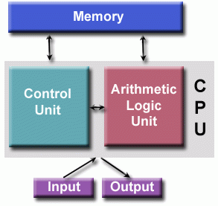
Von Neumann Architecture
Named after the Hungarian mathematician John von Neumann who first authored the general requirements for an electronic computer in his 1945 papers.
Also known as "stored-program computer" – both program instructions and data are kept in electronic memory. Differs from earlier computers which were programmed through "hard wiring".
Since then, virtually all computers have followed this basic design.
Comprised of four main components:
Memory
Control Unit
Arithmetic Logic Unit
Input/Output

Slide 19
Von Neumann Architecture
Basic Design
RD/WR, random access memory is used to store both program instructions and data
Program instructions are coded data which tell the computer to do something
Data is simply information to be used by the program
Control unit fetches instructions/data from memory, decodes the instructions and then sequentially coordinates operations to accomplish the programmed task.
Arithmetic Unit performs basic arithmetic operations
Input/Output is the interface to the human operator
Parallel computers still follow this basic design, just multiplied in units. The basic, fundamental architecture remains the same.

Slide 20
Flynn's Classical Taxonomy
There are different ways to classify parallel computers. One of the more widely used classifications, in use since 1966, is called Flynn's Taxonomy.
Flynn's taxonomy distinguishes multi-processor computer architectures according to how they can be classified along the two independent dimensions of Instruction and Data. Each of these dimensions can have only one of two possible states: Single or Multiple.
The Flynn matrix below defines the 4 possible classifications:
SISD Single Instruction, Single Data | SIMD Single Instruction, Multiple Data
MISD Multiple Instruction, Single Data | MIMD Multiple Instruction, Multiple Data

Slide 21
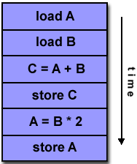
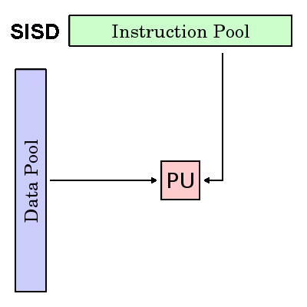
Single Instruction, Single Data (SISD)
A serial (non-parallel) computer
Single instruction: only one instruction stream is being acted on by the CPU during any one clock cycle
Single data: only one data stream is being used as input during any one clock cycle
Deterministic execution
This is the oldest and until recently, the most prevalent form of computer
Examples: most PCs, single CPU workstations and mainframes

Slide 22
Single Instruction, Multiple Data (SIMD)
A type of parallel computer
Single instruction: All processing units execute the same instruction at any given clock cycle
Multiple data: Each processing unit can operate on a different data element
This type of machine typically has an instruction dispatcher, a very high-bandwidth internal network, and a very large array of very small-capacity instruction units.
Best suited for specialized problems characterized by a high degree of regularity, such as graphics/image processing.
Synchronous (lockstep) and deterministic execution
Two varieties: Processor Arrays and Vector Pipelines

Slide 23
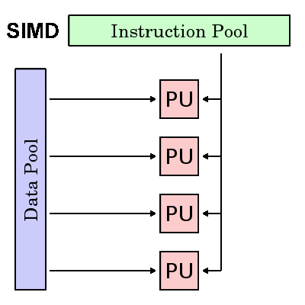
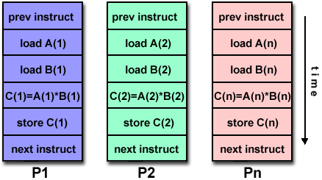
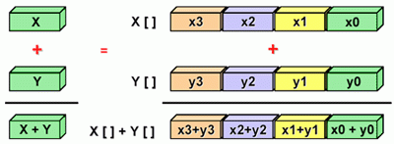
Single Instruction, Multiple Data (SIMD)
Examples:
Processor Arrays: Thinking Machine CM-2, MasPar MP-1 & MP-2
Vector Pipelines: IBM 9000, Cray C90, Fujitsu VP, NEC SX-2, Hitachi S820
Most modern computers, particularly those with graphics processor units (GPUs) employ SIMD instructions and execution units.

Slide 24
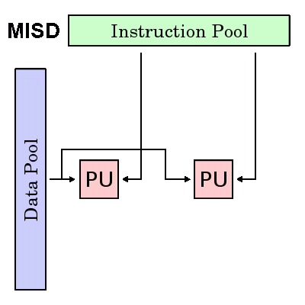
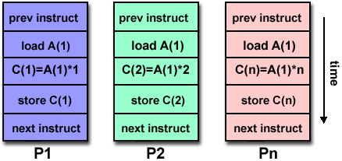
Multiple Instruction, Single Data (MISD)
A type of a parallel computer
Multiple Instruction: Each processing unit operates on the data independently. via independent instruction streams.
Single Data: A single data stream is fed into multiple processing units.
Few (if any) actual examples of this class of parallel computer have ever existed.
Some conceivable uses might be:
multiple frequency filters operating on a single signal stream
multiple cryptography algorithms attempting to crack a single coded message.

Slide 25
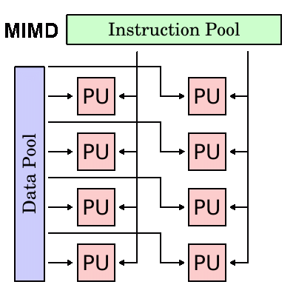
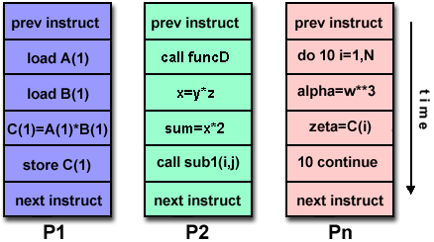
Multiple Instruction, Multiple Data (MIMD)
Currently, the most common type of parallel computer. Most modern computers fall into this category.
Multiple Instruction: every processor may be executing a different instruction stream
Multiple Data: every processor may be working with a different data stream
Execution can be synchronous or asynchronous, deterministic or non-deterministic
Examples: most current supercomputers, networked parallel computer "grids" and multi-processor SMP computers, multi-core PCs.

Slide 26
General Parallel Computing Terminology
CPU: Modern CPUs comprise one or more cores – a distinct execution unit with its own instruction stream. Cores with a CPU may be organized into one or more sockets - each socket with its own distinct memory . When a CPU consists of two or more sockets, usually hardware infrastructure supports memory sharing across sockets.
Node: A standalone "computer in a box." Usually comprised of multiple CPUs/processors/cores, memory, network interfaces, etc. Nodes are networked together to comprise a supercomputer.
Task: A logically discrete section of computational work. A task is typically a program or program-like set of instructions that is executed by a processor. A parallel program consists of multiple tasks running on multiple processors.
Pipelining: Breaking a task into steps performed by different processor units, with inputs streaming through, much like an assembly line; a type of parallel computing.

Slide 27
General Parallel Computing Terminology
Serial Execution: Execution of a program sequentially, one statement at a time. In the simplest sense, this is what happens on a one processor machine. However, virtually all parallel tasks will have sections of a parallel program that must be executed serially.
Parallel Execution: Execution of a program by more than one task, with each task being able to execute the same or different statement at the same moment in time.
Shared Memory: From a strictly hardware point of view, describes a computer architecture where all processors have direct (usually bus based) access to common physical memory. In a programming sense, it describes a model where parallel tasks all have the same "picture" of memory and can directly address and access the same logical memory locations regardless of where the physical memory actually exists.

Slide 28
General Parallel Computing Terminology
Distributed Memory: In hardware, refers to network-based memory access for physical memory that is not common. As a programming model, tasks can only logically "see" local machine memory and must use communications to access memory on other machines where other tasks are executing.
Communications: Parallel tasks typically need to exchange data. There are several ways this can be accomplished, such as through a shared memory bus or over a network, however the actual event of data exchange is commonly referred to as communications regardless of the method employed.
Synchronization: The coordination of parallel tasks in real time, very often associated with communications. Often implemented by establishing a synchronization point within an application where a task may not proceed further until another task(s) reaches the same or logically equivalent point. Synchronization usually involves waiting by at least one task and can therefore cause a parallel application's wall clock execution time to increase.

Slide 29
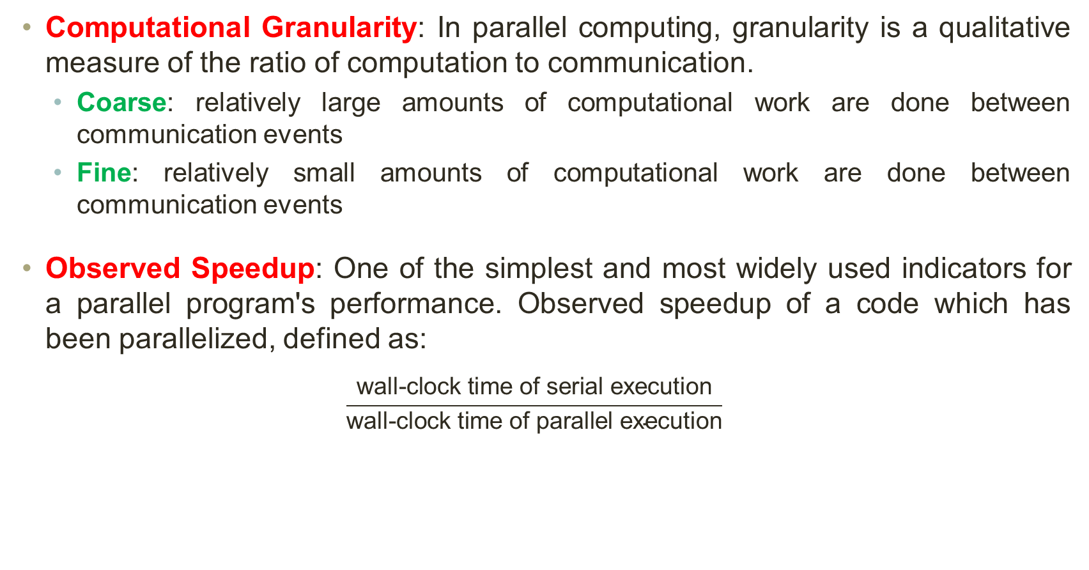
General Parallel Computing Terminology
Computational Granularity: In parallel computing, granularity is a qualitative measure of the ratio of computation to communication.
Coarse: relatively large amounts of computational work are done between communication events
Fine: relatively small amounts of computational work are done between communication events
Observed Speedup: One of the simplest and most widely used indicators for a parallel program's performance. Observed speedup of a code which has been parallelized, defined as:
$$\frac{\text{wall}\text{−}\text{clock} \text{time} \text{of} \text{serial} \text{execution}}{\text{wall}\text{−}\text{clock} \text{time} \text{of} \text{parallel} \text{execution}}$$

Slide 30
General Parallel Computing Terminology
Parallel Overhead: Required execution time that is unique to parallel tasks, as opposed to that for doing useful work. Parallel overhead can include factors such as:
Task start-up time
Synchronizations
Data communications
Software overhead imposed by parallel languages, libraries, operating system, etc.
Task termination time
Massively Parallel: Refers to parallel system hardware, having many processing elements. The meaning of "many" keeps increasing, but currently, the largest parallel computers are comprised of processing elements numbering in the hundreds of thousands to millions.

Slide 31
General Parallel Computing Terminology
Embarrassingly (IDEALLY) Parallel: Solving many similar, but independent tasks simultaneously; little to no need for coordination between the tasks.
Scalability: Refers to a parallel system's (hardware and/or software) ability to demonstrate a proportionate increase in parallel speedup with the addition of more resources. Factors that contribute to scalability include:
Hardware – particularly memory-CPU bandwidths and network communication
Application algorithm
Parallel overhead related
Characteristics of your specific application and coding

Slide 32
Design Goals of Parallel and Distributed Computing
Performance Improvement
Speedup: Execute tasks faster by dividing the workload among multiple processors.
High Throughput: Perform many tasks concurrently.
Low Latency: Reduce time to complete individual tasks through parallel execution.
Scalability
Horizontal Scalability: Add more nodes/processors without significant reconfiguration.
Vertical Scalability: Increase the power of existing nodes.
Load Balancing: Efficiently distribute work across available resources to prevent bottlenecks.

Slide 33
Design Goals of Parallel and Distributed Computing
Reliability and Fault Tolerance
Redundancy: Ensure backup systems are available in case of failure.
Replication: Duplicate critical data and services across nodes.
Recovery Mechanism: Enable quick recovery after failures through checkpointing and rollback mechanisms.
Resource Sharing and Utilization
Efficient Resource Utilization: Optimize the use of computational resources like CPU, memory, and network bandwidth.
Multi-user Support: Allow multiple users or tasks to share and access resources concurrently

Slide 34
Design Goals of Parallel and Distributed Computing
Transparency
Access Transparency: Users do not need to know the physical location of resources.
Location Transparency: Resource location changes are hidden from users.
Replication Transparency: Users are unaware of the presence of multiple copies.
Concurrency Transparency: Multiple processes execute simultaneously without conflict.
Failure Transparency: Failures are masked from users to ensure uninterrupted service.
Modularity and Flexibility
Modularity: Design systems as independent components that can be developed, tested, and maintained separately.
Flexibility: Easily upgrade, modify, or reconfigure the system without major overhauls.

Slide 35
Design Goals of Parallel and Distributed Computing
Heterogeneity Support:
Support for diverse hardware, operating systems, and network protocols to ensure seamless integration and communication.
Cost Effectiveness
Utilize cost-effective commodity hardware.
Reduce operational costs through optimized parallel and distributed processing.
Security and Privacy
Implement robust security measures like encryption, authentication, and secure communication to protect data in distributed environments.

Slide 36
Types of Parallel Systems
Shared Memory Systems:
Multiple processors share a single address space (RAM)
Communication happen through shared variables
Examples:
symmetric multiprocessing (SMP)
NUMA (non-uniform memory access)
Pros: Low communication overhead, easy programming
Cons: Scalability issues, memory access bottlenecks
Distributed Memory Systems:
Each processor has its own private memory
Processes communicate using message passing (MPI, PVM)
Examples:
Cluster Computing
Massively Parallel Processors (MPP)
Pros: High scalability, cost-effective
Cons: Complex programming, data consistency challenges

Slide 37
Types of Parallel Systems
Hybrid Systems (Distributed Shared Memory):
Combines shared memory and distributed memory models
Allows processes to communicate either through shared memory or message passing
Examples:
Intel Xeon Phi, Cray supercomputers
NUMA (non-uniform memory access)
SIMD vs. MIMD Systems:
SIMD (Single Instruction, Multiple Data) – One instruction operates on multiple data streams (e.g., GPUs).
MIMD (Multiple Instruction, Multiple Data) – Different processors execute different instructions independently.

Slide 38
Types of Distributed Systems
Cluster Computing
Multiple computers (nodes) work together as a single logical unit.
Typically uses high-speed local networks (LAN).
Example: Beowulf Clusters, Apache Hadoop Clusters.
Grid Computing
Uses geographically distributed computers to perform large-scale computations.
Typically, loosely coupled compared to clusters.
Cloud Computing
Uses virtualized distributed resources over the Internet.
Provides services like IaaS, PaaS, SaaS.
Example: AWS, Google Cloud, Microsoft Azure.

Slide 39
Types of Distributed Systems
Peer-to-Peer (P2P) Systems
No central authority; all nodes are equal and communicate directly.
Used in file sharing, cryptocurrencies, decentralized networks.
Example: BitTorrent, Ethereum blockchain.
Internet of Things (IoT) Systems
Distributed network of smart devices that process and share data.
Uses Edge & Fog Computing to process data closer to the source.
Example: Smart Cities, Industrial IoT.

Slide 40
Comparison of Parallel vs. Distributed Systems
Feature | Parallel Systems | Distributed Systems
Memory Sharing | Shared or Distributed | Completely Distributed
Communication | Fast, Low Latency | Uses Networks (LAN/WAN)
Scalability | Limited | Highly Scalable
Fault Tolerance | Lower | Higher
Use Cases | HPC, Scientific Simulations | Cloud, IoT, Big Data

Slide 41
Enabling Technologies for PDC
Hardware:
Multicore Processors
CPUs with multiple cores for parallel execution (e.g., Intel Xeon, AMD Ryzen).
GPUs (Graphics Processing Units)
Parallel execution of thousands of threads (e.g., NVIDIA CUDA, AMD ROCm).
FPGAs (Field-Programmable Gate Arrays)
Hardware acceleration for parallel tasks (e.g., Xilinx, Intel FPGA).
High-Speed Networks
InfiniBand, Ethernet, RDMA for fast inter-node communication.
Storage Technologies
HDFS, NVMe, Object Storage for distributed data access.

Slide 42
Enabling Technologies for PDC
Middleware and Communication:
Message Passing Interface (MPI)
Standard for distributed computing communication (e.g., OpenMPI, MPICH).
Remote Procedure Call (RPC)
Enables function calls between distributed systems (e.g., gRPC, Thrift).
Distributed File Systems
HDFS, Google File System (GFS), Ceph.
Virtualization & Containerization
Vmware, KVM, Docker, Kubernetes

Slide 43
Enabling Technologies for PDC
Cloud & Edge Computing:
Virtual Machines (VMs) & Hypervisors
Xen, KVM, Hyper-V for cloud-based distributed computing.
Serverless Computing
AWS Lambda, Google Cloud Functions, Azure Functions
Edge Computing Platforms
NVIDIA Jetson, Intel OpenVINO, AWS Greengrass

Slide 44
Platforms for PDC
High Performance Computing (HPC):
Supercomputers – IBM Summit, Fugaku, Cray XC40.
HPC Clusters – Linux-based Beowulf Clusters, Slurm Workload Manager.
Cloud Computing:
Amazon Web Services (AWS) – EC2, S3, Lambda, EMR.
Microsoft Azure – Azure Virtual Machines, Kubernetes Service.
Google Cloud Platform (GCP) – Compute Engine, Kubernetes, BigQuery.
Big Data Analytics:
Apache Hadoop – Distributed storage and processing (HDFS + MapReduce).
Apache Spark – Fast in-memory distributed processing.
Google BigQuery – Distributed cloud data warehouse.

Slide 45
Platforms for PDC
Blockchain & Distributed Ledger:
Ethereum – Smart contracts and decentralized applications.
Hyperledger Fabric – Enterprise blockchain solutions.
IoT and Edge Computing:
AWS IoT, Azure IoT Hub – Cloud-based IoT data processing.
Google TensorFlow Lite – AI inference on edge devices.

Slide 46
Software Environments for PDC
Programming Models & Languages:
Parallel Programming
OpenMP (C, C++, Fortran) – Shared memory parallelism.
MPI (C, C++, Python) – Message passing for distributed systems.
CUDA (C, Python) – GPU programming for high-performance tasks.
Distributed Programming
Hadoop MapReduce (Java, Python) – Large-scale data processing.
Apache Spark (Scala, Python) – Distributed in-memory computing.
TensorFlow, PyTorch (Python) – Distributed deep learning.
General-Purpose Languages
Python (Dask, Ray) – Distributed computing frameworks.
Rust – Safe and efficient parallel programming.
Java, Scala – Used in cloud-based distributed systems.

Slide 47
Software Environments for PDC
Workflow Management & Orchestration:
Apache Airflow – Distributed task scheduling.
Kubernetes – Container orchestration for cloud and edge.
Apache Kafka – Distributed streaming and event processing.
Distributed Databases:
NoSQL Databases: Apache Cassandra, MongoDB, Google Bigtable.
NewSQL Databases: Google Spanner, CockroachDB.

Slide 48
Summary: Technologies, Platforms, and Software
Category | Examples
Hardware | Multicore CPUs, GPUs (NVIDIA, AMD), FPGAs, InfiniBand
Middleware | MPI, RPC, gRPC, Distributed File Systems (HDFS, Ceph)
Cloud Platform | AWS, Azure, Google Cloud, OpenStack
Big Data | Apache Hadoop, Spark, Google BigQuery
Edge Computing | NVIDIA Jetson, AWS Greengrass, OpenVINO
Programming Models | OpenMP, MPI, CUDA, Dask, Ray
Workflow Tools | Apache Airflow, Kubernetes, Apache Kafka
Databases | Apache Cassandra, Google Spanner, MongoDB

Slide 49
Limitations of Parallel Computing
It requires designing the proper communication and synchronization mechanisms between the processes and sub-tasks
Exploring the proper parallelism from a problem is a hectic process
The program must have low coupling and high cohesion. But it’s difficult to create such programs
It needs relatively more technical skills to code a parallel program

