Slide 1
CSC 334 – Parallel and Distributed Computing
Instructor: Dr. M. Hasan Jamal
Lecture# 02: Types of Parallelism

Slide 2
Types of Parallelism
Implicit Parallelism: The compiler, runtime, or system automatically identifies and manages parallelism without requiring the programmer to explicitly define it.
Explicit Parallelism: The programmer directly specifies the parallelism, defining threads, synchronization, and communication.

Slide 3
Explicit Parallelism
A programming approach where the developer explicitly instructs the system where and how to parallelize operations using dedicated language features like operators, function calls, or directives.
Since multiple threads are executing concurrently, explicit synchronization mechanisms like barrier or locks are often required to ensure data consistency.
Examples of explicit parallelism techniques
Data parallelism
Task parallelism
Loop-level parallelism
Thread-based parallelism

Slide 4
Data Parallelism
Applying the same operation to large datasets in parallel, often using loops to iterate through data chunks. The same code segment runs concurrently on each processor, but each processor is assigned its own part of the data to work on.
For loops define the parallelism.
The iterations must be independent of each other.
Data parallelism is called "fine grain parallelism" because the computational work is spread into many small subtasks.

Slide 5
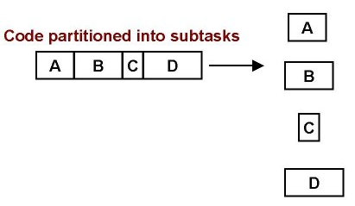
Task Parallelism
As the opposite of data parallelism, task parallelism breaks down a problem into independent tasks that can be executed concurrently on different processors. Different operations are performed on different parts of the data.
Task parallelism is called "coarse grain" parallelism because the computational work is spread into just a few subtasks.
More code is run in parallel because the parallelism is implemented at a higher level than in data parallelism.
Easier to implement and has less overhead than data parallelism.
Example: an image (like color channels) are processed in parallel using separate threads, effectively treating each color channel as a separate task.

Slide 6
Loop-Level Parallelism
Parallelizing operations within loops where each iteration can be executed independently
Loop-level parallelism is a specific technique often used to achieve data parallelism, but data parallelism encompasses a wider range of strategies.
Example:
#pragma omp parallel for
for (int i = 0; i < n; i++)
a[i] = b[i] + c[i];

Slide 7
Thread-Level Parallelism
Deals with the execution of multiple threads within a program to execute different parts of the code simultaneously. The programmer explicitly creates and manages threads that run concurrently.
Thread-level parallelism is a mechanism for achieving task parallelism by managing threads, but not all task parallelism requires explicit thread management.
Example: A web server using multiple threads to handle incoming requests simultaneously, where each thread processes a single request independently.

Slide 8
Implicit Parallelism
The compiler, runtime, or system automatically identifies and manages parallelism without requiring the programmer to explicitly define it.
Examples of implicit parallelism techniques
Instruction-Level Parallelism (ILP)
Compiler-Driven Parallelism

Slide 9
Instruction Level Parallelism
Instruction Level Parallelism (ILP) is a set of techniques for executing multiple instructions at the same time within the same CPU core (Note: ILP has nothing to do with multicore)
Basic Idea: Execute several instructions in parallel; i.e., overlap the execution of instructions to run programs faster (“to improve performance”)
The Problem: A CPU core has lots of circuitry, and at any given time, most of it is idle, which is wasteful.
The solution: Have different parts of the CPU core work on different operations at the same time. If the CPU core has the ability to work on 10 operations at a time, then the program can, in principle, run as much as 10 times as fast (although in practice, not quite so much).

Slide 10
Examples of Instruction Level Parallelism
Pipelining: Start performing an operation on one piece of data while finishing the same operation on another piece of data – perform different stages of the same INSTRUCTION on different sets of operands at the same time (like an assembly line).
Superscalar: Perform multiple instructions at the same time (for example, simultaneously perform an add, a multiply and a load)
Super-pipelining: A combination of superscalar and pipelining – perform multiple pipelined instructions at the same time.
Vectorization: Load multiple pieces of data into special registers and perform the same instruction on all of them at the same time.

Slide 11
5 Stages in Executing a MIPS instruction
IF: Instruction Fetch, Increment Program Counter
ID: Instruction Decode, Read Registers
EX: Execution
Mem-ref: Calculate Address
Arithmetic/logical: Perform Operation
MEM:
Load: Read Data from Memory
Store: Write Data to Memory
WB:
Write Data Back to Register

Slide 12
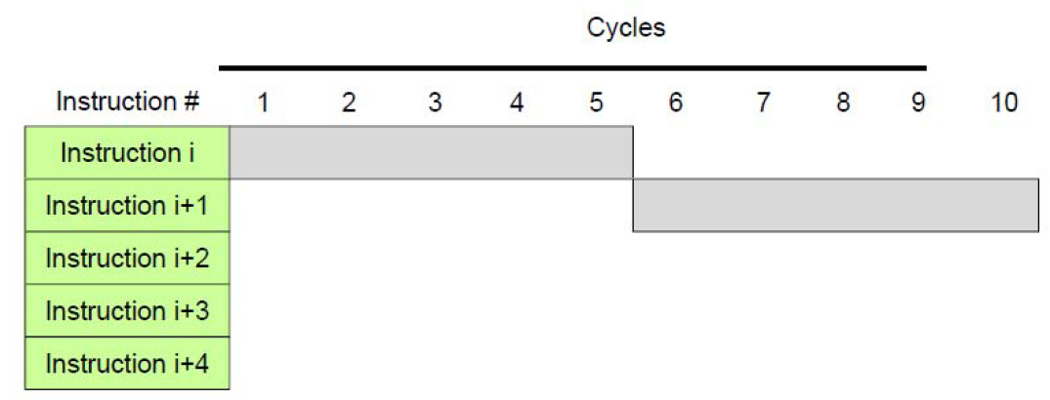
Instruction Execution

Slide 13
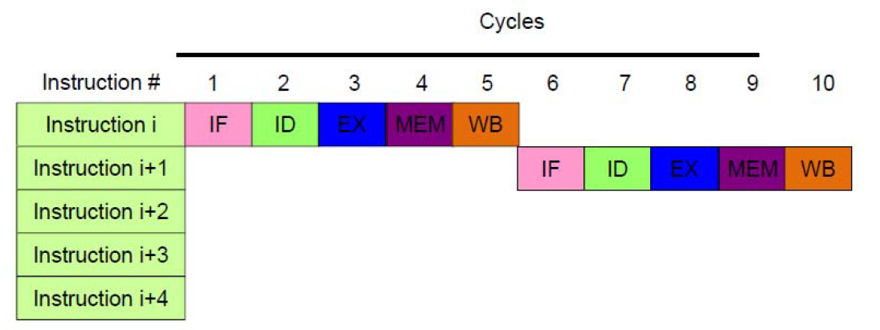
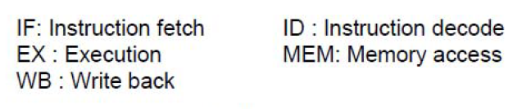
Instruction Execution

Slide 14
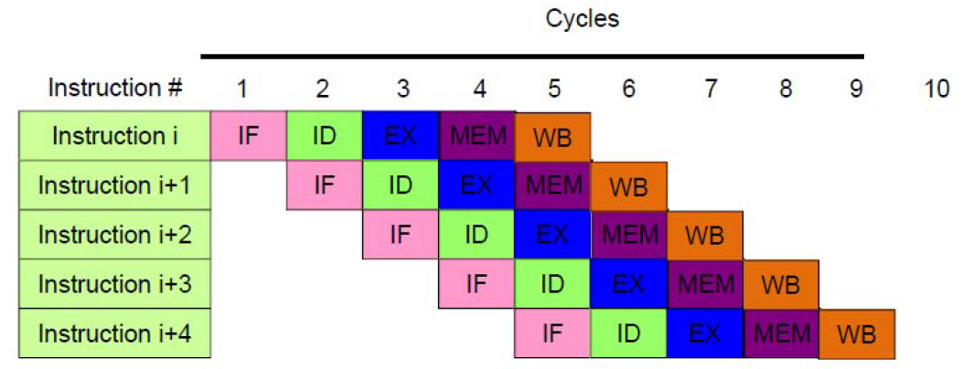
Pipelining Execution

Slide 15
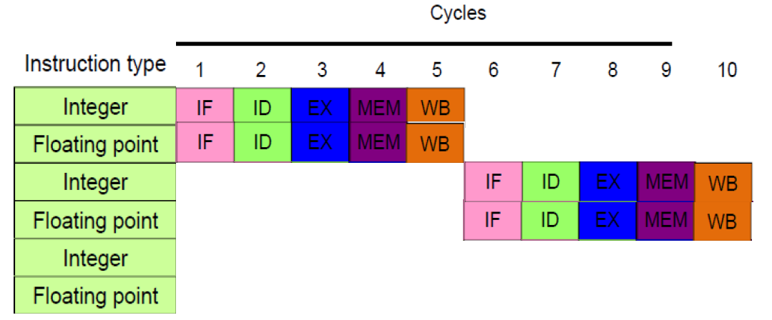
Superscalar Execution

Slide 16
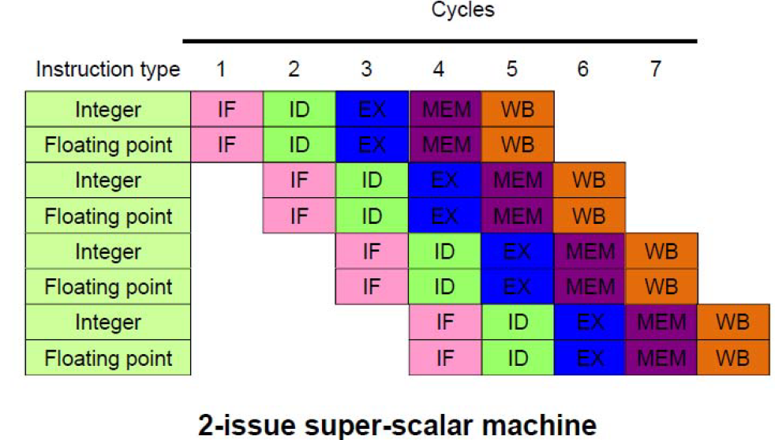
Super-pipelining: Superscalar + Pipeline

Slide 17
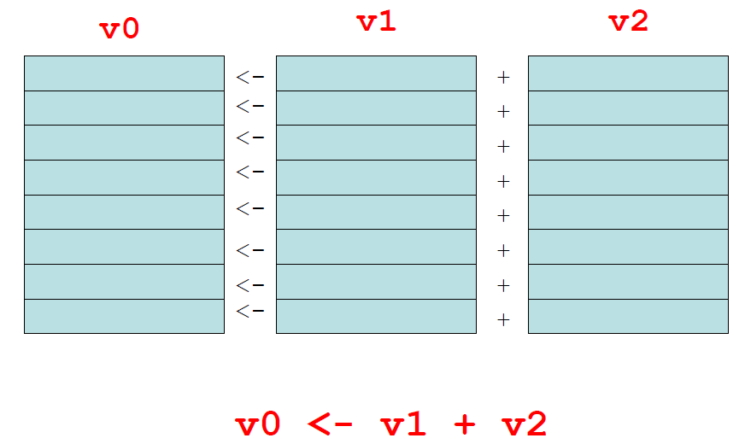
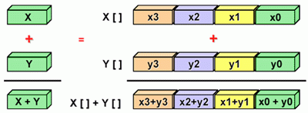
Vectorization
A vector register is a register that’s made up of many individual registers. that simultaneously perform the same operation on multiple sets of operands, producing multiple results. In a sense, vectors are like operation-specific cache.
A vector instruction is an instruction that performs the same operation simultaneously on all individual registers of a vector register.
for(i=0; i <=MAX; i++)
Z[i] = X[i] + Y[i];

Slide 18
What determines the degree of ILP?
Dependencies: A dependence indicates what program components (statements, loop iterations, etc.) may be executed ignoring the sequence of events specified by the programmer without changing the output. Program components that are not dependent on each other can be executed in parallel. Dependencies are a property of programs.
Hazards: When two instructions that have one or more dependences between them occur close enough that changing the instruction order will change the outcome of the program.
Not all dependencies lead to hazards!
The presence of a dependence indicates the potential for a hazard, but the existence of an actual hazard and the length of any stall are properties of the pipeline

Slide 19
Types of Dependencies
Data Dependence: Flow Dependence (True Dependence)
RAW: Read-After-Write
Named Dependencies:
WAR: Write-After-Read (Anti-Dependance)
WAW: Write-After-Write (Output Dependence)
Control Dependence:
When following instructions depend on the outcome of a previous branch/jump

Slide 20
What is Dependency Analysis?
Dependency analysis describes of how different parts of a program affect one another, and how various parts require other parts in order to operate correctly.
Dependency analysis is one of the major roles of a modern compilers
A data dependency governs how different pieces of data affect each other.
A control dependency governs how different sequences of instructions affect each other.

Slide 21
Data Dependence and Hazards
If two instructions are data dependent, they cannot execute simultaneously, be completely overlapped or execute in out-of-order
Instruction S2 is data dependent (aka true dependence) on Instruction S1
If data dependence caused a hazard in pipeline, then the hazard is called a Read After Write (RAW) hazard
S1: X = A + B
S2: C = X + 1
S1
S2

Slide 22
Loop-Carried Dependence
A type of data dependence that occurs when the output of a loop iteration depends on the output of a previous iteration
There is no way to execute iteration i until after iteration i-1 has completed, so this loop can’t be parallelized.
FOR i = 2 to MAX
a[i] = a[i-1] + b[i]
END FOR

Slide 23
Why do we care?
Loops are very common in many programs.
Also, it’s easier to optimize loops than more arbitrary sequences of instructions: when a program does the same thing over and over, it’s easier to predict what’s likely to happen next.
Loops are the favorite control structures of High-Performance Computing. Both hardware vendors and compiler writers build for optimizing loop performance using instruction-level parallelism (superscalar, pipelining, and vectorization).
Loop carried dependencies affect whether a loop can be parallelized, and how much.

Slide 24
ILP and Data Dependencies, Hazards
HW/SW must preserve program order: code must give the same results as if instructions were executed sequentially in original order of the source program
Importance of the data dependencies:
Indicates the possibility of a hazard
Determines order in which results must be calculated
Sets an upper bound on how much parallelism can possibly be exploited
Goal: Exploit parallelism by preserving program order only where it affects the outcome of the program

Slide 25
Named Dependence and Hazards
Name Dependence: When two instructions use the same variable name (register or memory location), but there is no flow of data between them associated with that variable name.
Anti-Dependence: Instruction S2 writes operand before Instruction S1 reads it
Output-Dependence: Instruction S2 writes operand before Instruction S1 writes it
If anti-dependence caused a hazard in pipeline, then the hazard is called a Write After Read (WAR) hazard
If output-dependence caused a hazard in pipeline, then the hazard is called a Write After Write (WAW) hazard
S1: A = X + B
S2: X = C + D
S1
S2
S1: X = A + B
...
S2: X = C + D
S1
S2

Slide 26
Control Dependencies
Every program has a well-defined flow of control that moves from instruction to instruction. Every instruction is control dependent on some set of branches (if condition, switch case, function calls, I/O), and, in general, these control dependencies must be preserved to preserve program order.
S1 is control dependent on p1, and S2 is control dependent on p2 but not on p1.
Control dependence need not be preserved
willing to execute instructions that should not have been executed, thereby violating the control dependences, if can do so without affecting correctness of the program
Speculative Execution
IF p1 THEN
S1
IF p2 THEN
S2

Slide 27
Speculation
Greater ILP: Overcome control dependence by hardware speculating on outcome of branches and executing program as if guesses were correct
Speculation ➔ fetch, issue, and execute instructions as if branch predictions were always correct
Dynamic scheduling ➔ only fetches and issues instructions
Essentially a data flow execution model: Operations execute as soon as their operands are available
Speculation is rampant in modern superscalars

Slide 28
Speculation
Different predictors
Branch Prediction
Value Prediction
Prefetching (memory access pattern prediction)
Inefficient
Predictions can go wrong
Need to flush out wrongly predicted data
Wrong predictions consume power

Slide 29
Limits to Pipelining
Hazards prevent next instruction from executing during its designated clock cycle
Structural hazards: attempt to use the same hardware to do two different things at once
Data hazards: Instruction depends on result of prior instruction still in the pipeline
Control hazards: Caused by delay between the fetching of instructions and decisions about changes in control flow (branches and jumps).

Slide 30
Why Does Order Matter?
Dependencies can affect whether we can execute a particular part of the program in parallel.
If we cannot execute that part of the program in parallel, then it’ll be SLOW.

Slide 31
Dependencies in Loops
Dependencies in loops are easy to understand if loops are unrolled. Now the dependences are between statement “instances”
FOR i = 1 to n
S1 a[i] = b[i] + 1
S2 c[i] = a[i] + 2
Iteration: 1 2 3 4 ...
Instances of S1:
...
Instances of S2:
S1
S2
S1
S1
S2
S2
S1
S2

Slide 32
Dependencies in Loops
A little more complex example
FOR i = 1 to n
S1 a[i] = b[i] + 1
S2 c[i] = a[i-1] + 2
Iteration: 1 2 3 4 ...
Instances of S1:
...
Instances of S2:
S1
S1
S2
S1
S2
S2
S1
S2

Slide 33
Dependencies in Loops
Even more complex example
FOR i = 1 to n
S1 a = b[i] + 1
S2 c[i] = a + 2
Iteration: 1 2 3 4 ...
Instances of S1:
...
Instances of S2:
S1
S2
S1
S1
S2
S2
S1
S2

Slide 34
Optimizing with Dependencies
It is valid to parallelize/vectorize a loop if no dependences cross its iteration boundaries:
FOR i = 1 to n
S1 a[i] = b[i] + 1
S2 c[i] = a[i] + 2
1 2 3 4 ...
...
S1
S2
S1
S1
S2
S2
S1
S2

Slide 35
Loop or Branch Dependency?
Is this a loop carried dependency or a branch dependency?
FOR i = 1 to MAX
IF (x[i] != 0)
y[i] = 1.0/x[i]
END IF
END FOR

Slide 36
Compiler-Driven Parallelism
Tricks that compilers play for automatic parallelization
Scalar optimizations
Loop-level optimizations

Slide 37
Scalar Optimizations
Copy Propagation
Constant Folding
Dead Code Removal
Strength Reduction
Common Subexpression Elimination
Variable Renaming
Loop Optimizations
Not every compiler does all these, so it sometimes can be worth doing these by hands

Slide 38
Copy Propagation
x = y
z = 1 + x
Before
Has data dependency
Compile
x = y
z = 1 + y
After
No data dependency

Slide 39
Constant Folding
Before
After
add = 100
aug = 200
sum = add + aug
sum = 300
Notice that sum is actually the sum of two constants, so the compiler can precalculate it, eliminating the addition that otherwise would be performed at runtime.

Slide 40
Dead Code Removal
Before
After
var = 5
PRINT *, var
STOP
PRINT *, var * 2
var = 5
PRINT *, var
STOP
Since the last statement never executes, the compiler can eliminate it.

Slide 41
Strength Reduction
Before
After
x = y^2.0
a = c / 2.0
x = y * y
a = c * 0.5
Raising one value to the power of another, or dividing, is more expensive than multiplying. If the compiler can tell that the power is a small integer, or that the denominator is a constant, it’ll use multiplication instead.

Slide 42
Common Subexpression Elimination
Before
After
d = c * (a / b)
e = (a / b) * 2.0
adivb = a / b
d = c * adivb
e = adivb * 2.0
The subexpression (a / b) occurs in both assignment statements, so there’s no point in calculating it twice.
This is typically only worth doing if the common subexpression is expensive to calculate.

Slide 43
Variable Renaming
Before
After
x = y * z
q = r + x * 2.0
x = a + b
x0 = y * z
q = r + x0 * 2
x = a + b
The original code has output dependency, while the new code doesn’t – but the final value of x is still correct.

Slide 44
Loop Optimizations
Hoisting Loop Invariant Code
Unswitching
Iteration Peeling
Index Set Splitting
Loop Interchange
Unrolling
Loop Fusion
Loop Fission
Inlining
Not every compiler does all these, so it sometimes can be worth doing these by hands

Slide 45
Hoisting Loop Invariant Code
The code that does not change inside the loop is known as loop invariant. It doesn’t need to be calculated over and over.
Before
After
FOR i = 1 to n
a[i] = b[i] + c * d
e = g(n)
END FOR
temp = c * d
FOR i = 1 to n
a[i] = b[i] + temp
END FOR
e = g(n)

Slide 46
Unswitching
FOR i = 1 to n
FOR j = 2 to n
IF (t(i) > 0) THEN
a[i][j] = a[i][j] * t(i) + b(j)
ELSE
a[i][j] = 0.0
END IF
END FOR
END FOR
The condition is j-independent
Before
FOR i = 1 to n
IF (t(i) > 0) THEN
FOR j = 2 to n
a[i][j] = a[i][j] * t(i) + b(j)
END FOR
ELSE
FOR j = 2 to n
a[i][j] = 0.0
END FOR
END IF
END FOR
So, it can migrate outside the j loop
After

Slide 47
Iteration Peeling
FOR i = 1 to n
IF ((i == 1) OR (i == n)) THEN
x[i] = y[i]
ELSE
x[i] = y[I + 1] + y[i - 1]
END IF
END FOR
Before
We can eliminate the IF by peeling the weird iterations.
x(1) = y(1)
FOR i = 2 to n-1
x[i] = y[I + 1] + y[i - 1]
END FOR
x(n) = y(n)
After

Slide 48
Index Set Splitting
FOR i = 1 to n
a[i] = b[i] + c[i]
IF ((i > 10) THEN
d[i] = a[i] + b[i – 10]
END IF
END FOR
Before
FOR i = 1 to 10
a[i] = b[i] + c[i]
END FOR
FOR i = 11 to n
a[i] = b[i] + c[i]
d[i] = a[i] + b[i - 10]
END FOR
After
Note that this is a generalization of peeling.

Slide 49
Loop Interchange
Before
After
FOR i = 1 to nj
FOR j = 1 to ni
a[i][j] = b[i][j]
END FOR
END FOR
FOR i = 1 to ni
FOR j = 1 to nj
a[i][j] = b[i][j]
END FOR
END FOR
The array elements a[i][j] and a[i][j+1] are near each other in memory, while a[i+1][j] may be far, so it makes sense to make the i loop be the outer loop.
This technique facilitates efficient exploitation of the phenomenon of locality of reference.

Slide 50
Unrolling
FOR i = 1 to n
a[i] = a[i] + b[i]
END FOR
Before
FOR i = 1, n, 4
a[i] = a[i] + b[i]
a[i+1] = a[i+1] + b[i+1]
a[i+2] = a[i+2] + b[i+2]
a[i+3] = a[i+3] + b[i+3]
END FOR
After
You generally shouldn’t unroll by hand.

Slide 51
Why Do Compilers Unroll?
A loop with a lot of operations gets better performance (up to some point), especially if there are lots of arithmetic operations but few main memory loads and stores.
Unrolling creates multiple operations that typically load from the same, or adjacent, cache lines.
So, an unrolled loop has more operations without increasing the memory accesses by much.
Also, unrolling decreases the number of comparisons on the loop counter variable, and the number of branches to the top of the loop.

Slide 52
Loop Fusion
FOR i = 1 to n
a[i] = b[i] + 1
END FOR
FOR i = 1 to n
c[i] = a[i] /2
END FOR
FOR i = 1 to n
d[i] = 1 / c[i]
END FOR
Before
FOR i = 1, n
a[i] = b[i] + 1
c[i] = a[i] / 2
d[i] = 1 / c[i]
END FOR
After
As with unrolling, this has fewer branches. It also has fewer total memory references.

Slide 53
Loop Fission
FOR i = 1, n
a[i] = b[i] + 1
c[i] = a[i] / 2
d[i] = 1 / c[i]
END FOR
Before
FOR i = 1 to n
a[i] = b[i] + 1
END FOR
FOR i = 1 to n
c[i] = a[i] /2
END FOR
FOR i = 1 to n
d[i] = 1 / c[i]
END FOR
After
Fission reduces the cache footprint and the number of operations per iteration.

Slide 54
To Fuse or to Fizz?
The question of when to perform fusion versus when to perform fission, like many optimization questions, is highly dependent on the application, the platform and a lot of other issues that get very, very complicated.
Compilers don’t always make the right choices.
That’s why it’s important to examine the actual behavior of the executable.

Slide 55
Inlining
Before
After
FOR i = 1 to n
a[i] = func(i)
END FOR
int func(x)
func = x * 3
RETURN func
FOR i = 1 to n
a[i] = i * 3
END FOR
When a function or subroutine is inlined, its contents are transferred directly into the calling routine, eliminating the overhead of making the call.

Slide 56
Task of the Compiler
It transform program to remove dependencies
Use dependence to reorganize computation for parallelism and locality.
However, manual transformation by hand can sometimes be more useful.

Slide 57
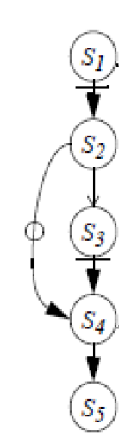
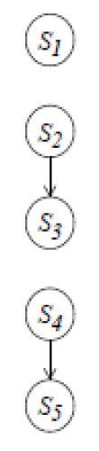
Transforming Programs: Renaming
S1: A = X + B
S2: X = Y + 1
S3: C = X + B
S4: X = Z + B
S5: D = X + 1
S1: A = X + B
S2: X1 = Y + 1
S3: C = X1 + B
S4: X2 = Z + B
S5: D = X2 + 1

Slide 58
Transform Programs: Scalar Expansion
FOR i = 1 to n
S1 a = b[i] + 1
S2 c[i] = a + d[i]
END FOR
...
S1
S2
S1
S1
S2
S2
S1
S2
FOR i = 1 to n
S1 a1[i] = b[i] + 1
S2 c[i] = a1[i] + d[i]
END FOR
a = a1[n]
...
S1
S2
S1
S1
S2
S2
S1
S2

Slide 59
Transform Programs: Scalar Expansion
The rule is simple: it is valid to expand a scalar if it is always assigned before it is used within the body of the loop and if either
its final value at the end of the loop is known, or
it is never used after the loop.

Slide 60
Final Message:
Implicit parallelism is becoming increasingly valuable with the advancement in hardware and compilers capabilities.
Try to get maximum of what a compiler can do for you automatically (LEARN compiler flags/options/directives). But keep ensured whether your BULL (the compiler) is really pulling your cart FAST (not just dancing), even that to the RIGHT direction.
Although a number of compiler/coding techniques have been discussed – but profiling and analyzing the benefit of a specific technique is a MUST TO DO.
While optimizing the code, use profiling to find out HOT SPOTS or Bottlenecks and then focus on those, one by one, also ensuring correctness. The 10-90 rule often works. Algorithm transformation could be considered, also.

