Slide 1
Mixed-Traffic Intersection Management Utilizing Connected and Autonomous Vehicles as Traffic Regulators
Author: Pin-Chun Chen (National Taiwan Univ., Taiwan), Xiangguo Liu (Northwestern Univ., USA), Chung-Wei Lin (National Taiwan Univ., Taiwan), Chao Huang (Univ. of Liverpool, UK), Qi Zhu (Northwestern Univ., USA)

Slide 2
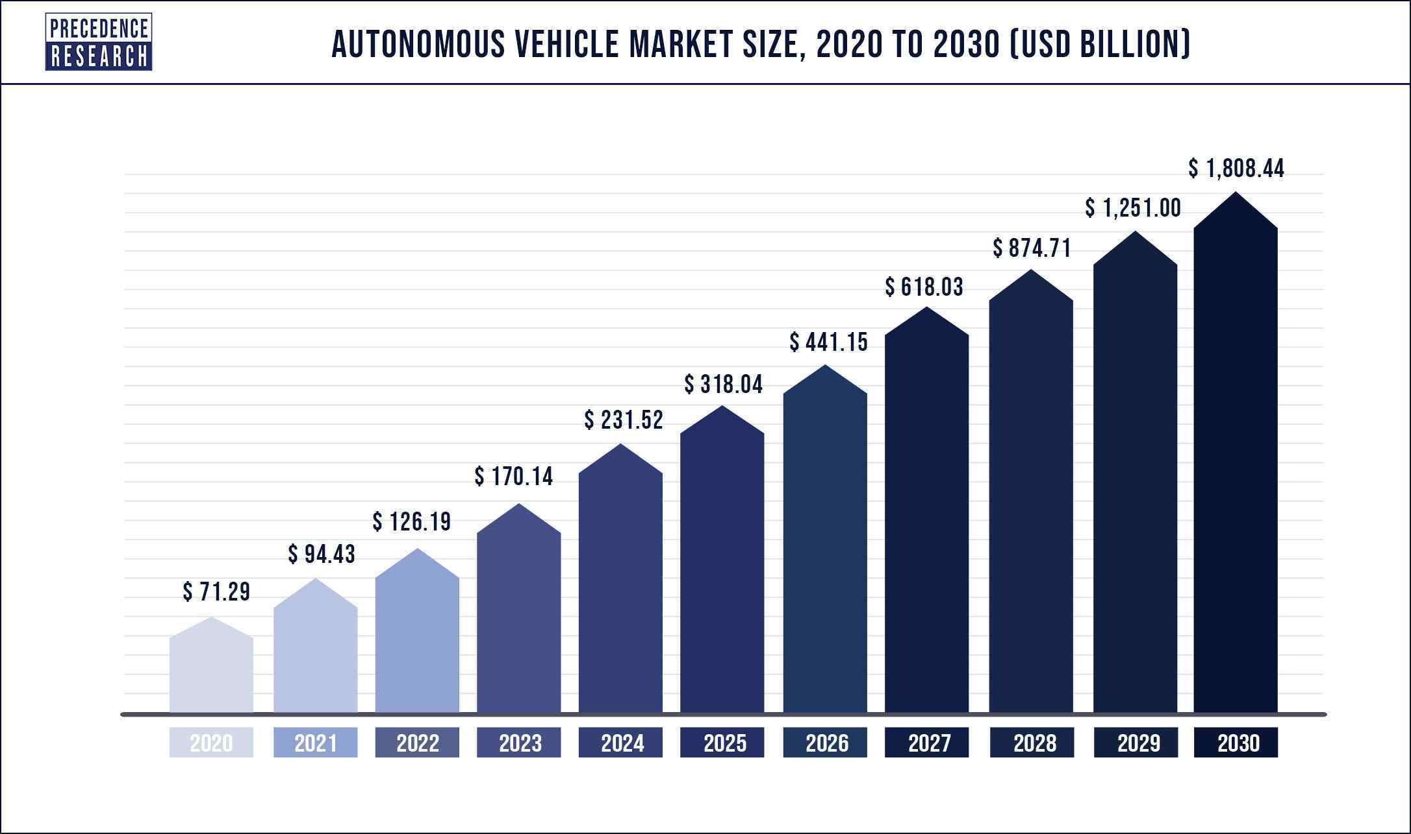
Connected Autonomous vehicles (CAV)
Precise controlling compared to human vehicles (HV)
Vehicle-to-Everything communication
Present great potentials to improve safety and traffic performance

Slide 3
Motivation
Due to Intersections being the main sources of collisions and jams in urban traffic. Intersection management for CAVs, including modeling, protocol design, scheduling, and analysis, is one of the highly-researched areas.
The similarity between intersections and other traffic scenarios called dynamic intersections provide extensibility to intersection management.
Dynamic Intersections
Unprotected Turns
Single Track Lanes
Merging Points

Slide 4

Motivation
However, current studies and many other CAV-related studies assume that the traffic consists of CAVs only, without any human-driving vehicle (HV) present.
Considering the principle that HVs do not change their behaviors to accommodate the presence of CAVs, it is challenging to fully utilize CAVs’ potential.
CAVs in mixed-traffic intersection protocols suffer performance loss due to the presence of HV. E.g. Aoki et al. proposed a mixed-traffic intersection protocol where the system falls back to a signalized intersection whenever an HV is detected.

Slide 5
Goal: Lessen the performance loss caused by HV in mixed traffic
Being able to schedule under mixed traffic.
Extendable to dynamic intersections.
Effective even without high CAV penetration rate.

Slide 6
Scheduling in mixed traffic
Inspired by Dissipation of Stop-And-Go Waves via Control of Autonomous Vehicles: Field Experiments by R. Stern et al.
Even only part of the traffic is controllable, within a non-overtaking scenario, the preceding vehicles still has control over following vehicles via blocking

Slide 7
Example Case

Slide 8
System model
Overtaking-prohibited mixed-traffic including CAVs and HVs. The intersection behaves depending on whether there exists an HV at the head (as the first vehicle) on at least one lane. If yes, the CAVs passes slower due to the uncertain behaviors of HVs; otherwise, CAVs may use a more efficient CAV protocol and past faster.
CAVs follow the intersection manager’s order to decide when it passes, whereas HVs pass as soon as possible.

Slide 9

System model
We define the 𝑖-th vehicle on lane 𝑙 as $v_{l,i} and w$e assume the following parameters are given to the intersection manager:
• 𝑁 : the total number of vehicles. • 𝐿: the number of lanes. • $N_{l}$: the number of vehicles on lane 𝑙. • $H_{l,i}$ : 1 / 0 if $v_{l,i}$is an HV / CAV. • $A_{l,i}$ : the estimated arrival time of $v_{l,i}$ . • 𝐺: the time gap for the next passing vehicle if there is no HV at the head on each lane. • 𝐺+: the time gap for the next passing vehicle if there exists an HV at the head on a lane.

Slide 10

Objective
Given the aforementioned parameters, the problem is to decide the entering time of each vehicle, which is the time that the vehicles enter the intersection: • $t_{l,i}$ : the entering time of $v_{l,i}$ .
The objective is to minimize the entering time of the last passing vehicle (which represents the time required of the intersection processing all vehicles): min $\left(\max_{1≤l≤L,1≤i≤N_{i}}{t_{l,i}}\right)$

Slide 11

Our approach
We came up with a DP solution to solve the problem optimally in polynomial, but with a strict restriction of the system model being single-conflict zone.
We then formulate a more general trajectory model and the constraints in MILP, which we use Gurobi as our MILP solver.
To solve cases with bigger size, we developed a MILP-based approach which divides the problem, solve these MILP subproblems them combine them in a way that does not violate the constraints.

Slide 12

Experiment Results
Due to uncontrollable HVs in mixed-traffic, existing studies on mixed-traffic focus on protocol or single-vehicle control rather than system-wide scheduling. Therefore, we will compare our approaches with the FCFS approach. 4 lanes, 5 vehicles on each.
We consider 4 lanes, 5 vehicles on each lane, 𝐺 = 1 (second), $G^{+}$ = 3 (second), and a Poisson arrival with 𝜆 = 0.5 vehicle per second.
The experiments were run on a laptop with 1.8GHz Intel Core i7-8550U processor and 16GB memory. Using Gurobi as the MILP solver.

Slide 13
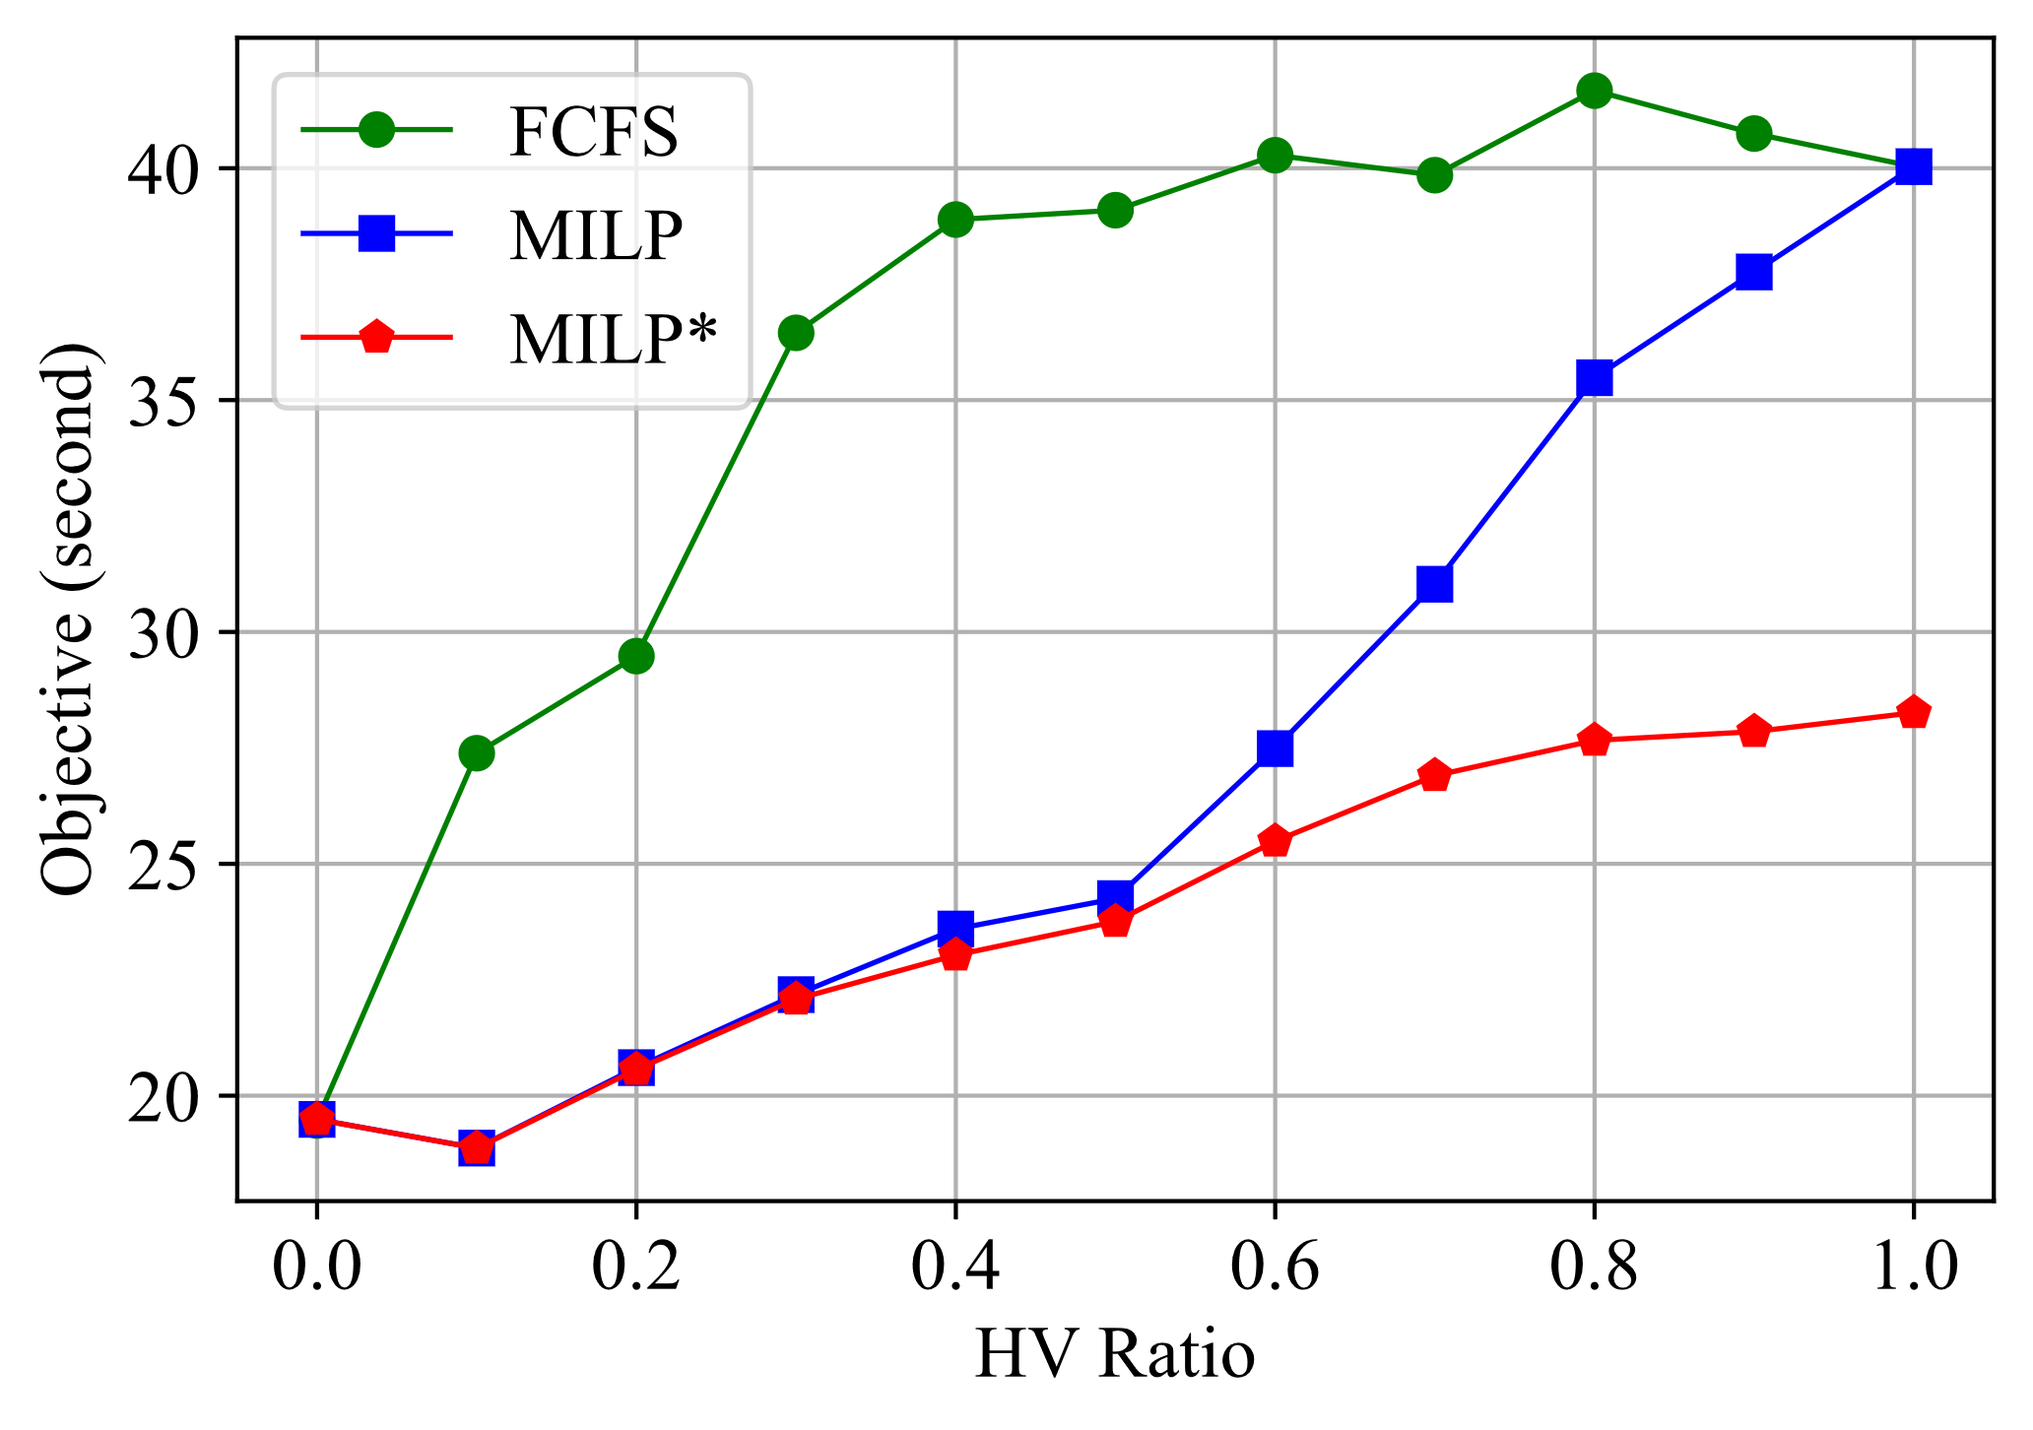
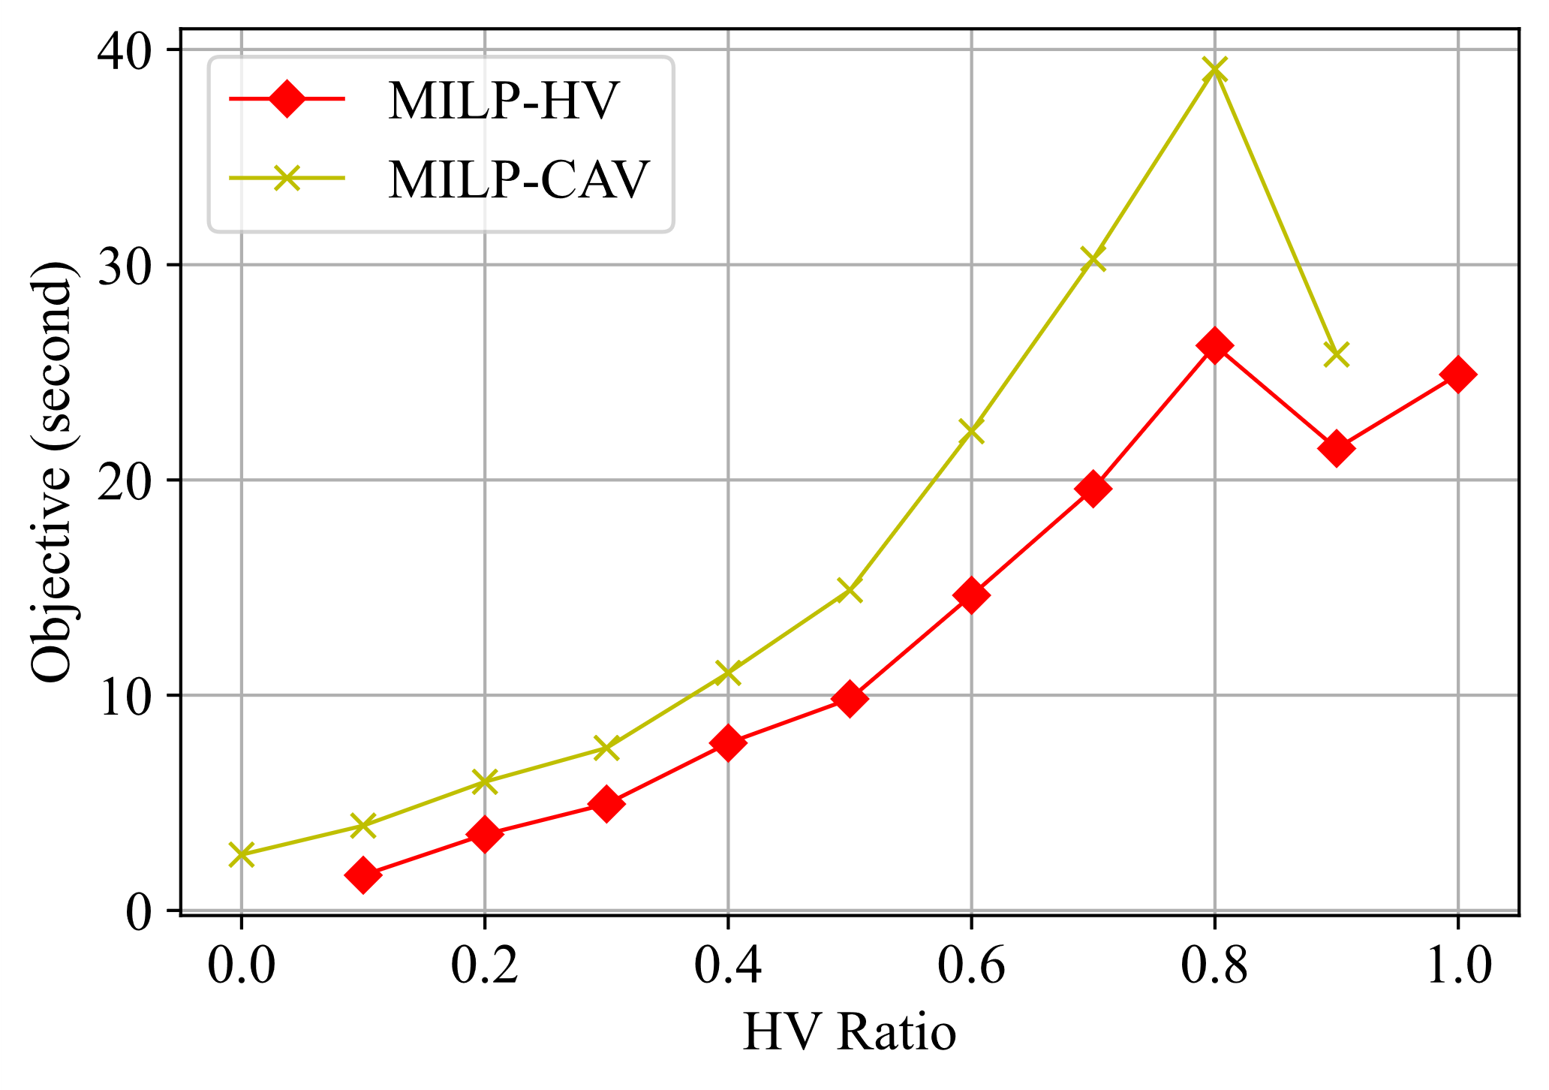
Experiment results
The figure on top shows comparison between the FCFS approach and the MILP formulation (including experiments assuming that HVs are controllable as CAVs, marked as MILP*) for the trajectory-based model.
The figure below shows the average waiting times of CAVs and HVs in the MILP formulation. We can observe that the waiting time of CAVs is larger than that of HVs. This is because, when the waiting time of an HV increases, it means that the HV is blocked by a CAV and implies that the waiting time of the CAV also increases. This indicates that our MILP formulation controls CAVs which suffer extra waiting times but improves the overall traffic performance.
Average runtime of solving the MILP formulation is 0.42 second.

Slide 14
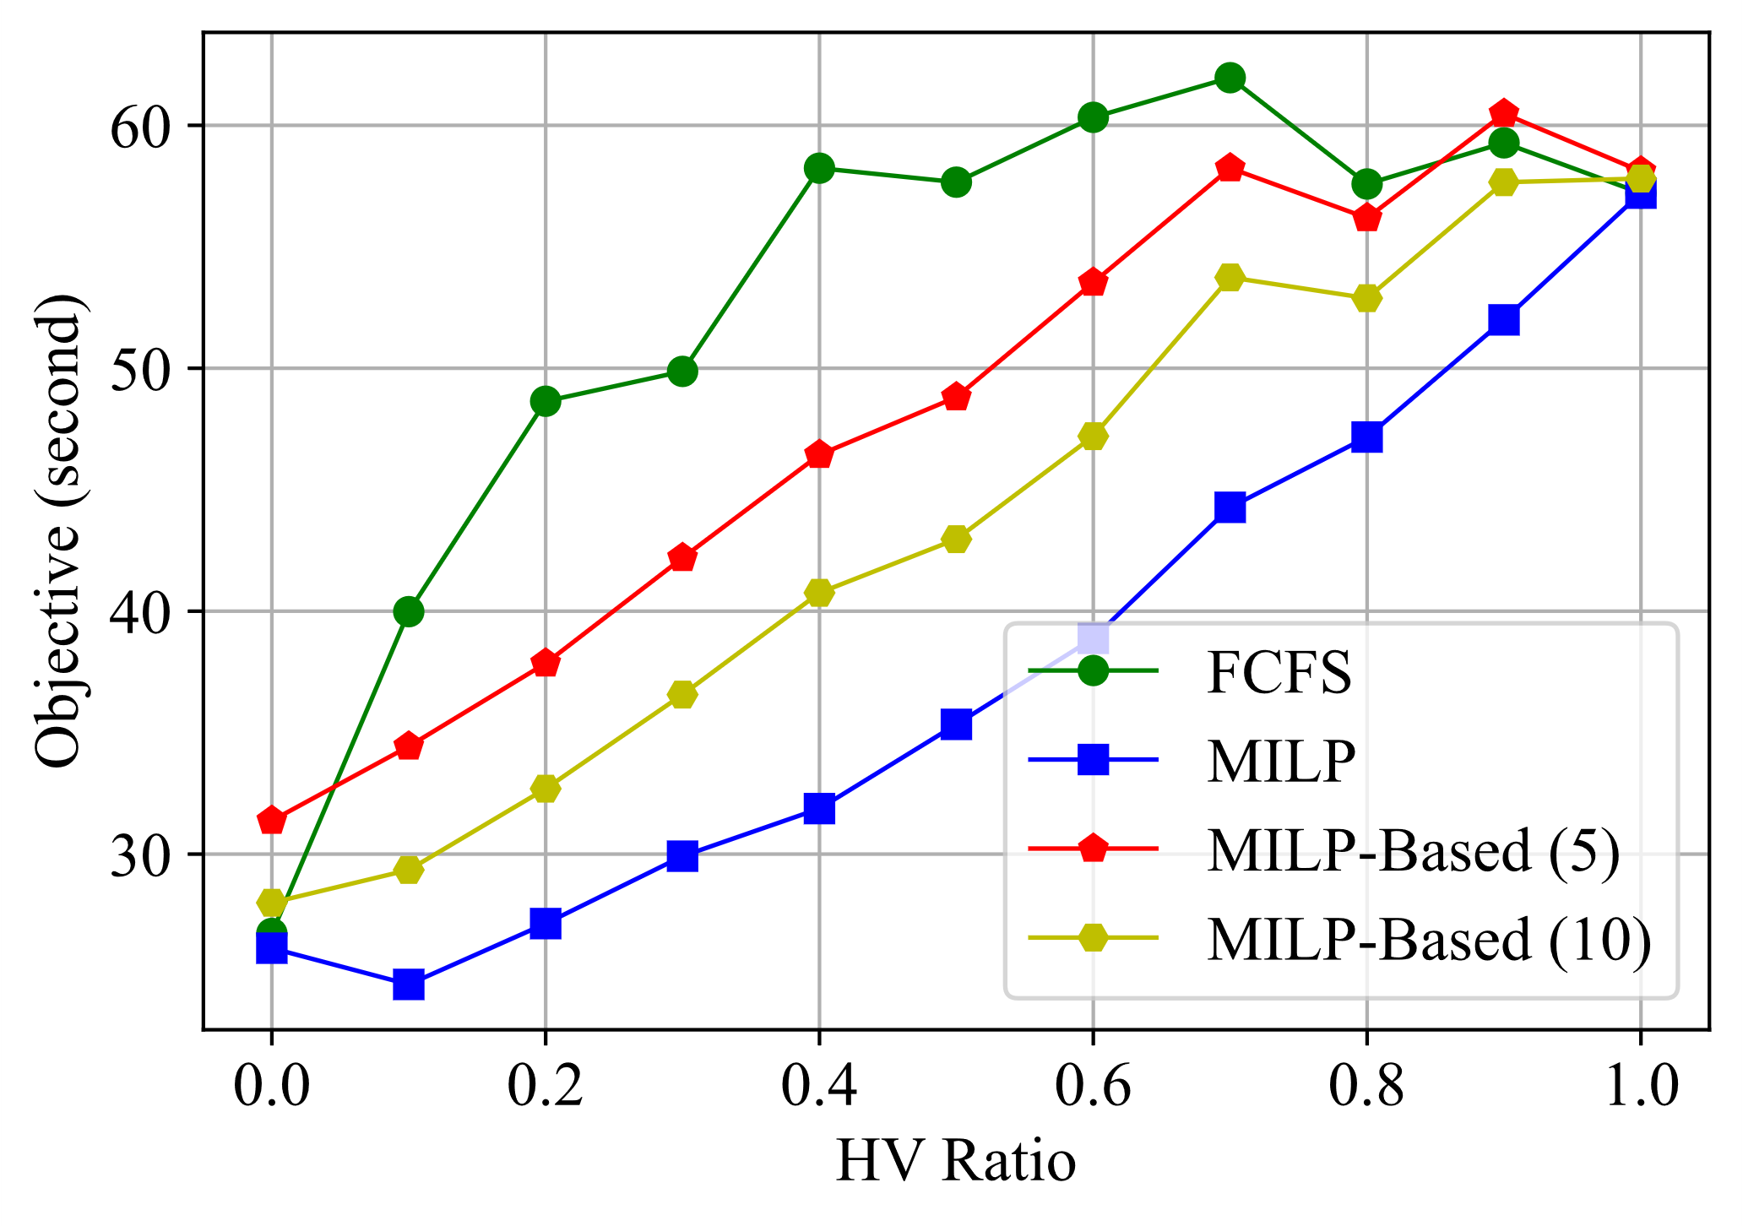
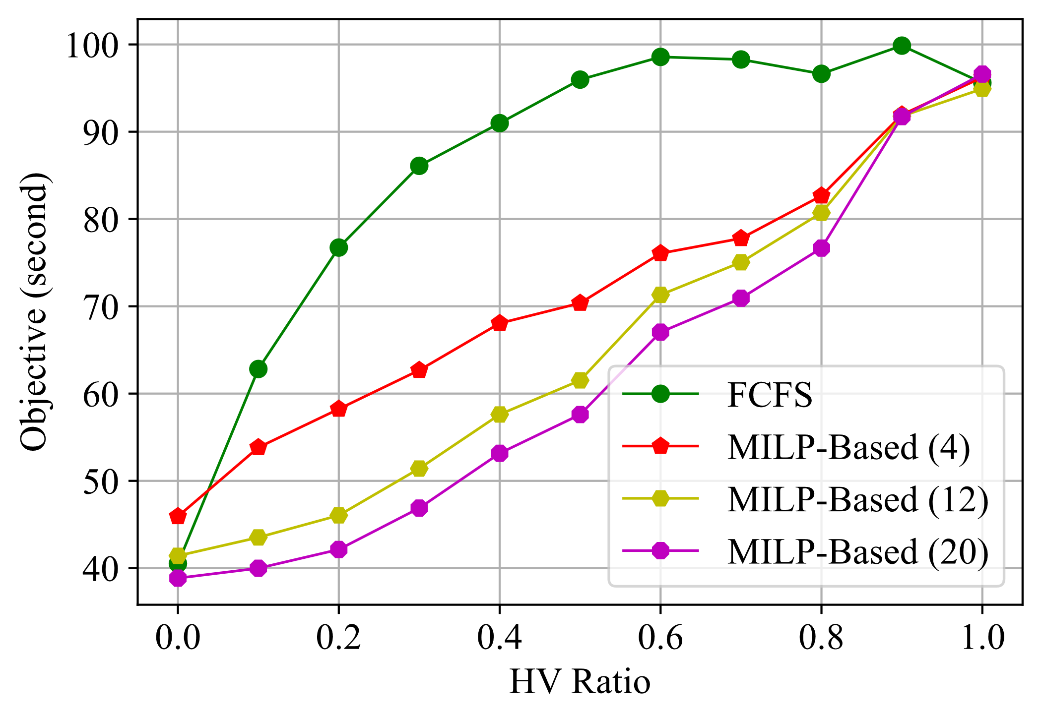
Experiment results
The figure above shows the result of our MILP-based approach applied on same test cases as previous experiments. When the subproblem size increases, the performance improves for the MILP-based approach, when the subproblem size is the number of vehicles, the MILP-based approach is equivalent to the MILP formulation which returns an optimal solution.
The figure below shows the result where the test cases are larger(10 vehicles on each lane), with different subcase sizes. The same relation between performance and subproblem size can be observed.
The average runtimes of the MILP-based approach with subproblem sizes 4, 12, and 20 are 0.01, 0.08, and 0.42 second, respectively. Therefore, we can observe a tradeoff between computation time and performance.

Slide 15
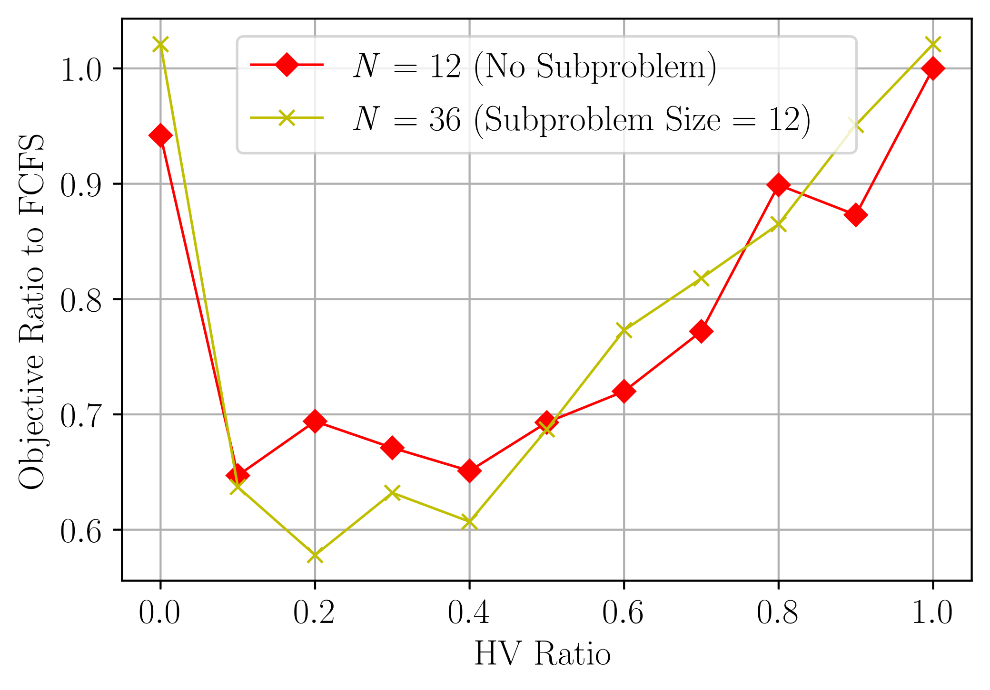
Experiment results
To compare the effectiveness of our MILP-based method and the original MILP (optimal) approach, we compare their objective ratio over FCFS.
The figure shows that our MILP-based approach achieves similar degree of improvement as when the MILP approach solves a problem with size the same as our subproblem size.

Slide 16
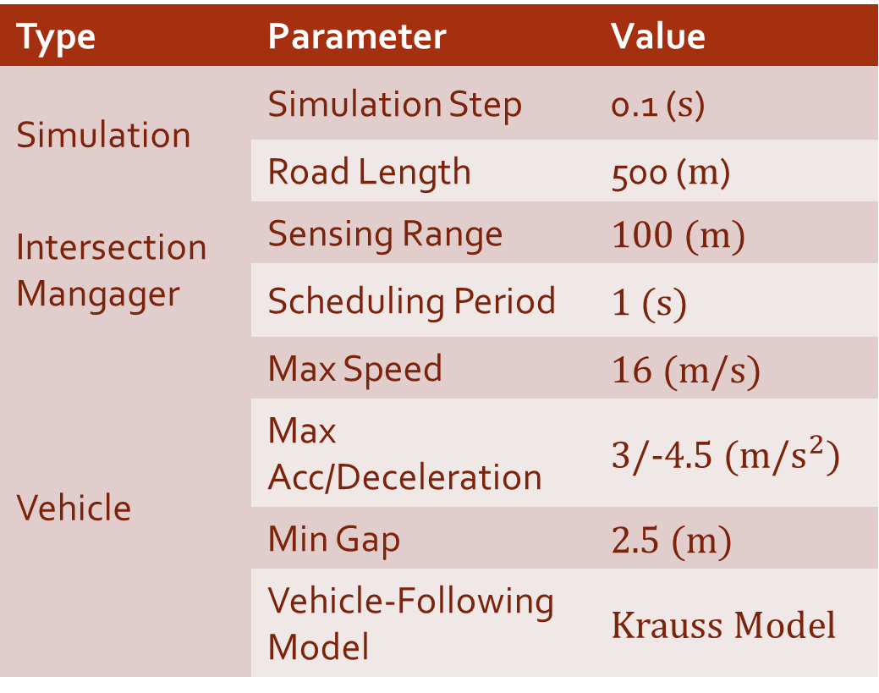
SUMO simulation
Type | Parameter | Value
Simulation | Simulation Step | 0.1 (s)
 | Road Length | 500 (m)
Intersection Mangager | Sensing Range | 100 (m)
 | Scheduling Period | 1 (s)
Vehicle | Max Speed | 16 (m/s)
 | Max Acc/Deceleration | 3/-4.5 (m/$s^{2}$)
 | Min Gap | 2.5 (m)
 | Vehicle-Following Model | Krauss Model
We applied our scheduling method on a unsignalized intersection in SUMO (Simulation of Urban MObility) as a proof of concept.
We apply our method using the traffic control interface (TraCI) of SUMO, also using it to adjust the intersection to fit our assumption that CAVs move slower with the presence of HVs.

Slide 17
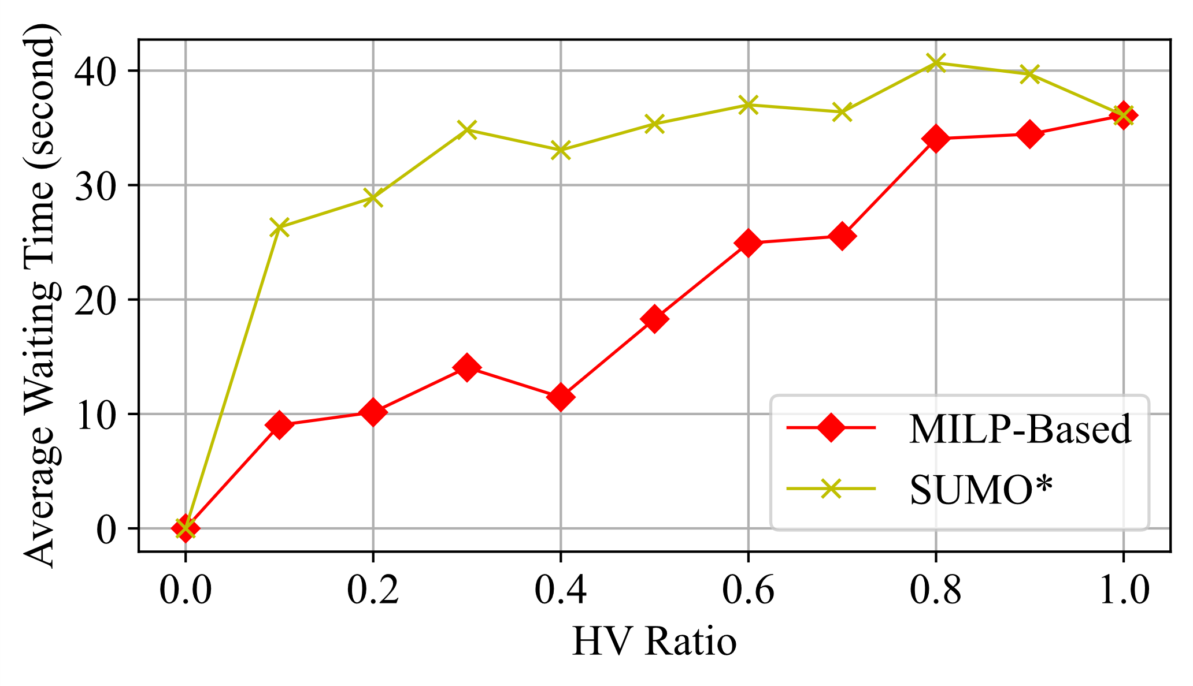
SUMO Results
As the traffic is continuous, we use the average waiting time to measure the effectiveness of our scheduling.
We see similar improving results compared to our method applied in our previous system models.

Slide 18
Contributions & Conclusion
We targeted the problem of mixed-traffic intersection management and scheduled CAVs to control the subsequent HVs.
We proposed an MILP-based approach which is more efficient and real- time-applicable than solving the optimal MILP formulation, while keeping good solution quality as well as outperforming the first- come-first-served (FCFS) approach.
Experimental results and SUMO Simulation indicated that controlling CAVs by our approaches is effective to regulate mixed-traffic even if the CAV penetration rate is low, which brings incentive to early adoption of CAVs.
Future directions include management with specific lanes for CAVs and HVs and management consider different dynamics of CAVs and HVs

