Slide 1
COMPARISON OF ENSEMBLE MODELS FOR CLASSIFICATION OF CARDIOVASCULAR DISEASE
CSC 529 Advanced Data Mining
Final Project
Thavaselvi Ramalingam and John Attisha

Slide 2
Motivation & problem statement
Cardiovascular disease remains the leading cause of death in the United States
Patients can benefit from advanced diagnosis
Advanced data mining and machine learning techniques can leverage current patient info to make better predictions
Comparison of ensemble models will help identify how various classifiers work on this dataset, as well as which performs best
Notes:
Bullet 1: according to Centers for Disease Control
Bullet 2: patients with attributable risk factors would benefit in knowing if they are susceptible to getting heart disease.
Bullet 3: Proper data mining and machine learning techniques can be used to leverage information we have about patients and supplement the domain expertise of medical professionals in order to better predict whether an individual may or may not have cardiovascular disease. (So this is the first problem we aim to solve: classification of cardiovascular disease).
Fourth bullet: The second problem we aim to solve is to identify how various ensemble classifiers work with respect to this particular dataset and determine which performs the best based on various metrics.

Slide 3
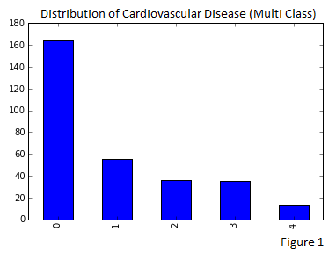
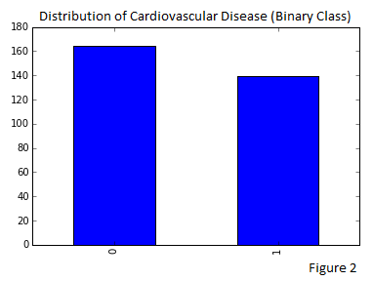
Methodology: data
13 Features:
6 Numeric, 3 Binary Categorical, 4 Multi-Class Categorical
303 patients (observations)
2 sets of class labels
Notes:
Dataset comes from Cleveland Clinic Heart Disease Database, which was donated to the UCI Machine Learning Repository.
First bullet: These attributes contain information such as a patient’s resting blood pressure, electrocardiographic results, and the number of major vessels colored by fluoroscopy
Second bullet: 303 observations
Third bullet:
According to the data documentation, experiments with the Cleveland database have concentrated on simply attempting to distinguish presence (values 1,2,3,4) from absence (value 0), meaning binary classification. For this particular project, we did both. As you will see, going from an imbalanced dataset to a balanced one dramatically affected performance of our models.
Multi-Class Distribution:
0: 164
1: 55
2: 36
3: 35
4: 13
Binary Class Distribution:
0: 164
1: 139
No information given on labels 2, 3, and 4. All we were given were: 0 indicates <50% diameter narrowing, and 1 indicates >50% diameter narrowing.

Slide 4
Methodology: approach
Three Ensemble Models:
Random Forest, AdaBoost, Extremely Randomized Trees
Decision trees as base classifiers
Fourth Model to Serve as Baseline Comparison:
Decision Tree
Grid Search to Identify Best Parameter Values Based on Accuracy
Notes:
How did we attempt to solve the two problems for this project? (Classification of heart disease and comparison of ensemble classifiers with respect to this particular dataset.) Grid search was implemented to test every possible combination of input parameter values, and 10-fold cross-validation was also performed on each combination. Grid Search Values tested included a variety of parameters and a range of values for each parameter. The combination of parameter values which provided the highest cross-validation accuracy were those values that were selected to construct our models.
Extremely Randomized Trees takes Random Forests and goes one step further with regard to how randomness is leveraged to determine the best split at a node. For Random Forests, a random subset of features are drawn and then the most discriminative threshold found among those random variables is chosen to split on. For Extremely Randomized Trees, not only are a random subset of features chosen when considering how to split a node, but also the thresholds are drawn at random for each candidate feature, and the best (i.e. the most discriminative) of these random thresholds is chosen as the threshold on which to split a node.

Slide 5
Model parameterS
Parameters from Grid search
Decision Tree | -Criterion: [Entropy, Gini] -Max Depth: The range of numbers from [1, 20], by 1. -Min Samples Leaf: The range of numbers from [2, 20], by 2. -Min Samples Split: The range of numbers from [2, 20], by 2.
Adaboost | -N Estimators: The range of numbers from [5, 75], by 5. -Learning Rate: 30 evenly spaced numeric values in the range [0.0001, 1]
Random Forest | -Criterion: [Entropy, Gini] -N Estimators: The range of numbers from [5, 50], by 5. -Max Depth: The range of numbers from [1, 20], by 1. -Min Samples Split: The range of numbers from [2, 20], by 2.
Extra Trees Classifier | -Criterion: [Entropy, Gini] -N Estimators: The range of numbers from [5, 50], by 5. -Max Depth: The range of numbers from [1, 20], by 2. -Min Samples Split: The range of numbers from [2, 20], by 2.

Slide 6
Results: Multi-class Problem

Slide 7
Results: binary-class Problem
 | Multi-class |  | Binary class
 | t-statistic | p-value | t-statistic | p-value
Decision Tree & Random Forest | -1.3 | 0.19 | -1.29 | 0.21
Decision Tree & Adaboost | -1.8 | 0.08 | -0.8 | 0.41
Decision Tree & Extra Trees | -0.8 | 0.42 | 1.74 | 0.09
Random Forest & Adaboost | -0.54 | 0.59 | 0.68 | 0.5
Random Forest & Extra Trees | 0.97 | 0.33 | 3.24 | 0.004
Adaboost & Extra Trees | 1.46 | 0.16 | 2.6 | 0.017
Notes:
Learning_rate argument tells the algorithm how much the misclassified matches are going to be up-weighted in the next round of decision three fitting. The rule of thumb is that the lower the learning rate is, the more estimators you need.
Important features: Cp_asymptomatic <=0.5
Slope_flat <= 0.5, ca <= 0.16, Age, gender, thal_reversible_defect, old_peak

Slide 8
Limitations and future work
Do we need ensemble classifiers for this dataset?
Multi-class problem: Certain classes under-represented
Apply sampling techniques for handling class imbalance such as SMOTE, ROSE, up-sampling, etc.
Non-linear separability in the data
Build non-linear models like SVM
Apply kernel transformations
before building models

