Slide 1
Pipeline presenting
By Praveen Attaluri

Slide 2
CIS Automotive
Pull real time market statistics, and raw listing data from database of over 575M vehicles and 40k dealers from all over the US.
Endpoints provide supply, pricing, vehicle, and sales data on the US automotive market on a brand and region basis.
They are generated daily from this database of 40k dealerships and over 430M vehicles.

Slide 3
Spotlights
Recovering stolen vehicles
Decode a vin and get recall information.
Search the dealer inventories for the best priced cars.
Build interactive dashboards with no backends.

Slide 4
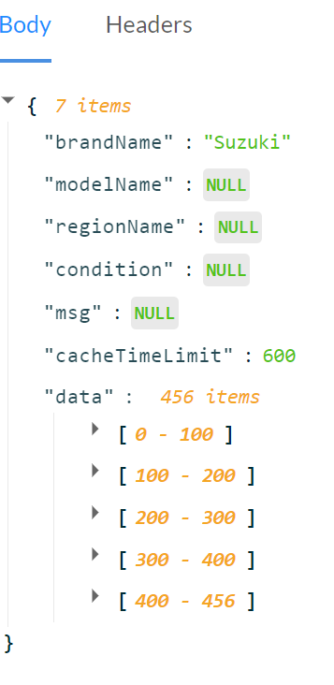
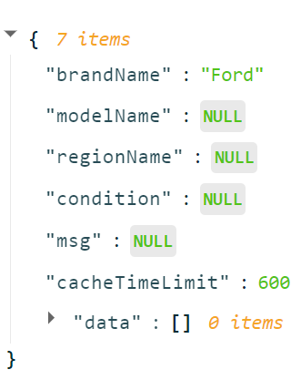
Data Ingestion
Using kafka to ingest the data into HDFS.
Finding out the inactive models across the brands around US.

Slide 5
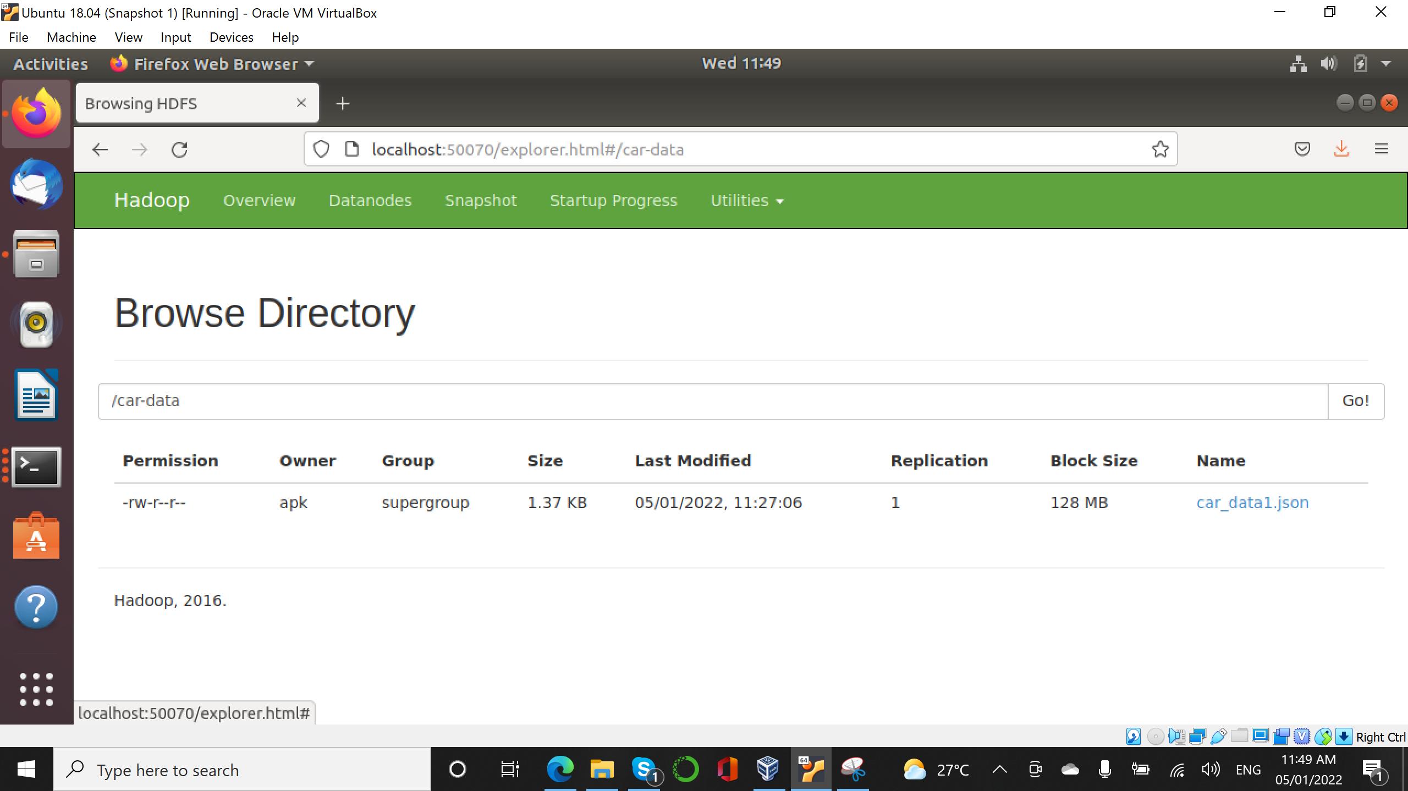
HDFS

