Slide 1

Multi-Gene Mammalian Species Classification Using Machine Learning
Suman Attri 1055553
DS-630

Slide 2
SCOPE
Problem: Traditional species classification is manual and slow.
Challenge: Hard to scale with massive genetic data.
Goal: Automate classification using DNA and ML.

Slide 3

Biological Background
DNA is the instruction code of life. Think of it like a biological text document.
Started with sequences from 6 genes across 105 mammal species.
In DNA some genes store evolutionary data.
These sequences contain patterns that ML can learn.

Slide 4
Gene Set and Mammalian Groups:
Genes: COI, CYTB, RAG1, BRCA1, APOB, and 16S rRNA.
Mammalian Groups: 105 species
Primates: 25 species
Rodents: 25 species
Carnivores: 25 species
Ungulates (Bats): 20 species

Slide 5
Project Pipeline Overview
1. Download & clean DNA sequences
2. Align and prepare sequences
3. Metadata Integration (e.g., geographic regions, conservation status).
4. Feature extraction: k-mers, one-hot, BioVec
5. Train ML models
6. Phylogenetic tree supervision for evaluation

Slide 6
Data Acquisition
Retrieved an existing phylogenetic tree from the Open Tree of Life via the public API.
Downloaded species metadata from the Mammal Diversity Database.
Acquired DNA sequences for six genes from NCBI using the Entrez API.

Slide 7
Initial Filtering
Excluded 16S rRNA due to significant missing data across mammalian species.
Filtered the dataset to retain only mammalian species with complete sequences for the five remaining target genes—resulting in 64 species.

Slide 8
Gene-wise Sequence Filtering and Cleaning
Each gene dataset was saved as a separate FASTA file.
Sequences were filtered to remove low-quality entries and ambiguous bases (e.g., 'N').
Gene | Total Sequences | Filtered | Deleted- Length | Deleted- Ambiguity
COI | 92 | 87 | 1 | 4
CytB | 91 | 81 | 0 | 10
RAG1 | 84 | 60 | 9 | 15
BRCA1 | 73 | 55 | 9 | 9
APOB | 74 | 46 | 18 | 10

Slide 9
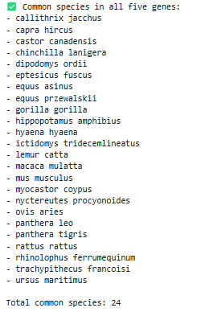
Identifying Common Species Across Genes
Species names were extracted from sequence headers and standardized for consistency.
A cross-gene comparison identified 24 species present in all five filtered gene datasets.

Slide 10
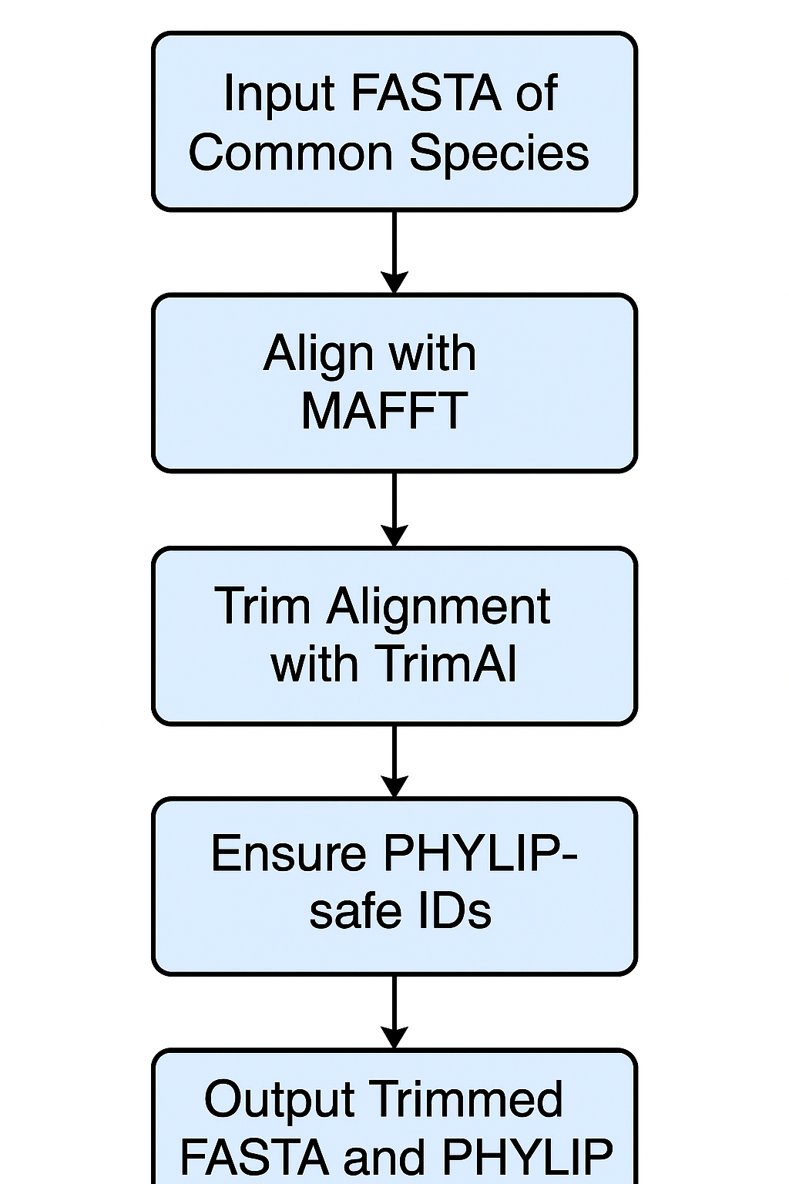
Phylogenetic Preprocessing
MAFFT was used to align sequences from common species for each gene.
TrimAl removed poorly aligned or gappy regions to enhance alignment quality.
Unique PHYLIP-safe IDs were generated to ensure compatibility with phylogenetic tools.
Final outputs included trimmed FASTA and PHYLIP files, ready for tree reconstruction.

Slide 11
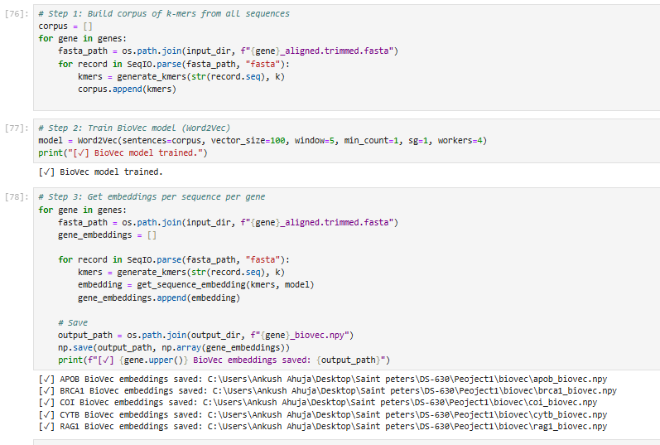
Feature Engineering
K-mer Frequencies(k=3): Captures small DNA patterns (like word counts).
One-Hot Encoding: Converted aligned sequences into a 5-channel matrix: A, T, G, C, gap to preserve position and structure in sequences.
BioVec Embeddings: Used pre-trained Genism model- Word2Vec, to create 100-dimensional semantic vectors from DNA sequences.

Slide 12
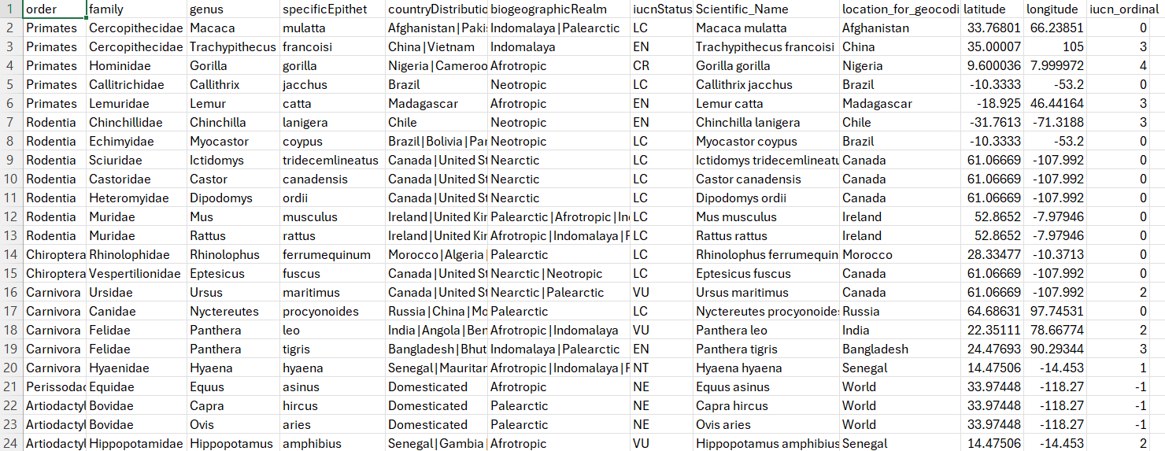
Metadata Integration
Geocoded species distribution.
Encoded IUCN conservation status as ordinal.

Slide 13
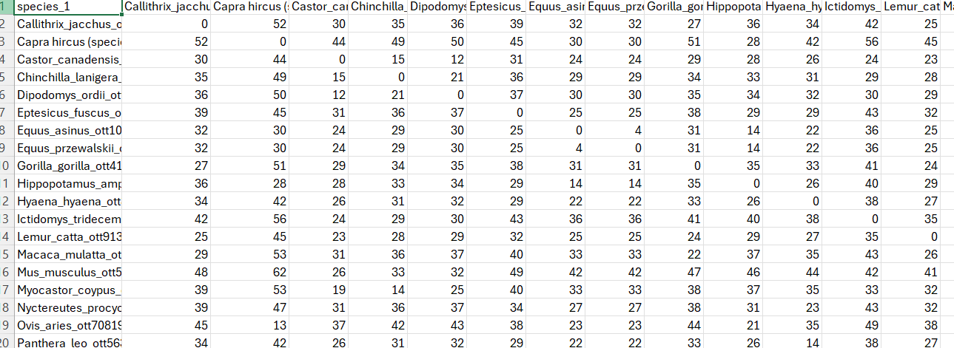
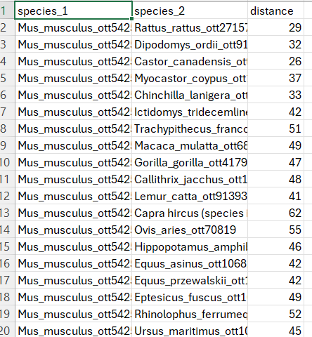
Phylogenetic Supervision:
Generated Distance dataframe from Pylogenetic tress.
Created a square matrix representing pairwise evolutionary distances between species.

Slide 14
Machine Learning Models
Hierarchical Clustering: Applied clustering on species using BioVec embeddings to capture evolutionary relationships.
Multi-Input CNN: Developed a convolutional neural network (CNN) model utilizing gene embeddings (one-hot encoded) along with metadata features.
Goal: The primary objective is to create a phylogenetic tree based on gene embeddings to better understand species relationships.

Slide 15
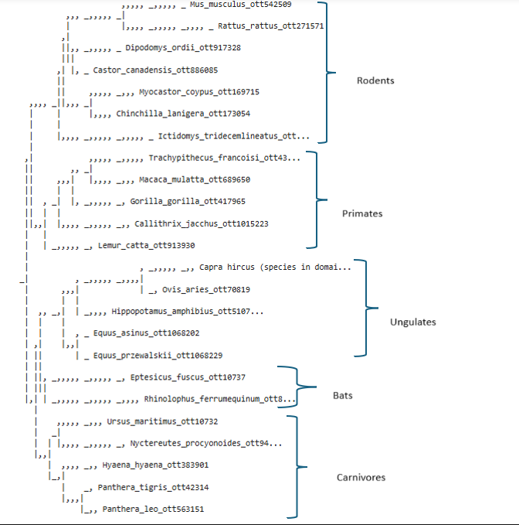
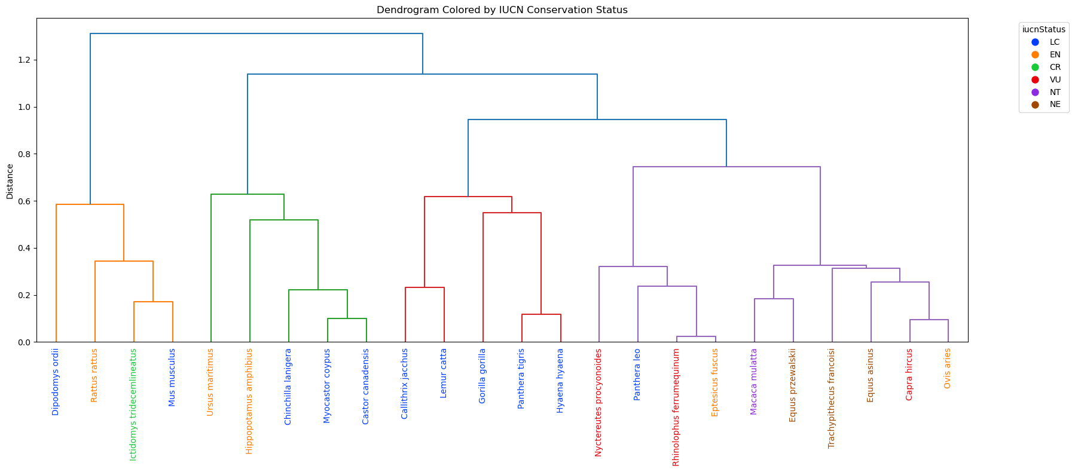
Generated Phylogenetic Trees

Slide 16
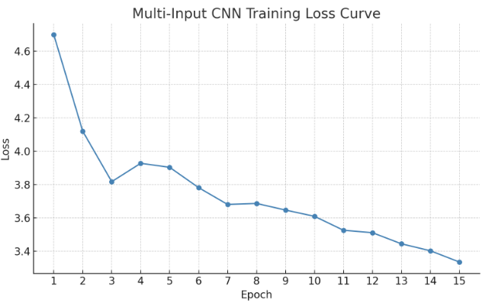
Evaluation Metrics
CNN Model Evaluation:
Accuracy: 0.5
Precision: 0.39
Recall: 0.5
F1 Score: 0.44
Training Curve: Visualized for CNN model performance.
Dendrograms: Visualized using Phylo.draw_ascii for CNN results.
Hierarchical Clustering Evaluation:
Distance Metric: Cosine distance used for clustering.
Cluster Validity: Measured using Silhouette Score (0.4511).
Contingency Tables: Used to assess cluster coherence.
Dendogram was visualized.

Slide 17
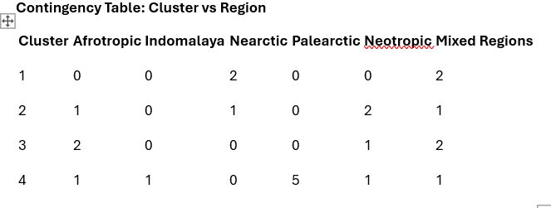
Clustering by Biogeographic Region:
Cluster Distribution across Regions:
Cluster 1: Primarily concentrated in the Nearctic|South and Central America.
Cluster 2: Predominantly found in the Afrotropic, Neotropic and Nearctic|Northern Hemisphere.
Cluster 3: Strong representation in regions like Afrotropic, Neotropic| Norther Asia.
Cluster 4: Enriched with species from the Palearctic, Neotropic,Indomalaya and Afrotropic|Southern Asia.
Key Insight: Species are clustering not only by evolutionary features but also according to their geographic proximity.

Slide 18
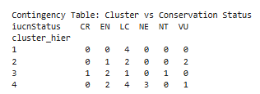
Clustering by Conservation Status:
Cluster Distribution across Conservation Status (IUCN):
Cluster 1: Species mostly have Least Concern (LC) status.
Cluster 2: A mix of species, with a notable presence of Endangered (EN) and Vulnerable (VU) species.
Cluster 3: Primarily Endangered (EN) and Critically Endangered (CR) species.
Cluster 4: Contains a large proportion of Endangered and Vulnerable (VU) species.
Key Insight: Clusters show a correlation between species evolutionary distance and their conservation risk.

Slide 19
Key Results
BioVec performed well in clustering, but one-hot performed better in classification
Best clustering: BioVec + cosine distance
Best classification: One-hot encoding + multi-input CNN

Slide 20

Surprising Outcomes
One-hot encoding outperformed BioVec in classification due to alignment preserving positional pattern

Slide 21
Future Work
Apply to environmental DNA samples to detect species presence.
Predict branch lengths directly using deep regression
Develop web tools for researchers
Expand dataset size and diversity

Slide 22
Conclusion
ML can assist biological taxonomy
Multi-gene input improves accuracy
BioVec-style embeddings show strong promise

