Slide 1
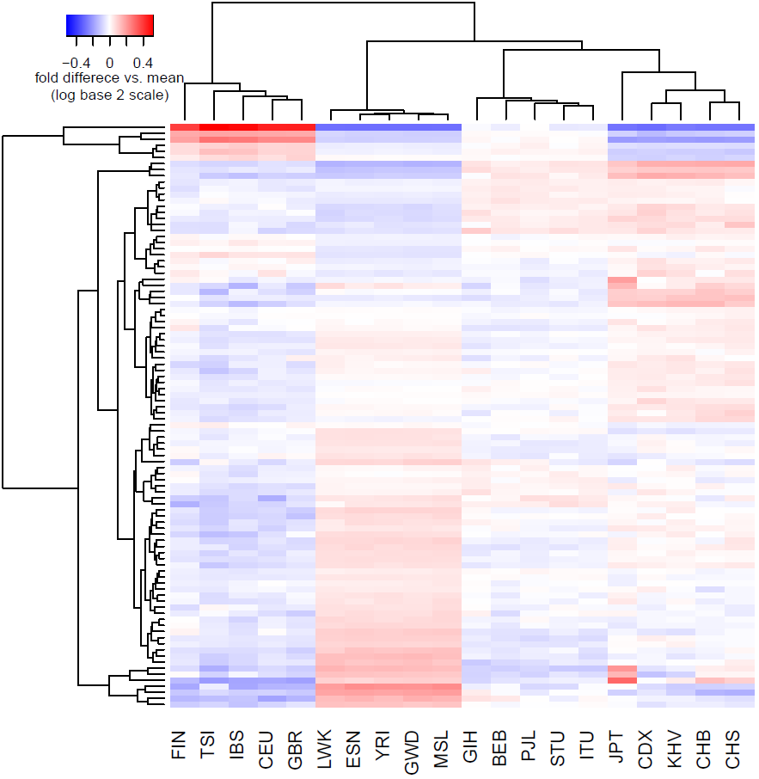
Europe C→T elevation (1)
Asia elevated (2)
CpG transitions (3)
Japan enriched (4a)
Cluster Membership
Europe C→T elevation (1) | TCT→T ACC→T TCA→T CCC→T ACT→T TCC→T
Asia elevated (2) | GAT→T ACC→A GAC→T
CpG transitions (3) | *CG→T (4 types)
Japan enriched (4ab) | CAC→C (a) TAT→T (a) GAC→C (b) AAC→C (b) TAC→C (b)
CpG transversions (5) | GCG→G ACG→G CCG→A ACG→A
Japan enriched (4b)
CpG transversions (5)

