Slide 1
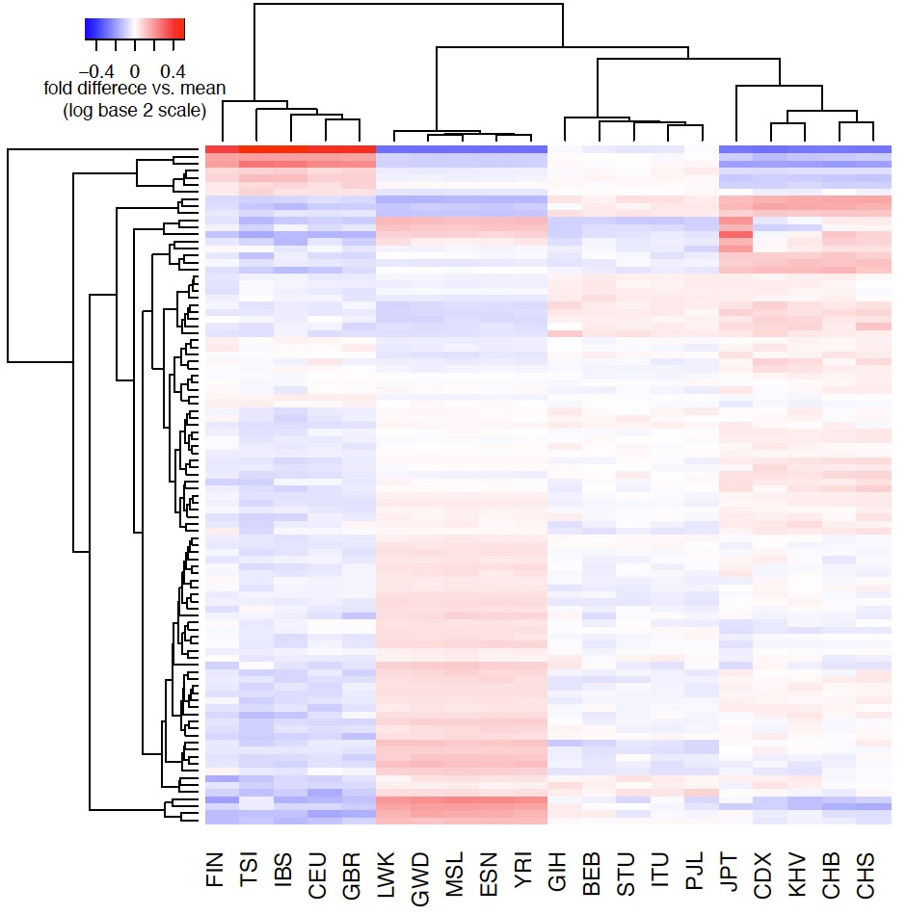
Europe C→T enriched (#1)
Asia enriched (#2a)
Cluster Membership
Europe C→T enriched (#1) | TCT→T ACC→T TCA→T CCC→T ACT→T TCC→T GCC→T
Asia enriched (#2) | GAT→T (a) ACC→A (a) GAC→T (a)
 | GAA→T (b) GCC→A (b) TCC→A (b) CCC→A (b) CCC→G (b)
Japan enriched (#3a, #3b) | CAC→C (a) TAT→T (a)
 | GAC→C (b) AAC→C (b) TAC→C (b)
CpG transitions (#4) | *CG→T (4 types)
CpG transversions (#5) | GCG→G ACG→G CCG→A ACG→A
Japan enriched (#3a, #3b)
CpG transitions (#4)
Asia enriched (#2b)
CpG transversions (#5)

Slide 2
