Slide 1
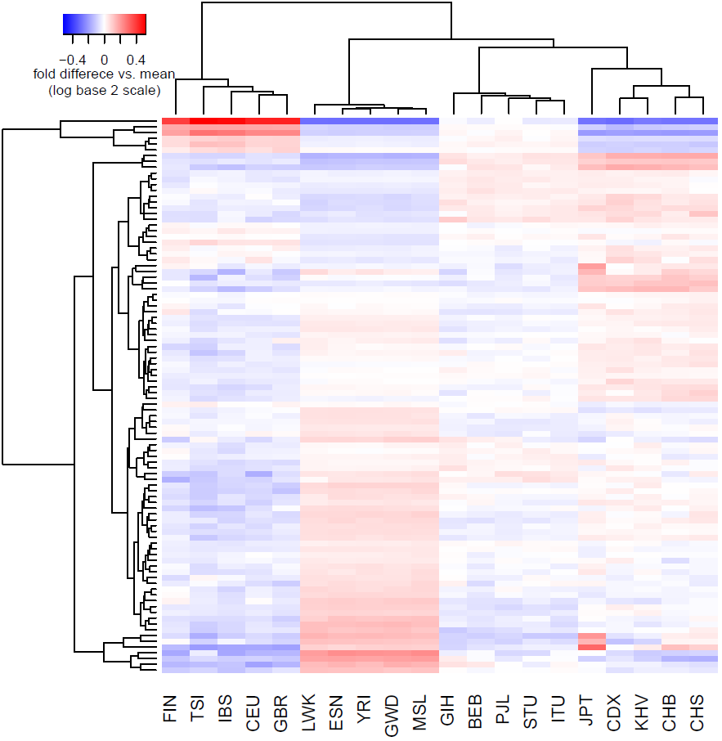
Europe C→T enriched (1)
Asia enriched (2)
CpG transitions (3)
Japan enriched (4a)
Cluster Membership
Europe C→T enriched (1) | TCT→T ACC→T TCA→T CCC→T ACT→T TCC→T
Asia enriched (2) | GAT→T ACC→A GAC→T
CpG transitions (3) | *CG→T (4 types)
Japan enriched (4a, 4b) | CAC→C (a) TAT→T (a)
 | GAC→C (b) AAC→C (b) TAC→C (b)
CpG transversions (5) | GCG→G ACG→G CCG→A ACG→A
Japan enriched (4b)
CpG transversions (5)

