Slide 1
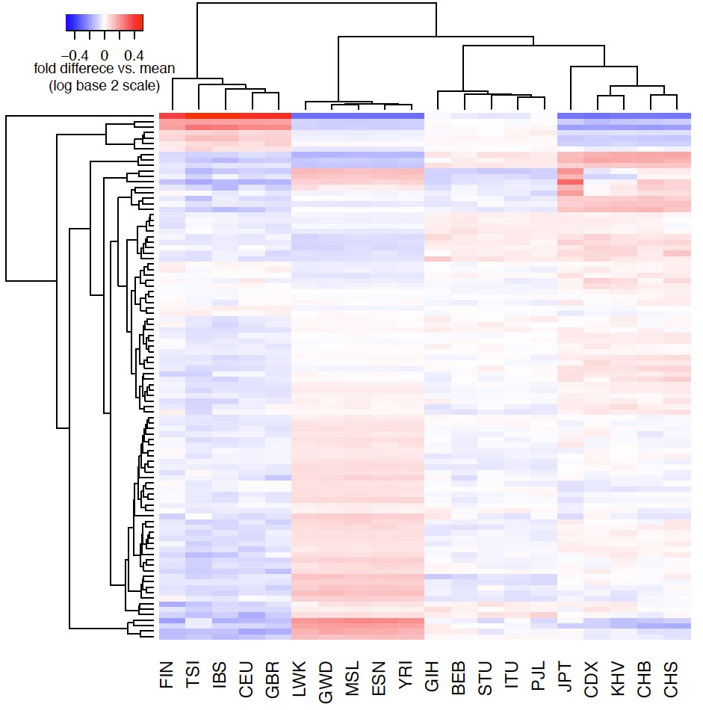
Europe C→T enriched (#1)
Asia enriched (#2)
Japan enriched (#3a, #3b)
CpG transitions (#4)
Cluster Membership
Europe C→T enriched (#1) | TCT→T ACC→T TCA→T CCC→T ACT→T TCC→T GCC→T
Asia enriched (#2) | GAT→T ACC→A GAC→T
Japan enriched (#3a, #3b) | CAC→C (a) TAT→T (a)
 | GAC→C (b) AAC→C (b) TAC→C (b)
CpG transitions (#4) | *CG→T (4 types)
CpG transversions (#5) | GCG→G ACG→G CCG→A ACG→A
CpG transversions (#5)

Slide 2
