Slide 1

Yellow Taxi
Maximize Income

Slide 2
Indent
Objective
Dataset
EDA
Model and Results
Conclusion

Slide 3
Objective
Maximize your income as a taxi driver
How would you enrich dataset?
What you don’t find useful

Slide 4
Dataset
Yellow Taxi data – June 2017
10,48,575 rides
266 locations

Slide 5
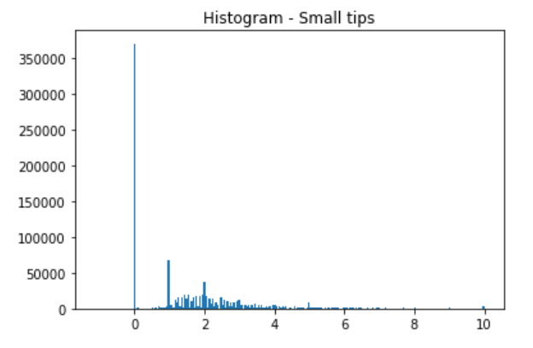
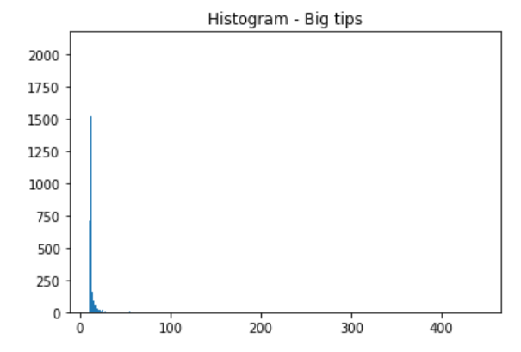
EDA results – Tip Distribution
tip <= $10
tip > $10

Slide 6
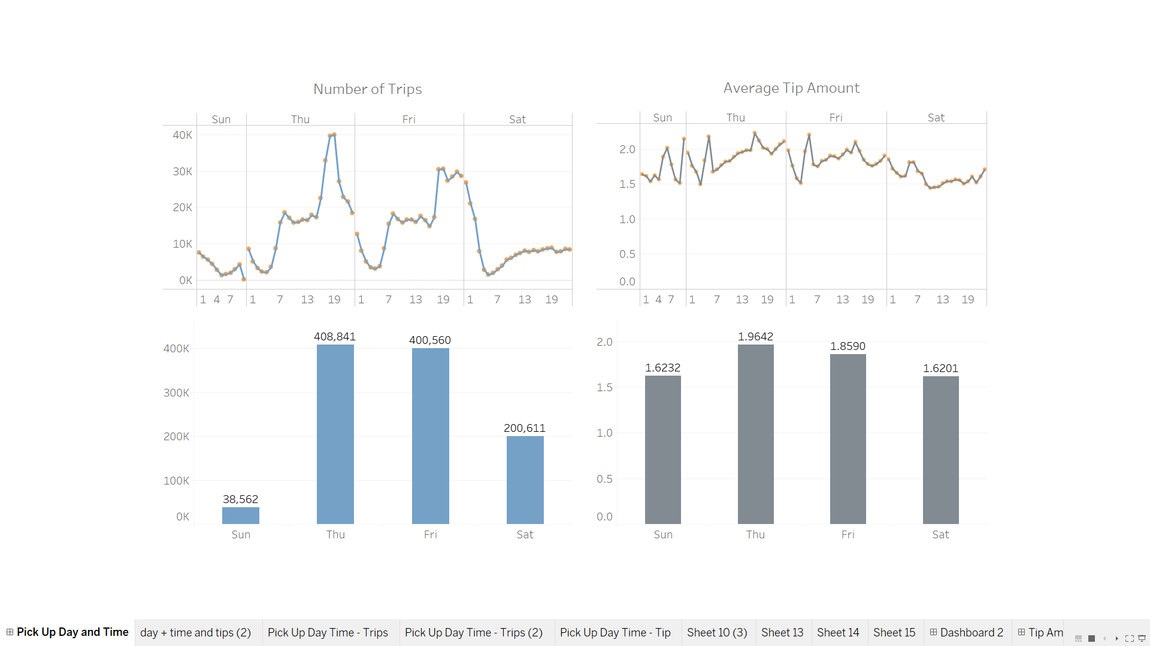
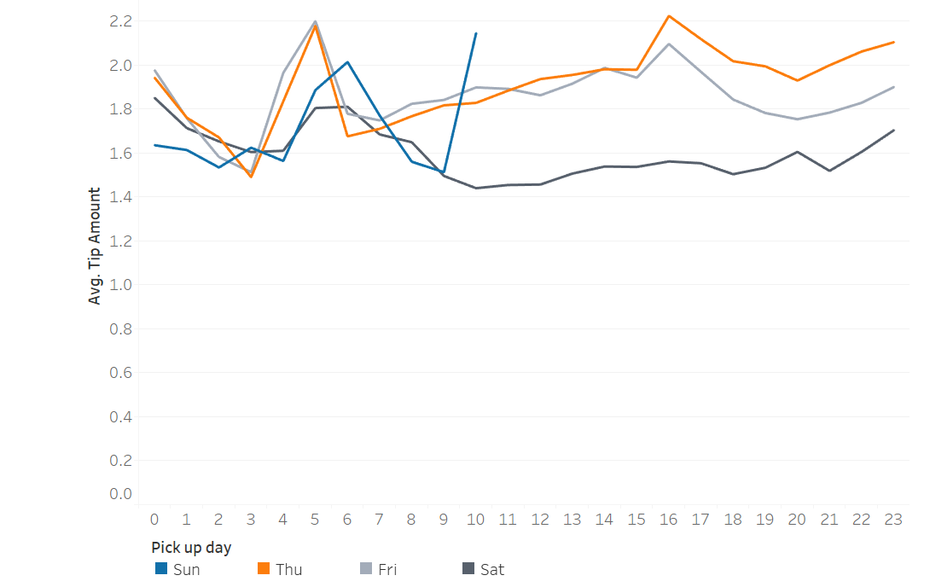
EDA - Average Tip Amount Distribution

Slide 7
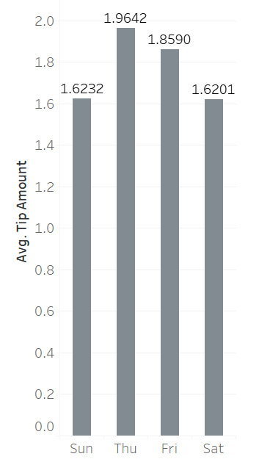
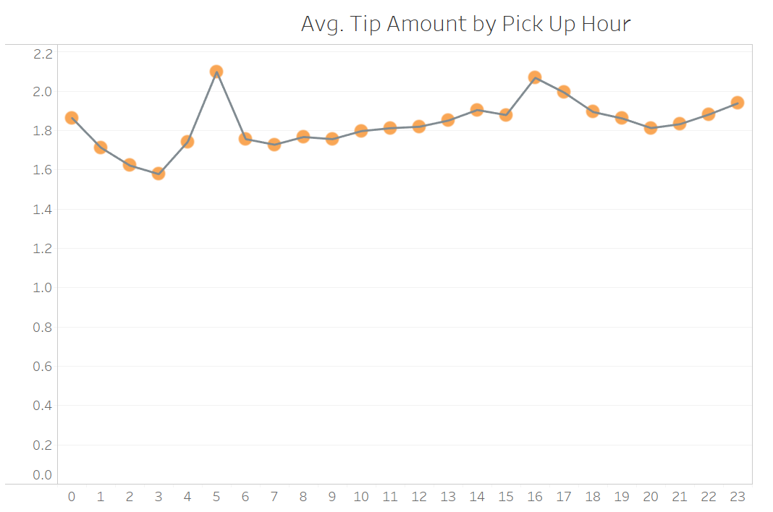
Average Tip Amount
By Day of Week
By Pick Up hour

Slide 8
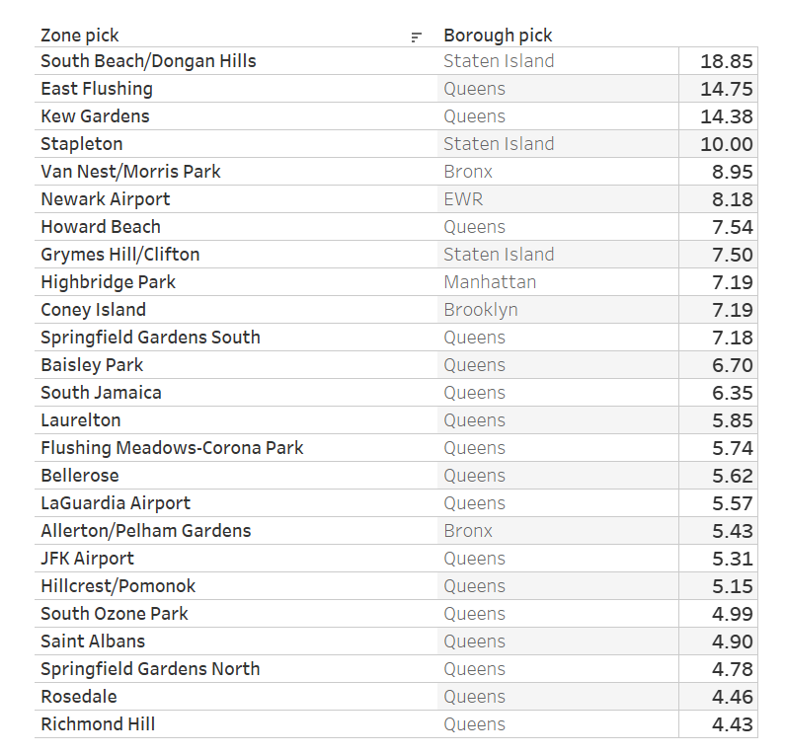
Average tip amount by Pick Up Location
Top 25 pick up zones

Slide 9
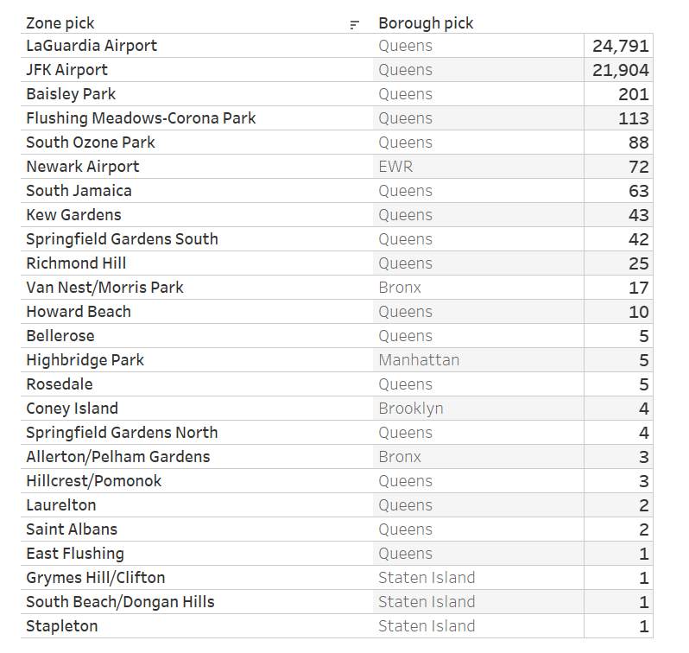
EDA results – Number of Trips
By Zones
By Day and Time

Slide 10
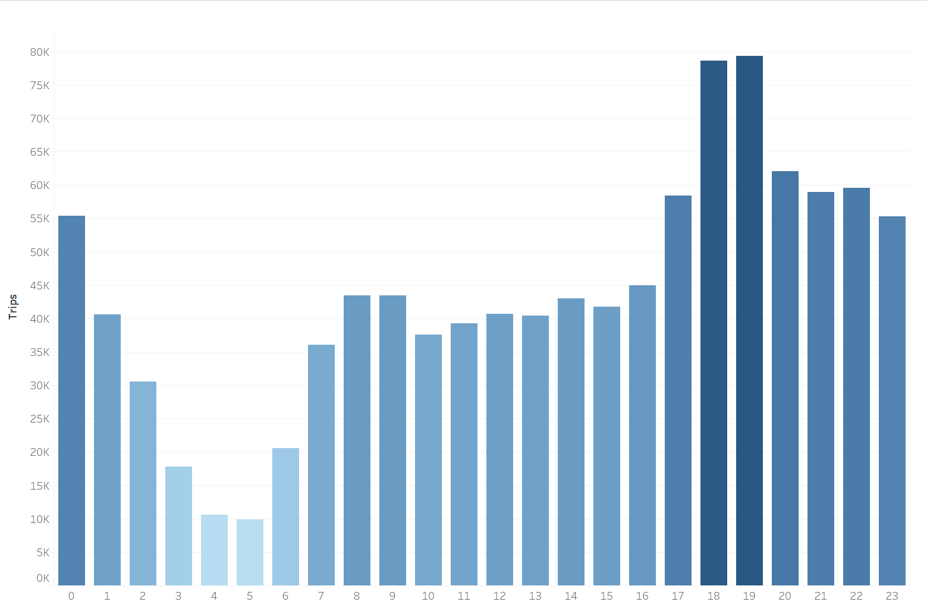
Number of Trips by Pick up hour
Peak hours in our dataset : 18, 19

Slide 11
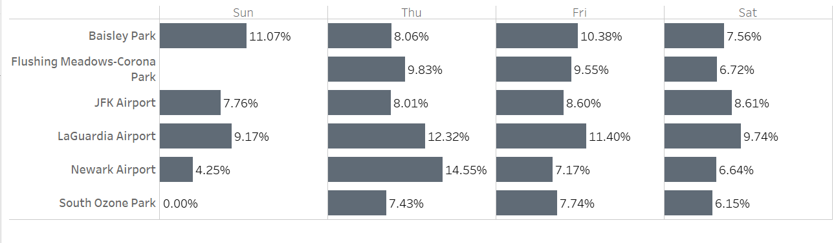
Further analysis of our top 6 pick up locations
More than 10% tips at
Baisley Park on Friday and Sunday
La Guardia Airport on Thursday and Friday
Newark Airport on Thursday

Slide 12
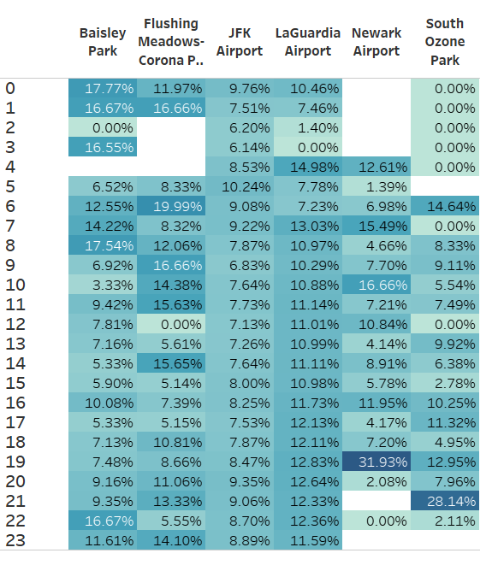
Further analysis of our top 6 pick up locations
Late evenings fair better tips than afternoon.

Slide 13
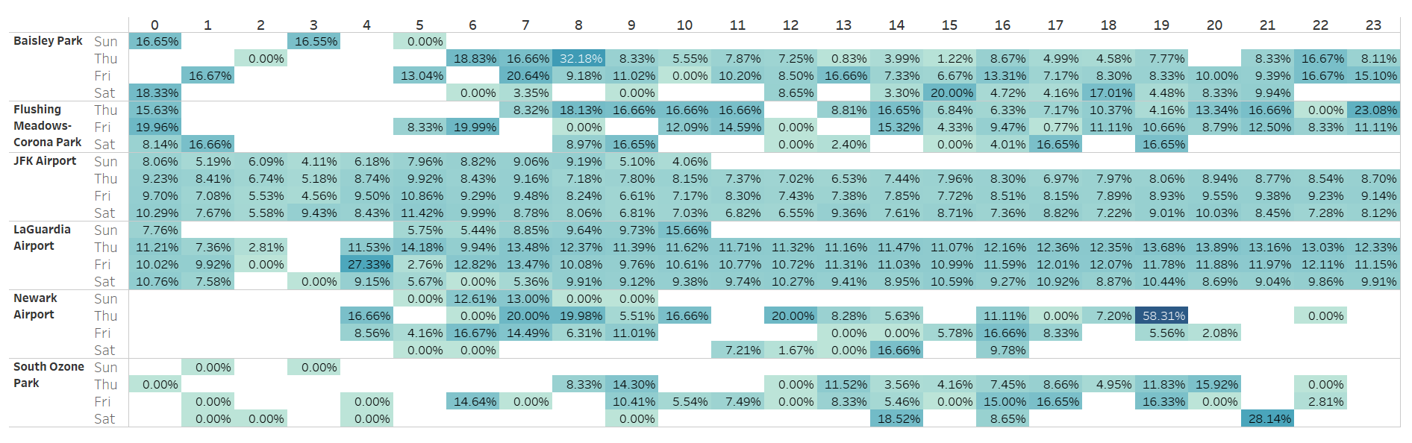
Further analysis of our top 6 pick up locations
I would select location and time where tip percentage is greater than 15%

Slide 14
Maximize your income as a taxi driver
As mentioned in the problem statement , I want to work 10 hours each week, therefore I would want these 10 hours to be most productive.
I would be looking up areas and days and hour of the day where I can get rides with minimum waiting time and maximum income
Approach 1
I can first select locations where waiting time is minimum or select locations with maximum pickups
After selecting locations I can look for optimum day of the week and time of the day to work based on tip amount or tip amount percentage (of total amount)
Approach 2
For best utilization of time, I can check total amount earned by trip duration. For example money earned per minute of trip. And analyze data so as to maximize this metric

Slide 15
Maximize your income as a taxi driver
Pick areas with frequent pick ups
Airports and Parks seemed to be popular pick up location in our dataset
Airports
LaGuardia Airport
JFK Airport
Newark Airport
Parks
Baisley
Flushing Meadows-Corona
South Ozone

Slide 16
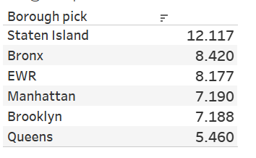
Maximize your income as a taxi driver
Choose location where customers pay maximum tip
Customers are likely to tip more in Staten Island
Though Queens is better if you check Zone wise

Slide 17
Maximize your income as a taxi driver
Choose time and day when customers pay maximum tip consider all locations
Drivers earn highest tips when customer is picked up around 5 am
Drivers earn highest tips when customer is picked up on Thursday
Combining day and Time analysis –
4 pm on Thursday & 5 am on Thursday and Friday customers pay highest

Slide 18
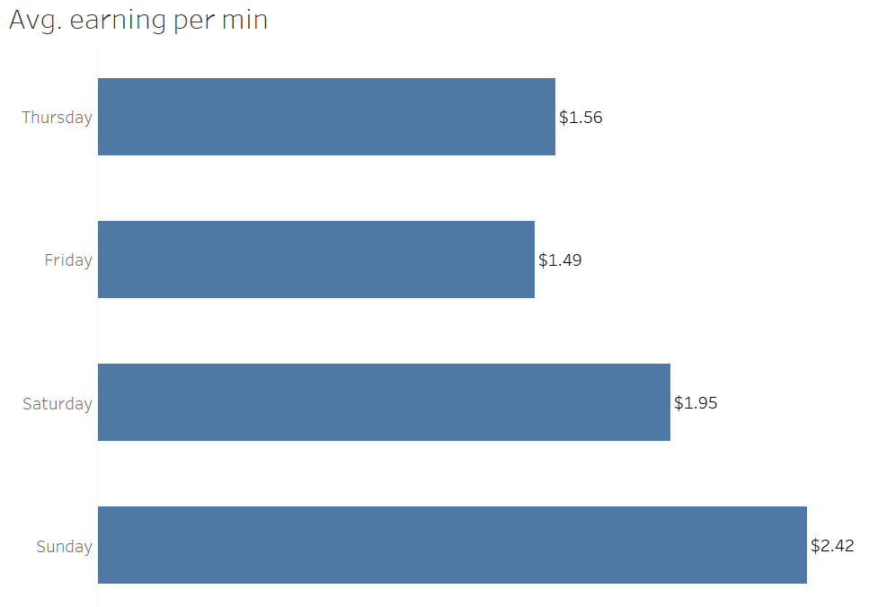
Maximize your income as a taxi driver
Pick day by average earnings per min (selected pickups only)
Average Earning per min =
Total Amount / Trip Duration in mins
Weekends have better average than Weekday (our dataset only has data for Thurs , Fri, Sat and Sun. Therefore, this analysis may be biased)
This analysis is only for our top 6 pickup locations

Slide 19
Maximize your income as a taxi driver
Using Data Science - Getting feature importance
After initial data analysis, I ran random forest model with tip percentage as our target variable
This is to understand the impact of features on the target variable
Due to computing limitation I have run the code for 100,000 records. Therefore, results might differ on entire dataset
As per these results, passenger_count (95%) and trip_distance (5%) are most important to get higher tip percentage
One can say that when more people travel in group they tend to tip more than individual customers

Slide 20
Enrich dataset
Features added in dataset:
Pick up hour
Pick up day
Trip duration
Avg. earning
Tip percentage
How would I enrich the dataset
Adding longitude and latitude information of pick ups would help in better geo analysis
The data is missing information on cash tips. I would add that for better selection of hours and days the driver should work
The current dataset only contains information for days – Thurs, Fri, Sat, Sun. I would add full weeks data for better analysis of weekend vs weekdays
Once we have geo locations we can also do analysis for optimizing the route taken to save time

Slide 21
What you don’t find useful
Payment Method
The dataset has maximum Credit Card Payment rides.
This field doesn’t give us any important information for maximizing income
Store_and_fwd_flag
Service zone in the taxi zone lookup table

Slide 22
Conclusion
Recommended time and Location
Newark Airport –
Thursday late evenings – 8 pm to 1 am
Friday early mornings - 4 am to 7 am
Baisley Park –
Saturday 3 pm – 4pm
South Ozone Park –
Saturday 9 pm – 10 pm

