Slide 1
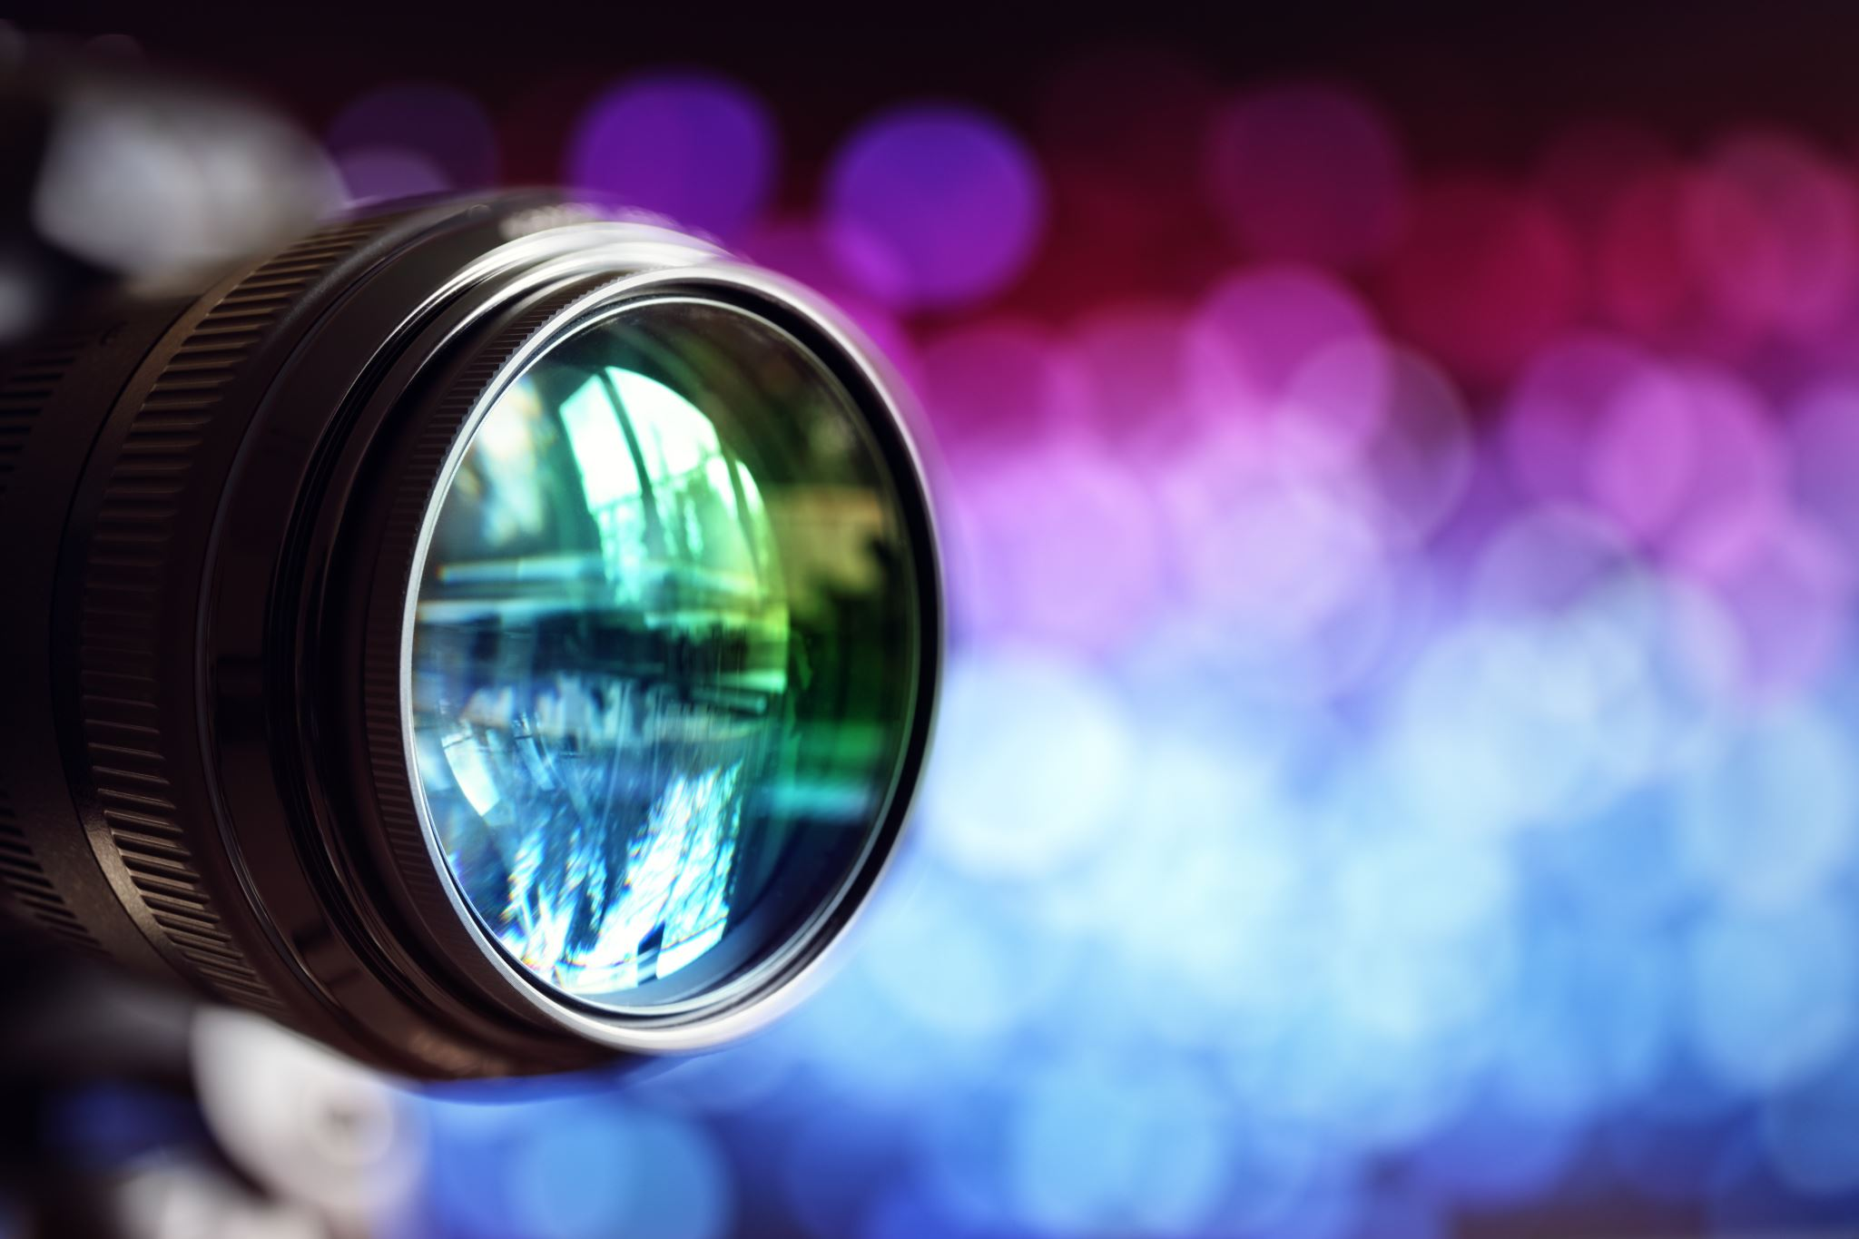
Contents
Basic Of Camera Calibration
My Approach
Procedure and Tool Used
How to Run

Slide 2
What is Camera Calibration
The process of estimating the parameters of a camera is called camera calibration (That means finding the quantities internal to the camera that affect this imaging process).
A Camera Projects 3D world points onto 2D image Plane. With camera calibration we determine an accurate relationship between a 3D point in the real world and its corresponding 2D projection (pixel) in the image captured by camera.
Camera calibration Parameters
Intrinsic parameters: The parameters necessary to link the pixel coordinate of an image point with the corresponding coordinate in the camera reference frame such as focal length, optical center, and radial distortion coefficients of the lens.
External parameters : The parameters that define the location and orientation of the camera reference frame with respect to a known world reference frame

Slide 3
What are the reference frame in camera calibration
Object Coordinate Frame – This fixed 3D coordinate system, and do not change regardless how the object place in scene
World Coordinate Frame – 3D coordinate system and useful to interrelating object in 3D
Camera coordinate Frame – 3D Coordinate system and useful for representing objects to the location of camera
Image plane coordinate Frame – 2D coordinate system
Pixel coordinate Frame -2D coordinate system, each pixels in this frame has integer pixels coordinates

Slide 4



Extrinsic Parameter Calculation
Extrinsic parameter
Capture the relation between World Coordinate and Translation Coordinate
We calculate 3D Rotation and Translation Vector
X,Y, Z - Coordinates
R,T = 3D rotation Matrix and Translation Vector
Subscripts
C = for camera coordinate frame
W = for world coordinate frame

Slide 5
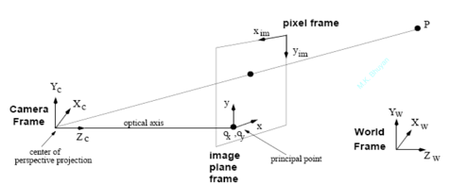
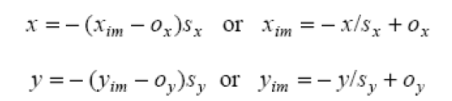
Extrinsic Parameter Calculation
We calculate the camera matrix (focal distance, optical center)
Geometric distortion by optics
(ox , oy) are the coordinates of the principal point
e.g., ox = N/2, oy = M/2 if the principal point is
the center of the image sx , sy correspond to the effective size of the pixels in the horizontal and vertical directions
(in millimeters)

Slide 6
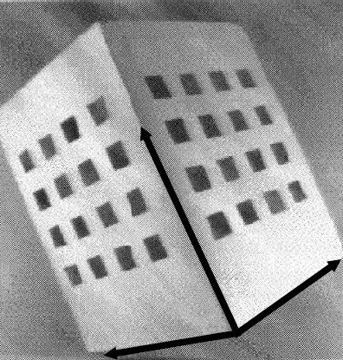
Steps for Camera Calibration
Calibration relies on one or more images of a calibration object:
(1) 3D object of known geometry.
(2) Located in a known position in space.
(3) Yields image features which can be located accurately.
Steps -
A geometry 3D of Two orthogonal grids of equally spaced black squares as showing in fig. Let assume that the world reference frame is centered at the lower left corner of the right grid, with axes parallel to the three directions identified by the calibration pattern.
Step – 1 Obtain 3D coordinates (Xw, Yw, Zw)
Given the size of the planes, the number of squares etc. (i.e., all known by construction), the coordinates of each vertex can be computed in the world reference frame using trigonometry.
Step – 2 Obtain 2D coordinates (xim, yim)
The projection of the vertices on the image can be found by intersecting the edge lines of the corresponding square sides (or through corner detection).

Slide 7

My Approach (Note In place of table I used white plane paper)
Why is the checkerboard
Checkerboard patterns are distinct and easy to detect in an image.
the corners of squares on the checkerboard are ideal for localizing them because they have sharp gradients in two directions.
these corners are also related by the fact that they are at the intersection of checkerboard lines.
All these facts are used to robustly locate the corners of the squares in a checkerboard pattern.
Use checkerboard pattern of known size to define the real world 3d Coordinates
Capture the images of the checkerboard from different angles
Detect the checkerboard corner with the help of opencv package
Find the camera calibrated parameter with opencv package help
Object dimension detection:
Known – camera calibrated parameter (I calibrate with checkerboard and tool I used python3 and opencv2) and object distance from camera (because camera is fixed ), focal dis in mm
S = D * P *$\frac{Sc}{pc∗f}$
Where,
S = Object dimensions, D = distance from camera
sc, pc = size of camera sensor window and camera resolution
$f$ = focal distance
P = object size in pixels

Slide 8
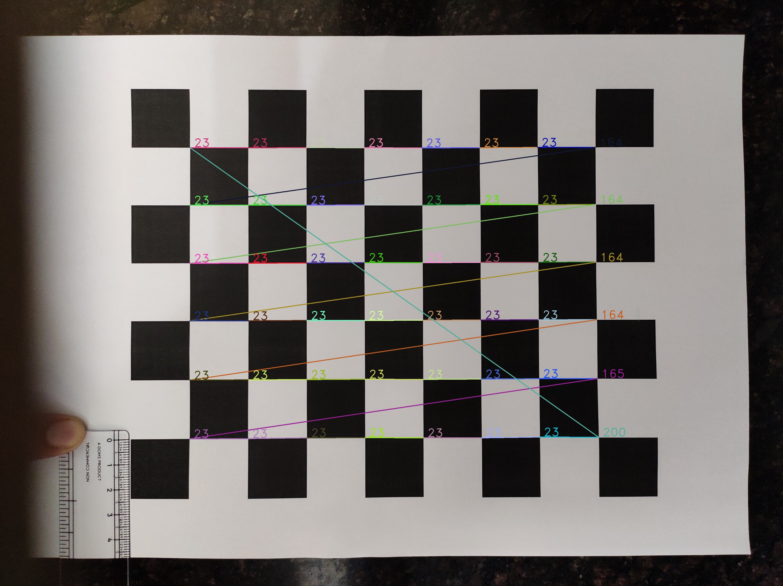
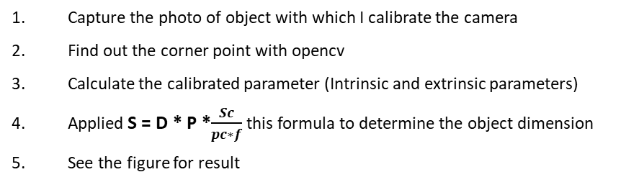
Procedure
Capture the photo of object with which I calibrate the camera
Find out the corner point with opencv
Calculate the calibrated parameter (Intrinsic and extrinsic parameters)
Applied S = D * P *$\frac{Sc}{pc∗f}$this formula to determine the object dimension
See the figure for result
Tools
Camera (I don’t have web camera, so I used my phone)
Python3
Opencv
numpy

Slide 9
How to Run
Install dependency (use any one method)
By Setup Virtual Environment –
Run following command (make sure you are in proper Dir where requirement.txt file is present)
!pip install –r requiremts.txt
Run the solution
To calibrate the camera run camera_calibration.py python script but before that making the changes in config file – set the config.py file
Define - calibration_img_dir, calibration_parameter_dir, checkerboard_dim
To measure the dimension run dimension.py python script but before running this do the following changes in config.py file
Define - sensor_size, camera_pixel, depth, test_imge_path

