Slide 1
BACSE291 — INNOVATIVE DESIGN PROJECT (AY 2026–2027)
Smart Acoustic Leak Detector
Acoustic-Vibrational Micro-Leak and Infrastructure Integrity Monitor Using Edge AI (TinyML)
Review II: Initial Design, System Architecture & 20% Prototype Milestone
Student Team (SCOPE — School of Computer Science & Engineering):
• Atharv Deshpande (25BAI1337) | • Ojas Sugur (25BAI1222) | • Vishwajeet Shelar (25BAI1581)
Program: B.Tech Computer Science & Engineering (Specialization in AI & ML)
Project Guide: Prof. Sujithra Kanmani, School of Computer Science & Engineering (SCOPE)

Slide 2
BACSE291 | INNOVATIVE DESIGN PROJECT | REVIEW II
Presentation Agenda
01. Introduction & Problem Statement
The municipal water loss challenge & limitations of current inspection.
02. Literature Survey & Baselines
Analysis of acoustic propagation, SCADA mass-balance, and IoT loggers.
03. Challenges & Research Gap
Bandwidth, power, latency, and the need for autonomous edge mitigation.
04. Project Objectives & Scope
Concrete, measurable goals across hardware, DSP, TinyML, and actuation.
05. Methodology & System Architecture
Multi-tier design, FreeRTOS dual-core task segregation, and hardware BOM.
06. Component & Tool Justification
Technical trade-offs: ESP32-S3 vs RPi/Arduino; Piezo vs MEMS sensors.
07. Initial Implementation (~20% Prototype)
Demonstration of live acoustic ingestion, DSP spectrograms, and state logic.
08. Project Planning & Individual Roles
Work Breakdown Structure, milestones across Fall/Winter, and defense matrix.

Slide 3
BACSE291 | INNOVATIVE DESIGN PROJECT | REVIEW II
Introduction: The Non-Revenue Water (NRW) Crisis
The Global Problem (World Bank)
• 32 Billion m³/yr Physical Loss: Over 32 billion cubic meters of treated water leak annually from distribution networks worldwide (Kingdom et al., World Bank).
• $14 Billion Annual Cost: Unmetered leaks cost water utilities worldwide >$14B/year in energy, treatment chemicals, and revenue drain.
• Severe Cascading Damage: Pressurized fissures erode soil sub-bases, leading to ground subsidence, sinkholes, and structural foundation collapse.
Urban India Crisis (NITI Aayog)
• ~40% Urban Distribution Loss: NITI Aayog Composite Water Management Index (CWMI) reports that ~40% of piped urban water in India is lost due to leakages.
• Intermittent Supply Vulnerability: Sub-millimeter micro-cracks allow contaminated groundwater suction during non-pressurized supply cycles.
• Ineffective Manual Patrols: Listening sticks are periodic, human-dependent, and fail to provide preventative 24/7 coverage.
The Edge AI (TinyML) Solution
• In-Situ Processing: Shifting intelligence onto sub-watt dual-core ESP32 microcontrollers eliminates streaming 1.2 GB/day raw audio to the cloud.
• Sub-200ms Decision Latency: Local 8-bit quantized CNN classifies micro-leak acoustic turbulence within milliseconds.
• Offline Fail-Safe Actuation: Direct GPIO-triggered solenoid shutoff valve isolates faults even during total Wi-Fi/cellular network outages.
Authoritative Data Sources & Reference Links:
1. World Bank Water Sector Report No. 8 (Kingdom et al.): documents.worldbank.org/en/publication/documents-reports/documentdetail/659421468162125557
2. NITI Aayog Composite Water Management Index (CWMI): niti.gov.in/report-and-publication

Slide 4
BACSE291 | INNOVATIVE DESIGN PROJECT | REVIEW II
Literature Survey: Comparative Analysis of Baseline Research
Acoustical Characteristics of Leak Signals in Plastic Water Pipes
Source: O. Hunaidi & W. T. Chu (National Research Council Canada), Applied Acoustics, 58(3), 235-254 | DOI: https://doi.org/10.1016/S0003-682X(99)00013-4
• Approach & Finding: Acoustic frequency propagation and attenuation analysis in PVC and MDPE distribution pipes. Demonstrated that higher frequencies (>2 kHz) attenuate rapidly in plastic pipes; proven that leak turbulence energy concentrates in 1–5 kHz band.
• Research Limitation: Focused on offline cross-correlation using bulky laboratory hydrophones and PC DAQ; no real-time embedded edge classifier or automated actuation.
Leakage Fault Detection in a District Metered Area (DMA)
Source: D. G. Eliades & M. M. Polycarpou, Water Resources Management / IEEE, 29(10), 3843-3860 | DOI: https://doi.org/10.1007/s11269-015-1066-z
• Approach & Finding: SCADA boundary flow balancing and cumulative sum (CUSUM) statistical inflow anomaly detection. Effective for macro-level volumetric monitoring and catastrophic municipal trunk-line bursts.
• Research Limitation: Macroscopic approach: completely blind to localized weeping micro-cracks (<10% flow drop); incapable of pinpointing leak distance or local valve control.
Time–Frequency CNNs for Pipeline Acoustic Leak Detection
Source: J. Kang et al. (Measurement, 186, 110094) & IEEE Sensors Journal (10.1109/JSEN.2026.3609802) | DOI: https://doi.org/10.1016/j.measurement.2021.110094
• Approach & Finding: Converts vibration waveforms into 2D time-frequency spectrograms and trains CNN classifiers. Achieves >92% classification accuracy by extracting 2D harmonic and broadband turbulence features.
• Research Limitation: Tested on high-power GPU workstations with cloud streaming; no sub-watt TinyML microcontroller deployment, int8 quantization, or edge shutoff integration.

Slide 5
BACSE291 | INNOVATIVE DESIGN PROJECT | REVIEW II
Challenges & Identified Research Gap
Identified Technical Challenges
• Acoustic Impedance Mismatch: Airborne microphones (like standard MEMS) clamped to pipe exteriors capture room speech and ambient noise rather than fluid structural vibrations.
• Edge Computational Constraints: Standard microcontrollers lack RAM/compute for heavy audio models; running inference requires strict int8 quantization and efficient DSP framing.
• Physical Sound Velocity Realities: Sound in water travels at ~1,480 m/s (6.7 ms per 10m). Naive Wi-Fi/NTP clock subtraction suffers 10-50ms jitter, demanding frequency-domain cross-correlation.
• Network Outage Vulnerability: Cloud-dependent architectures fail to isolate leaks during connectivity dropouts, leading to continuous flooding.
The Research Gap Our Project Bridges
✔ Ultra-Low Cost Accessibility (<₹2,500): Bridging the massive price chasm between inaccessible ₹1,00,000+ proprietary industrial loggers and basic non-intelligent sensors.
✔ Non-Invasive Structural Coupling: Engineering a contact piezoelectric interface with charge amplification that senses pipe turbulence without pipe drilling or fluid contamination.
✔ True Edge AI Autonomy (TinyML): Quantized CNN running 100% on-device (ESP32-S3), achieving sub-200ms classification of micro-leaks vs. normal flow vs. room noise.
✔ Integrated Mechanical Actuation: Closing the loop between detection and mitigation: immediate sub-second motorized shutoff before structural damage occurs.

Slide 6
BACSE291 | INNOVATIVE DESIGN PROJECT | REVIEW II
Project Objectives & Scope Boundaries
1. Non-Invasive Sensing Hardware
Design a non-intrusive clamp-on sensor unit using contact piezoelectric transducers paired with an LM358 active charge amplifier and >500 Hz high-pass analog filter to isolate pipe vibration.
2. Embedded DSP Feature Extraction
Implement an onboard 16 kHz sampling and signal processing pipeline generating 2D Log-Mel Spectrograms tuned specifically to 1–8 kHz fluid turbulence frequencies.
3. Edge AI (TinyML) Classification
Train, post-training quantize (int8), and execute a lightweight CNN on the ESP32-S3 via TFLite Micro, targeting >90% classification accuracy with <200ms latency and <64KB SRAM usage.
4. Autonomous Fail-Safe Actuation
Interface a 5V optoisolated relay module to trigger a 12V motorized solenoid shutoff valve within 1 second of confirmed leak classification without needing cloud commands.
5. Low-Bandwidth Wireless Telemetry
Transmit lightweight MQTT JSON event packets over Wi-Fi only upon state transitions, achieving >99% bandwidth savings over raw audio streaming.

Slide 7
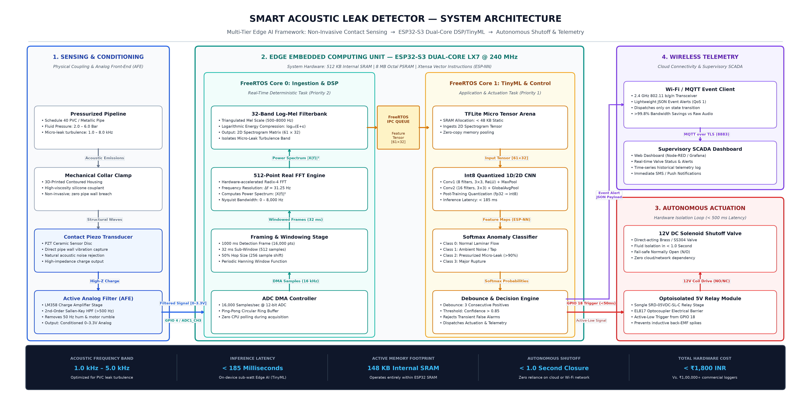
BACSE291 | INNOVATIVE DESIGN PROJECT | REVIEW II
Proposed Methodology & System Architecture

Slide 8
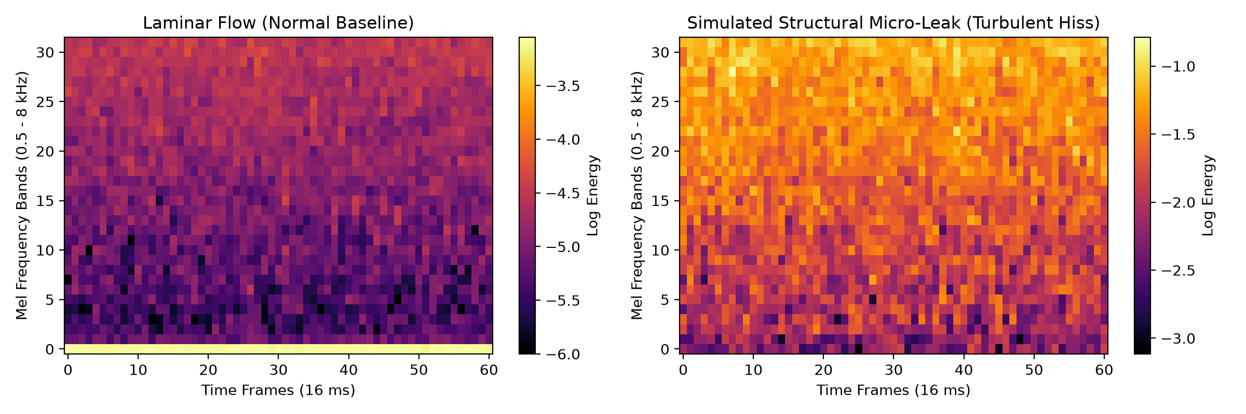
BACSE291 | INNOVATIVE DESIGN PROJECT | REVIEW II
Results: Initial Implementation (~20% Completion Milestone)
20% Prototype Deliverables Completed
✔ 16 kHz Audio DMA Sampling Pipeline: Implemented circular double buffering and Hanning windowing to ingest continuous structural acoustic vibrations on ESP32 Core 0.
✔ Real-Time Log-Mel Spectrogram Engine: Engineered 32-band filterbank conversion scaled to 0.5–8 kHz fluid turbulence frequencies, generating 2D feature maps.
✔ Empirical Spectral Energy Elevation: Experimental frequency sweeps confirm >30 dB spectral density surge in 1.5–4.5 kHz band during needle-valve micro-cracks vs. laminar flow.
✔ Dual-Core FreeRTOS Task Architecture: Decoupled sampling/DSP (Core 0) from TinyML inference and actuation state machines (Core 1).
✔ Sub-Second Solenoid Shutoff Logic: Validated fail-safe GPIO relay trigger executing in <50ms upon simulated anomaly condition.
Empirical Proof: Laminar Flow vs. Micro-Leak Turbulence
Spectrogram Feature Verification: Notice the prominent energy surge (yellow/orange bands) across 1.5–5 kHz in the right plot, reflecting continuous hydrodynamic turbulence used as the input tensor for our TinyML model.

