Slide 1
Compilers
Static Semantics
Credit: UW (Perkins)

Slide 2
Agenda
Static semantics
Attribute grammars
Symbol tables
Types & type checking
Wrapup

Slide 3

What do we need to know to check if this is legal and compile it?
class C {
int a;
C(int initial) {
a = initial;
}
void setA(int val) {
a = val;
}
}
class Main {
public static void main(){
C c = new C(17);
c.setA(42);
}
}

Slide 4

Beyond Syntax
There is a level of correctness not captured by a context-free grammar
Has a variable been declared?
Are types consistent in an expression?
In the assignment x=y, is y assignable to x?
Does a method call have the right number and types of parameters?
In a selector p.q, is q a method or field of class instance p?
Is variable x guaranteed to be initialized before it is used?
Could p be null when p.q is executed?
Etc. etc. etc.
Notes:
Au02: Based on one of Cooper’s slides

Slide 5
What else do we need to know to generate code?
Where are fields allocated in an object?
How big are objects? (i.e., how much storage needs to be allocated by new)
Where are local variables stored when a method is called?
Which methods are associated with an object/class?
How do we figure out which method to call based on the run-time type of an object?

Slide 6
Agenda
Static semantics
Attribute grammars
Symbol tables
Types & type checking
Wrapup

Slide 7

Semantic Analysis
Main tasks:
Extract types and other information from the program
Check language rules that go beyond the context-free grammar
Resolve names – connect declarations and uses
“Understand” the program well enough for synthesis
Key data structure: Symbol tables
Map each identifier in the program to information about it (kind, type, etc.)
Later: assign storage locations (stack frame offsets) for variables, add other annotations
This is the final part of the analysis phase (front end) of the compiler

Slide 8

Some Kinds of Semantic Information
Information | Generated From | Used to process
Symbol tables | Declarations | Expressions, statements
Type information | Declarations, expressions | Operations
Constant/variable information | Declarations, expressions | Statements, expressions
Register & memory locations | Assigned by compiler | Code generation
Values | Constants | Expressions

Slide 9
Semantic Checks
For each language construct we want to know:
What semantic rules should be checked
Specified by language definition (type compatibility, required initialization, etc.)
For an expression, what is its type (used to check whether expression is legal in the current context)
For declarations, what information needs to be captured to use elsewhere

Slide 10
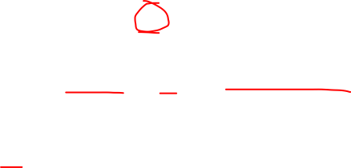
A Sampling of Semantic Checks (0)
Appearance of a name: id
Check: id has been declared and is in scope
Compute: Inferred type of id is its declared type
Constant: v
Compute: Inferred type and value are explicit

Slide 11
A Sampling of Semantic Checks (1)
Binary operator: exp₁ op exp₂
Check: exp₁ and exp₂ have compatible types
Identical, or
Well-defined conversion to appropriate types
Compute: Inferred type is a function of the operator and operand types

Slide 12
A Sampling of Semantic Checks (2)
Assignment: exp₁ = exp₂
Check: exp₁ is assignable (not a constant or expression)
Check: exp₁ and exp₂ have (assignment-)compatible types
Identical, or
exp₂ can be converted to exp₁ (e.g., char to int), or
Type of exp₂ is a subclass of type of exp₁ (can be decided at compile time)
Compute: Inferred type is type of exp₁

Slide 13
A Sampling of Semantic Checks (3)
Cast: (exp₁) exp₂
Check: exp₁ is a type
Check: exp₂ either
Has same type as exp₁
Can be converted to type exp₁ (e.g., double to int)
Downcast: is a superclass of exp₁ (usually requires a runtime check to verify; at compile time we can at least decide if it could be true)
Upcast (Trivial): is the same or a subclass of exp₁
Compute: Inferred type is exp₁

Slide 14
A Sampling of Semantic Checks (4)
Field reference: exp.f
Check: exp is a reference type (not primitive type)
Check: The class of exp has a field named f
Compute: Inferred type is declared type of f

Slide 15
A Sampling of Semantic Checks (5)
Method call: exp.m(e₁, e₂, …, e_{n})
Check: exp is a reference type (not primitive type)
Check: The type of exp has a method named m
(inherited or declared as part of the type)
Check: The method m has n parameters
Or, if overloading allowed, at least one version of m exists with n parameters
Check: Each argument has a type that can be assigned to the associated parameter
Same “assignment compatible” check for assignment
Overloading: need to find a “best match” among available methods if more than one is compatible – or reject if result is ambiguous (e.g., full Java, C++, others)
Compute: Inferred type is given by method declaration (or could be void)

Slide 16
A Sampling of Semantic Checks (6)
Return statement: return exp; or: return;
Check:
If the method is not void: The expression can be assigned to a variable that has the declared return type of the method – exactly the same test as for assignment statement
If the method is void: There is no expression

Slide 17
Agenda
Static semantics
Attribute grammars
Symbol tables
Types & type checking
Wrapup

Slide 18
Attribute Grammars
A systematic way to think about semantic analysis
Formalize properties checked and computed during semantic analysis and relate them to grammar productions in the CFG (or AST)
Sometimes used directly, but even when not, AGs are a useful way to organize the analysis and think about it

Slide 19

Attribute Grammars
Idea: associate attributes with each node in the (abstract) syntax tree
Examples of attributes
Type information
Storage location
Assignable (e.g., expression vs variable – lvalue vs rvalue in C/C++ terms)
Value (for constant expressions)
etc. …
Notation: X.a if a is an attribute of node X

Slide 20
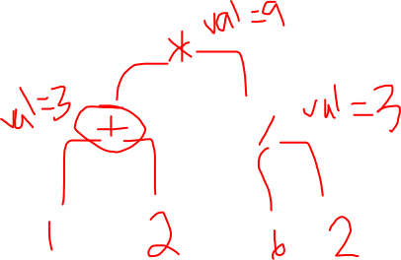
Attribute Example
Assume that each node has a .val attribute giving the computed value of that node
AST and attribution for (1+2) * (6 / 2)

Slide 21

Inherited and Synthesized Attributes
Given a production X ::= Y₁ Y₂ … Y_{n}
A synthesized attribute X.a is a function of some combination of the attributes of the Y_{i}’s (bottom up)
An inherited attribute Y_{i}.b is a function of some combination of attributes X.a and other Y_{j}.c (top down)
Often restricted a bit: only Y’s to the left can be used (has implications for evaluation)

Slide 22

Attribute Equations
For each kind of node we give a set of equations (not assignments) relating attribute values of the node and its children
Example: plus.val = exp₁.val + exp₂.val
Attribution (evaluation) means finding a solution that satisfies all of the equations in the tree
This is an example of a constraint language

Slide 23
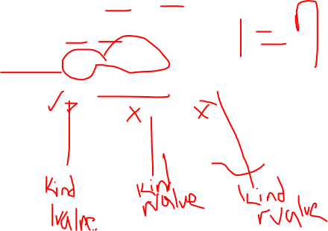
Informal Example of Attribute Rules (1)
Suppose we have the following grammar for a trivial language
program ::= decl stmt
decl ::= int id;
stmt ::= exp = exp ;
exp ::= id | exp + exp | 1
What attributes would we create to check types and assignability (lvalue vs rvalue)?

Slide 24

Informal Example of Attribute Rules (2)
Attributes of nodes
env (environment, e.g., symbol table)
synthesized by decl, inherited by stmt
Each entry maps a name to its type and kind
type (expression type)
synthesized
kind (variable [var or lvalue] vs value [val or rvalue])
synthesized

Slide 25

Attributes for Declarations
decl ::= int id;
decl.env = {id ⟶ (int, var)}

Slide 26
Attributes for Program
program ::= decl stmt
stmt.env = decl.env

Slide 27
Attributes for Constants
exp ::= 1
exp.kind = val
exp.type = int

Slide 28

Attributes for Identifier Expressions
exp ::= id
(type, kind) = exp.env.lookup(id)
exp.type = type (i.e., id type)
exp.kind = kind (i.e., id kind)

Slide 29

Attributes for Addition
exp ::= exp₁ + exp₂
exp₁.env = exp.env
exp₂.env = exp.env
error if exp₁.type != exp₂.type
(or error if not compatible, depending on language rules)
exp.type = exp₁.type (or exp₂.type)
(or whatever type that language rules specify)
exp.kind = val

Slide 30

Attribute Rules for Assignment
stmt ::= exp₁ = exp₂;
exp₁.env = stmt.env
exp₂.env = stmt.env
Error if exp₂.type is not assignment compatible with exp₁.type
Error if exp₁.kind is not var (can’t be val)

Slide 31
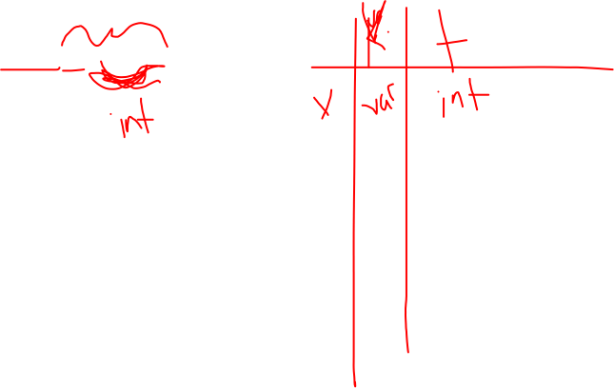
Example
int x; x = x + 1;

Slide 32
Extensions
This can be extended to handle sequences of declarations and statements
Sequences of declarations builds up larger environments, each decl synthesizes a new env from previous one plus the new binding
Full environment is passed down to statements and expressions

Slide 33
Observations
These are equational computations
Think functional programming, no side effects
Solver can be automated, provided the attribute equations are non-circular
But implementation problems
Non-local computation
Can’t afford to literally pass around copies of large, aggregate structures like environments

Slide 34
In Practice
Attribute grammars give us a good way of thinking about how to structure semantic checks
Symbol tables will hold environment information
Add fields to AST nodes to refer to appropriate attributes (symbol table entries for identifiers, types for expressions, etc.)
Put in appropriate places in AST class inheritance tree and exploit inheritance. Most statements don’t need types, for example, but all expressions do.

Slide 35
Agenda
Static semantics
Attribute grammars
Symbol tables
Types & type checking
Wrapup

Slide 36
Symbol Tables
Map identifiers to <type, kind, location, other properties>
Operations
Lookup(id) => information
Enter(id, information)
Open/close scopes
Build & use during semantics pass
Build first from declarations
Then use to check semantic rules
Use (and augment) in later compiler phases

Slide 37
Aside: Implementing Symbol Tables
Big topic in classical (i.e., ancient) compiler courses: implementing a hashed symbol table
These days: use the collection classes that are provided with the standard language libraries (Java, C#, C++, ML, Haskell, etc.)
Then tune & optimize if it really matters
In production compilers, it really matters
Up to a point…
Java:
Map (HashMap) will handle most cases
List (ArrayList) for ordered lists (parameters, etc.)

Slide 38
Engineering Issues (1)
In multipass compilers, inner scope symbol tables need to persist for use in later passes
So really can’t delete symbol tables on scope exit
Retain tables and add a pointer to the parent scope (effectively a reverse tree of scope symbol tables with root = global table)
Keep a pointer to current innermost scope (leaf) and start looking for symbols there

Slide 39
Engineering Issues (2)
In practice, often want to retain O(1) lookup or something close to it
Would like to avoid O(depth of scope nesting), although some compilers assume this will be small enough not to matter
When it matters, use hash tables with additional information (linked lists of various sorts) to get the scope nesting right
Usually need some sort of scope entry/exit operations
See a compiler textbook for ideas & details

Slide 40
Error Recovery
What to do when an undeclared identifier is encountered?
Goal: only complain once (Why?)
Can forge a symbol table entry for id once you’ve complained so it will be found in the future
Assign the forged entry a type of “unknown”
“Unknown” is the type of all malformed expressions and is compatible with all other types
Allows you to only complain once! (How?)

Slide 41
“Predefined” Things
Many languages have some “predefined” items (constants, functions, classes, namespaces, standard libraries, …)
Include initialization code or declarations to manually create symbol table entries for these when the compiler starts up
Rest of compiler generally doesn’t need to know the difference between “predeclared” items and ones found in the program
Can put “standard prelude” information in a file or data resource and use that to initialize
Tradeoffs?

Slide 42
Agenda
Static semantics
Attribute grammars
Symbol tables
Types & type checking
Wrapup

Slide 43
Types
Classical roles of types in programming languages
Run-time safety
Compile-time error detection
Improved expressiveness (method or operator overloading, for example)
Provide information to optimizer
In strongly typed languages, allows compiler to make assumptions about possible values
Qualifiers like const, final, or restrict (in C) allow for other assumptions

Slide 44
Type Checking Terminology
Static vs. dynamic typing
static: checking done prior to execution (e.g. compile-time)
dynamic: checking during execution
Strong vs. weak typing
strong: guarantees no illegal operations performed
weak: can’t make guarantees
Caveats:
Hybrids common
Inconsistent usage
common
“untyped,” “typeless”
could mean dynamic
or weak
 | static | dynamic
strong | Java, SML | Scheme, Ruby
weak | C | PERL

Slide 45
Type Systems
Base Types
Fundamental, atomic types
Typical examples: int, double, char, bool
Compound/Constructed Types
Built up from other types (recursively)
Constructors include records/structs/classes, arrays, pointers, enumerations, functions, modules, …
Most language provide a small collection of these

Slide 46
How to Represent Types in a Compiler?
One solution: create a shallow class hierarchy
Example:
abstract class Type { … } // or interface
class BaseType extends Type { … }
class ClassType extends Type { … }
Should not need too many of these

Slide 47
Types vs ASTs
Types nodes are not AST nodes!
AST = abstract representation of source program (including source program type info)
Types = abstract representation of type semantics for type checking, inference, etc. (i.e., an ADT)
Can include information not explicitly represented in the source code, or may describe types in ways more convenient for processing
Be sure you have a separate “type” class hierarchy in your compiler distinct from the AST

Slide 48
Base Types
For each base type (int, boolean, char, double, etc.) create exactly one object to represent it (singleton!)
Base types in symbol table entries and AST nodes are direct references to these objects
Base type objects usually created at compiler startup
Useful to create a type “void” object to tag functions that do not return a value
Also useful to create a type “unknown” object for errors
(“void” and “unknown” types reduce the need for special case code in various places in the type checker; don’t have to return “null” for “no type” or “not declared” cases)

Slide 49
Compound Types
Basic idea: use a appropriate “type constructor” object that refers to the component types
Limited number of these – correspond directly to type constructors in the language (pointer, array, record/struct/class, function,…)
So a compound type is represented as a graph
Some examples…

Slide 50
Class Types
Type for: class id { fields and methods }
class ClassType extends Type {
Type baseClassType; // ref to base class
Map fields; // type info for fields
Map methods; // type info for methods
}
(MiniJava note: May not want to represent class types exactly like this, depending on how class symbol tables are represented; e.g., the class symbol table(s) might be a sufficient representation of a class type.)

Slide 51
Array Types
For regular Java this is simple: only possibility is # of dimensions and element type (which can be another array type or anything else)
class ArrayType extends Type {
int nDims;
Type elementType;
}

Slide 52
Array Types for Other Languages
Example: Pascal allowed arrays to be indexed by any discrete type like an enum, char, subrange of int, or other discrete type
array [indexType] of elementType
(fantastic idea – would be nice if it became popular again)
Element type can be any other type, including an array (e.g., 2-D array = 1-D array of 1-D array)
class GeneralArrayType extends Type {
Type indexType;
Type elementType;
}

Slide 53
Methods/Functions
Type of a method is its result type plus an ordered list of parameter types
class MethodType extends Type {
Type resultType; // type or “void”
List parameterTypes;
}
Sometimes called the method “signature”

Slide 54
Type Equivalance
For base types this is simple: types are the same if they are identical
Can use pointer comparison in the type checker if you have a singleton object for each base type
Normally there are well defined rules for coercions between arithmetic types
Compiler inserts these automatically where required by the language spec or when written explicitly by programmer (casts) – often involves inserting cast or conversion nodes in AST

Slide 55
Type Equivalence for Compound Types
Two basic strategies
Structural equivalence: two types are the same if they are the same kind of type and their component types are equivalent, recursively
Name equivalence: two types are the same only if they have the same name, even if their structures match
Different language design philosophies
e.g., are Complex and Point the same?
e.g., are Point (Cartesian) and Point (Polar) the same?

Slide 56
Structural Equivalence
Structural equivalence says two types are equal iff they have same structure
Atomic types are tautologically the same structure and equal if they are the same type
For type constructors: equal if the same constructor and, recursively, type (constructor) components are equal
Ex: atomic types, array types, ML record types
Implement with recursive implementation of equals, or by canonicalization of types when types created, then use pointer/ref. equality

Slide 57
Name Equivalence
Name equivalence says that two types are equal iff they came from the same textual occurrence of a type constructor
Ex: class types, C struct types (struct tag name), datatypes in ML
special case: type synonyms (e.g. typedef in C) do not define new types
Implement with pointer equality assuming appropriate representation of type info

Slide 58
Type Equivalence and Inheritance
Suppose we have
class Base { … }
class Derived extends Base { … }
A variable declared with type Base has a compile-time type or static type of Base
During execution, that variable may refer to an object of class Base or any of its subclasses like Derived (or can be null), often called the the runtime type or dynamic type
Since subclass is guaranteed to have all fields/methods of base class, type checker only needs to deal with declared compile-time types of variables and, in fact, can’t track all possible runtime types

Slide 59
Type Casts
In most languages, one can explicitly cast an object of one type to another
sometimes cast means a conversion (e.g., casts between numeric types)
sometimes cast means a change of static type without doing any computation (casts between pointer types or pointer and numeric types in C)
for objects can be a upcast (free and always safe) or downcast (requires runtime check to be safe)

Slide 60
Type Conversions and Coercions
In full Java, we can explicitly convert a value of type double to one of type int
can represent as unary operator
typecheck, codegen normally
In full Java, can implicitly coerce a value of type int to one of type double
compiler must insert unary conversion operators, based on result of type checking

Slide 61
C and Java: type casts
In C/C++: safety/correctness of casts not checked
allows writing low-level code that’s type-unsafe
C++ has more elaborate casts, and one of them does require runtime checks
In Java: downcasts from superclass to subclass need runtime check to preserve type safety
static typechecker allows the cast
codegen introduces runtime check
(same code needed to handle “instanceof”)
Java’s main need for dynamic type checking

Slide 62
Various Notions of Type Compatibility
There are usually several relations on types that we need to analyze in a compiler:
“is the same as”
“is assignable to”
“is same or a subclass of”
“is convertible to”
Exact meanings and checks needed depend on the language spec.
Be sure to check for the right one(s)

Slide 63
Useful Compiler Functions
Create a handful of methods to decide different kinds of type compatibility:
Types are identical
Type t₁ is assignment compatible with t₂
Parameter list is compatible with types of expressions in the method call
Usual modularity reasons: isolate these decisions in one place and hide the actual type representation from the rest of the compiler
Probably belongs in the same package with the type representation classes

Slide 64
Agenda
Static semantics
Attribute grammars
Symbol tables
Types & type checking
Wrapup

Slide 65
Disclaimer
This overview of semantics, type representation, etc. should give you a decent idea of what needs to be done in your project, but you’ll need to adapt the ideas to the project specifics.
You’ll also find good ideas in your compiler book…
And remember that these slides cover more than is needed for our specific project

Slide 66
Coming Attractions
To get a running compiler we need:
Execution model for language constructs
x86-64 assembly language for compiler writers
Code generation and runtime bootstrap details
We’ll also spend considerable time on compiler optimization
Intermediate reps., graphs, SSA, dataflow
Optimization analysis and transformations

