Slide 1
Introduction to Python
Presented by Hina Ota

Slide 2
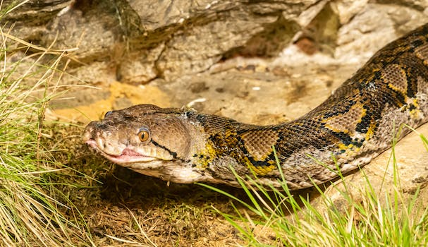
Introduction to Python
- Basics of Python programming language
- Advantages of using Python
- Common applications of Python
- Overview of Python syntax and data types
Keyword: Python Introduction

Slide 3
Python Features and Applications
- Key features of Python
- Python as a versatile language
- Application areas of Python, such as web development, data analysis, and automation
- Examples of popular Python frameworks and libraries
Keyword: Python Features

Slide 4
Credits
Images provided by Pexels: https://www.pexels.com

