Slide 1

ENCHANTMENT DAY-2018
Organized by:-
SCHOOL OF COMPUTER
SCIENCE &ENGINEERING
Powered by:-

Slide 2
PROJECT NAME :
POORNIMA UNIVERSITY
STUDENT APPLICATION
[BETA VERSION]

Slide 3
APPLICATION ENTARANCE
Firstly the application is password protected so it would ask for password.

Slide 4
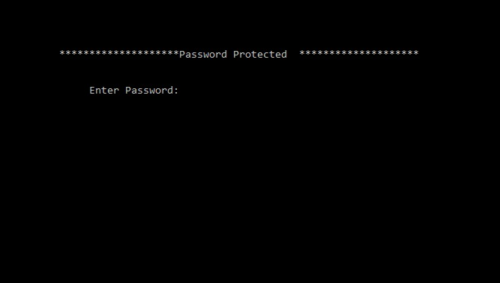

Slide 5
POORNIMA APPLICATION
HOME DASHBOARD
This dashboard will put in front of the functionalities
(modules) of this very application to choose from.

Slide 6
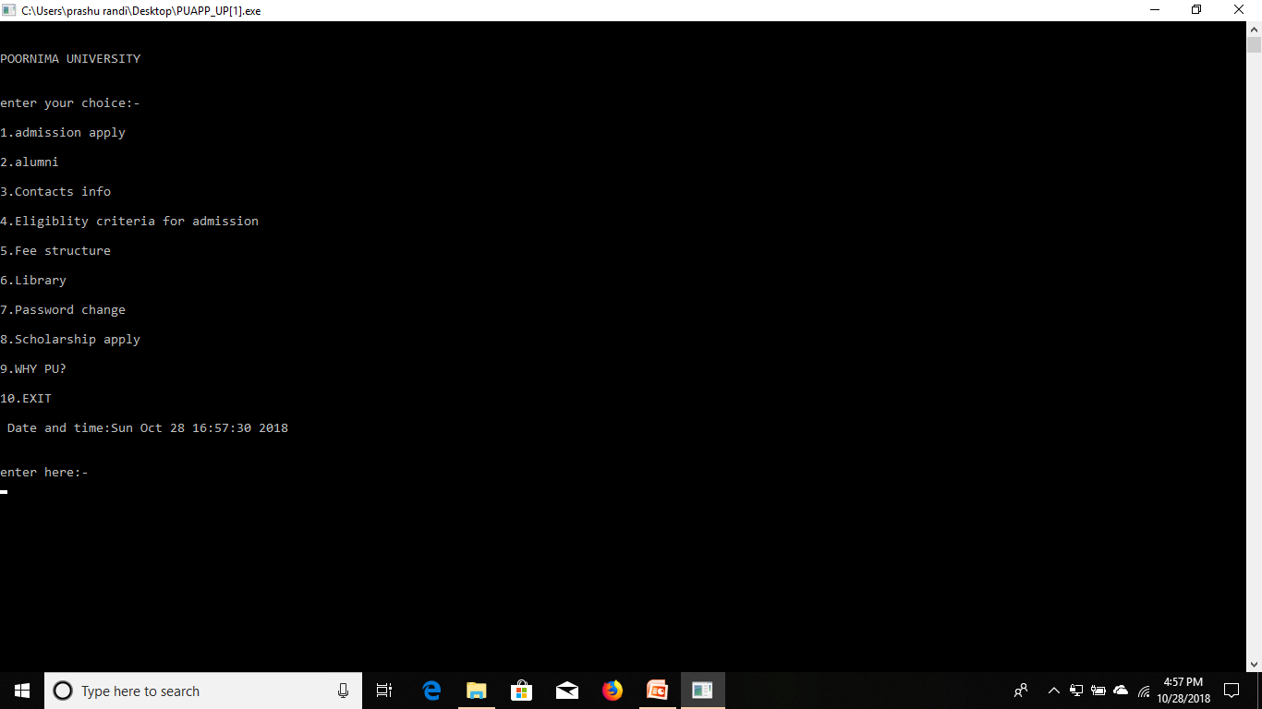

Slide 7
ADMISSION APPLICATION
This module will help you for registration process of the
course of your choice for admission purpose.

Slide 8
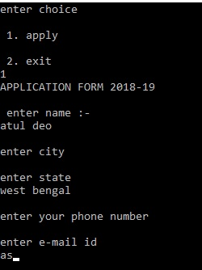

Slide 9
ALUMNI INFORMATION
The alumni segment will provide info. about the pass out
students who are making university proud.

Slide 10
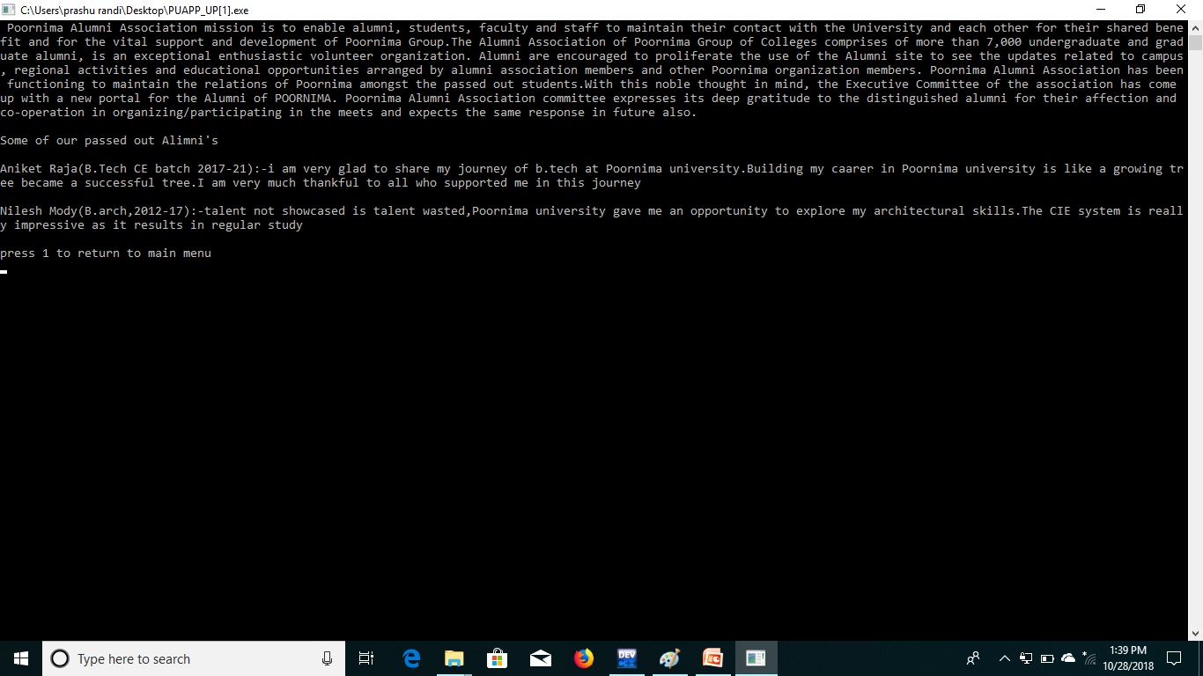

Slide 11
CONTACT US SEGMENT
This very module will display the required information to
contact and reach the management of Poornima University.

Slide 12
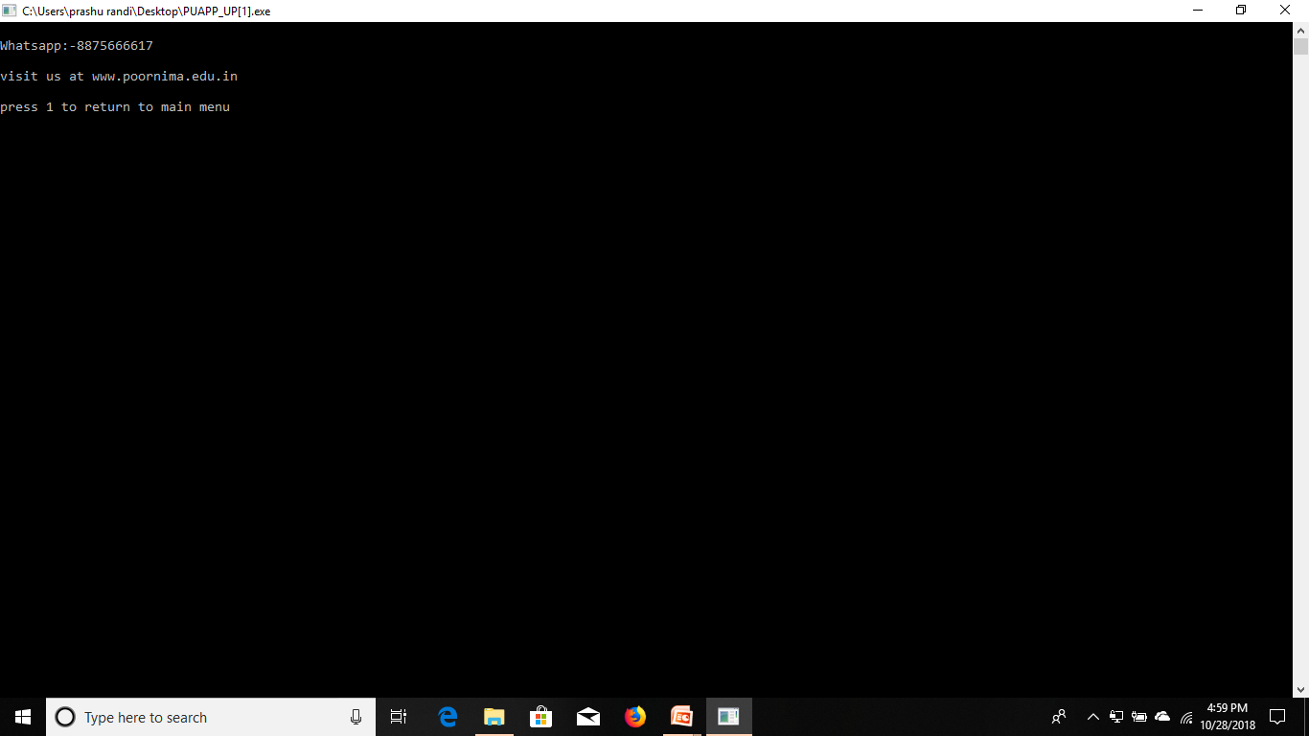

Slide 13
ELIGIBILITY CRITERIA
It will provide information to the admission seekers if they are
eligible to take admission in this university based upon their
previous education results.

Slide 14
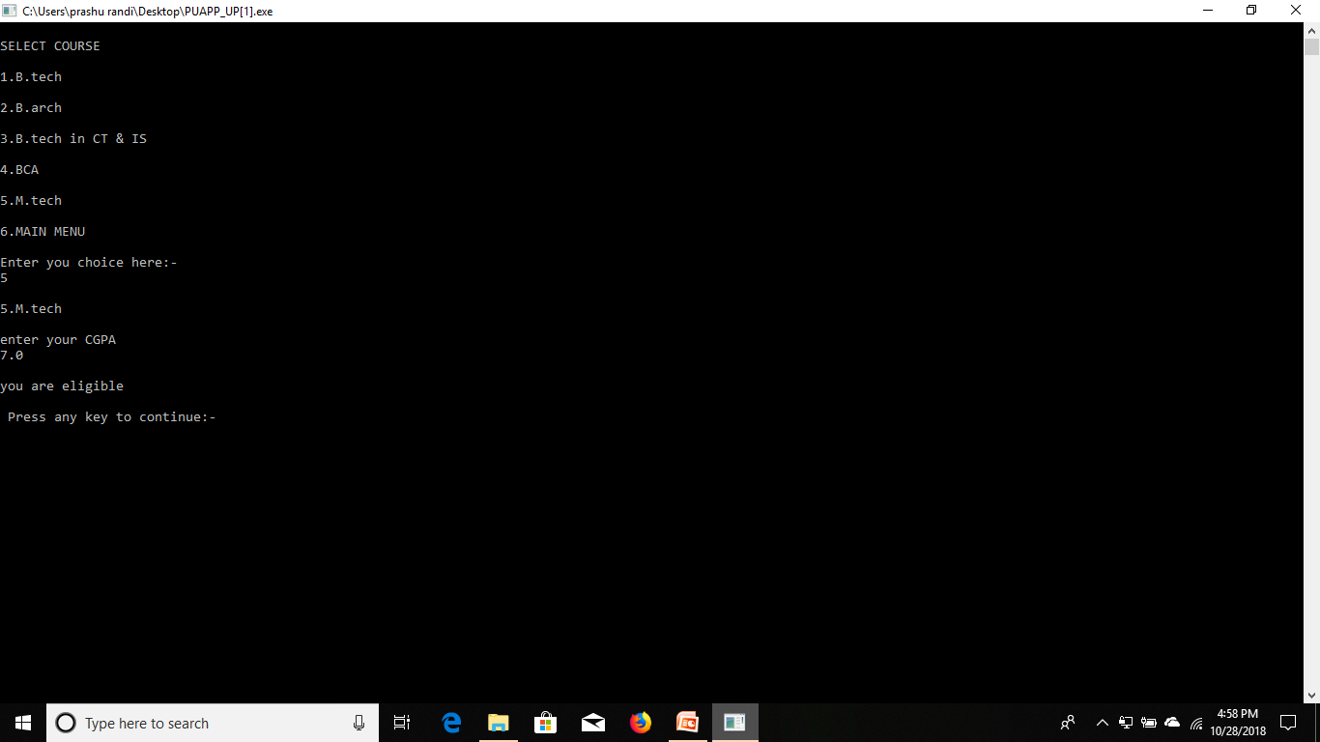

Slide 15
FEES STRUCTURE FUNTION
As its name this module will give information to the admission
seekers about the fees structure of different courses of PU.

Slide 16
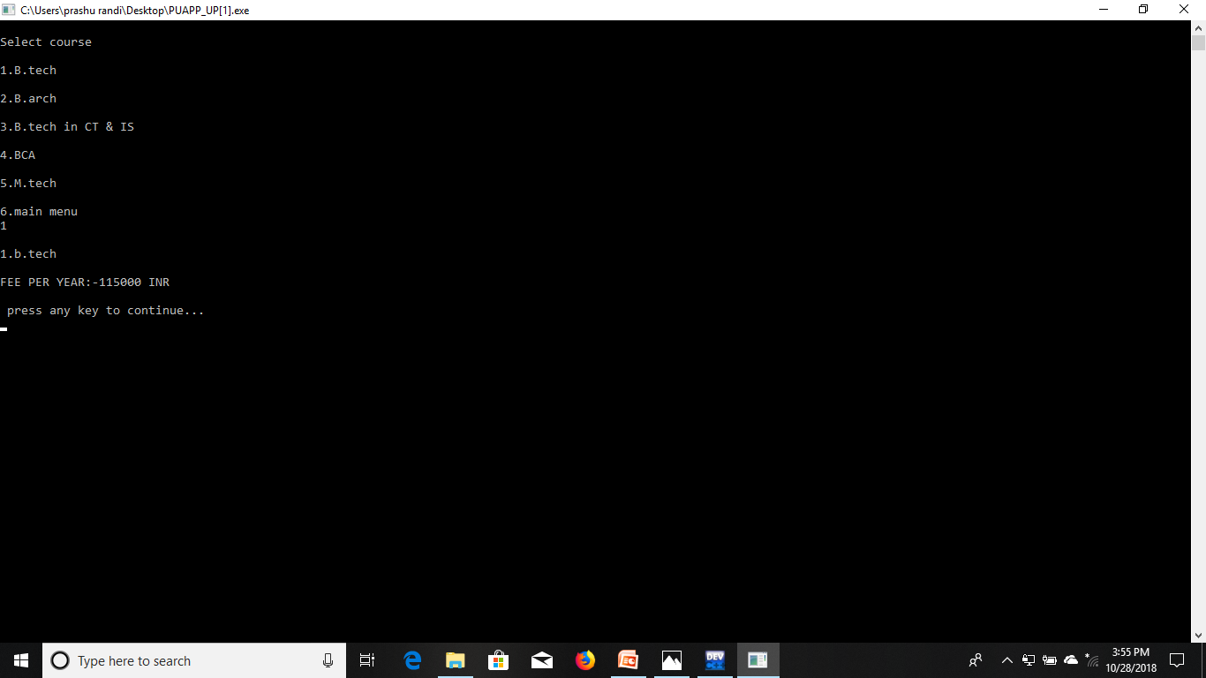

Slide 17
SCHOLARSHIP APPLICATION
The scholarship module will inform the admission seekers
if they are eligible for scholarship or not for their selected
course.

Slide 18
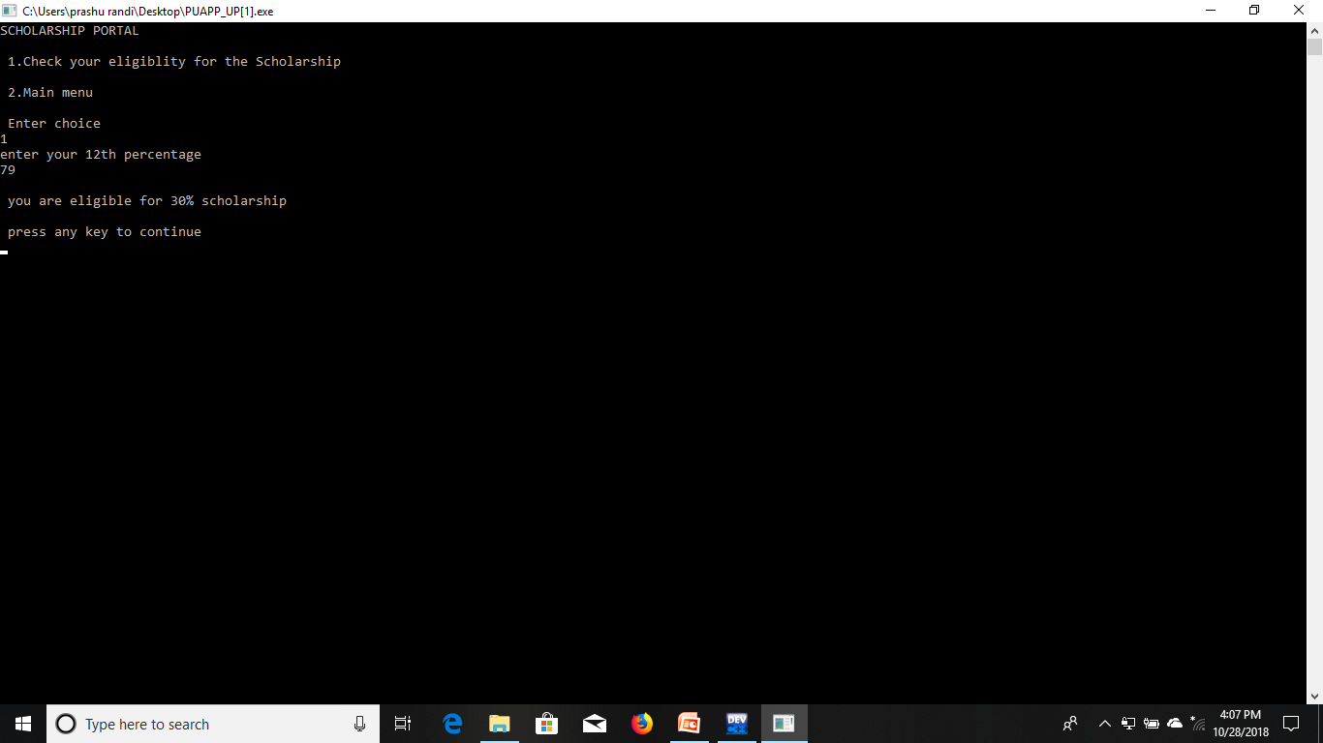

Slide 19
PASSWORD CHANGE
This is a private module for the developer who will use
this functionality for changing password .

Slide 20
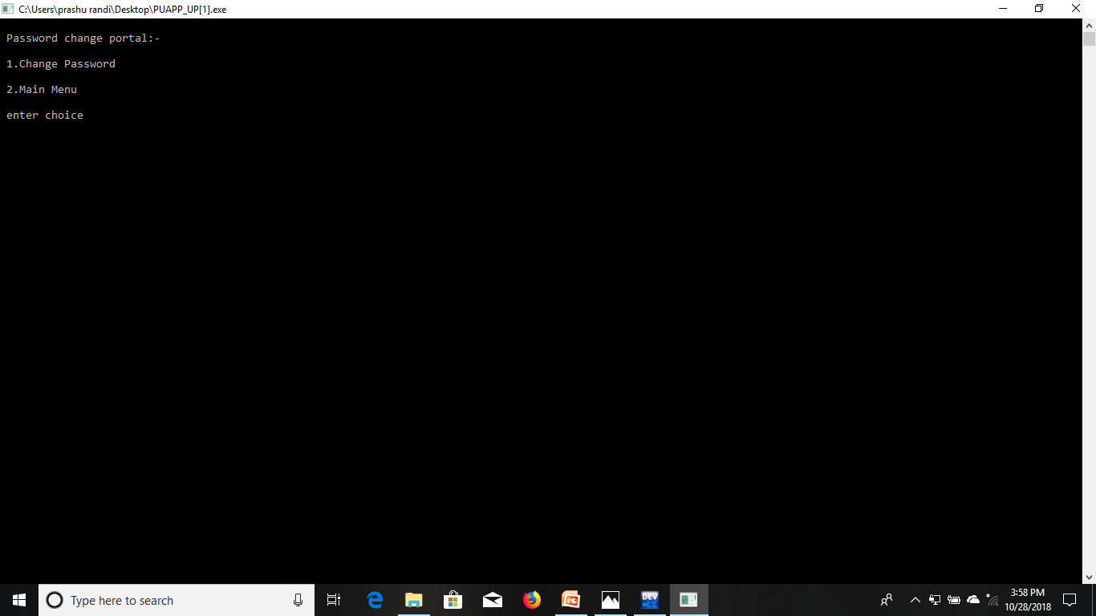

Slide 21
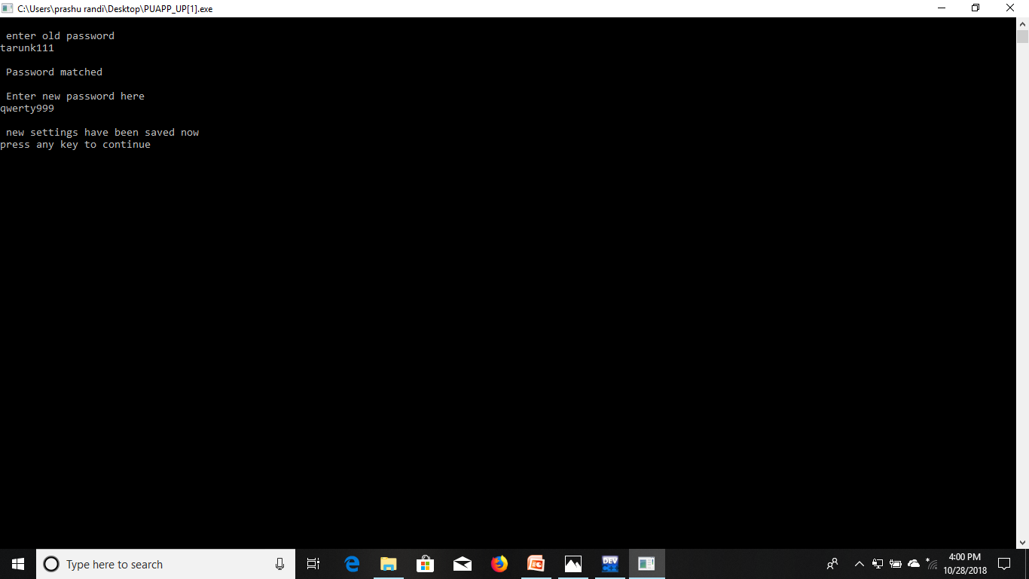

Slide 22
WHY PU ?
This will inform applicants why they should choose PU
for their career building and future enhancement.

Slide 23


Slide 24


Slide 25
LIBRARY MANAGEMENT
SYSTEM

Slide 26
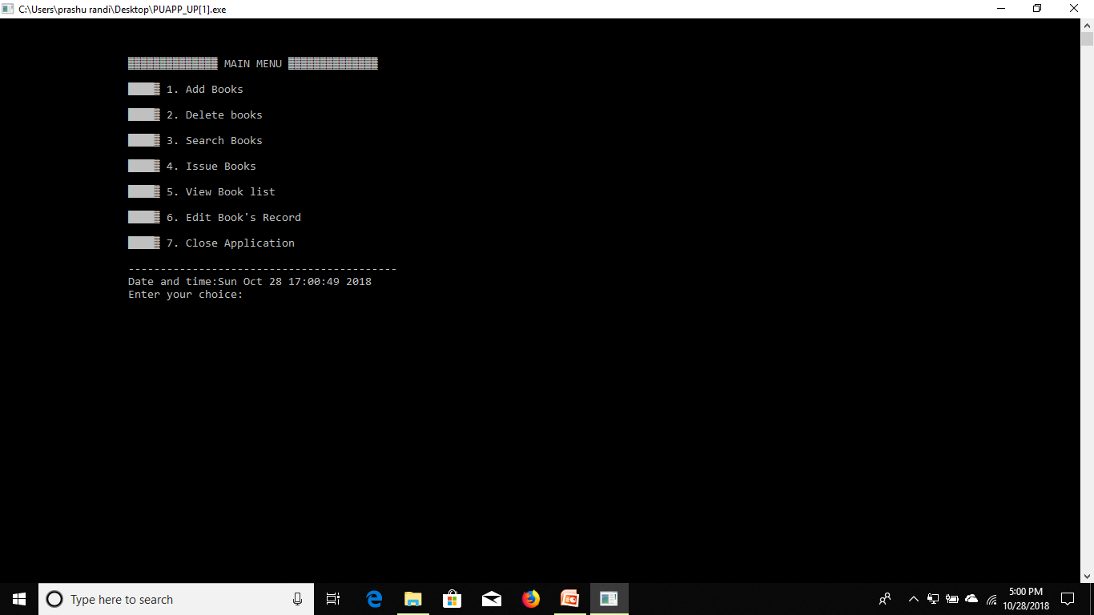

Slide 27
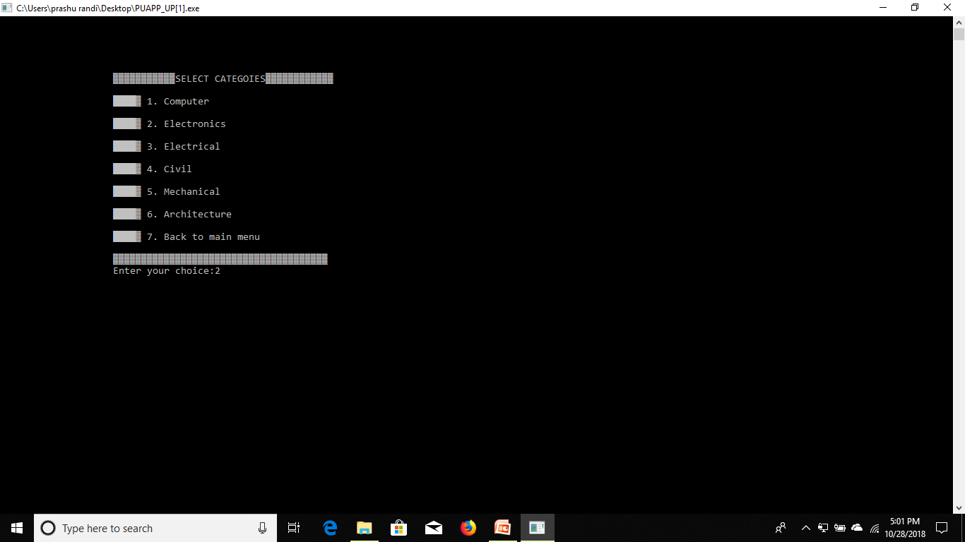

Slide 28
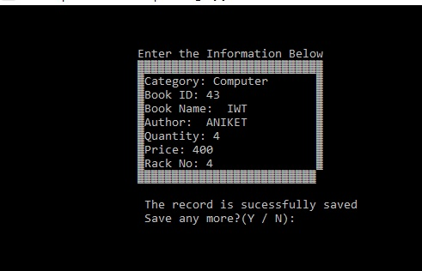

Slide 29
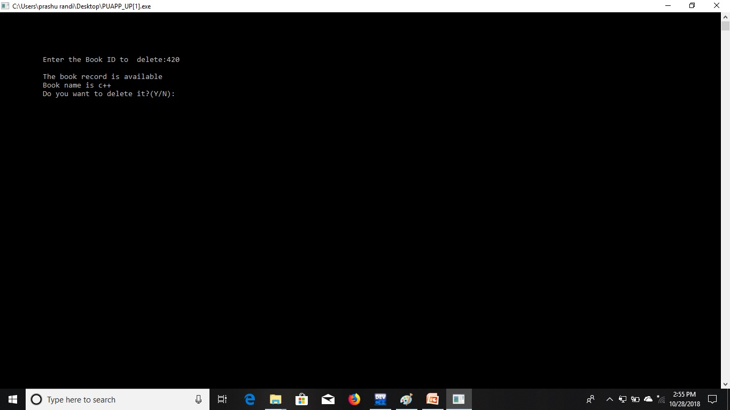

Slide 30
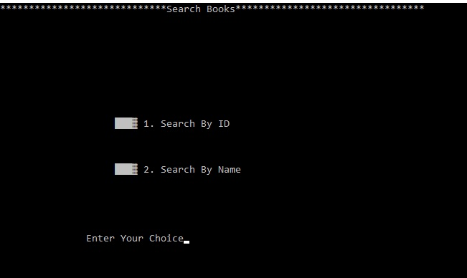

Slide 31
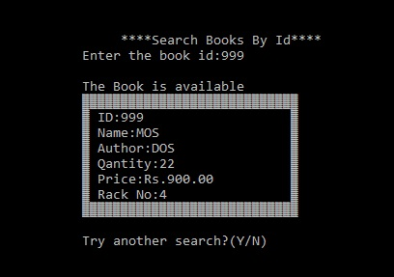

Slide 32
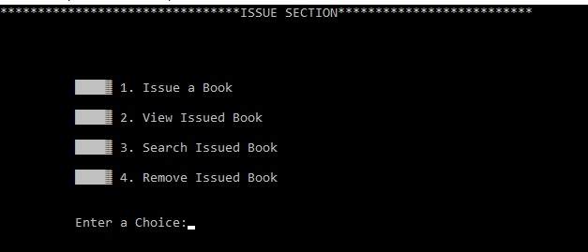

Slide 33
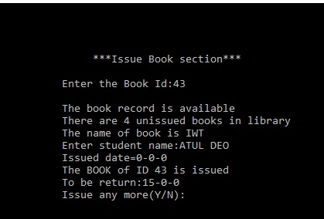

Slide 34
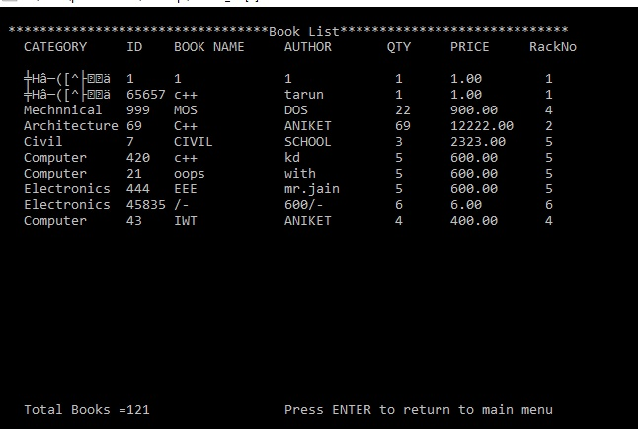

Slide 35
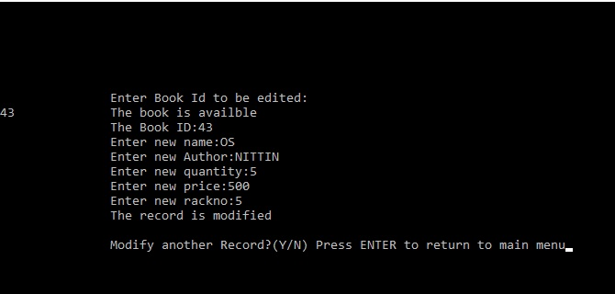

Slide 36
THANK YOU !!!
POORNIMA UNIVESITY
&
I’NURTURE

