Slide 1

Policy Workshop on ICT-based Innovative Industries Case Study

Slide 2
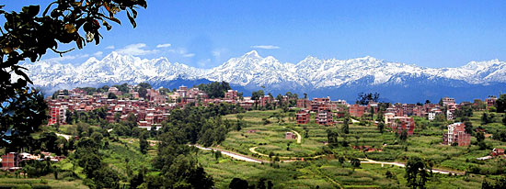
City Profile
Name of City: Dhulikhel
District - Kavre
Province No. - 3
Country – Nepal
Nominated for the Capital City of Province 3
Population - 16,263 (Population Census 2011)
Around 1550m above Sea Level
Situated 30 km South-East of Kathmandu (Capital city)
Popular Tourist destination near the Capital
The only IT Park is situated close to the city

Slide 3
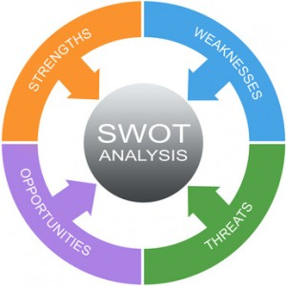
SWOT Analysis Effectiveness of Government ICT Policy
Recently updated IT Policy ( August 2015) Aimed at securing the SD goals and economic growth Focus on e-Governance Relevance in various fields | Lack of adequate IT Infrastructure Lack of enough IT Trained human resources Low effectiveness of proper regulatory and monitoring body Resistance to change
Strength | Weakness
Opportunity | Threat
Bridging the digital divide and quality of education Employment creation opportunities Fast growing telecommunication and ubiquity of mobile devices Access and service to all | Cyber Security, data protection and Privacy Negligence of Intellectual Property Rights Brain drain related to ICT Misuse of technology

Slide 4

National/Local plan in ICT innovation and development for industries
e-Government Master Plan (eGMP) 2015
Shaping of the progressive e-Governance strategy based on lessons from previous e-Governance initiatives
Concept of speeding up e-Governance implementation nation-wide
Objective of bring public services closer to citizens
Ensure efficiency, transparency, reliability, interoperability and cost saving/affordability
Priority Streams : e‐Agriculture, e‐Education, e‐Health and e‐Tourism
Requirements for successful implementation

Slide 5

Participation of Stakeholders
Ministry of Information and Communication (MOIC)
Develop & expand the information & communication technology sector
National Information and Technology Center (NITC)
Government of Nepal’s central ISP, responsible for e-Governance
High Level Commission for Information Technology (HLCIT)
Organizes Tech events, overseas implementation of National IT Policy and Strategy
Department of Information Technology (DOIT)
Department of MOIC focused on e-Governance
Provide all government services through automated system by maximizing the use of IT
Computer Association of Nepal (CAN)
Helps in development of strategies for development of literacy and skills regarding Computer Science
Organizes CAN Infotech and SoftTech annually
Information technology Society Nepal (ITS- Nepal)
Forum for all ICT related activities aimed at students, youths and entrepreneurs
ICT Association of Nepal
Umbrella organization of ICT Product importers, distributers, dealers and professionals
Raises voice for getting protection of compliance with Government Acts

Slide 6

Indicators and Measures of successful implementation
ICT Initiative of LGCDP / MoFALD for Local Level Units
Official Website for all Local Levels
Technical support through team of ICT Experts
Funds for IT infrastructure development for each local level units
Internet Connectivity / Speed
Recruitment and training of IT Officers in each local level units
Initiation and funding for development of IT tools and software as per the needs of Local Level Units
Piloting of integrated systems for recording, reporting and service delivery processes to implement all over the country
Capacity development for local government staffs regarding IT

Slide 7

ICT-based Innovative Industries
Overall Trends | Good Practices | Challenges | Prospects
ISPs and Data Centers
Software Development Companies
Apps Development
IT Colleges
Offshore Outsourcing
e-Payment
e-Commerce
Online Shopping
Online Ticketing

Slide 8

Thank You

