Slide 1

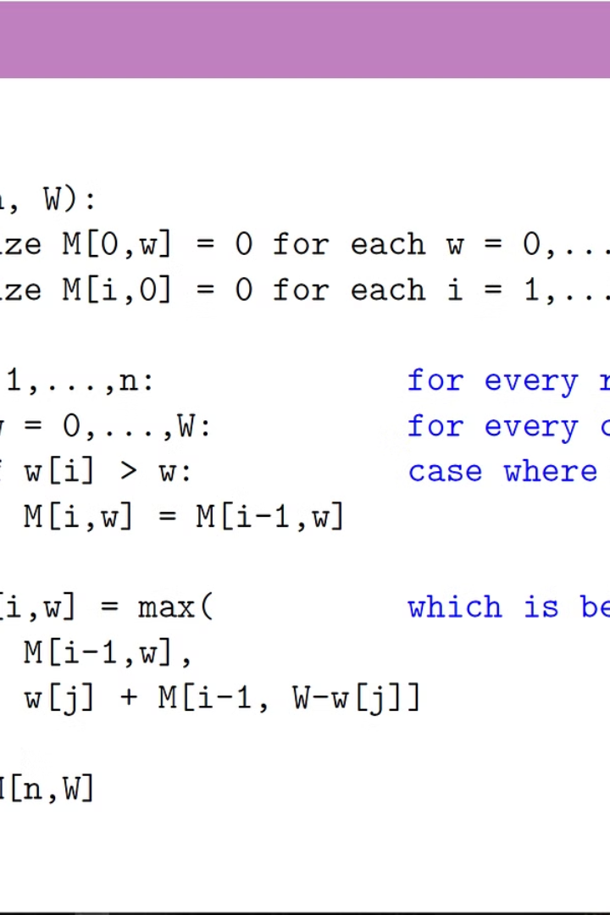


Why Pseudocode is Important
Pseudocode, an informal programming language, improves human comprehension by providing a plain English representation of complex software (geeksforgeeks, 2023).
by Atul Dhital

Slide 2

Flowcharts: A Visual Representation
1
Useful Tool
2
Symbols
3
Program Flow
Flow charts are useful tools that represent the program flow in symbols or visual format.
Flow charts use symbols to connect the technical and non-technical persons to create a program and understand its flow.
Flow charts help to fix issues in a program and monitor its flow, connecting different elements and processes.

Slide 3
Starting the Voting System
1
Step 1: Software Initialization
Start the voting software to initiate the voting process.
2
Step 2: Admin or Voter
Choose between admin and voter to proceed with the voting system.
3
Step 3: Admin Options
If admin is chosen, provide a PIN for validation and access various options like creating voters, candidates, and elections.
4
Step 4: Voter Options
If voter is chosen, authenticate and proceed with options like registering to vote, editing profile, and displaying vote.

Slide 4
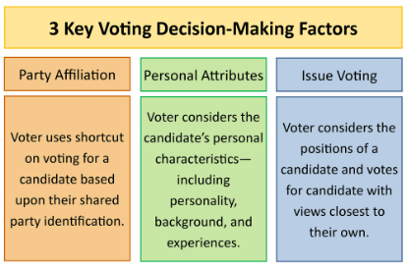
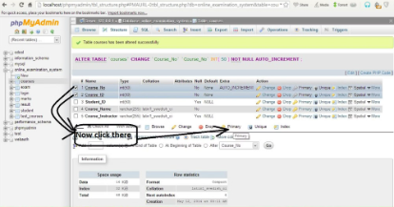
Admin Options in Detail
Create Voter
Create Candidates
Create Election
Admins can create new voter profiles in the system.
Admins have the option to create new candidates for the elections.
Admins can set up new elections within the voting system.

Slide 5



Voter Options in Detail
Register to Vote
Edit Profile
Display Vote
Voters can register to cast their votes in the elections.
Voters have the option to edit their profiles within the voting system.
Voters can view and display their votes within the system.

Slide 6

Importance of Goal Setting
1
Clear Direction
2
Measure Progress
Setting achievable goals provides a clear direction and target to aim for.
Goals help measure progress and keep individuals motivated.
3
SMART Goals
Remember to make goals SMART - Specific, Measurable, Achievable, Relevant, and Time-bound.

Slide 7
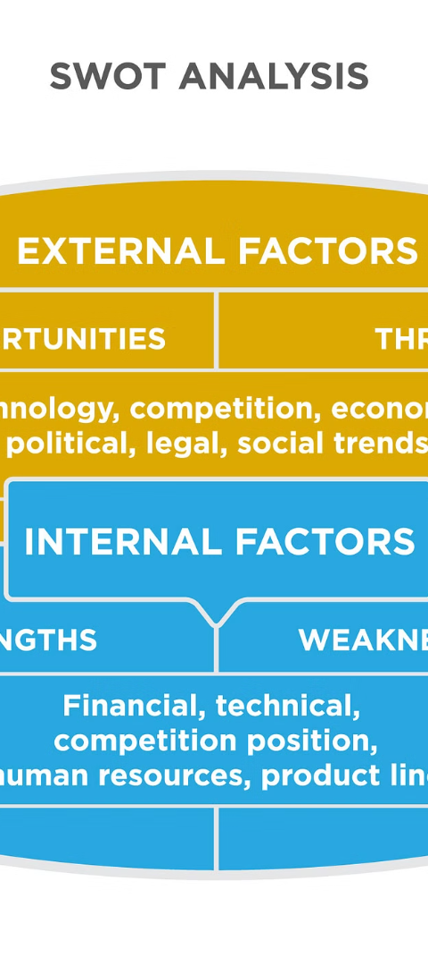
Identifying Strengths
1
First Step
2
Focus on Skills
Identifying strengths is the initial step in leadership development.
Understanding one's natural strengths helps focus on areas where one can excel and contribute the most.
3
Contribution
Identifying strengths is crucial for making valuable contributions.

Slide 8
Tools & Resources for Leadership Development
1
Books & Courses
2
Real-world Experiences
3
Developing Skills
Gathering the right tools and resources includes books, courses, and mentors.
The right resources help in developing the necessary skills for effective leadership.
Practical experiences provide valuable insights for effective leadership development.

