Slide 1
Linux
Ubuntu - Through a DevOps Lens

Slide 2

Just Enough
Linux

Slide 3

Why Linux?
Developer Survey results
2025

Slide 4

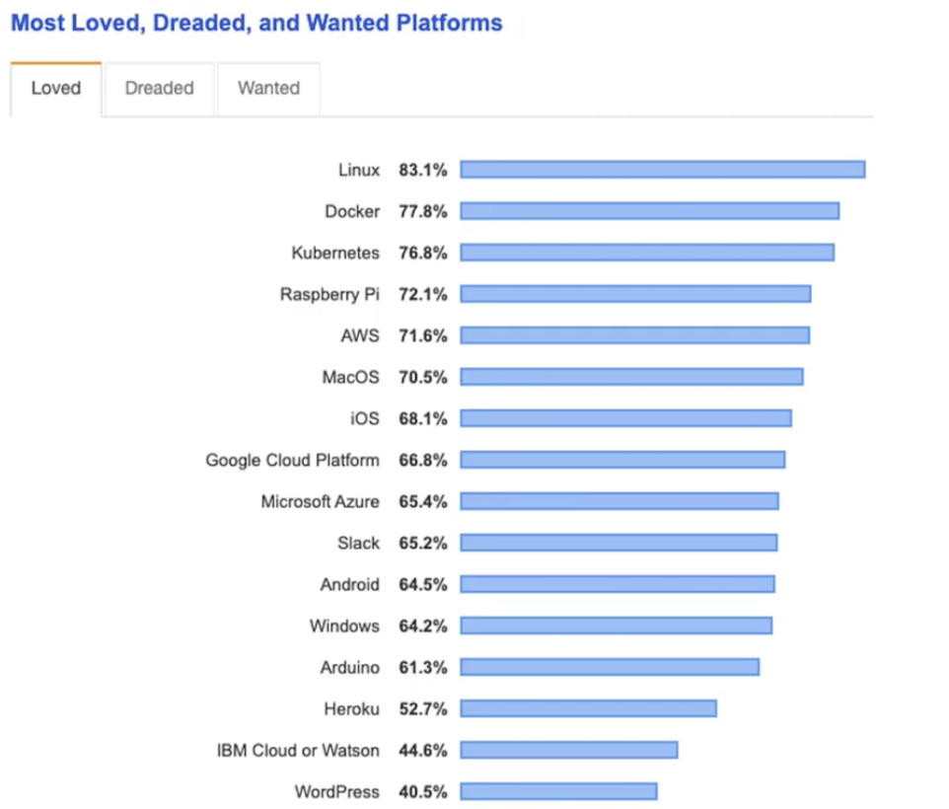
Why Linux?

Slide 5


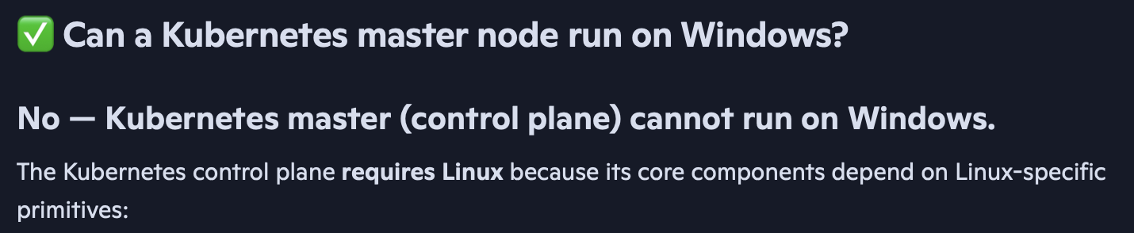

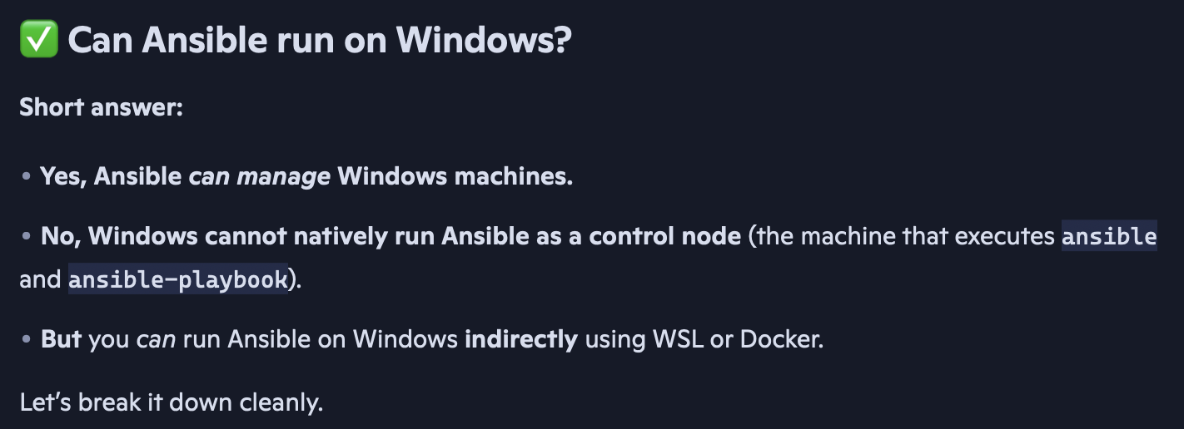
Why Linux?
2013 – Docker was born
2016 – Docker for Windows was born

Slide 6
Linux Principles
● Everything is a file (Including Hardware)
● Small Single purpose Programs
● Ability to chain programs together for complex operations
● Avoid Captive User Interface
● Configuration data stored in text file

Slide 7
Popular Linux distros
Popular Desktop Linux OS
Ubuntu Linux
Linux Mint
Arch Linux
Fedora
Debian
OpenSuse
Popular Server Linux OS
Red Hat Enterprise Linux
Ubuntu Server
Centos
SUSE Enterprise Linux

Slide 8
Most used Linux distros currently in IT industry.
RPM based
RHEL,
Centos,
Oracle Linux
Debian based
Ubuntu Server,
Kali Linux

Slide 9
Linux Basics
Linux CLI
VI Editor
Package management
Service Management

Slide 10
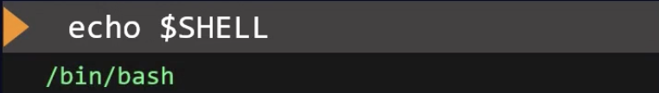
Shell Types
Bourne Shell (sh Shell)
C Shell (csh)
Z Shell (zsh)
Bourne again Shell (bash)

Slide 11
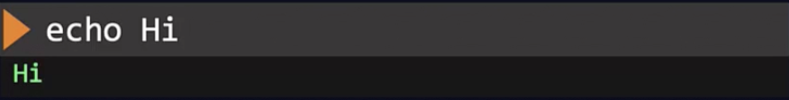
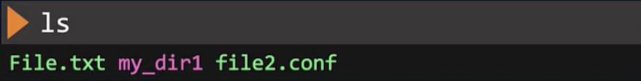
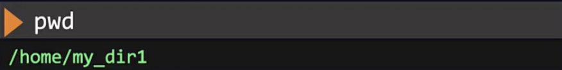

Basic Commands
Print to Screen
Listing the files and directories
Change Directory
Check Present working Directory
Make/Create Directory
Executing multiple commands in one line.

Slide 12
Commands - Directories
/test/Telangana/Hyderabad/Ameerpet/ACS
Make a directory hierarchy
mkdir /test
mkdir /test/Telangana
mkdir /test/Telangana/Hyderabad
mkdir /test/Telangana/Hyderabad/Ameerpet
mkdir /test/Telangana/Hyderabad/Ameerpet/ACS
mkdir –p /test/Telangana/Hyderabad/Ameerpet/ACS
rmdir –r /test/my_dir1
Remove directory
cp –r my_dir1 /test/my_dir2
Copy directory

Slide 13
Commands - Files
Create a new file (no contents)
touch new_file.txt
cat > new_file.txt
Working with Linux
CTRL+D
Add contents to file
cat new_file.txt
Working with Linux
View contents of file
cp new_file.txt copy_file.txt
Copy file
mv new_file.txt sample_move.txt
Move (rename) File
rm new_file.txt
Remove File

Slide 14
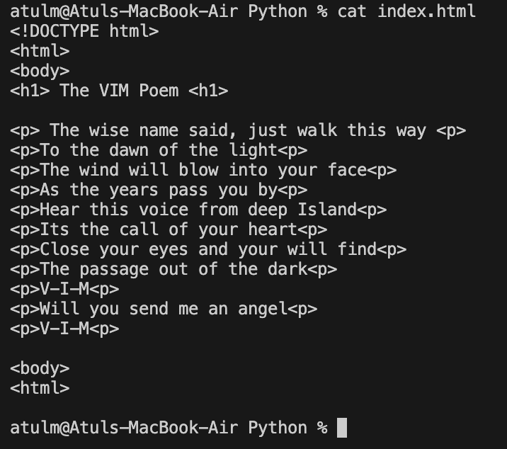
VI Editor
VI - Visual display editor
VIM - Visual display editor improved

Slide 15
Modes
Command Mode
Insert mode (edit mode)
Note: When you open the vi editor, it will be in the command mode by default.

Slide 16
User Accounts
Every user of the system is assigned a unique user ID ( the UID)
Users name and UID are stored in /etc/paswd
Users passwords are stored in /etc/shadow in encrypted form
Users are assigned home directory and a program that is run when they login (usually a shell)
Users cannot read, write or execute each others files without permissions.
TYPE | EXAMPLE | USER ID (ID) | GROUP ID (GID) | HOME DIR | SHELL
ROOT | root | 0 | 0 | /root | /bin/bash
REGULAR | Atul, ubuntu, | 1000 to 60000 | 1000 to 60000 | /home/username | /bin/bash
SERVICE | ftp, ssh, apache | 1 to 999 | 1 to 999 | /var/ftp etc | /sbin/nologin

Slide 17
Passwd file
Field Number | Field Name | Value | Meaning
1 | Username | ubuntu | The login name of the user
2 | Password Placeholder | x | Indicates password is stored securely in /etc/shadow
3 | UID (User ID) | 1000 | Unique ID for the user; first normal user gets UID 1000
4 | GID (Group ID) | 1000 | Primary group ID for this user
5 | GECOS (User Info) | Ubuntu | Comment field; usually full name or description
6 | Home Directory | /home/ubuntu | User’s personal directory
7 | Login Shell | /bin/bash | Default shell started when user logs in

Slide 18
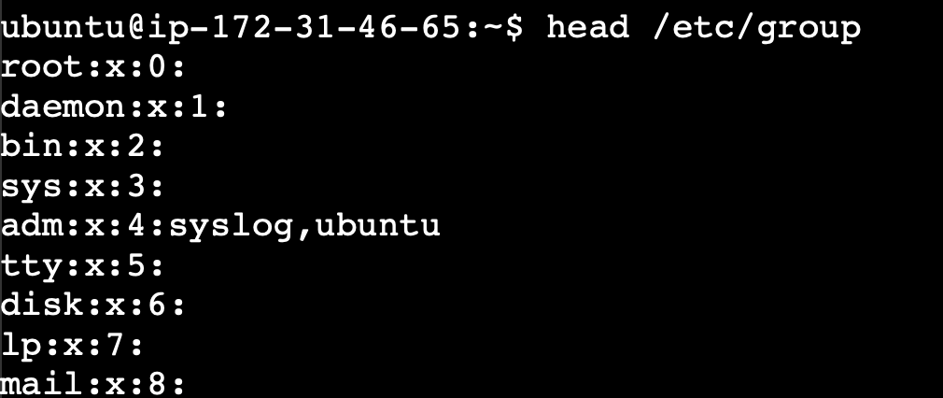
Group file
Group name, group password, GID, group members

Slide 19
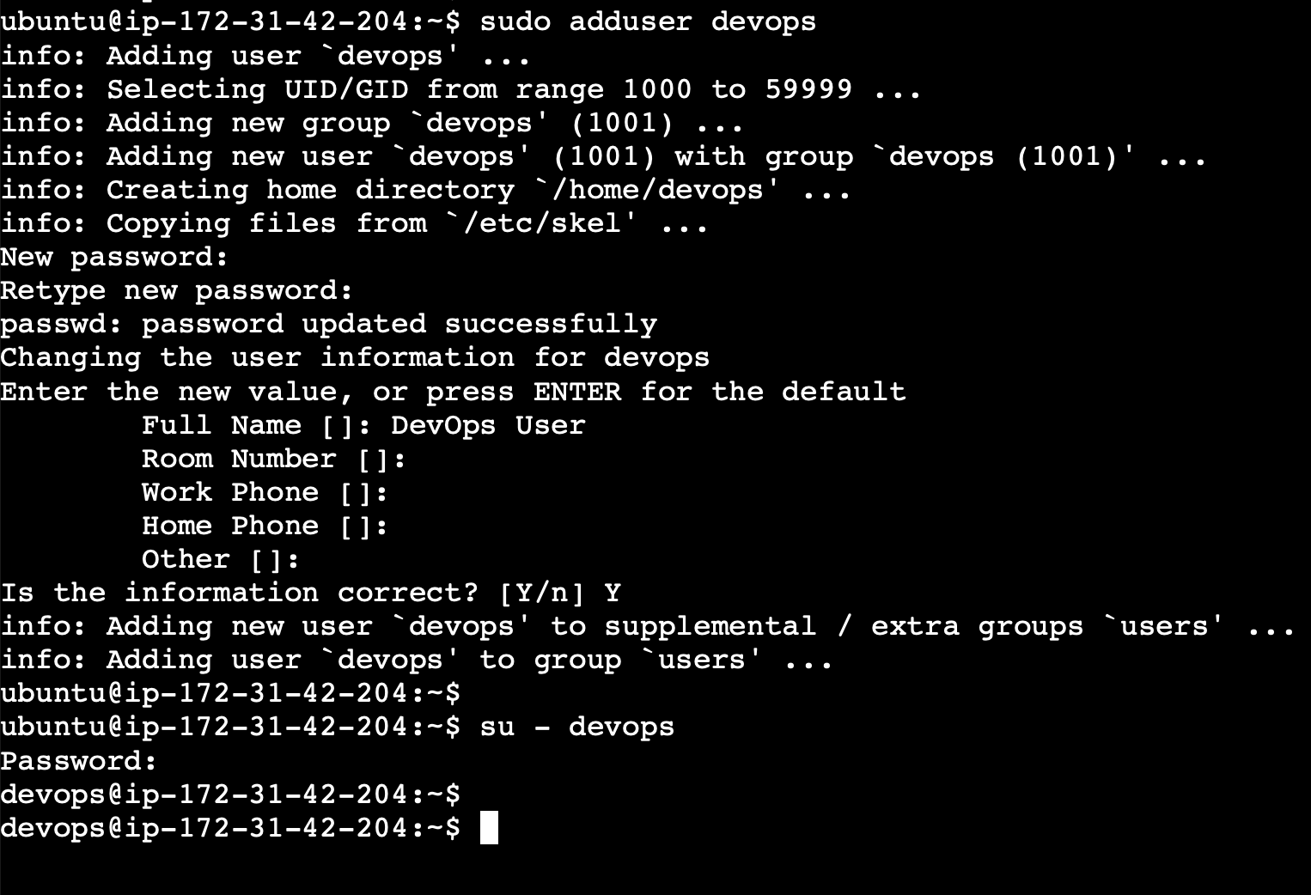
ADD USER, SET PASSWORD & SWITCH TO USER
Notes:
sudo useradd -m -s /bin/bash atul
sudo passwd atul
su - atul
-------------- sudo adduser atul
Adding user `atul' ...
Creating home directory `/home/atul' ...
Copying files from `/etc/skel' ...
New password:
Retype new password:
sudo usermod -aG sudo atul
----------------
ls -ld /home/atul

Slide 20
ADD USER, GROUP & USER INTO GROUP

Slide 21
Commands | Description
useradd | Creates user in RedHat
adduser | Creates user in ubuntu
id | shows user info
groupadd | Creates group
usermod –G grpname username | Adds user to a group
passwd | set/reset password
userdel –r | removes user with home-directory
groupdel | removes group
last | shows last login in system
who | who is logged in to a system
whoami | username
lsof –u user | list files opened by user

Slide 22
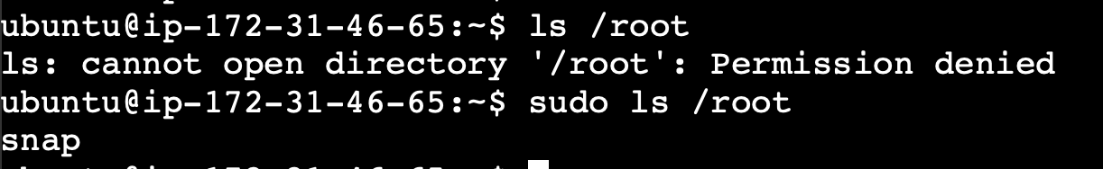
Sudo
sudo gives power to a normal user to execute commands which is owned by root user.
/etc/sudoers
Elevated privileges – same as root/superuser
User must be part of /etc/sudoers list

Slide 23
Download Files
curl https://www.some-site.com/some-file.txt -o
wget https://www.some-site.com/some-file.txt -o some-file.txt
-o to save the file otherwise file will be printed on the screen.

Slide 24
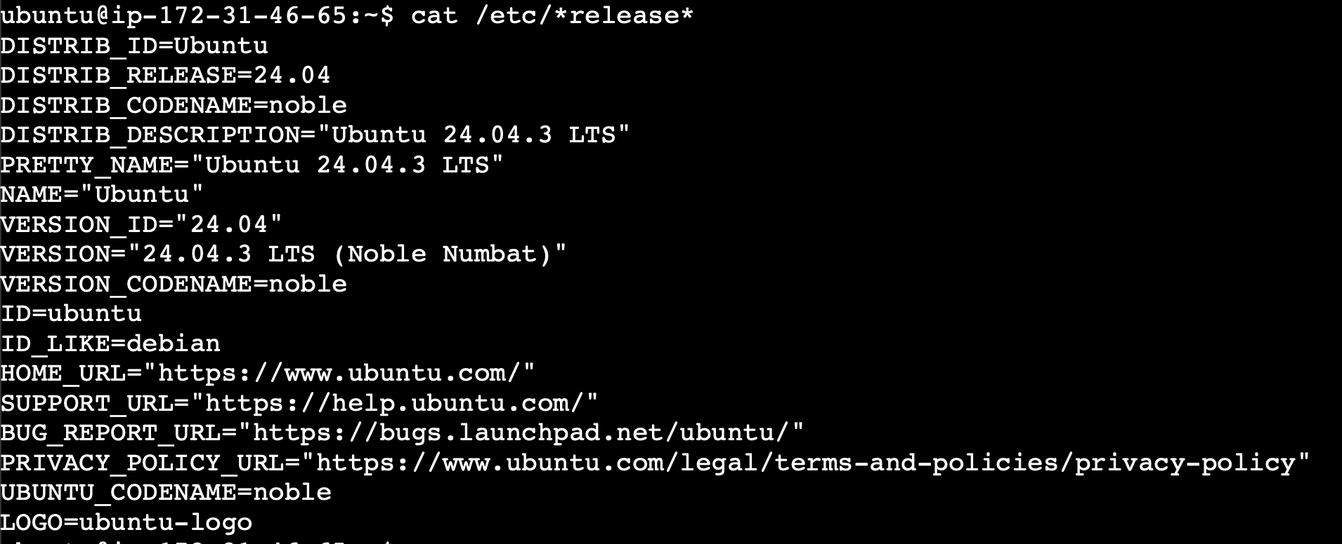
Check OS version
ls /etc/*release*
cat /etc/*release*

Slide 25
The Role of Package Managers
Easy Software Management
Package managers help you install, update, and remove software on Linux easily, making things faster and simpler.
Handles Software Needs Automatically
They take care of all the extra software your programs need, so nothing breaks or goes missing.
Keeps Your System Safe and Easy to Manage
Using one tool to manage everything makes your system safer and saves you time compared to doing it all by hand.
Notes:
Image source: Microsoft 365 content library Package managers in Linux distributions streamline software installation, updates, and removal, ensuring system stability. They resolve software dependencies automatically, preventing conflicts and missing libraries. By centralizing management, package managers enhance security, simplify maintenance, and save users significant time compared to manual software handling.

Slide 26
RPM (RedHat Package Manager)
rpm -i some-package.rpm
rpm –e some-package.rpm
rpm –q some-package.rpm
Install a package
Uninstall package
query package
RPM
telnet.rpm
Dependencies
?
?
?
?
RPM
ansible
Notes:
Package managers help you install various software on the Linux system, and when you go through DevOps
and cloud courses, you will install various software such as web servers, database servers, and DevOps
tools or dependent softwares.
And most of these are installed using package managers.
Centos uses an RPM based package manager just like Red Hat Enterprise Linux or Fedora.
RPM stands for Red Hat Package Manager.
A software is packaged into a bundle with the extension. RPM.
To install the package, use the RPM command and the Dash I option for install and specify the package
name.
To uninstall a package, use the Dash E option and to query the database and get details about an installed
Package use the Dash Q option.
So RPM requires you to point it to the exact location where the RPM package is available.
You then install that package on the system.
It does not care about any dependencies that this package may have.
For example, say you were installing another software like Ansible and it requires a Python and other
dependent software.
So simply installing Ansible with the RPM command would not take care of installing Python and other
dependent libraries if they are not already installed.
And that's why you need a solution that can make these easy for you.
A single command that can query the package, find its location, and install all dependencies as well
as the package itself.
That's where package managers like yum come into play.

Slide 27
YUM (Yellowdog Updater, Modified)
YUM is a package manager used in RHEL-based Linux distributions (CentOS, Red Hat, Oracle Linux, Amazon Linux).
High-level package manager and uses RPM underneath
Key Functions
Install packages with automatic dependency resolution
Update system packages to latest versions
Remove unwanted packages cleanly
Search for available software
Manage repositories (enable/disable/add repos)
Handle dependencies without manual intervention.
Notes:
Yum searches software repositories that act as warehouses containing hundreds and thousands of RPM package files.
These repositories can be local that is installed on your laptop, for example, or on a remote location, either a secure server in your enterprise or available publicly in the internet.
Under the hood, yum still makes use of the RPM Package manager, so when you try to install a package using yum yum searches these repositories, finds the required packages and dependencies, and installs all of them in the right order.
So what is this remote repository and how are packages stored there?
Like how does yum find where a particular package is located?
The information about the repository in a configuration file at path slash Etsy slash yum dot reposed directory. Every operating system comes bundled with its own set of repositories, from which you can install a lot of commonly used software and tools.
So you might not need to edit the list of repositories, but at times the default set of repositories may not have the software you need or may not have the latest version of software that you need to install.
So in that case, you will need to configure additional repositories so that yum can find those packages. Instructions to configure additional repositories are usually made available along with the software itself, and we'll see an example of that.
So to see the list of repositories available on a system, run the yum repolist command.
And here we see that there are a set of CentOS repositories, such as the base and extra repository, as well as MongoDB and MySQL ones.
So listing the files under the Etsy Yum repos directory shows the files where these repositories are configured.
And if you look inside one of these files, you will see the URL of the location where all packages are stored.
Now if you visit this URL, you can see the RPM files that yum will eventually download and install on your local system with the RPM utility.
So that's kind of how yum finds a package in this case, since we are relying on an existing yum repo on a CentOS, it takes us to an older version of Ansible, which happens to be version 2.4.
To see a list of installed or available packages, run the yum list command.
Yum and followed by the package name if you want to search for a particular package. It provides the package name and version, and if it's an installed package or just an available package.
To remove an installed package, run the yum remove command followed by the package name, and to list all available versions of a package, run the yum list command, but this time with the show duplicates option.
To install a specific version of a package, run the yum install command with the package name, followed by a hyphen and the version of the package.

Slide 28
Common YUM commands
Task | Command
Install a Package | yum install httpd
Update System | yum update
Remove Package | yum remove httpd
Search Package | yum search nginx
List installed Packages | yum list installed
Clean Cache | yum clean all

Slide 29
APT (Advanced Package Tool)
APT is the primary package management system used in Debian and its derivatives (Ubuntu, Mint, Kali, etc.).
APT (Command-line frontend)
High-level tool used for:
Installing packages
Updating repositories
Upgrading the system
Removing packages
apt update
apt install nginx
apt upgrade

Slide 30
Continued…
dpkg (Low-level package manager)
Installs or removes .deb files directly
Does NOT handle dependencies automatically
Example: dpkg -i package.deb
APT-GET (Older CLI tool)
Predecessor to apt
Still widely used in scripts
Example: apt-get install apache2

Slide 31
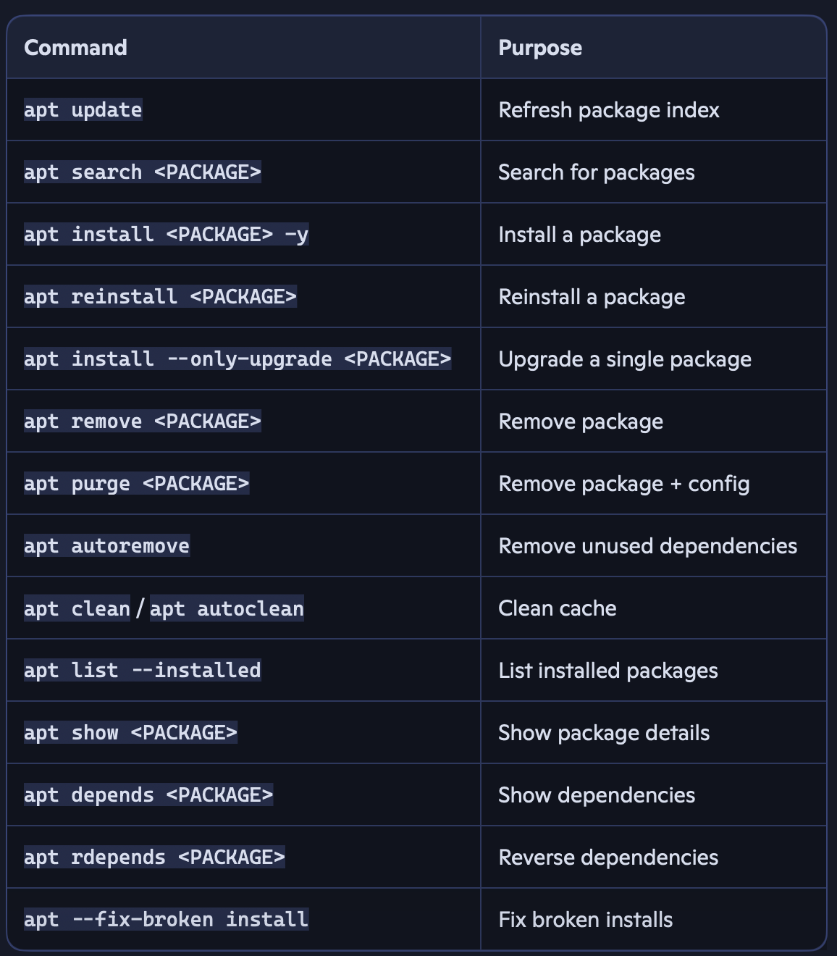
Ubuntu Commands
Notes:
apt update - Refresh package index before doing anything.
apt search <PACKAGE>search for a package before installing it.
apt show <PACKAGE> - Show details before installation.
apt install <PACKAGE> -y - Install the package.
apt list –installed | grep <PACKAGE> - Verify installation.
Apt depends <PACKAGE> - show dependencies.
apt rdepends <PACKAGE> - Show reverse dependencies (who depends on it).
apt reinstall <PACKAGE> Demonstrate reinstalling.
apt install –only-upgrade <PACKAGE> - Show upgrading a single package.
apt remove <PACKAGE> - Remove the package but keep config files.
apt purge <PACKAGE> - Remove package + configuration files.
apt autoremove - Remove unused dependencies.
apt clean / apt autoclean - Clean cached package files.

Slide 32
Service
In Linux, services help manage software to run continuously in the background, ensuring they start automatically during server reboots and follow the proper startup sequence.
When software like web servers, database servers, or DevOps tools such as Docker are installed, they are typically set up as services on the system by default.
The modern way to start a service is by using the system kernel command, specifically the systemctl command, followed by the service name.
On current systems, the SERVICE command functions as a wrapper around systemctl.

Slide 33
Services
sudo service httpd start
Start httpd service (old)
sudo systemctl start httpd
Start httpd service (new)
sudo systemctl stop httpd
stop httpd service
sudo systemctl status httpd
check httpd service status
sudo systemctl enable httpd
Configure httpd to start at startup
sudo systemctl disable httpd
Configure httpd to not start at startup
Note: httpd in this example is an Apache web server.
Notes:
Once you install a software on servers, especially those that run in the background, such as web servers
or database servers, you would need to make sure that those servers or services are running and that
they stay running even after the servers are rebooted.
And also you want to make sure that these servers are started in the right order, especially if there
are multiple services available on the server and if they are kind of dependent on each other, you
want to make sure that they all kind of start in the right order.
So services in Linux help you configure software to run in the background and make sure that they run
all the time automatically when servers are rebooted as well as they follow the right order of startup.
When any software that runs as a service in the background is installed, such as a web server or database
server or DevOps tools like Docker, they are automatically configured as a service on the system.
To start that service, you run the service, start command and providing the service name, which happens
to be in this case http ID.
So HTTP in this example is an Apache web server.

Slide 34
how do you configure a program or software as a service?
etc/systemd/system
Creating a systemd unit file
Defining how your application starts, stops, restarts
Defining environment variables, working directory, user, logs
Placing the service file in the correct directory
Reloading systemd so it recognizes your service
#This is the core of “configuring a service.”
Notes:
the systemctl command line utility is used to manage the system services, so we
must configure our program as a systemd service.
So how do we do that?

Slide 35
Continued…
creating a systemd unit file
sudo vi /etc/systemd/system/hello-web.service
#Put this inside (adjust paths if your username or directory differs):
[Unit]
Description=Simple Python Hello World Web Service
After=network.target
[Service]
User=ec2-user
WorkingDirectory=/home/ec2-user/hello-web
ExecStart=/home/ec2-user/hello-web/venv/bin/python /home/ec2-user/hello-web/app.py
Restart=always
Environment="PATH=/home/ec2-user/hello-web/venv/bin"
Environment="PYTHONUNBUFFERED=1"
[Install]
WantedBy=multi-user.target
etc/systemd/system

Slide 36
Continued….
#4. Reload systemd and start the service
sudo systemctl daemon-reload
sudo systemctl start hello-web
sudo systemctl status hello-web
If status shows active (running), you’re good.
Enable it at boot:
sudo systemctl enable hello-web

