Slide 1

“ What is Continuous Integration? ”

Slide 2

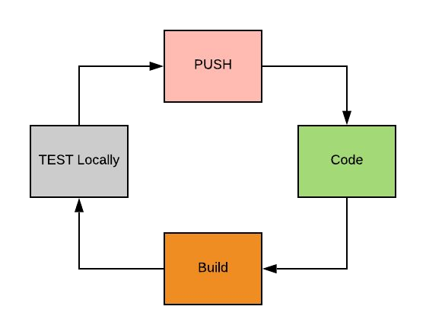
Code, Build, Test & Push

Slide 3
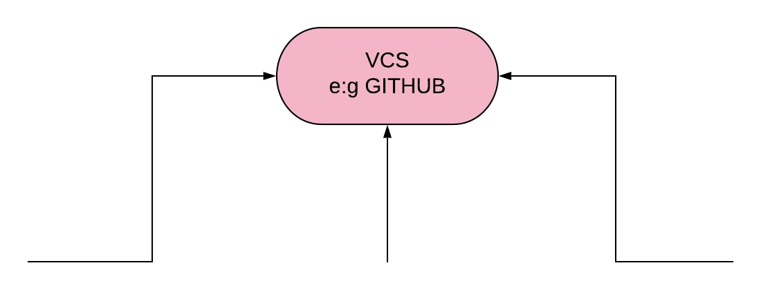
Code, Build, Test S Push

Slide 4

Merged But Not Integrated
Developers keep merging code to VCS several times in a day. All the code collected from diﬀerent developers would have generated conﬂicts and bugs.
Code Merged from a long time when built throws Conﬂict, Bugs and errors.
All these conﬂict, bugs s errors need to be resolved, which takes a very long time and halts development.

Slide 5
Integration is Painful
“
”

Slide 6

Solution
Build code from VCS after every commit.
CONTINUOUS INTEGRATION.

Slide 7
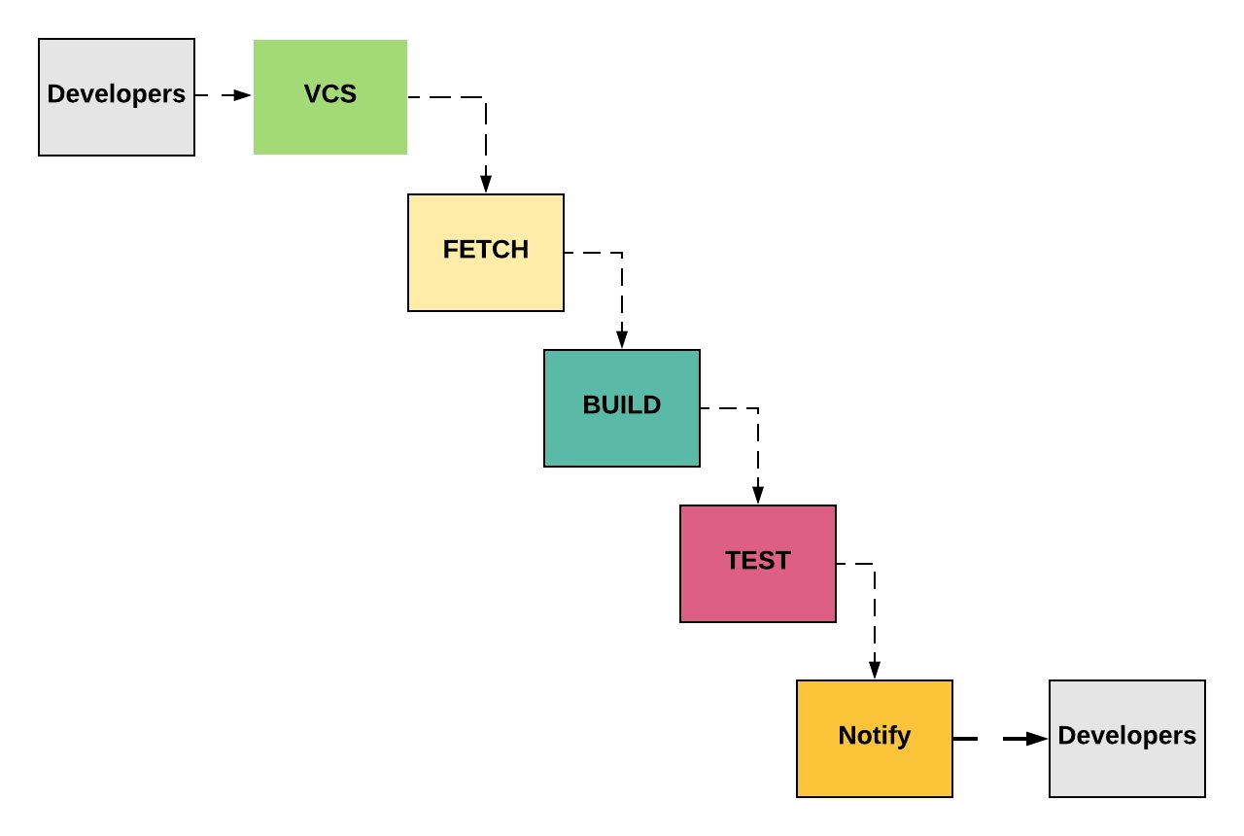
Continuous Integration Process

Slide 8
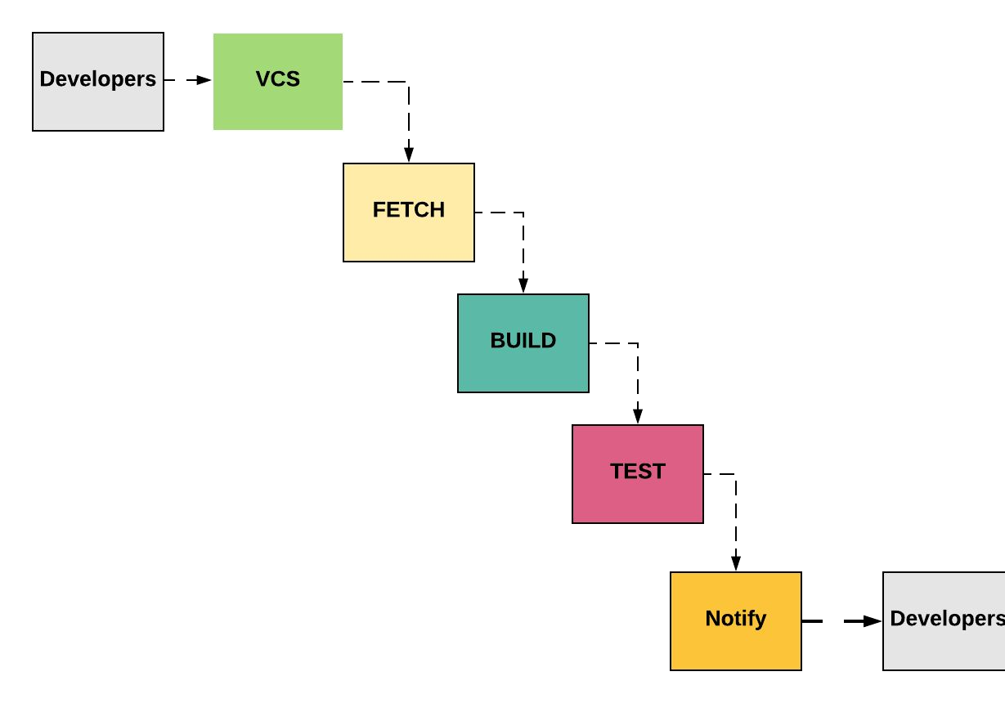
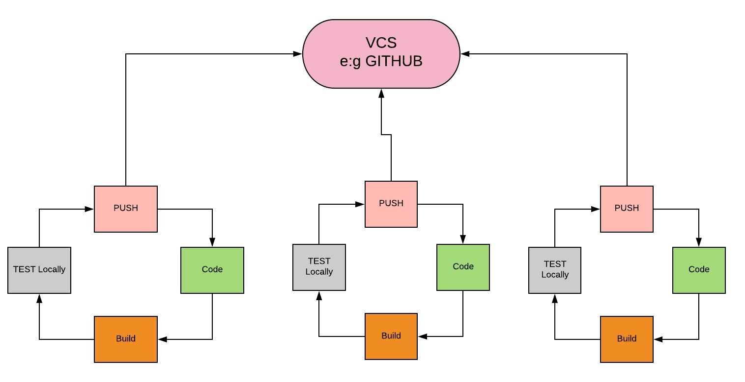

Slide 9
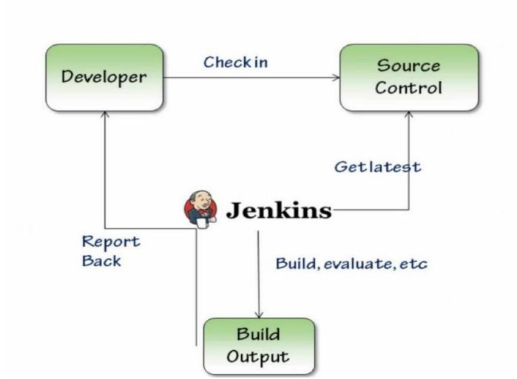
CI with Jenkins

Slide 10
Jenkins Features
OpenSource
Extensible Plugins:
VCS Plugin
Build Plugin
Cloud Plugin
Testing Plugin
Etc etc etc
OpenSource

Slide 11
Jenkins Installation
Prerequisite
Java- JRE, JDK
Any OS

Slide 12
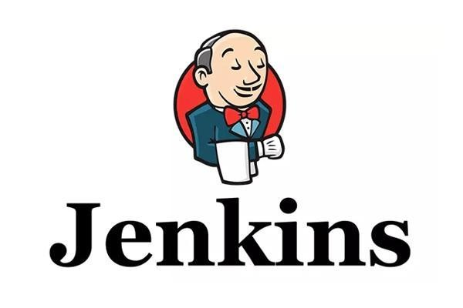
Pipeline As Code
Jenkinsfile declares stages in Pipeline

Slide 13
Introduction
Automate pipeline setup with Jenkinsfile
Jenkinsfile defines Stages in CI/CD Pipeline
Jenkinsfile is a text file with Pipeline DSL Syntax
Similar to groovy
Two Syntax
Scripted
Declarative

Slide 14
Pipeline Concepts
★ Pipeline
★ Agent
★ Stage
★ Step

Slide 15
pipeline { agent any stages {
stage('Build') { steps {
//
}
}
stage('Test') { steps {
//
}
}
stage('Deploy') { steps {
//
}
}}}

Slide 16
pipeline {
..
…
…..
}

Slide 17
pipeline {
agent {
}
tools {
}
environment {
}
stages {
}
}

Slide 18
pipeline {
agent {
label "master"
}
tools {
maven "Maven"
}
}

Slide 19
pipeline {
environment {
NEXUS_VERSION = "nexus3" NEXUS_PROTOCOL = "http"
NEXUS_URL = "you-ip-addr-here:8081" NEXUS_REPOSITORY = "maven-nexus-repo" NEXUS_CREDENTIAL_ID = "nexus-user-credentials" ARTVERSION = "${env.BUILD_ID}"
TIME = “${BUILD_TIMESTAMP}”
}
}

Slide 20
pipeline {
stages {
stage("Clone code from VCS") {
}
stage("Maven Build") {
}
stage("Publish to Nexus Repository Manager") {
}
}
}

Slide 21
pipeline {
stages {
stage("Clone code from VCS") { steps {
}
post {
}
}
}

Slide 22
pipeline {
stage('BuildAndTest'){ steps {
sh 'mvn install'
}
post {
success {
echo 'Now Archiving...'
archiveArtifacts artifacts: '**/target/*.war'
}
}
}

Slide 23

Everything Needs Automation
PIPELINE AS A CODE

Slide 24
Code Analysis
Detects Vulnerability and functional errors

Slide 25
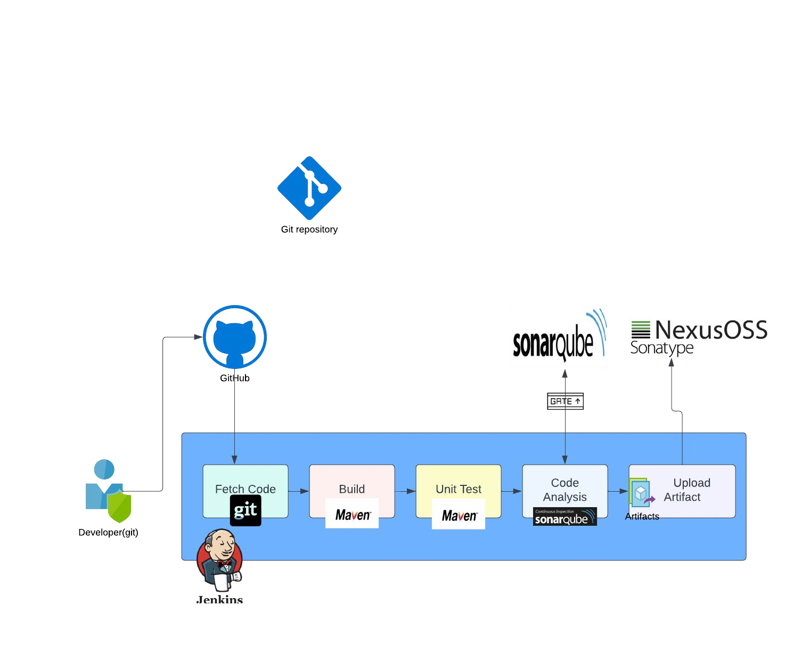

Slide 26
Why Code Analysis?
Best Practices
Vulnerabilities in code
Functional Errors before deployment
Variety of test performed on the CODE.

Slide 27

Tools
Checkstyle
Cobertura
mstest
.
owasp
SonarQube Scanner
Etc etc etc ….

Slide 28
Software Repositories
Storage location for software packages

Slide 30

Your own Repo for Softwares/Packages
Maven
Maven dependencies
apt
Packages for debian based systems.
yum
Packages for RedHat based systems.
nuget
package manager for .NET.
Npm
package manager for JavaScript
Docker
Registry to store Docker Images

Slide 31

Nexus Software Repository Manager.
Key Points
Runs on java
Used to store artifacts
Used as a Package manager for dependencies
Opensource & Enterprise Versions
Supports Variety of repo like maven,apt,docker, Ruby gems etc etc

Slide 32
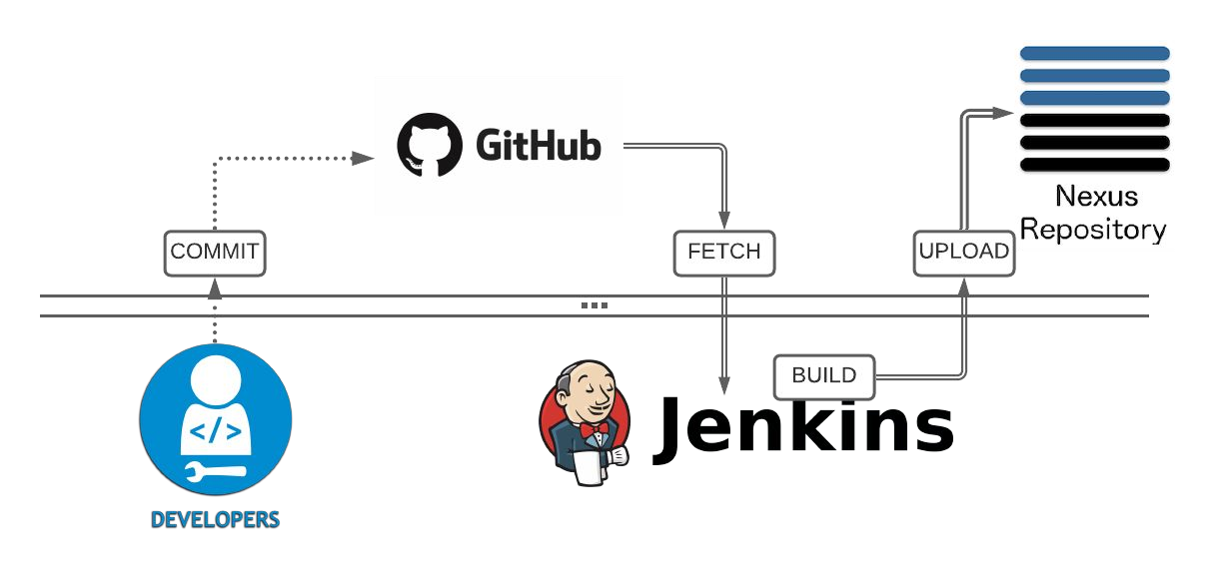
Jenkins Integration with Nexus

Slide 33
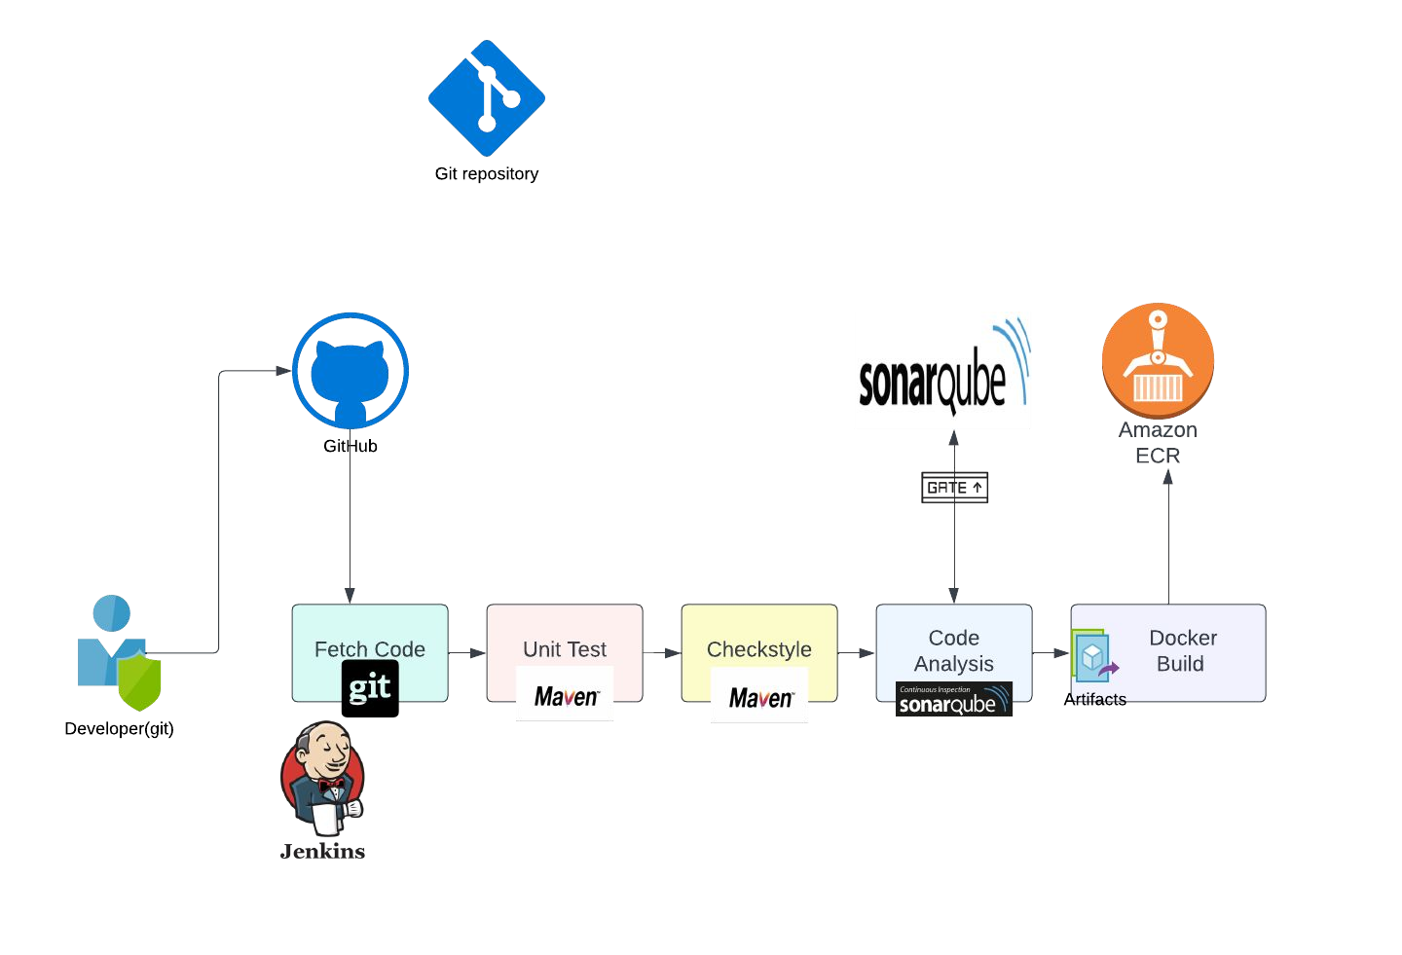

Slide 34
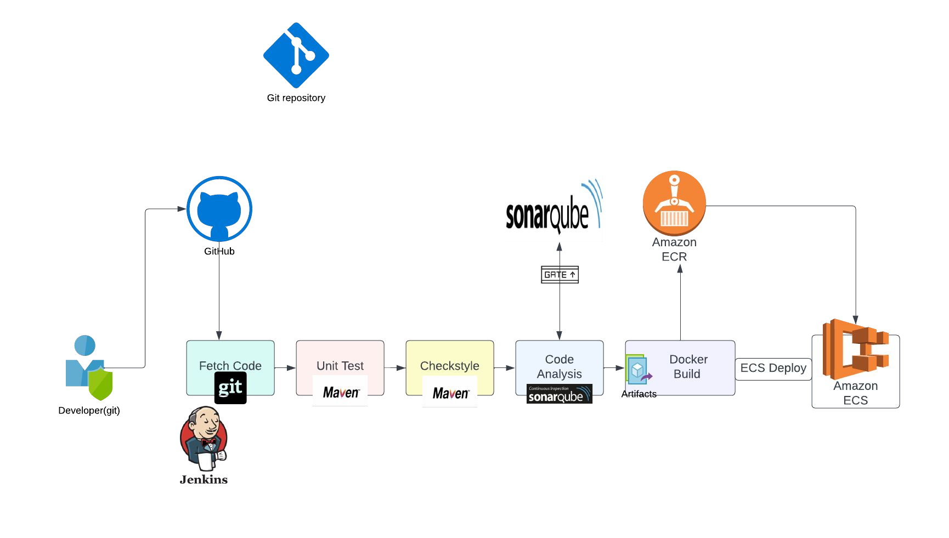

Slide 35

Jenkins Master/Slave
Distributed Builds, Cross Platform builds and much more

Slide 36
Use Cases
Load Distribution
Jenkins Master Executes Build Job on Node it selected.
Cross Platform Builds Executing Build of other platforms like
.net(Windows), IOS(Mac OS)
from Jenkins Master(Linux)
Software Testing
Execute Testers Test Automation Scripts from Node.

Slide 37
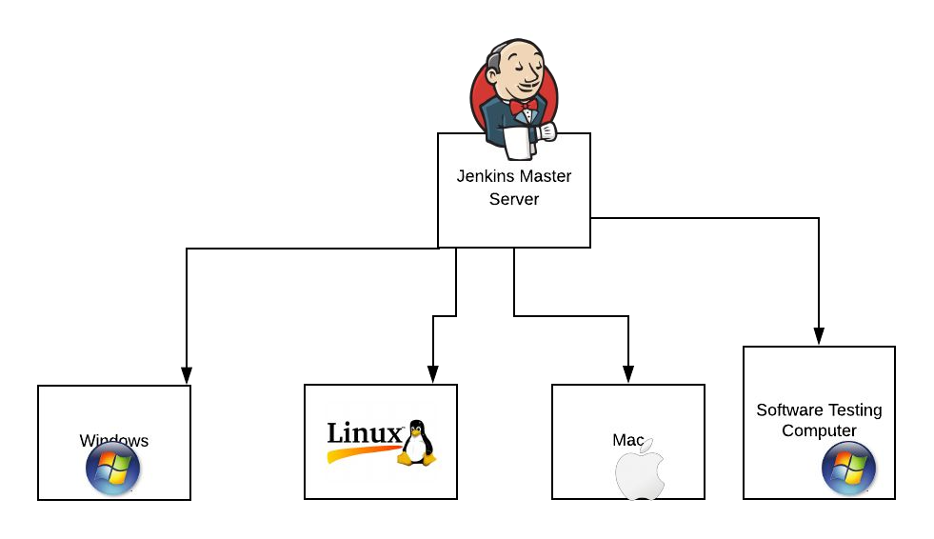
Jenkins Master/Slave

Slide 38

Execute Anything
Can add any computer in network as Jenkins Node and execute commands on Nodes.
e:g scripts, commands, test scripts, etc

Slide 39
Prerequisites for Node Setup
Any OS
Network access from Master
Note: Check Firewall rules
Java, JRE, JDK
User
Directory with User ownership
Tools as required by the Jenkins job e:g Maven, Ant, Git etc

Slide 40
Jenkins Security
user, permissions, roles, jobs permissions

Slide 41
Securing Jenkins
User Login
Jenkins own database.
Sign Up LDAP Integration
Permissions on Jenkins
Permissions on Jobs
Admin
Read
Jobs
Credentials
Plugins etc
View
Build
Delete
Configure
etc
43

Slide 42
Jenkins Tools
Install & Integrate various tools from Jenkins

Slide 43
Jenkins integration with tools
Plugin
Install plugin related to the tool like Git, Ant, Docker, Maven etc
Install Tool in Jenkins for the plugin
Git, Ant, Docker, Maven etc
45

Slide 44

Sonarqube Integration
Code Analysis with SonarQube

Slide 45
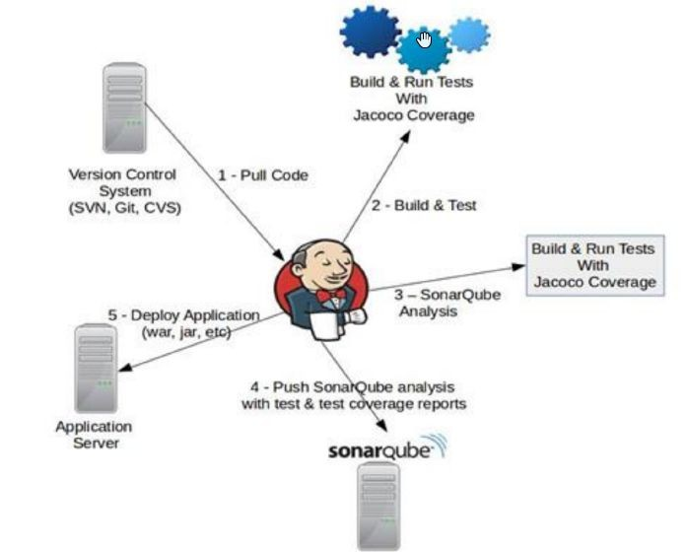
Sonarqube Integration

Slide 46
Sonarqube Installation
Prerequisite
Any OS
JDK
Database like MySQL

Slide 47
Build Triggers
Run Jenkins Job Automatically

Slide 48
Build Job Remotely
Generate Job URL
Generate API Token
Generate CRUMB
Use URL,API Token &CRUMB in Curl URL to execute Job Remotly

Slide 49
Build After a Job
Set as downstream job

Slide 50
Build Periodically
Set Cronjob format schedule
Job can get execute at a specified time
OR Periodically execution like every 15 mins Cron Format
Min Hour DOM Month DOW
Min = 0-59, hour = 0 - 23, DOM = 1-31, Month = 1-12, DOW = 0-7

Slide 51
Poll SCM
Cronjob to POLL SCM like Github
Execute Job when new commit found.

Slide 52
Pipeline As Code
Jenkinsfile declares stages in Pipeline

Slide 53
Benefits
Version control your Pipeline
Use Groovy syntax for setting up logic

Slide 54
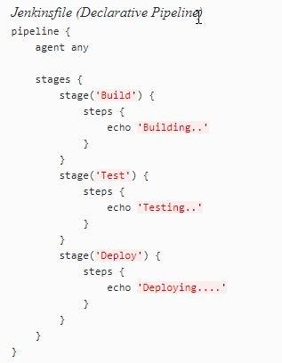
Sample

