Slide 1


What is Ansible ?

Slide 2

History of Automation
Perspective 1. Bash Scripting / Batch Scripting 2. Python/ PERL/ Ruby 3. Powershell 4. Puppet => pull model 5. Salt Stack => pull 6. Chef => pull 7. Ansible => push 8. Terraform Ansible

Slide 3

USE CASES
Change Management
Production Server changes
Provisioning Setup Servers from scratch/ Cloud provisioning
Orchestration Large scale automation framework
Automation
Any System Automation

Slide 4
Ansible is Simple
No Agents Target machines/Services are accessed by SSH, winrm & API No Complex Setup It’s just a Python Library
No Databases YAML, INI & Texts No Residual Software Push Python package Execute Return Output

Slide 5
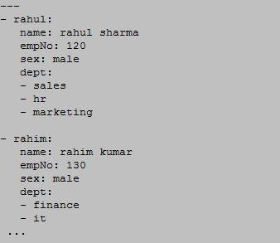
YAML
No Programming Structured
Easy to Read & Write

Slide 6
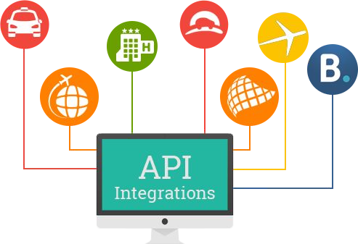
API
URL/Restful Calls(e:g Cloud) Shell Commands
Scripts

Slide 7
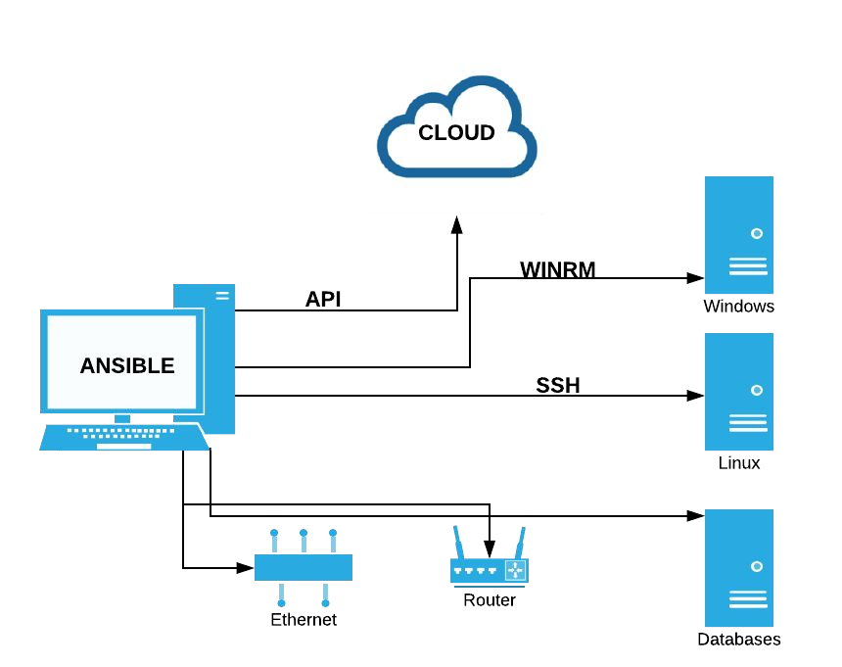
Ansible Connections

Slide 8
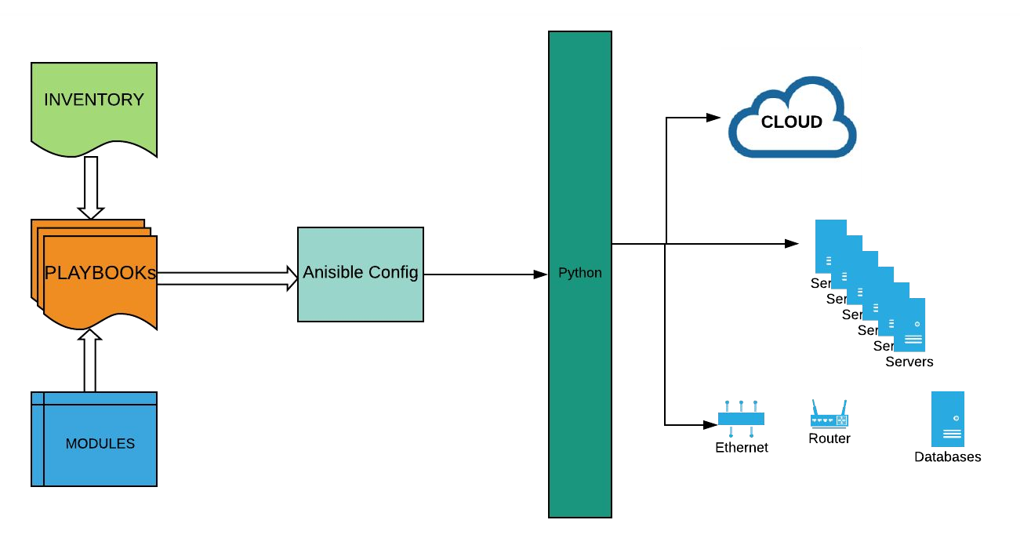
Ansible Architecture

Slide 9

Ansible Power
Can replace almost every or any Automation tool in DevOps or Ops work.

