Slide 1
RAG Retrieval Augmented Generation
Presented by Atul Nandan

Slide 2
Agenda:
1. What is RAG 2. Why RAG is Needed 3. Components of RAG 4. RAG Pipeline 5. Conclusion

Slide 3
What is RAG ?
RAG (Retrieval-Augmented Generation) is an AI technique where a language model retrieves relevant information from an external knowledge source and uses it to generate more accurate and up-to-date response.
Document Loaders
Text
Splitters
RAG
Retrievers
Vector
Databases
RAG = Search relevant data
+ Generate answer using that data.

Slide 4
Why we need RAG ?
Prompt
LLM
Response
Normal Flow

Slide 5
Why we need RAG ?
Prompt
LLM
Response
Normal Flow
What if I ask ChatGPT about our company’s leave policy?

Slide 6
Why we need RAG ?
Prompt
LLM
Response
Normal Flow
What if I ask ChatGPT about our company’s leave policy?
Lack Of Private Data

Slide 7
Why we need RAG ?
Prompt
LLM
Response
Normal Flow
What if I ask ChatGPT about our company’s leave policy?
Lack Of Private Data
Not trained on “Recent Data”

Slide 8
Why we need RAG ?
Prompt
LLM
Response
Normal Flow
What if I ask ChatGPT about our company’s leave policy?
Lack Of Private Data
Not trained on “Recent Data”
Hallucination

Slide 9
Why we need RAG ?
Prompt
LLM
Response
Normal Flow
What if I ask ChatGPT about our company’s leave policy?
Lack Of Private Data
Not trained on “Recent Data”
Hallucination
What is the Solution ?

Slide 10
Fine-Tuning
Fine-tuning is the process of taking a pre-trained AI model and training it further on a smaller and more specific dataset. so, it performs better on a particular task. is the process of taking a pre-trained AI model and training it further on a smaller, specific dataset so it performs better on a particular task.

Slide 11
Fine-Tuning
Fine-tuning is the process of taking a pre-trained AI model and training it further on a smaller and more specific dataset. so, it performs better on a particular task. is the process of taking a pre-trained AI model and training it further on a smaller, specific dataset so it performs better on a particular task.
Imagine a student named Rahul.
Rahul studied many subjects in college like:
Mathematics
Physics
English
Software Development
So Rahul already has general knowledge and skills.
Rahul gets placed in a company called XYZ.
Even though Rahul is educated, the company still gives him 2–3 months of training.
During this training he learns:
how the company’s system works
how to work in a team
company coding standards
project workflow
tools used in the company
After training:
Rahul performs better in XYZ company projects
He understands specific company requirements

Slide 12
Fine-Tuning
Fine-tuning is the process of taking a pre-trained AI model and training it further on a smaller and more specific dataset. so, it performs better on a particular task. is the process of taking a pre-trained AI model and training it further on a smaller, specific dataset so it performs better on a particular task.
Example:
Mathematics
Physics
The pre-trained model = Rahul's college education
The company training program = Fine-tuning
The company's work style and projects = specialized dataset
Rahul
Software Development
English

Slide 13
Question: Is Fine-Tuning Enough?

Slide 14
Question: Is Fine-Tuning Enough?
No, fine-tuning alone is often not enough for many modern AI applications.

Slide 15
Question: Is Fine-Tuning Enough?
No, fine-tuning alone is often not enough for many modern AI applications.
Imagine you fine-tune a model on data from 2023.
Now in 2025:
New technologies appear
Company data changes
New facts are available
But, The model still gives old answers because it cannot access updated information
The Reason is :
1. Knowledge Becomes Outdated

Slide 16
Question: Is Fine-Tuning Enough?
No, fine-tuning alone is often not enough for many modern AI applications.
The Reason is :
Knowledge Becomes Outdated
Retraining Is Expensive
Difficult to Use Large or Dynamic Data
A company updates its policies every month.
With fine-tuning:
You must retrain the model every time
This increases cost and effort
So, it is ideally not good for the companies who gets updated time to time.

Slide 17
Question: Is Fine-Tuning Enough?
No, fine-tuning alone is often not enough for many modern AI applications.
The Reason is :
Knowledge Becomes Outdated
Retraining Is Expensive
Difficult to Use Large or Dynamic Data
Basically it means that, Organizations may have:
thousands of documents
large databases
So, Fine-tuning on all this data will slow the system andit will be inefficient

Slide 18
Question: Is Fine-Tuning Enough?
No, fine-tuning alone is often not enough for many modern AI applications.
The Reason is :
Knowledge Becomes Outdated
Retraining Is Expensive
Difficult to Use Large or Dynamic Data
Because of these limitations, developers use a technique called “In-Context Learning”.

Slide 19
Question: Is Fine-Tuning Enough?
No, fine-tuning alone is often not enough for many modern AI applications.
The Reason is :
Knowledge Becomes Outdated
Retraining Is Expensive
Difficult to Use Large or Dynamic Data
Because of these limitations, developers use a technique called “In-Context Learning”.
In-Context Learning is a core capability of Large Language Models (LLMs) like GPT-3/4, Claude, and Llama, where the model learns to solve a task purely by seeing examples in the prompt.

Slide 20
Example of In-Context Learning : Few-Shot Prompting
Few-shot prompting is a technique where we provide a small number of examples in the prompt to help the AI model understand how to perform a task.
Instead of training the model again, we guide it using a few sample inputs and outputs.
The simple definition to understand few-shot prompting is
Instead of training the AI again, we simply:
give 2–3 examples
and the AI understands by itself what to do and how to do
In Simple Words
It’s like telling someone:
“Look at these examples and do the same thing.”
The AI sees the pattern and follows it. Lets understand it with an example:

Slide 21
Example of In-Context Learning : Few-Shot Prompting
Few-shot prompting is a technique where we provide a small number of examples in the prompt to help the AI model understand how to perform a task.
Instead of training the model again, we guide it using a few sample inputs and outputs.
Suppose we want the AI to classify text as Positive or Negative. Prompt can be:
Text: I love this product.
Sentiment: Positive
Text: This movie was terrible.
Sentiment: Negative
Text: The service was amazing.
Sentiment:
Output:
Positive

Slide 22
Example of In-Context Learning : Few-Shot Prompting
Few-shot prompting is a technique where we provide a small number of examples in the prompt to help the AI model understand how to perform a task.
Instead of training the model again, we guide it using a few sample inputs and outputs.
Suppose we want the AI to classify text as Positive or Negative. Prompt can be:
Text: I love this product.
Sentiment: Positive
Text: This movie was terrible.
Sentiment: Negative
Text: The service was amazing.
Sentiment:
And that’s how RAG came into the picture
Output:
Positive

Slide 23
What is RAG ?
Query
Prompt
LLM
Response
+
RAG (Retrieval-Augmented Generation) is a way to make a language model Smarter by giving it extra information at the time you ask your query.
Context
RAG = Search relevant data + Generate answer using that data.

Slide 24
Components Of RAG
Document Loaders
Text
Splitters
RAG
So, I hope till now you have understood the need of RAG and a basic overview of RAG, Now I will explain you more about the RAG in depth SO lets start with components of RAG
Retrievers
Vector
Stores

Slide 25
Document Loader
It is responsible for importing data from different sources into the RAG system.
It reads documents such as PDFs, Word files , databases or text files.
It converts these documents into structured format that can be processed further.
.

Slide 26
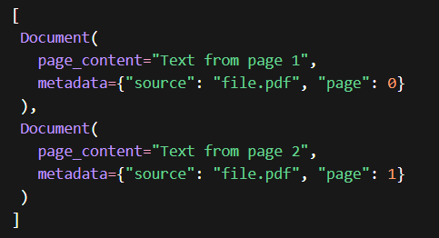
Document Loader
It is responsible for importing data from different sources into the RAG system.
It reads documents such as PDFs, Word files , databases or text files.
It converts these documents into structured format that can be processed further.
.
Document Objects
A Document Object is a structured way to store text data along with its extra information (metadata).
It is the basic unit of data that the system processes.
🧠 Simple Explanation
Instead of storing just plain text, we store:
👉 Text + Information about the text
This combination is called a Document Object.

Slide 27
Document Loader
It is responsible for importing data from different sources into the RAG system.
It reads documents such as PDFs, Word files , databases or text files.
It converts these documents into structured format that can be processed further.
.
Document Objects
Example sources:
TextLoader
PyPDFLoader
WebBaseLoader
CSV loader

Slide 28
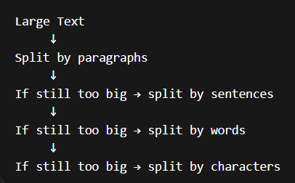
2. Text Splitter
It is very difficult and time taking to process very large documents.
Text Splitting divides documents into smaller chunks.
.

Slide 29
2. Text Splitter
It is very difficult and time taking to process very large documents.
Text Splitting divides documents into smaller chunks.
.
Types :
1. Character Text Splitter
2. Recursive Character Text Splitter
3. Recursive Character Text Splitter Based On Languages

Slide 30
3. Vector Stores
A vector store is a system designed to store and retrieve data represented as numerical vectors.
Typically refers to a lightweight library or service that focuses on storing vectors (embeddings) and performing similarity search.
.
🧠 Simple Explanation
Instead of storing text normally, we convert it into numbers that represent meaning.
👉 These numbers are called embeddings 👉 And they are stored inside a vector store

Slide 31
Vector Stores
A vector store is a system designed to store and retrieve data represented as numerical vectors.
Typically refers to a lightweight library or service that focuses on storing vectors (embeddings) and performing similarity search.
.
Vector Databases
A full-fledged database system designed to store and query vectors.
Offers additional “database-like” features:
▪ Distributed architecture for horizontal scaling
▪ Durability and persistence (replication, backup/restore)
▪ Metadata handling (schemas, filters)
▪ Potential for ACID or near-ACID guarantees
▪ Authentication/authorization and more advanced security

Slide 32
Vector Stores
A vector store is a system designed to store and retrieve data represented as numerical vectors.
Typically refers to a lightweight library or service that focuses on storing vectors (embeddings) and performing similarity search.
.
Vector Databases
A full-fledged database system designed to store and query vectors.
Offers additional “database-like” features:
▪ Distributed architecture for horizontal scaling
▪ Durability and persistence (replication, backup/restore)
▪ Metadata handling (schemas, filters)
▪ Potential for ACID or near-ACID guarantees
▪ Authentication/authorization and more advanced security
Vector Database = Vector Store + Database features

Slide 33
4. Retrievers
A retriever is a component in RAG that fetches relevant documents from a data source in response to a user’s query.

Slide 34
4. Retrievers
A retriever is a component in LangChain that fetches relevant documents from a data source in response to a user’s query.
.
Query
Retriever
Document
Response

Slide 35
4. Retrievers
A retriever is a component in LangChain that fetches relevant documents from a data source in response to a user’s query.
.
Query
Retriever
Document
Response
Types :
1. Wikipedia Retriever
2. Vector Store Retriever
3. Multi-Query Retriever

Slide 36
RAG Pipeline
A RAG pipeline is a sequence of steps where a system retrieves relevant data from external sources and augments it with a user query to generate accurate responses.

Slide 37
RAG Pipeline
A RAG pipeline is a sequence of steps where a system retrieves relevant data from external sources and augments it with a user query to generate accurate responses.
Retrieve Relevant Documents
Add Context to Prompt
Prompt
Convert to Embedding
LLM generates Answer

Slide 38
RAG Pipeline
A RAG pipeline is a sequence of steps where a system retrieves relevant data from external sources and augments it with a user query to generate accurate responses.
Retrieve Relevant Documents
Add Context to Prompt
Prompt
Convert to Embedding
Steps in a RAG pipeline:
Indexing
Retrieval
Augmentation
Generation
LLM generates Answer

Slide 39
Indexing
Indexing is the process of preparing the knowledge so the system can search it efficiently.
This steps consists of 4 sub-steps.
1. Document Ingestion
2. Text Chunking
3. Embedding Generation
4. Storage in a Vector Store
.

Slide 40
Indexing
Indexing is the process of preparing the knowledge so the system can search it efficiently.
This steps consists of 4 sub-steps.
1. Document Ingestion
2. Text Chunking
3. Embedding Generation
4. Storage in a Vector Store
What is Embedding Generation ?
Embeddings are numerical vector representation of a text that captures its semantic meaning.
2. It allows machines to understand similarity between words.
3. Text are sent to an Embedding model which converts it into a vector i.e. list of numbers
Example: [0.23, -0.11, 0.76, 0.45, ….]
4. There can be very high dimensions in a vector, Eg: 384, 768, 1536 etc.

Slide 41
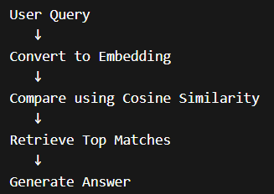
Retrieval
When a user asks a question, the system searches the vector database and retrieves the most relevant chunks.
Retrieves the data created during indexing based on the user’s question.
.

Slide 42
Retrieval
When a user asks a question, the system searches the vector database and retrieves the most relevant chunks.
Retrieves the data created during indexing based on the user’s question.
It uses Cosine Similarity to measure how
close two vectors are in meaning
Value ranges from -1 to 1
1 → very similar
0 → unrelated
-1 → opposite
.
Top matching chunks are retrieved and passed to the model.

Slide 43
Augmentation
Augmentation refers to the step where the retrieved documents (chunks of relevant context) are combined with the user’s query to form a new, enriched prompt for the LLM.

Slide 44
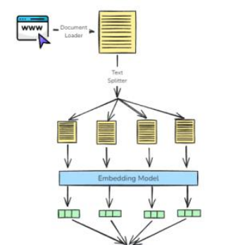
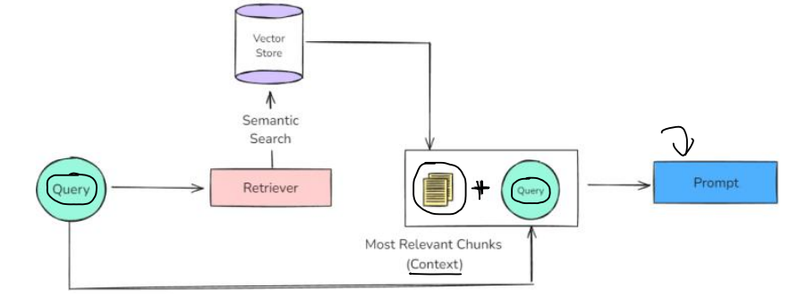
Augmentation
Augmentation refers to the step where the retrieved documents (chunks of relevant context) are combined with the user’s query to form a new, enriched prompt for the LLM.

Slide 45
Generation
Generation is the final step where a Large Language Model (LLM) uses the user’s query and the retrieved & augmented context to generate a response.

Slide 46
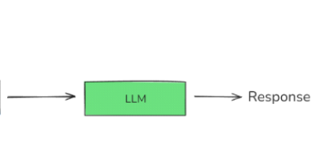
Generation
Generation is the final step where a Large Language Model (LLM) uses the user’s query and the retrieved & augmented context to generate a response.

Slide 47
Conclusion Retrieval-Augmented Generation (RAG) enhances AI by combining information retrieval with text generation

Slide 48
Conclusion Retrieval-Augmented Generation (RAG) enhances AI by combining information retrieval with text generation It helps overcome limitations of traditional models like outdated knowledge and hallucinations

Slide 49
Conclusion Retrieval-Augmented Generation (RAG) enhances AI by combining information retrieval with text generation It helps overcome limitations of traditional models like outdated knowledge and hallucinations Components such as document loaders, vector databases, and retrievers work together to deliver accurate results

Slide 50

Q & A
Panel discussion session

