Slide 1
Welcome
Presenter : Atul Shimpi,
14-Feb-2017 14:45

Slide 2
Agenda
About Me
Project Requirement and features
Architecture
Demo
Source code walk through
Improvements

Slide 3
About Me
I am Atul from India. You can see me here www.HiAtul.com
I have 8 years of experience developing web-applications
For last 4.5 years I am working on AWS
For three years I worked as AWS developer (ruby and java sdks)
Since last 1 years I am also playing role of cloud architect
Most of the projects were automating deployment of on-premise application and migrating existing application without any automation
Contact details
1) shimpiatul@Hotmail.co
2) Skype id : shimpiatul

Slide 4
Project Requirement
Architect, design and develop automation of deploying mybb application on AWS. MyBB is the free and open source web based application.
The deployment architecture should be Highly Available, Scalable, Secure, Cost Effective and easy to monitor
Create a monitor application for monitoring running of the deployed mybb stacks.
This is 30% completed as of now. I still have 3-4 hours. Let see if I can do it till then.
Create a design, deployment doc
Create a demo

Slide 5
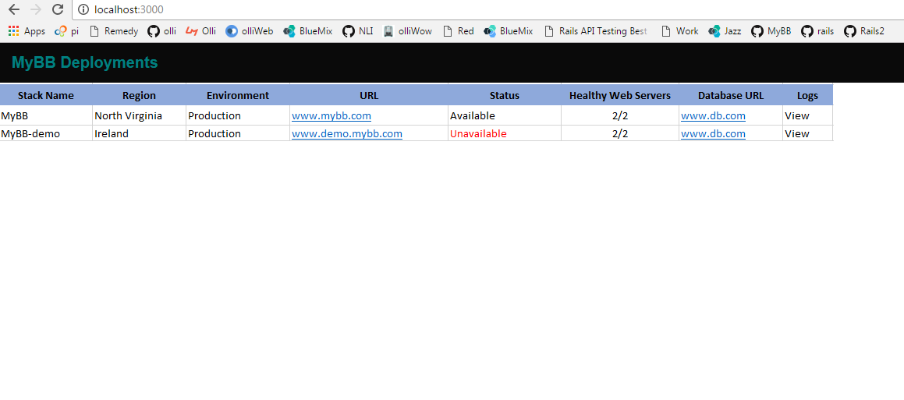
Monitoring app

Slide 6
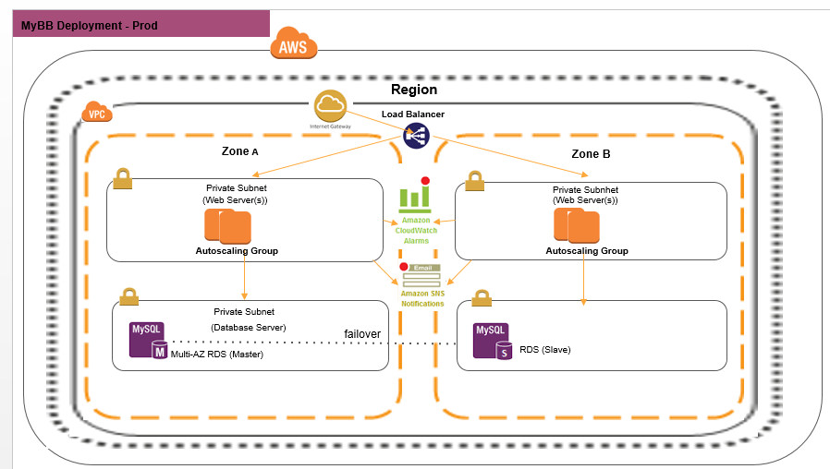
Architecture

Slide 7
Improvements
Security
1) Enable MFA for deleting stack or accessing production servers
2) Remove ssh rule from web-server security groups once launch configuration script is executed
High Availability
1) Enable global high availability by using hosted zone’s routing policies like Failover and Health checks. and taking domain name from user
Speed
Instead of installing MyBB application and depencies during instance first boont or launch configuration, create AMI’s for application and launch instance from that AMI in autoscaling.

Slide 8
Thank you

