Slide 1
Campus Lost & Found
Management System
DBMS Experiential Learning
Level 3, PES University
LOST
& FOUND
Atul Suresh · PES1UG24CS098
Aryan Musale · PES1UG24CS085
Next.js 16.4.3
PostgreSQL and MongoDB
01
Notes:
Introduce the project as a verified recovery system. A student can report an item, discover plausible matches and submit private ownership evidence. Staff verification and an atomic handover complete recovery. Team: Atul Suresh, PES1UG24CS098, and Aryan Musale, PES1UG24CS085. Source: README.md and docs/team.json.

Slide 2
Problem and recovery workflow
Students need a searchable record of lost belongings and a controlled way to prove ownership.
Report
Match
Claim
Verify
Return
Public item details
Ranked candidates
Private evidence
Staff decision
Recorded handover
Unique marks remain private. Staff approve ownership before an item changes hands.
02
Notes:
Disconnected posts make discovery difficult. Publishing every identifying mark helps an unrelated person imitate ownership. The application separates public discovery from private verification. Walk through reporting, matching, private claim, staff review and recorded handover. This goes beyond CRUD. Source: course requirements and lib/service.mjs.

Slide 3
Application and database architecture
Next.js browser interface
API and service layer
Authentication, validation and role checks
PostgreSQL
MongoDB
Users, reports, claims, handovers
Constraints, locks and outbox state
Flexible item profiles
Private clues and audit aggregation
Outbox
delivery
SQL transactions protect the workflow. Document delivery can retry after failure.
03
Notes:
The browser calls Next.js route handlers. The backend authenticates sessions, validates input and checks roles/ownership. PostgreSQL owns the workflow and writes an outbox event in the same transaction. The dispatcher writes MongoDB profiles/audit events and marks SQL delivery after success. SQL and MongoDB are eventually consistent. Source: app/api/[...path]/route.js, lib/db.mjs, lib/projection.mjs.

Slide 4
Core relational design
users
1 : N
items
1 : N
claims
PK id
role, email, SRN
PK id
FK reporter, category, location
kind and status
PK id
FK item, claimant, lost link
status and review
0 : 1
Lookups
handovers
categories and locations
FKs referenced by items
Unique claim / item keys
Staff and receipt note
Foreign keys preserve relationships. Unique indexes protect one verified owner.
04
Notes:
A user owns item reports and can make claims on another user's found item. A claim references its found item, its claimant and an optional claimant-owned lost report. A handover has unique claim and item keys. Categories and locations are shared lookup tables. The full ER diagram and exact data dictionary are in the report and source. Source: db/schema.sql and docs/ER_DIAGRAM.mmd.

Slide 5
Advanced SQL features
Transactions and row locks
One approved owner under simultaneous requests
Views
Directory joins and category dashboard aggregates
Stored functions
Matching, review and atomic handover
Triggers
Database guards, audit events and final-state checks
Indexes
Partial unique, composite and GIN indexes
Full-text search
Generated tsvector and ranked text queries
05
Notes:
Point to the exact implementation in db/schema.sql. Transactions and row locks serialize competing approvals. Views power directory and dashboard queries. Stored functions centralize ranking, review and handover. Triggers guard role/state consistency and emit audit events. Partial unique indexes prevent duplicate active claims and multiple owners. Full-text search uses a generated tsvector and GIN index. db/queries.sql demonstrates JOIN, GROUP BY, HAVING, subqueries and safe DDL.

Slide 6
MongoDB profiles and recoverable delivery
Flexible item profile
1
SQL commit stores the report and event
{
"public": {
"brand": "Milton",
"capacity": "750 ml"
},
"secret": "Private identifying clue",
"event_id": 52
}
2
Dispatcher writes the MongoDB document
3
Successful delivery clears the payload
4
A failed write remains queued for retry
Document consistency is eventual. SQL remains authoritative for claim and handover state.
06
Notes:
The document model accommodates category-specific descriptors such as capacity or model without adding a SQL column for each kind. Private clues are separate from public fields. MongoDB JSON Schema rejects malformed descriptor values. The SQL outbox and idempotent MongoDB keys allow retries. A failure-recovery test blocks a MongoDB write, verifies the SQL event remains queued, restores validation and successfully retries it. Source: lib/projection.mjs and tests/integration.test.mjs.

Slide 7
Explainable matching
Category
35
Same category
required
Location
20
Color
15
Case and spaces
are normalized.
Blank colors earn
no bonus.
Date proximity
15
Text overlap
15
Maximum 100 points. Suggestions help discovery; staff verify ownership.
07
Notes:
Only an open lost report can be matched. Candidates must be open found reports from another reporter in the same category. A weighted score uses category, location, normalized nonempty color, date proximity and full-text rank. The score is capped at 100, results are capped at twelve, and a score is a heuristic rather than proof of ownership. Regression tests cover category mismatch, whitespace/case color normalization and empty color handling. Source: match_candidates in db/schema.sql.

Slide 8
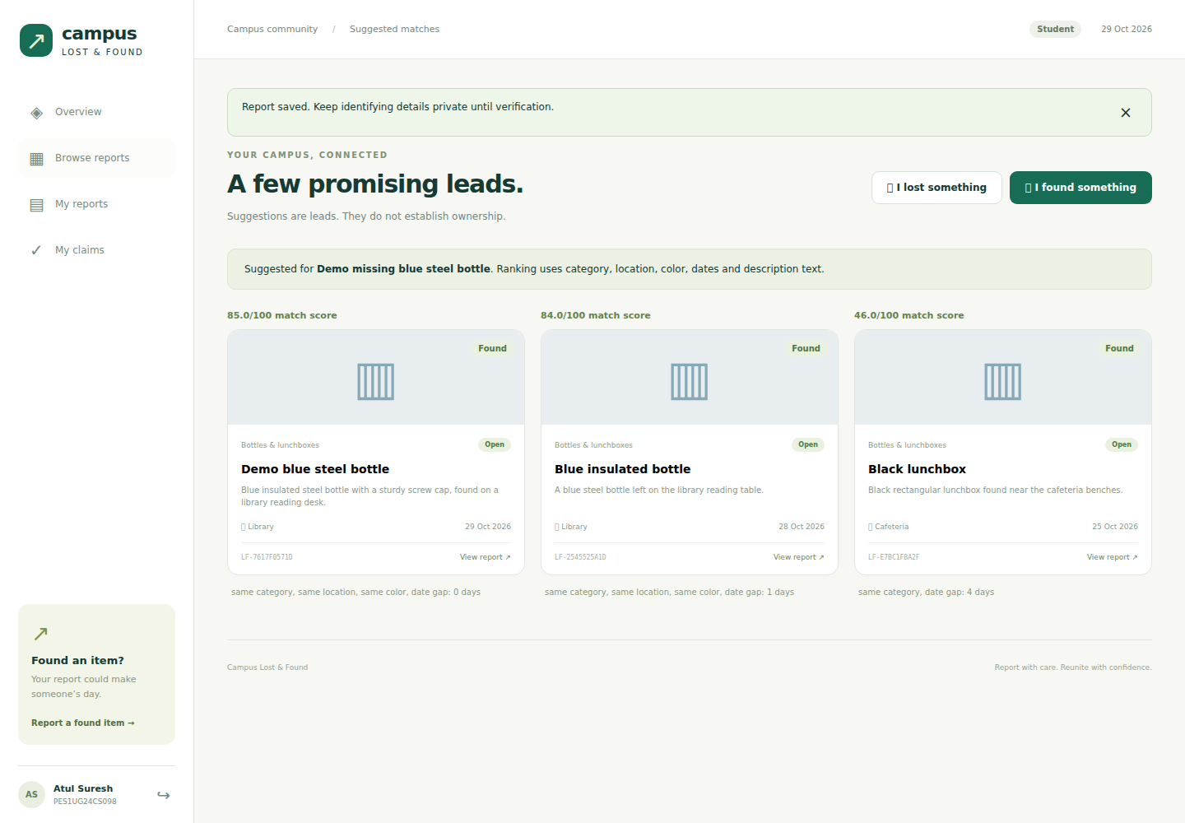
Student matching interface
Actual browser capture using synthetic demonstration records
08
Notes:
Show this genuine browser capture, then switch to the live app. The student opens My reports, chooses an open lost report and selects Find matches. Candidate cards show relevance scores and matching reasons. Opening a found item reveals public descriptors while withholding the finder's private identifying clue. Source: evidence/screenshots/04-matches.png and evidence/browser_results.json.

Slide 9
Verified handover and consistent state
Stage | Found report | Claim | Linked lost
Before review | open | pending | open
After approval | reserved | approved | open
After handover | returned | handed_over | closed
One SQL transaction applies the final handover changes.
Unique ownership, row locks and deferred checks protect the final state.
09
Notes:
Explain the row-locking path. Staff review locks the found item before the claim. Approving one claim reserves the item and rejects competing pending claims. confirm_handover creates a unique receipt, completes the claim, returns the found item and closes the linked lost report in one transaction. Deferred triggers reject inconsistent final states. The native concurrency test proved that simultaneous approvals leave exactly one owner. Source: review_claim, confirm_handover and deferred triggers in db/schema.sql.

Slide 10
Recorded verification
Suite | Passed | Failed | Skipped
Database / service | 35 | 0 | 0
Formatting / attributes | 3 | 0 | 0
Production HTTP | 20 | 0 | 0
Browser workflow | 17 | 0 | 0
Concurrent approval passed. Nine browser screenshots are included.
Production build passed with Next.js 16.4.3. Recorded npm audit: 0 vulnerabilities.
10
Notes:
All stated checks were executed on 29 October 2026. The database/service suite ran against native PostgreSQL 17.6 and native MongoDB 8.0.15. The source build used an explicitly documented startup adaptation for the single-UID test container; the delivered Docker configuration uses standard upstream images. Native concurrent approval, rollback, privacy and MongoDB recovery tests passed. Chromium ran the real UI workflow and captured nine screenshots. Next.js 16.4.3 production build passed and npm audit reported zero known JavaScript dependency vulnerabilities. Sources: evidence/test_results.tap, unit_results.tap, http_results.json, browser_results.json and verification.json.

Slide 11
Live demonstration
1
Student: browse reports and show suggested matches
2
Student: submit private evidence with a lost-report link
3
Staff: compare clues, approve and record handover
4
Show final states, audit history and important queries
The demonstration uses synthetic data and heuristic matching.
Staff remain responsible for ownership verification.
11
Notes:
Start Docker Desktop, then open START_PROJECT.command. Use the local demo password CampusDemo@2026 unless changed before seeding. Sign in as Atul, show search/matches and a pending claim. Sign out and sign in as staff, compare private evidence, approve and complete handover. Show returned/handed_over and the closed lost report, then open Activity log and run npm run demo:queries. Explain that all data is synthetic, matching is heuristic and SQL/MongoDB delivery is eventual. Both students should explain their component ownership and any actual personal modifications. Source: docs/PRESENTATION_AND_VIVA.md.

