Slide 1

Good Tech Scholars Program StockIT App Theme: Digital Transformation
for Social Change
By,
Atul Vyshnav R Krishnanand K
Aparna A Kallu Sudarsan
Gokul S Pillai Malavika S
RIT, Kottayam Oct 2021

Slide 2



‹#›
Table of Contents
Problem Statement and its relevance
Solution Approach
Description
Architecture diagram
Demo
Pre-recorded video
Q&A

Slide 3
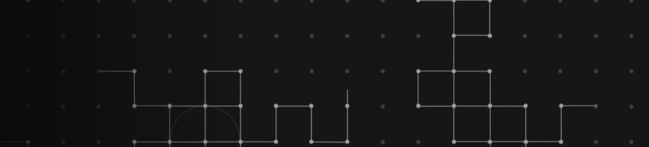

Problem statement and relevance
Context
Problem Summary
Outcomes
Impact
Lack of common people's involvement in the Indian equities market.
Most indian investors lack a basic knowledge about the way stock market function.
Only less than 5% of the population is actively involved in stock market.
Lack of financial intelligence, trust and education
are some of the reasons it isn't mainstream.
Increase in active investors in Indian market.
More investment in domestic companies.
More employment opportunities.
Financial intelligence amongst people.
Increase in GDP and Liquidity.
People can achieve financial freedom.
‹#›
Notes:
Revision 1 (20/09/21:09:30AM): <ANBU>
1. Hands-on experience lets them develop industry/pro skills. And opportunity is already mentioned in the sub-title – hence removed.
2. Additional Info to be used as talking points: The UN had the following Sustainable Development Goals to achieve by 2030 – we can mention a few if required: (1) No Poverty, (2) Zero Hunger, (3) Good Health and Well-being, (4) Quality Education, (5) Gender Equality, (6) Clean Water and Sanitation, (7) Affordable and Clean Energy, (8) Decent Work and Economic Growth, (9) Industry, Innovation and Infrastructure, (10) Reducing Inequality, (11) Sustainable Cities and Communities, (12) Responsible Consumption and Production, (13) Climate Action, (14) Life Below Water, (15) Life On Land, (16) Peace, Justice, and Strong Institutions, (17) Partnerships for the Goals.
</ANBU>

Slide 4
Solution Approach
Description
An interactive platform that educates novice users with trade suggestions backed by ML predictions. It will make a same impact as made by the digital payment applications in India.
Game based Intuitive approach to learning.
Mock trade sessions on real time charts
Simplified UI
ML price action prediction models
Education about owning stocks.
Access to equities, options trading etc., based on test scores.
Trading jargons explained in Layman's terms.
Zero commission model on trades.
‹#›

Slide 5
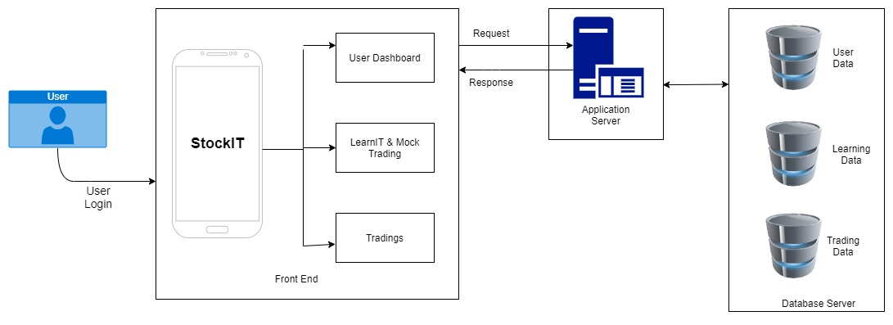
Solution Flow
ARCHITECTURE DIAGRAM
‹#›

Slide 6
Demo
https://drive.google.com/file/d/1bdLAzCi1y768R76-oHXw-gVVgeJkFO35/view?usp=sharing

Slide 7
FUTURE SCOPE
Personalized action alerts can be incorporated.
A fully fledged card game can be made with an advanced animated version.
Can add more number of indicators in the subsequent levels.
Performance can be improved with integration with ML.
Can include Crypto exchanges.
Mobile based trading has made stock market accessible to investors in small town.
With the proliferation of smart phone and mobile data consumption, it will gain popularity among the people.
‹#›

Slide 8
Q&A
‹#›

