Slide 1
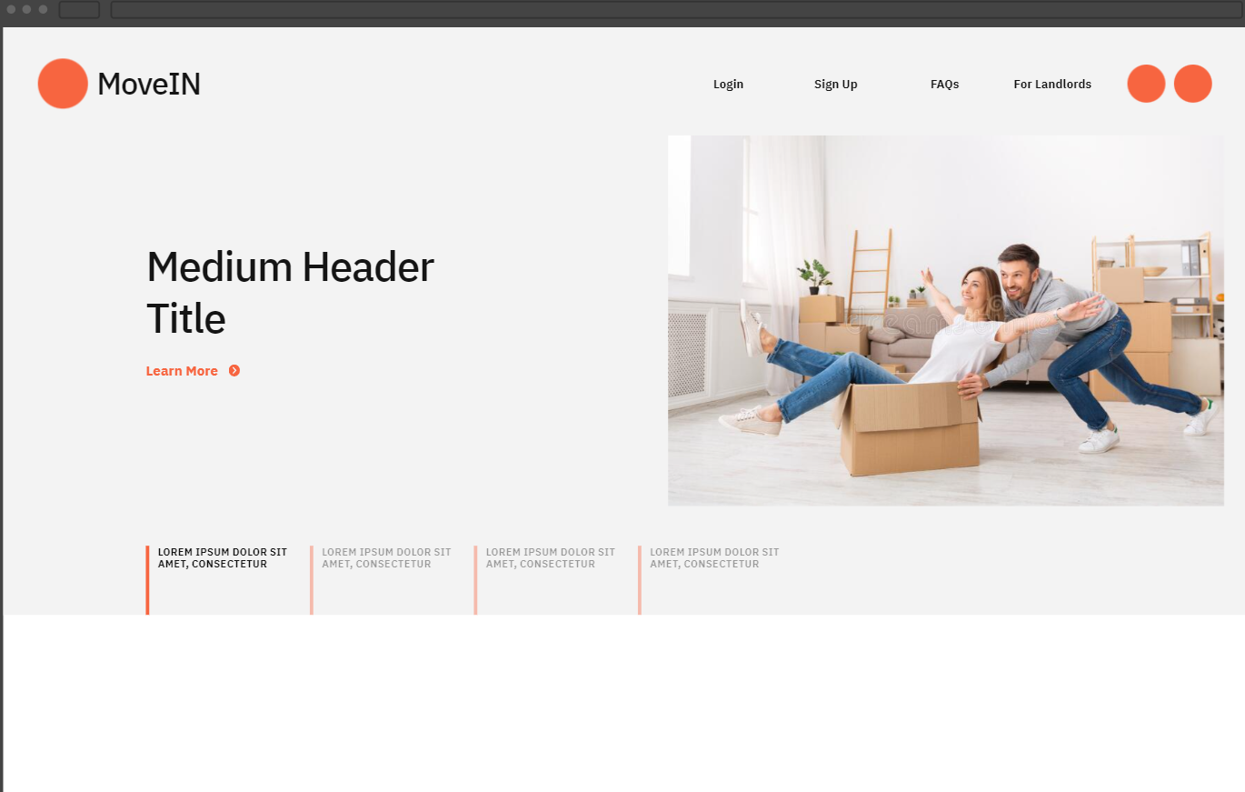
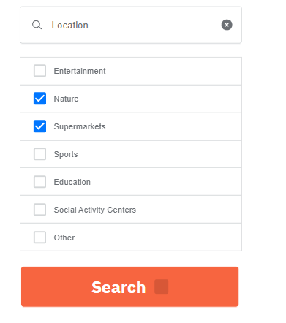
MoveIn Prototype Template

Slide 2
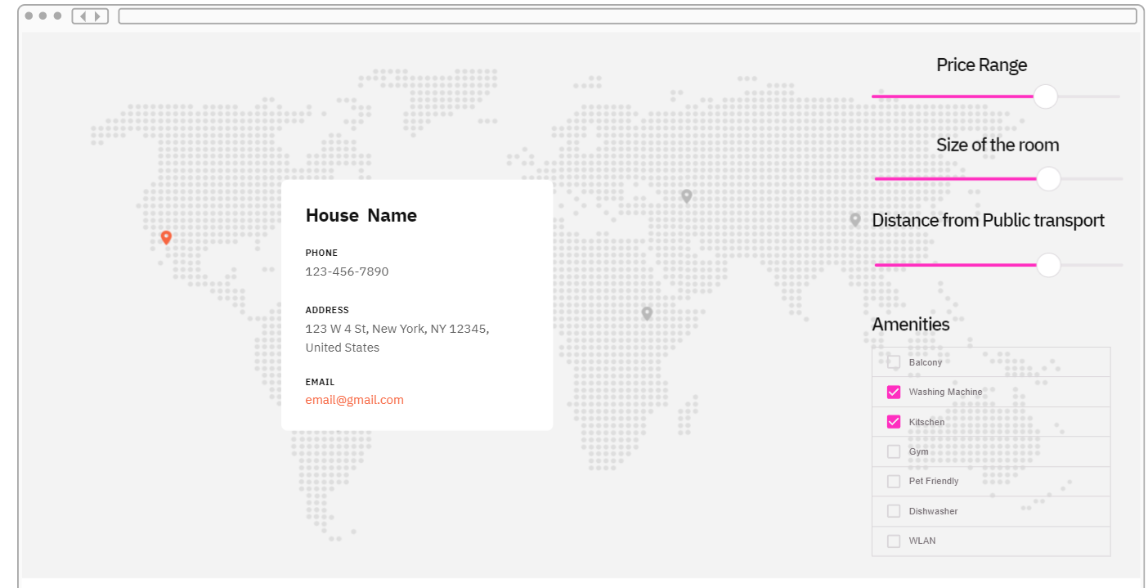

Slide 3
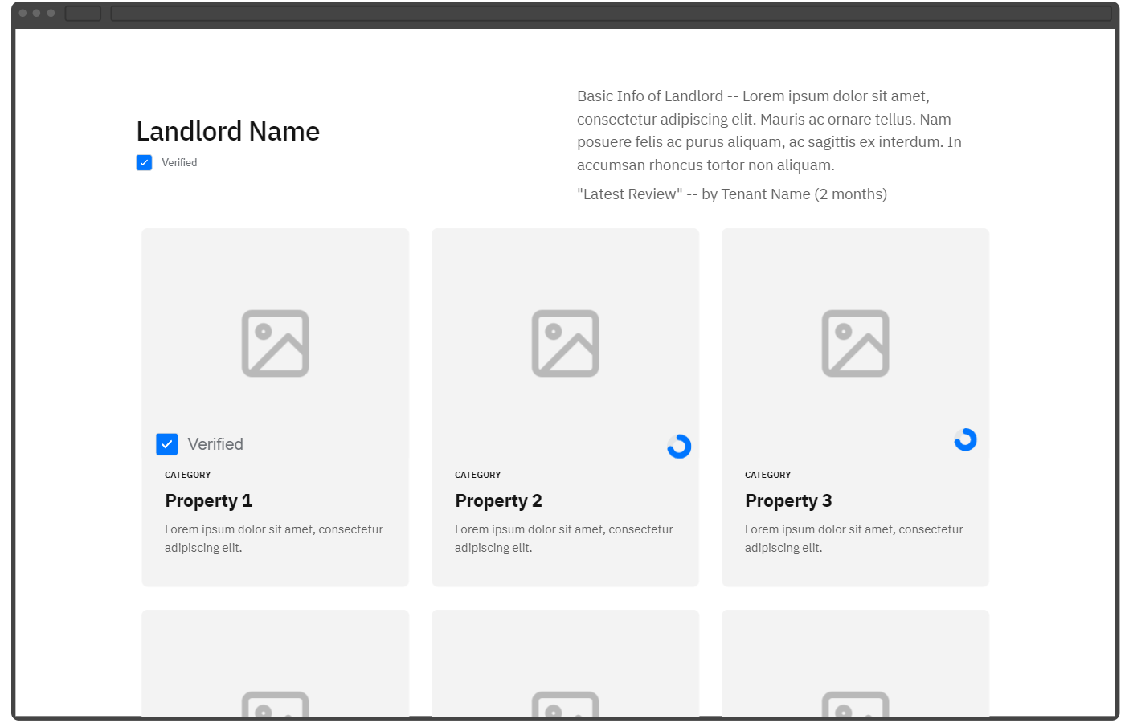

Slide 4
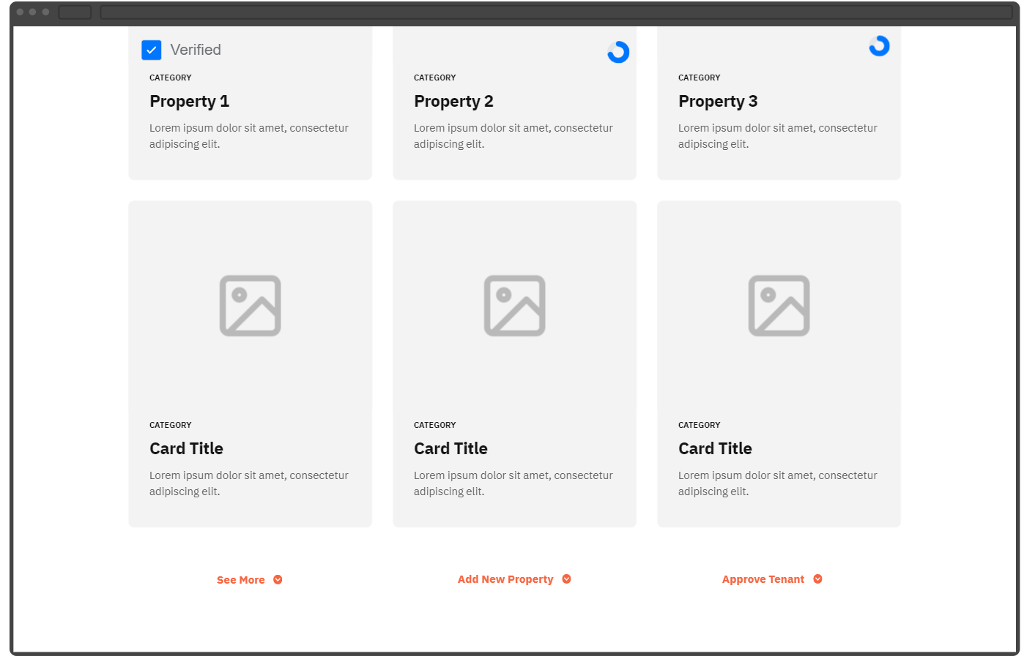

Slide 5
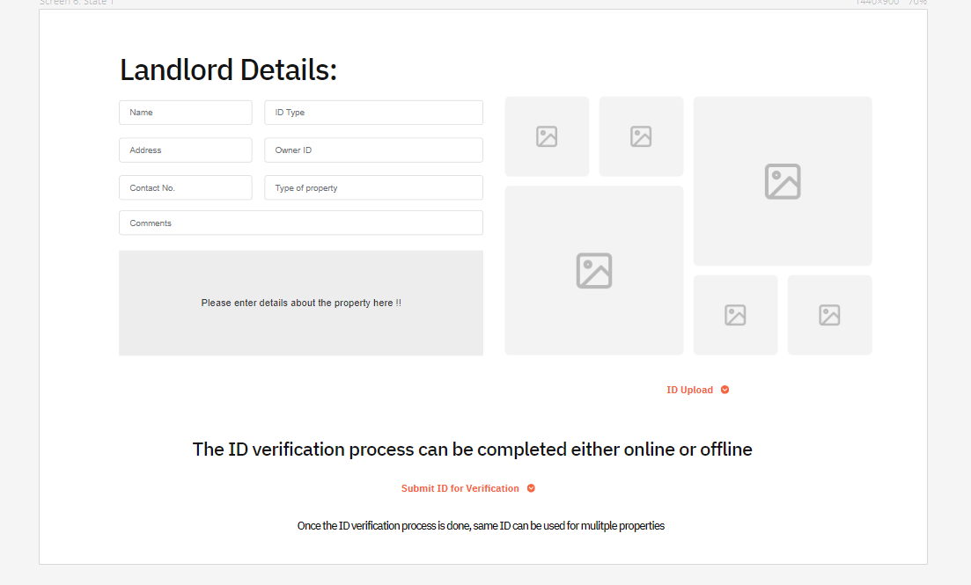

Slide 6
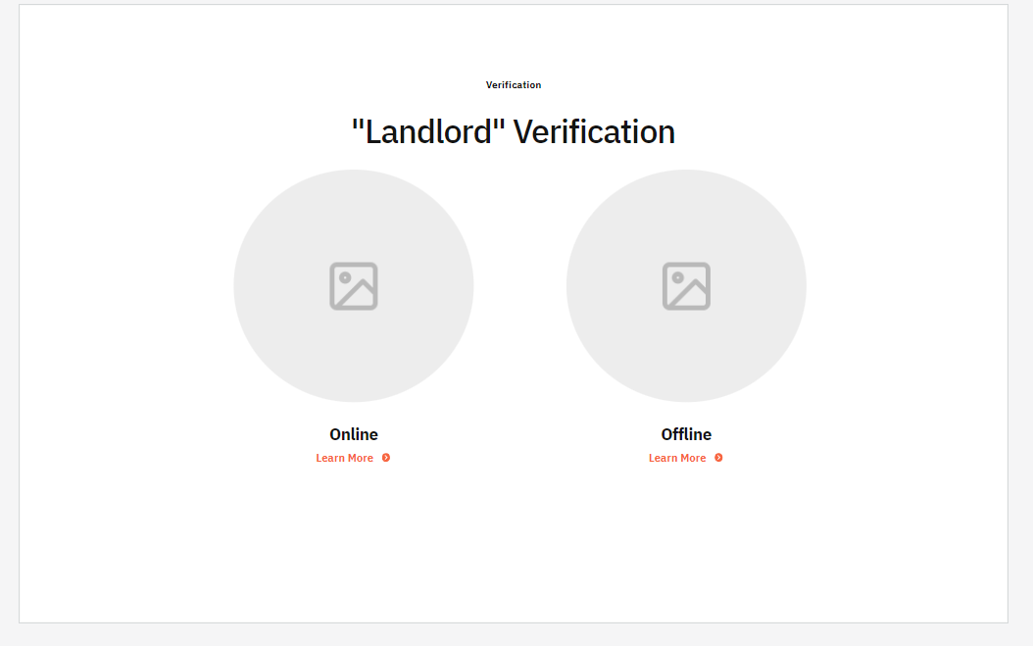
Takes 1-2 days
Takes 2-3 hours
Takes 1-2 days
Takes 2-3 hours

Slide 7

3rd Party Verification services

Slide 8

3rd Party Verification services

Slide 9
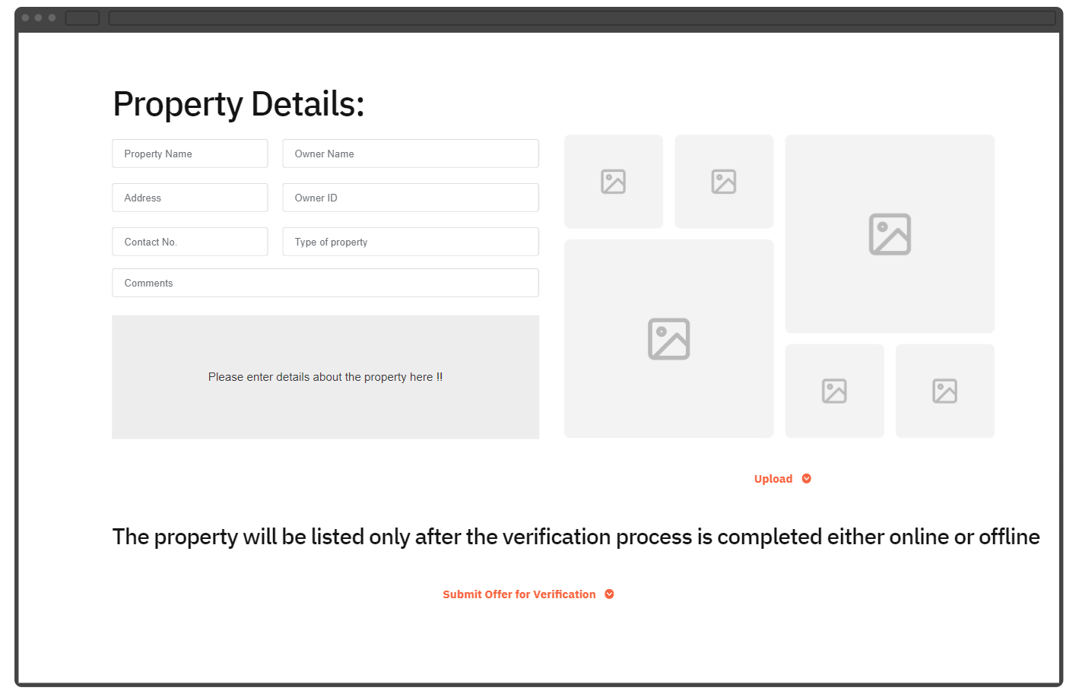

Slide 10
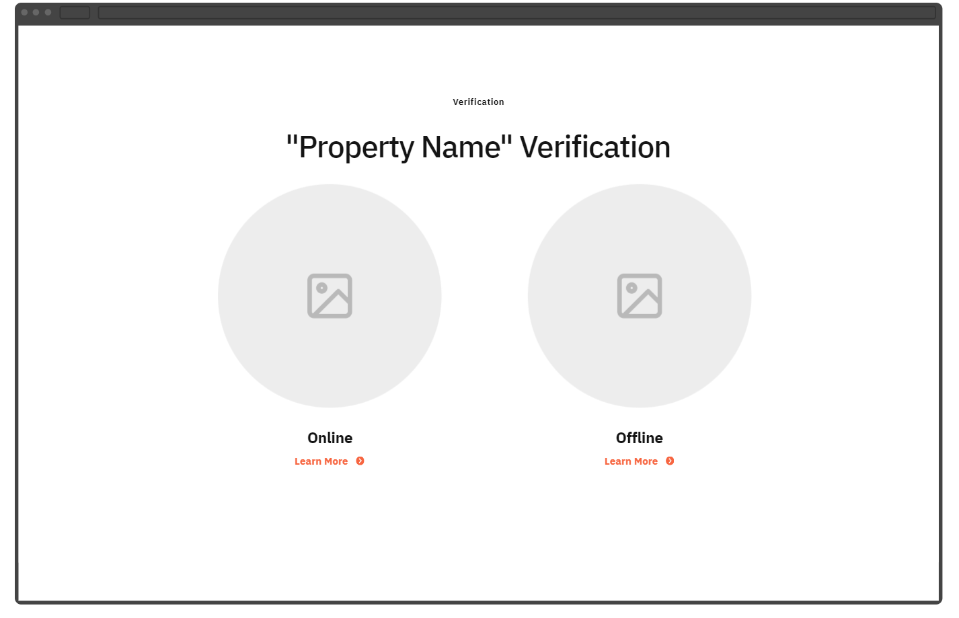
Takes 2-3 hours
Takes 1-2 days

