Slide 1
Introduction To Machine Learning
Robin Raju

Slide 2
Contents
What is Machine Learning ?
Types of Learning

Slide 3

Machine Learning – An art of intelligence
Train your machine to make itself capable of doing work for you

Slide 4

Confusion – Oh how it’s work ?

Slide 5
Don’t worry here is the answer
How we have learned things ?
From examples, so let the machine also do the same !
Give your data to machine and ask it to learn from the data.

Slide 6

Ohho, Then what you mean by learning ?

Slide 7
Here we go
We can classify our ML into 4 main categories
Supervised learning
Unsupervised learning
Semi-supervised learning
Reinforcement learning

Slide 8

Hmm, Are these terms seems complex ?
Don’t worry we will go one by one

Slide 9
Supervised Learning
Without a teacher how we could come up here ?
Yes, supervised learning is nothing but it’s like a teacher teaching you something.
We have some input data with corresponding output and then we ask machine to learn from it.

Slide 10
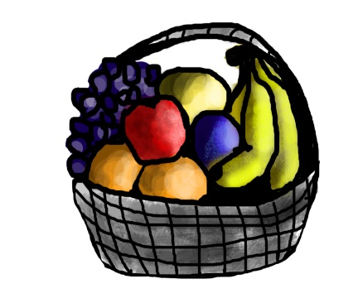
Basket of Fruits !
If shape of object is rounded and depression at top having color Red then it will be labelled as – Apple.
If shape of object is long curving cylinder having color green yellow then it will be labelled as – Banana.

Slide 11
So what’s the conclusion ?
In supervised learning, we will give a set of data to our machine to learn from it.
In that data we will be providing both input as well as output for training and later we will ask the machine what will be the output for a new data which was not part of training data.

Slide 12

Categories of Supervised learning
So we have two categories under supervised learning
Classification
Regression
What are these terms ? We will see

Slide 13

Classification
When we have a set input data for which the output falls into some category we will say it as a classification problem.

Slide 14

Types of classification
Classification problems can be two types
Binomial
Multinomial
Nothing but how many different categories we have!

Slide 15
Classification Algorithms
We have a lot to explore!
Here are few of them
K-nearest neighbour
Naïve Bayes
Decision Tree
Support Vector Machine
Random forest

Slide 16

K-nearest neighbor
Lazy learner
On an assumption that data points of similar classes are closer to each other
“Birds of a feather flock together.”

Slide 17
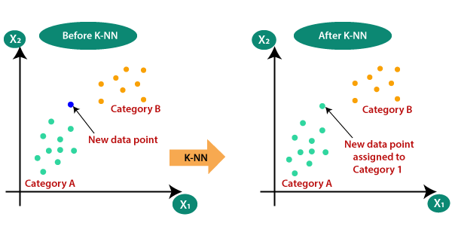
How it works ?
Assume you have training data with labelled classes

Slide 18

Based on distance calculation
Define a ‘k’ which is the number of neighbour you want to consider
For a new data point to be classified,
Find the distance of your new data point with each point in the training data
Find the k nearest neighbour’s and go for a voting !

Slide 19
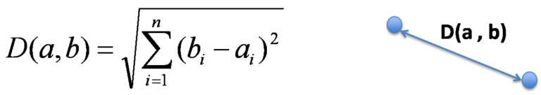
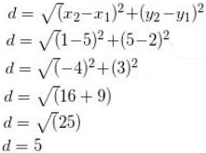
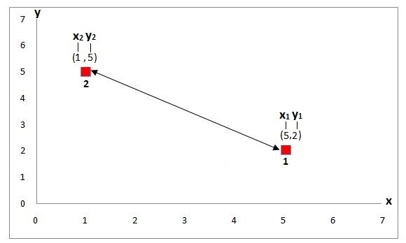
Ohho What’s the distance calculation ?
Euclidean Distance

Slide 20
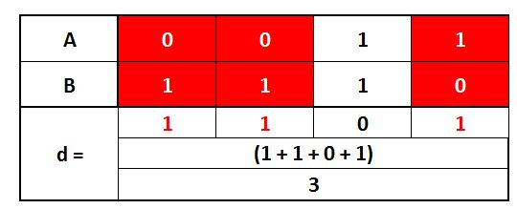
Ohho What’s the distance calculation ?
Hamming Distance
D(x,y) = Σ_{d}1x_{d≠}y_{d}

Slide 21
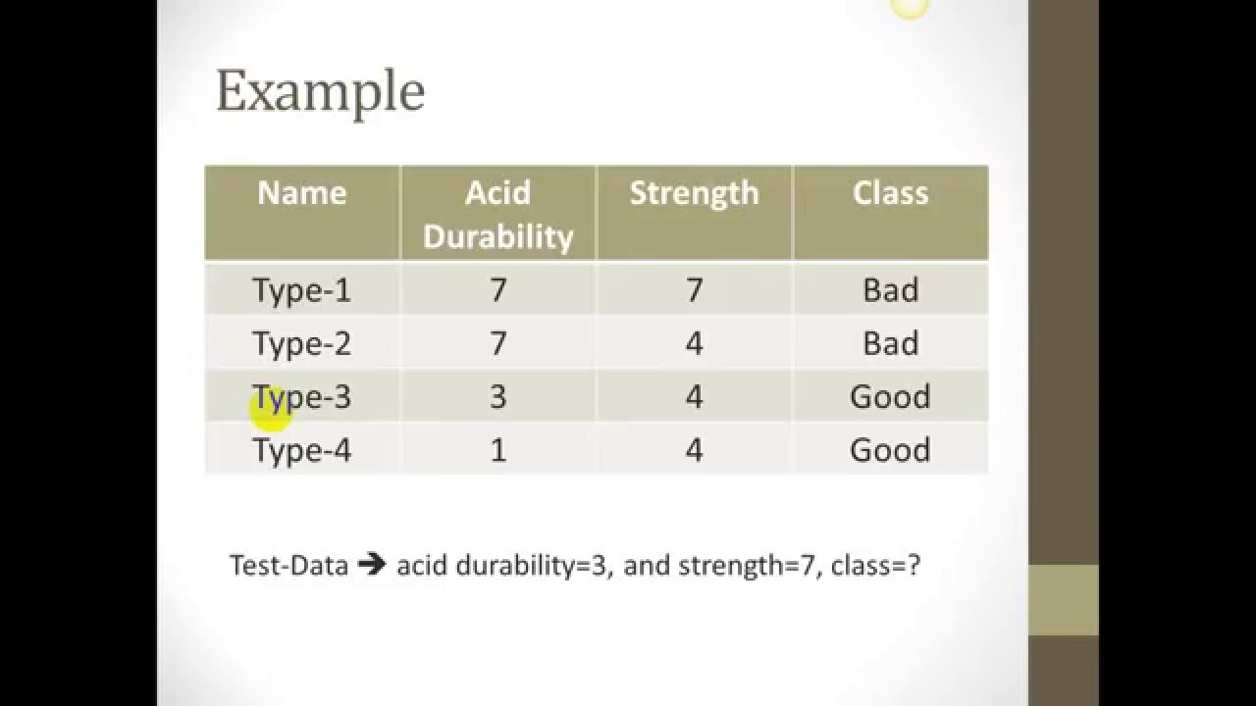

An example with Euclidean
Assume new data point is (5,4) and k = 3
Distance with first point = (7-5)^2 + (7-4)^2 = 13
Like with second point = 4
Third point = 4
Fourth = 16
So we have 3 neighbors as “good, bad, bad”
Majority is bad so classified as bad

Slide 22
Pros ad Cons
Pros:
It is very simple algorithm to understand and interpret.
It is very useful for nonlinear data because there is no assumption about data in this algorithm.
Cons:
It is computationally a bit expensive algorithm because it stores all the training data.
High memory storage required as compared to other supervised learning algorithms.

Slide 23

Naïve Bayes Algorithm
Based on Bayes rule
Basically, we are trying to find probability of event A, given the event B is true. Event B is also termed as evidence.
P(A) is the priori of A (the prior probability, i.e. Probability of event before evidence is seen). The evidence is an attribute value of an unknown instance(here, it is event B).
P(A|B) is a posteriori probability of B, i.e. probability of event after evidence is seen.

Slide 24
An example
Sl no | swim | fly | crawl | class
1 | fast | no | no | fish
2 | fast | no | yes | animal
3 | slow | no | no | animal
4 | fast | no | no | animal
5 | no | short | no | bird
6 | no | long | no | bird
7 | slow | no | yes | fish
8 | no | rarely | no | animal
9 | fast | no | no | bird

Slide 25
An example
P(animal) = 4/9
P(bird) = 3/9
P(fish) = 2/9
P(F1 = slow / animal) = 1/5 , like so
P(F1= fast/animal) = 2/5
P(F1= no/animal) = 1/5
P(F2 = no/animal) = 3/5
P(F2 = short/animal) = 0/5
P(F2 = rarely/animal) = 1/5
P(F2= long/animal) = 1/5

Slide 26
An example
The new data
‘Slow, rarely, no’
For class animal = 1/5 * 1/5 * 3/5 * 4/9
For class bird = 0/5 * 0/5 * 3/5 * 3/9
For class fish = 1/5 * 0/5 * 1/5 * 2/9
So it will classify as ‘Animal’

Slide 27
Problem with Bayes
It assumes that every feature is independent with each other, which may not true in real world scenarios!
If categorical variable has a category in test data set, which was not observed in training data set, then model will assign a 0 (zero) probability and will be unable to make a prediction. This is often known as Zero Frequency

Slide 28
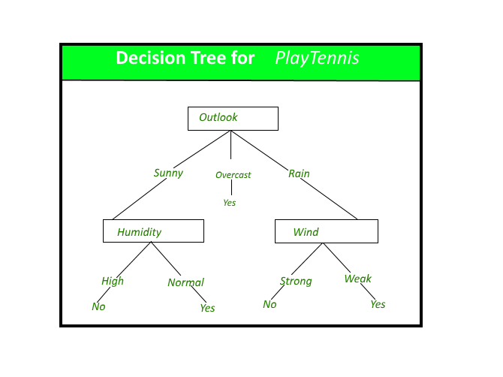
Decision Tree
It’s a classifier in structure of a tree which will have two types of nodes
Decision node : nothing but the feature
Leaf node : class label

Slide 29
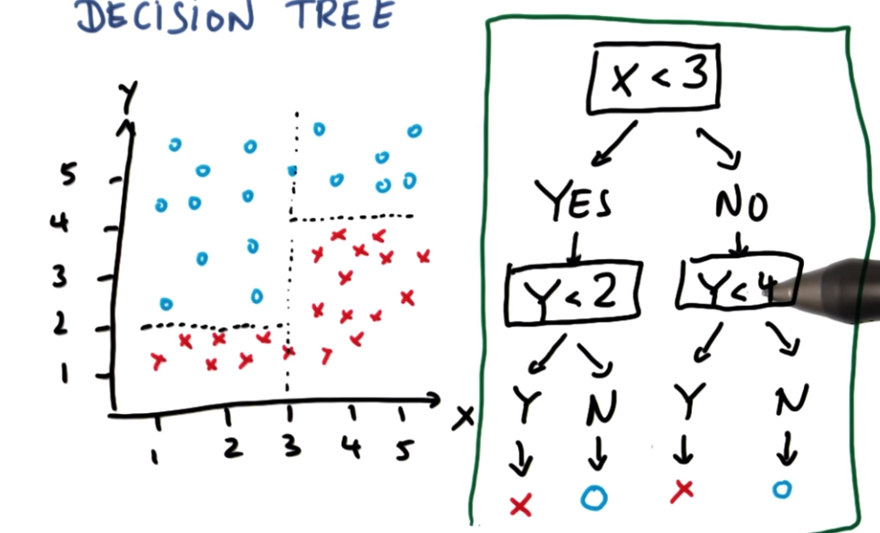
Which attribute is best ?

Slide 30

Information gain
Measures how well a given attribute separates the training example according to their target classification

Slide 31

Attribute selection
If we have a set of training samples as ‘S’
Entropy : Measures the impurity of ‘S’
Eg: (5+, 2-) = -5/7* log₂ 5/7 – 2/7 log₂ 2/7

Slide 32


So much calculations
All this calculations seems very complex and difficult to understand.
Hmm but don’t worry, in real scenario when we are using the algorithms we need not worry about these calculations, it’s already taken care by the ‘sklearn’ package

Slide 33
Problems with Decision Tree
Overfitting:
Learning a tree that classifies training data perfectly will not always lead to perfect model
Overfitting is nothing but the model has a high accuracy on training data but not on test data.

Slide 34

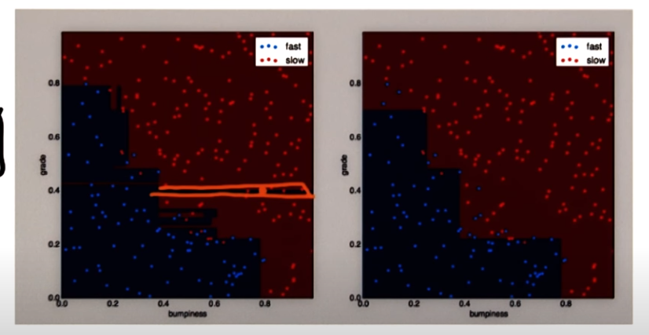
But how it happens ?
Suppose your training data contains some noise, it will try to fit those noise also for an accurate prediction.
But when coming to test data, it will reduce the accuracy

Slide 35
Is there any solution ?
Luckily we have some solutions for avoiding this overfitting
This is called Pruning
Pre-Pruning or early stopping:
Stop if all instances belongs to same class, or all attribute values are same etc.
Nothing but stop splitting if it seems worthless for further split

Slide 36
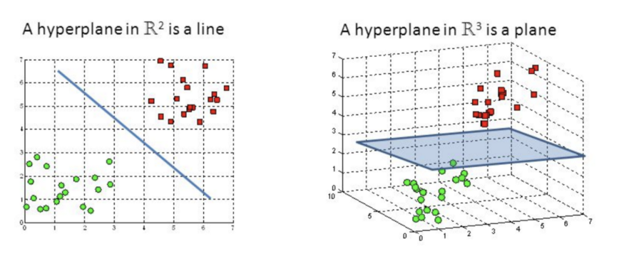
Support Vector Machines
The objective of the support vector machine algorithm is to find a hyperplane in an N-dimensional space(N — the number of features) that distinctly classifies the data points.

Slide 37
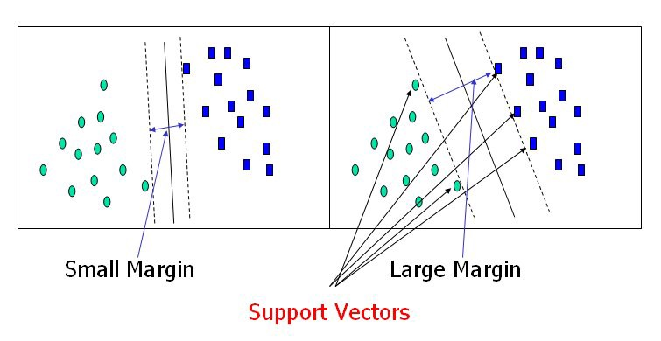
SVM
Support vectors are data points that are closer to the hyperplane
Find a hyperplane which will maximize the margin along with correctly classifying the data points

Slide 38
What is the best hyperplane ?
The best hyperplane should correctly classify the data points as well as maximize the margin.
A lot of calculations are involved here to find the best one, but again need not worry our ‘sklearn’ package will take care of it.

Slide 39
Random Forest
It’s an ensemble method of learning
Then what is ensemble ?
use multiple learning algorithms to obtain better predictive performance than could be obtained from any of the constituent learning algorithms alone
Sounds a little bit interesting ?

Slide 40
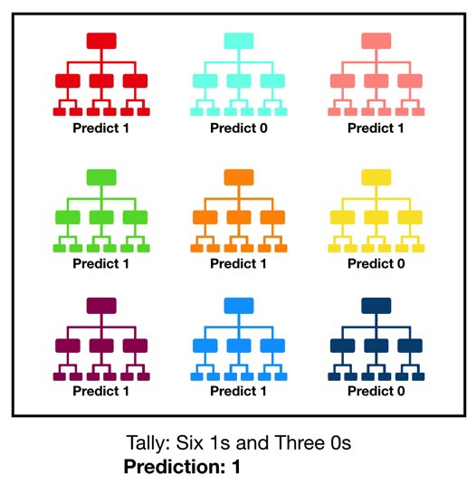
Basic Idea
Let them train on training data, and finally new data point will be predicted by each of them take the majority voting

Slide 41
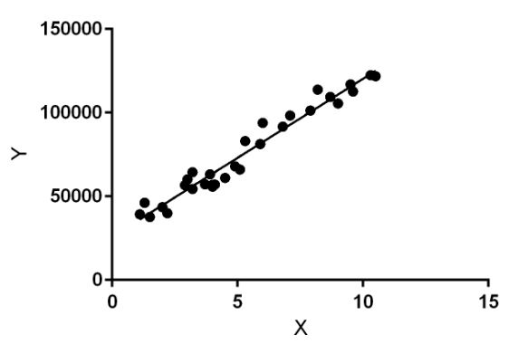
Regression
It’s not a classification algorithm.
In classification algorithm the output values are discrete but in regression the output is continuous.

Slide 42
Old mathematical equation!
If you remember
Y = mx + b ( equation for a line)
Best example of linear regression
Linear regression performs the task to predict a dependent variable value (y) based on a given independent variable (x).
Y = ouput, x =input, m = coef of x, b = intercept

Slide 43
How it works ?
When training the model – it fits the best line to predict the value of y for a given value of x.
The model gets the best regression fit line by finding the best m and b values.

Slide 44

Concept of Root Mean Square Error
To find the best values for m and b, minimize the root mean square error between predicted vale and true y value

