Slide 1

For internal use only / © Siemens AG 2011. All rights reserved.

Slide 2
Machine Learning Algorithms-Recap
training the model using the data, analyses the training data and produces a correct outcome from labeled data.
Supervised Learning
when the output variable is a real or continuous value
Regression
Classification
when the output variable is a category
training of machine using information that is neither classified nor labeled and allowing the algorithm to act on that information without guidance
Unsupervised Learning
finding a structure or pattern in a collection of uncategorized data
Clustering
Association
establish associations amongst data objects inside large databases.

Slide 3
Confusion Matrix/Error Matrix
Summarized table that is often used to describe the performance of a classification model on a set of test data for which true values are known
The number of correct and incorrect predictions are summarized with count values and broken down by each class
Gives errors made by the classifier and type of errors that are being made
Metrics of Confusion Matrix :
Accuracy
Precision
Recall
Specificity
F Score

Slide 4
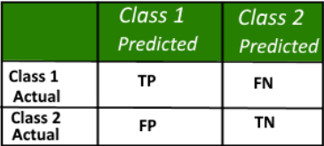
Classification Problem
Structure of a 2*2 Confusion Matrix
Class 1 : Positive
Class 2 : Negative
Definition of the Terms:
Positive (P) : Observation is positive (for example: is an apple).
Negative (N) : Observation is not positive (for example: is not an apple).
True Positive (TP) : Observation is positive, and is predicted to be positive.
False Negative (FN) (or Type2 Error): Observation is positive, but is predicted negative.
True Negative (TN) : Observation is negative, and is predicted to be negative.
False Positive (FP) (or Type1 Error ) : Observation is negative, but is predicted positive.

Slide 5
Classification Rate/Accuracy
Ratio of Number of all correct predictions divided by the total number of predictions
Accuracy = TP + TN
TP + TN + FP + FN
***The best ACC is 1.0, whereas the worst is 0.0

Slide 6
Recall
Sensitivity Rate/Hit Rate/True Positive Rate(TPR)
Ratio of the total number of correctly classified positive examples divide to the total number of positive examples
Recall = TP
TP + FN
***The best recall is 1.0, whereas the worst is 0.0
***High Recall indicates the class is correctly recognized (a small number of FN).

Slide 7
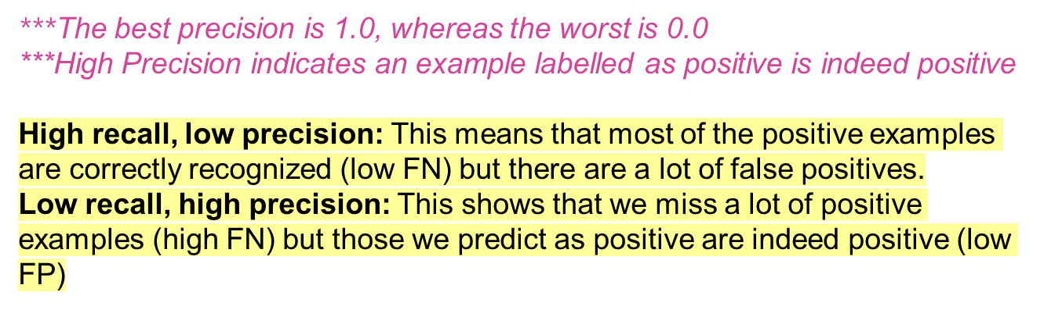
Precision
Positive Predictive Value
Ratio of Number of correct positive predictions divided by the total number of positive predictions
Precision = TP
TP + FP

Slide 8
Specificity
True Negative Rate
Measures the proportion of actual negatives that are correctly identified as such.
It is the opposite of recall.
Specificity = TN
TN + FP
***The best precision is 1.0, whereas the worst is 0.0

Slide 9
F-Measure/F-Score
Weighted average of the true positive rate (recall) and precision
Measure of test’s accuracy
F-Measure = 2*Recall*Precision
Recall + Precision
***It can have a maximum score of 1 (perfect precision and recall) and a minimum of 0.

Slide 10
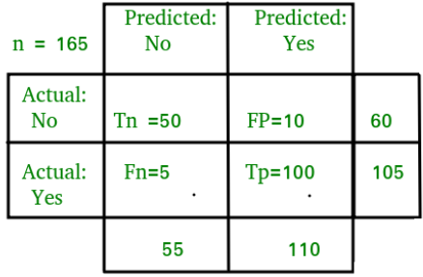
Example to interpret confusion matrix:
Classification Rate/Accuracy:
Accuracy = (TP + TN) / (TP + TN + FP + FN) = (100 + 50) /(100 + 5 + 10 + 50) = 0.90
Recall:
Recall = TP / (TP + FN) = 100 / (100 + 5) = 0.95
Precision:
Precision = TP / (TP + FP)=100/ (100+10) = 0.91
F-measure:
Fmeasure = (2 * Recall * Precision) / (Recall + Presision) = (2 * 0.95 * 0.91) / (0.91 + 0.95) = 0.92

Slide 11
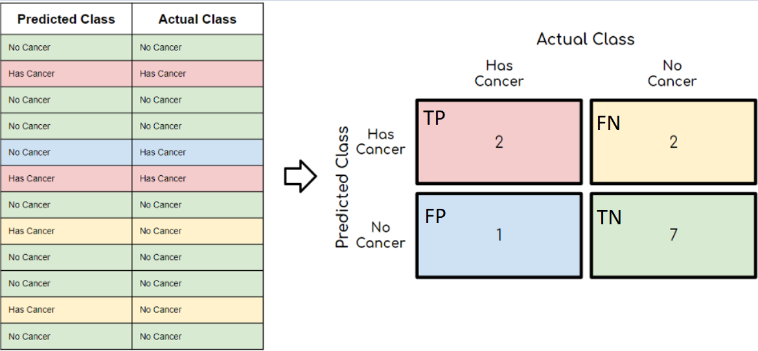
Cancer Detection Example
Accuracy = (2+7)/12 = 75%
Recall = 2/(2+2) = 50%
Precision = 2/(2+1) = 66%
***Precision and Recall have to be close to 100% as possible

Slide 12

Thank You
And
Happy Learning

