Slide 1
Online Event Planner
Team : DevEight
Events Made Easy, Memories Made Forever
Team Members:
1. Anurag Singh
2. Atul Grover
3. Garima Goyal
4. Kritika Jain
5. Poorvi Sahu
6. Stuti Mongia
7. Yash Rajpurohit
8. Yasha Jain
Date : 15/09/2023

Slide 2
Table of contents
01
02
03
Introduction
Project Overview
Frontend Overview & Features
04
05
Backend
Overview
Backend
Structures & Features
06
07
Snapshots of
Code
Key Concepts &
Learnings

Slide 3
01
Introduction

Slide 4
Introduction
Introducing the Event Planning Website – Your Ultimate Event-Planning Powerhouse!
One-Stop Event Planning Hub
Unleash the magic of seamless event planning with our cutting-edge platform. Here's what makes us shine:
Vendor Management Made Effortless
Empower your inner event maestro – you're the boss!
Effortlessly manage a roster of vendors, all in one place.
Vendor information at your fingertips – no more frantic searches.

Slide 5
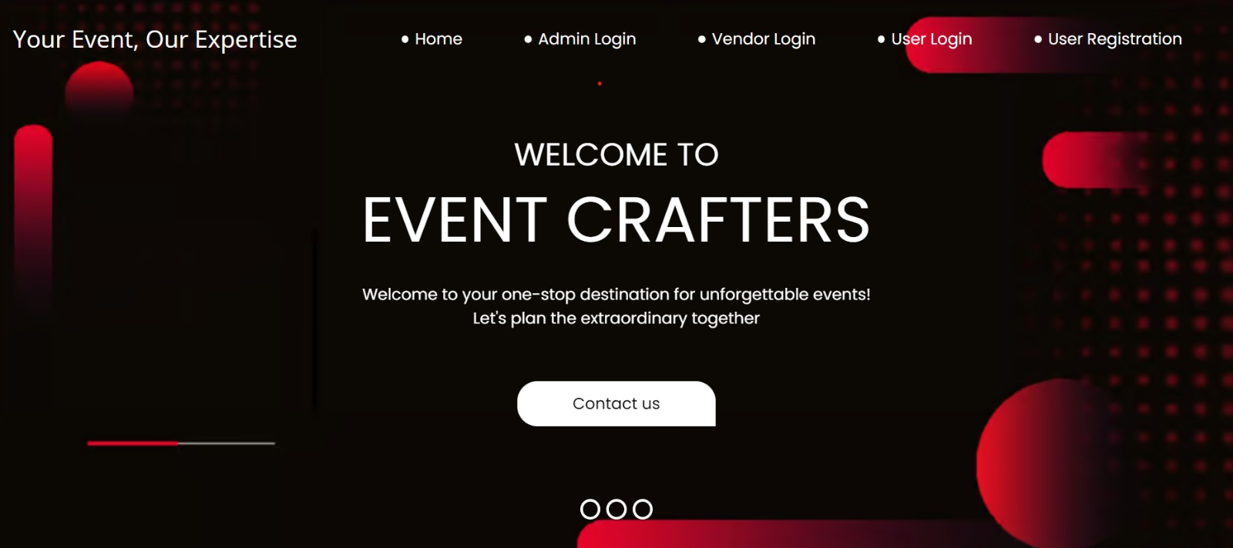
Quotation Handling, Simplified
Say goodbye to quote chaos.
Streamline and organize quotes from multiple vendors.
Make informed decisions with ease.
User Registration Tracking
Keep tabs on your event's guest list.
Monitor user registrations in real-time.
Seamlessly manage attendee information.
Centralized Event Planning
Be in control with a single administrator.
Power at your fingertips – manage vendors and users effortlessly.
Your event planning HQ.
Join the event-planning revolution today with the Event Planning Website! Simplify, organize, and elevate your events like never before.

Slide 6
02
Project Overview

Slide 7
Project Overview
Admin Panel
Vendor Management
Quotation Handling
Vendor Management Functions
Admin oversees event service vendors.
Vendor details include User ID, Full Name, Username, and Department.
Single authorized admin for secure platform management.
Access and control through a secure login.
Admin adds new vendors with user details.
Manages vendor profiles and information.
Controls quotation status (accepts/rejects).
Vendors submit service quotations.
Quotations include package description and cost.
Admin can accept, reject, or leave them pending.

Slide 8
— Benefits:
User Registration Tracking
Admin monitors user registrations.
User details are stored for management.
Centralized Control:
Efficient vendor and user management from one dashboard.
Vendor Accountability:
Quotation system ensures vendor performance tracking.
Enhanced User Experience:
Simplifies event planning by connecting users with vendors.

Slide 9
03
Frontend Overview & Features

Slide 10
User-Centric Design
Admin Dashboard
Vendor Dashboard
Vendors in control of their destiny.
Showcase their services with flair.
Swiftly respond to user requests.
Unleash their event planning prowess.
Tailored for Admins, Vendors, and Users.
Each role has distinct privileges and features.
Empowering administrators with superpowers.
Add Vendors, View Vendor List, and Monitor User List.
Ensures a seamless event planning experience.

Slide 11
User Home Page
Powered by Tools
A personalized journey for every user.
View and fine-tune your profile.
Fortify account security with password updates.
Kickstart event planning with Plan Requests.
Make informed choices with Quotation Reviews.
Crafted with HTML, CSS, JavaScript, and the magic of Bootstrap.
Our Online Event Planner Website: Where Planning Meets Perfection!

Slide 12
Backend Overview
04

Slide 13
Technology Stack: 1. Developed using Java. 2. Utilizes MySQL Workbench as the database system. Java Version: Implemented with JDK 11 to harness its resourcefulness and extensive built-in functions, enhancing performance and functionality. Architectural Pattern: Follows the MVC (Model-View-Controller) architectural pattern, ensuring clean separation of concerns and maintainability. Layered Structure: Divided into Business Layer and Data Access Layer, streamlining development, scalability, and code organization. Exception Handling: Implements robust Exception Handling mechanisms to enhance application stability and reliability. This backend infrastructure forms the foundation of our Online Event Planner, combining modern technologies and best practices to deliver a reliable and efficient platform for planning and managing events.

Slide 14
Backend Structures & Features
05

Slide 15
MVC Architecture
Model-View-Controller (MVC):
Model: This represents the application's data and core business logic. It encapsulates data handling, processing, and business rules. The Model is responsible for maintaining data integrity and consistency. In database-driven applications, it often interacts with the Data Access Layer.
View: The View presents data to users and collects user input. It's responsible for the user interface and how data is displayed. In web applications, the View is often implemented using technologies like JavaServer Pages (JSP), HTML, and JavaScript.
Controller: The Controller handles user input, processes it, and communicates with the Model to perform business operations. It's responsible for orchestrating the flow of data between the View and the Model. In web applications, Controllers are typically implemented using servlets or web framework components.

Slide 16
Business Layer
The Business Layer, sometimes referred to as the Service Layer, is an intermediate layer that separates the Controller from the Data Access Layer. Its primary responsibilities include:
Processing and validating user inputs.
Implementing business rules and logic.
Coordinating interactions between the Controller and the Data Access Layer.
Performing transactions, security checks, and data manipulation.
Encapsulating complex business operations.
In this layer, you create custom Java classes and services that represent application-specific business logic and workflows. The Business Layer acts as a bridge between user interface interactions and data handling, ensuring that business rules are consistently applied.

Slide 17
Data Access Layer
The Data Access Layer is responsible for managing interactions with data sources, typically relational databases. Its key responsibilities include:
Connecting to the database.
Executing SQL queries using JDBC Connectivity
Handling data retrieval, storage, and updates.
Abstracting the complexities of data access and database-specific operations.
This layer shields the upper layers (Business Layer and Controller) from the intricacies of database interactions and provides a consistent and efficient way to work with data.

Slide 18
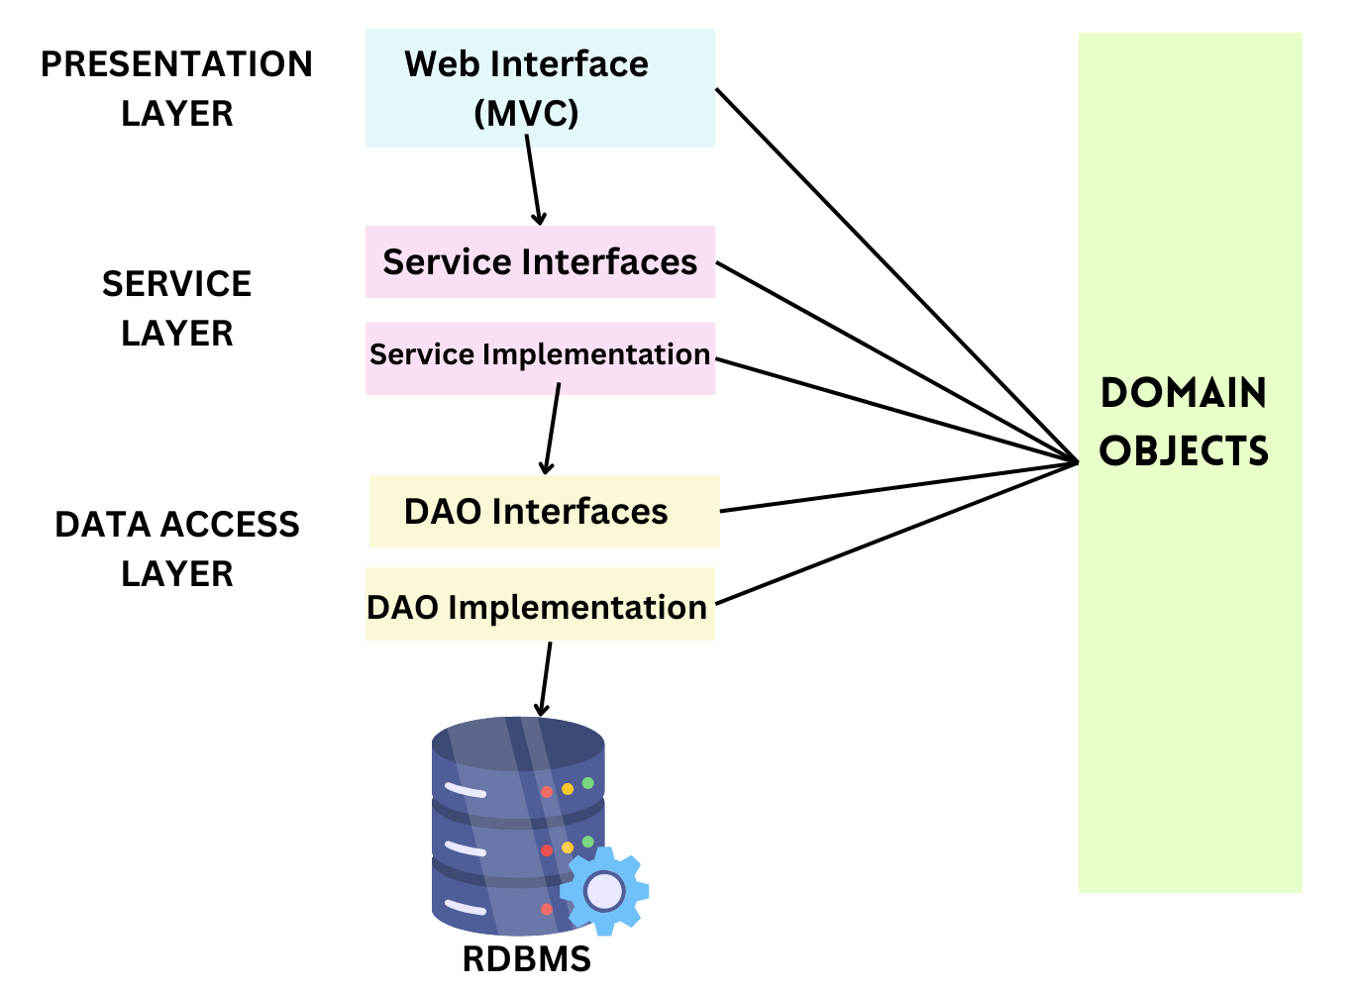
MVC Architecture With Business Logic and Data Access Layer

Slide 19
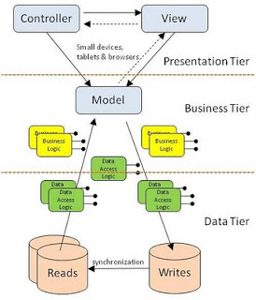

Slide 20
Interaction Between the Layers
User interactions begin in the Controller, where user inputs are received and initial processing occurs.
The Controller communicates with the Business Layer to execute business logic, invoking the appropriate services and operations.
The Business Layer may interact with the Data Access Layer to retrieve or update data from the database.
Data retrieved from the Data Access Layer is processed by the Business Layer before being presented to the user through the View.

Slide 21
Technologies and Frameworks
1. MVC Design Pattern Components:
Model: Represents the application's data and business logic.
Java for core business logic.
View: Handles user interface presentation.
Controller: Manages user input and controls application flow.
2. Business Layer (Service Layer):
Java classes or components for custom business logic.
Custom service classes that implement business operations and workflows specific to the application.
3. Data Access Layer:
Java Database Connectivity (JDBC): For direct interaction with databases using SQL queries.
Database: We have choose database system MySQL.

Slide 22
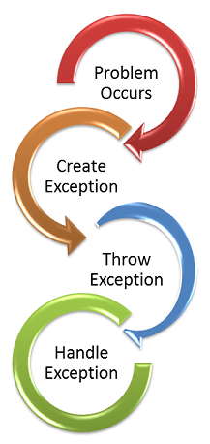
Exception Handling
Exception handling is like having a plan for when unexpected problems pop up in your software.
It helps your program deal with things like wrong inputs from users or issues with connecting to a database without crashing.
It gives your program the ability to show helpful error messages and, in some cases, try to recover from errors so that users can continue using the software smoothly.

Slide 23
Entity Relationship (ER)Diagram
An Entity-Relationship Diagram (ERD) is a visual tool that illustrates the structure of a database by representing entities, their attributes, and the relationships between them.
ERDs simplify database design and communication, making it easier to understand and plan how data is organized and connected in a database system.

Slide 24
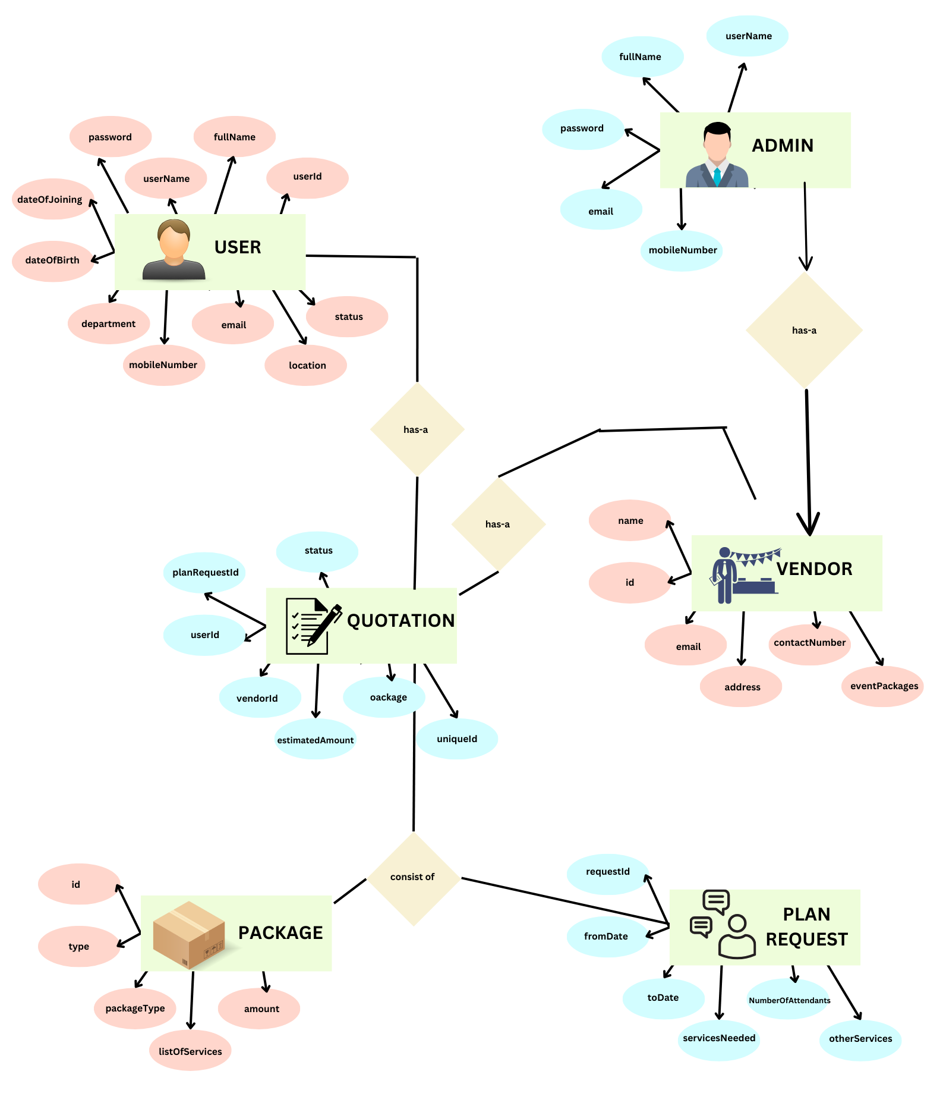
Entity RelationShip (ER)Diagaram

Slide 25
Class Diagram
A class diagram is a visual representation in software engineering that illustrates the structure of a software system by depicting classes, their attributes, methods, and relationships between them.
It helps software developers and architects plan, design, and document the organization of classes and objects in a system, facilitating clear communication and efficient software development.

Slide 26
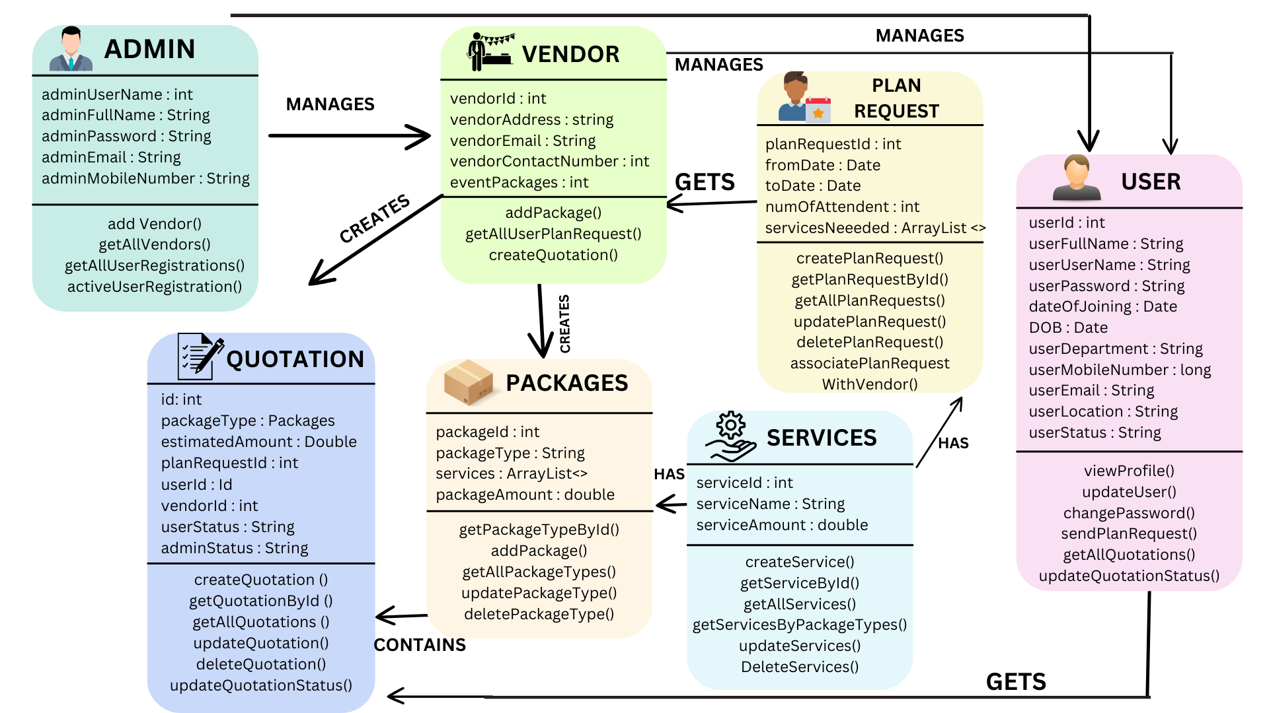
Class Diagram

Slide 27
06
Snapshots of Codes

Slide 28
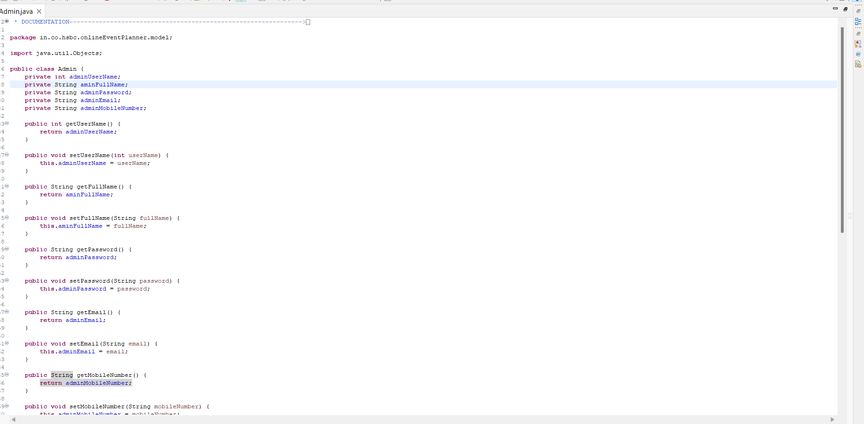
Model Class

Slide 29
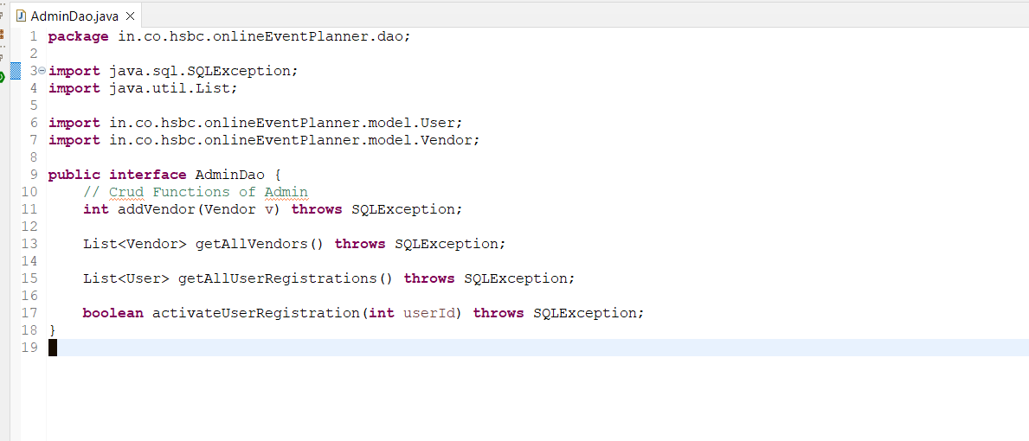
Data Access Layer (Dao Interface)

Slide 30
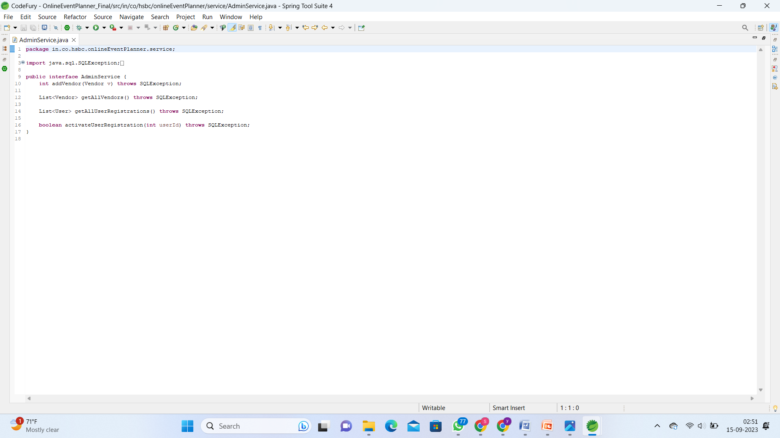
Business Layer(Service Interface)

Slide 31
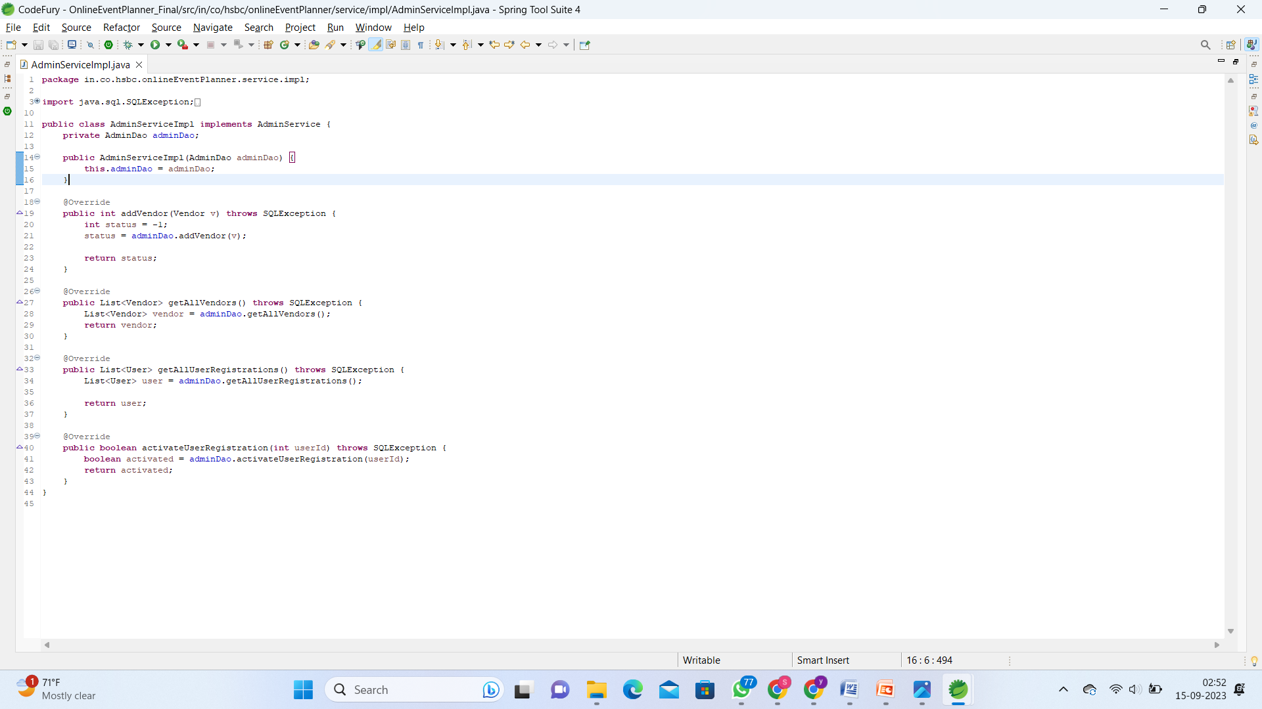
Business Layer (Service Impl)

Slide 32
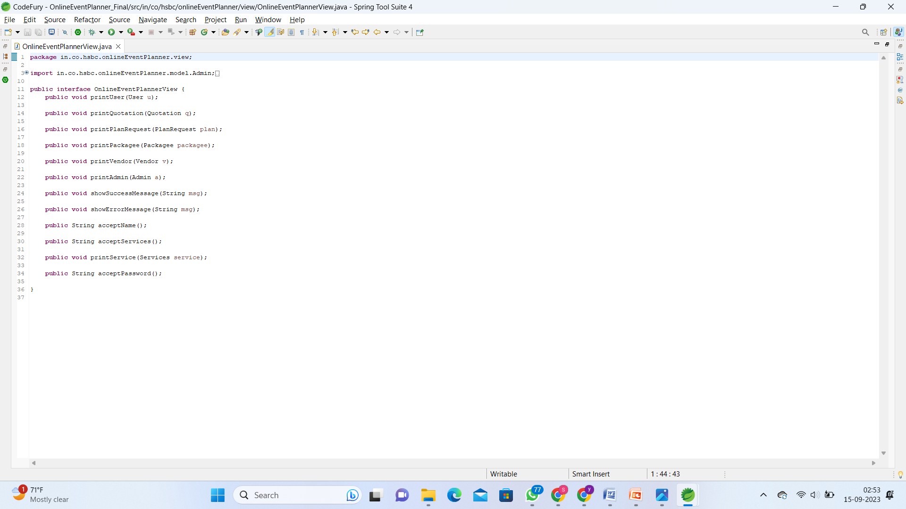
View Layer (View Interface)

Slide 33
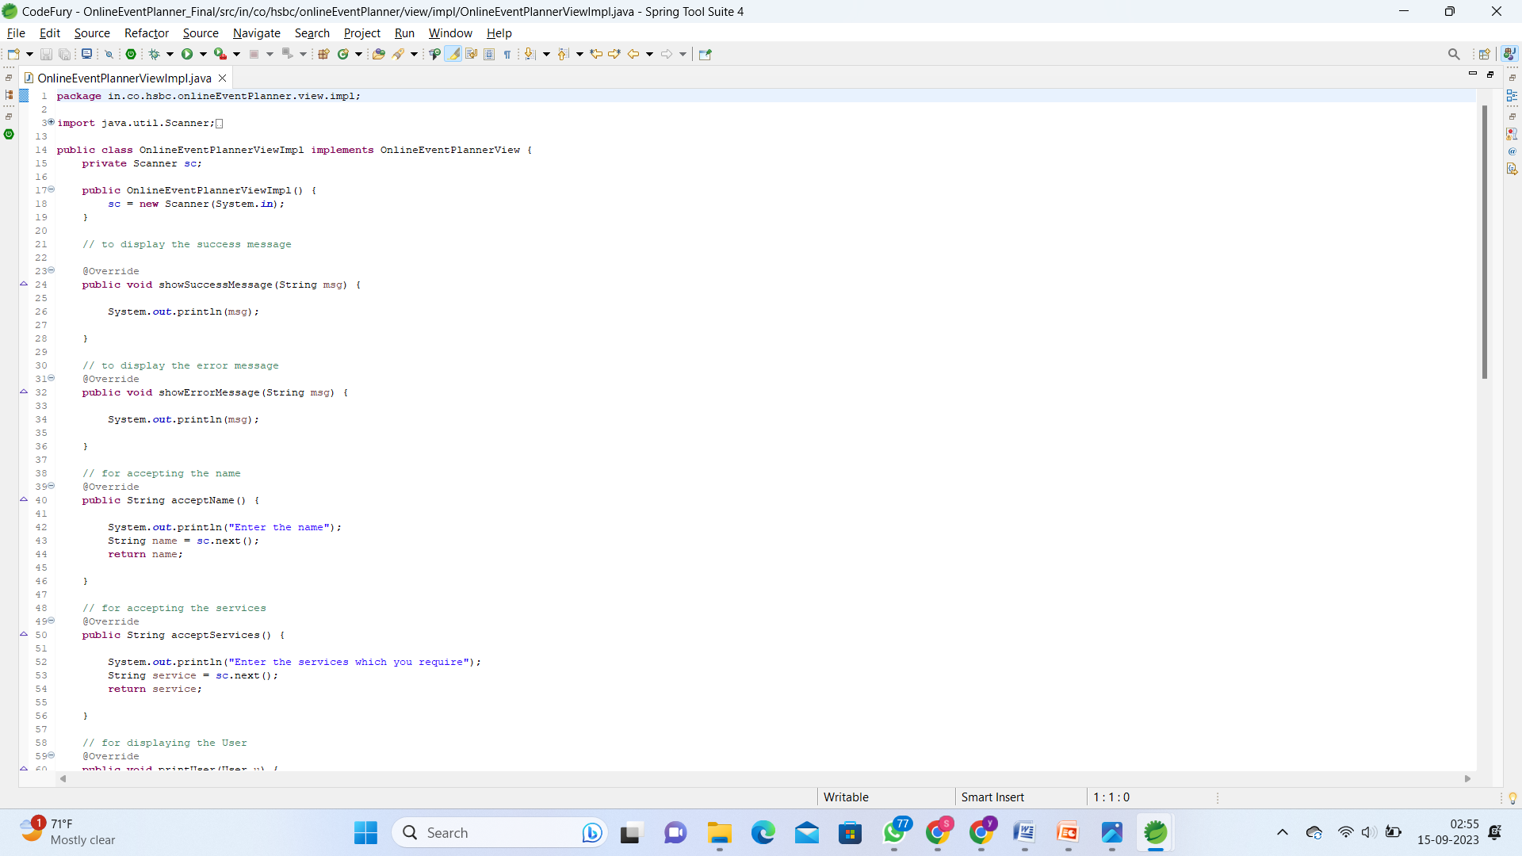
View Impl

Slide 34
07
Key Concepts & Learnings

Slide 35
MVC Magic
Java Journeys
Collaboration Chronicles
Here are the key concepts and learnings from our online Event Planner Website project
1
2
3
4
HTML, CSS, and JS Wizardry
We wielded the power of MVC (Model-View-Controller) architecture to elegantly divide and conquer our application. This made our codebase a symphony of efficiency, with crystal-clear boundaries between data management (Model) and the captivating user interface (View).
Our journey through Java programming was like a thrilling adventure. We embraced the world of object-oriented programming and became masters of data manipulation, all in the pursuit of crafting a stellar backend for our event planner.
On the frontend, we harnessed the mystical trio of HTML, CSS, and JavaScript to weave enchanting, responsive user interfaces that left our users spellbound.
Collaboration was the beating heart of our project. We formed a dynamic team that became a powerhouse of communication, teamwork, and project management skills. Together, we orchestrated a masterpiece.

Slide 36
Conclusion

Slide 37
In conclusion, our journey in creating the online Event Planner Website was a whirlwind of learning and innovation. We embraced the mighty MVC architecture, transforming our codebase into a harmonious symphony of data management (Model) and captivating user interfaces (View). Java programming became our trusted companion, leading us into the realm of object-oriented mastery and data manipulation. On the frontend, we conjured magic with HTML, CSS, and JavaScript, crafting captivating and responsive user interfaces that wowed our users. But the true heart of our success lay in collaboration, where we forged a dynamic team that mastered communication, teamwork, and project management. As we present our online Event Planner Website, we bring with us not just a digital platform, but a journey of growth, skill development, and a deep understanding of how to create an exceptional online experience

Slide 38
Thanks!
Team : DevEight
Team Members:
1. Anurag Singh
2. Atul Grover
3. Garima Goyal
4. Kritika Jain
5. Poorvi Sahu
6. Stuti Mongia
7. Yash Rajpurohit
8. Yasha Jain

