Slide 1
MARKS ANALYSER
PROJECT
PRESENTATION
Automated Response-Sheet Analysis System
A web-based platform that extracts responses from examination PDFs, calculates marks, and presents clear result analytics.
React
Express.js
Flask • MongoDB
YAMALAVALASA SRINIVAS
Master of Computer Applications
Noble Institute of Science & Technology | 2024–2026

Slide 2
Presentation Roadmap
A structured view of the project from problem to future scope
1
Problem & objectives
2
System analysis and proposed solution
3
Architecture and UML design
4
Implementation and technology stack
5
Testing, security, and future scope
MARKS ANALYSER • MCA PROJECT PRESENTATION
02

Slide 3
Project Overview
What Marks Analyser delivers
Purpose
Core Workflow
Automates objective-exam marks calculation from PDF response sheets.
Reduces manual checking, transcription errors, and repetitive calculations.
Provides candidate-level score summaries and response-wise analysis.
Upload a response sheet PDF.
Extract candidate details and marked responses.
Compare with answer key and marking scheme.
Store and present the calculated result.
MARKS ANALYSER • MCA PROJECT PRESENTATION
03

Slide 4
Problem Statement
Why a unified analysis system is needed
Manual response-sheet evaluation is slow and error-prone.
Spreadsheets and isolated scripts do not provide a consistent workflow.
PDF layouts require examination-aware extraction logic.
Administrators need traceable results, health visibility, and reliable error handling.
Manual process
Read PDF
Record answers
Compare key
Calculate marks
Prepare result
MARKS ANALYSER • MCA PROJECT PRESENTATION
04

Slide 5
Objectives of the Project
Target outcomes
Accept PDF response sheets through a simple web interface.
Extract candidate details and selected answers accurately.
Calculate correct, incorrect, unattempted, and total marks.
Persist results for retrieval and administration.
Support extensible examination-specific parsing pipelines.
Provide secure, maintainable, and monitorable services.
MARKS ANALYSER • MCA PROJECT PRESENTATION
05

Slide 6
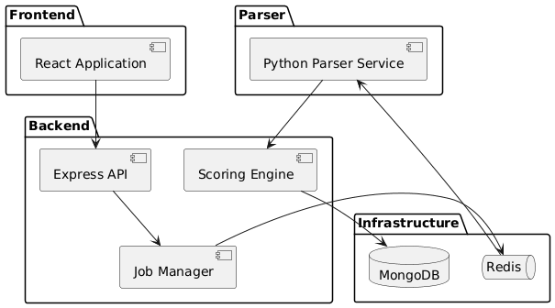
System Architecture
High-level component architecture
Frontend → Express API → Parser & Scoring → MongoDB / Redis
MARKS ANALYSER • MCA PROJECT PRESENTATION
06

Slide 7
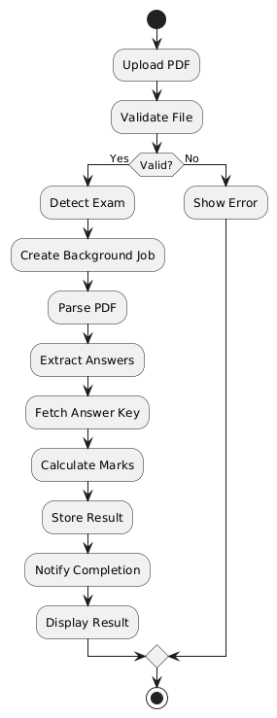
End-to-End Processing Flow
From PDF upload to result presentation
User uploads a PDF response sheet.
Backend validates type and size.
Parser extracts answers and candidate details.
Scoring compares answers with the key.
Result is stored and displayed.
Failures return clear, structured messages.
MARKS ANALYSER • MCA PROJECT PRESENTATION
07

Slide 8
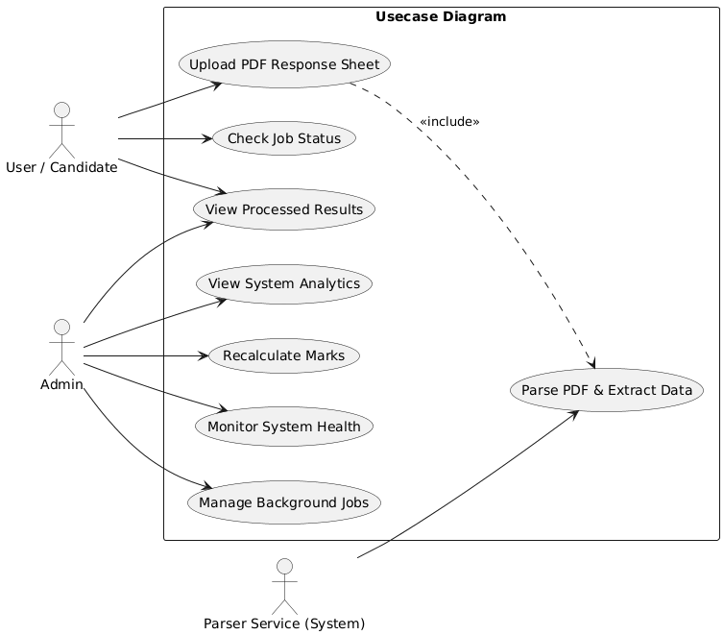
Use-Case Model
Actors and key system interactions
Candidate: upload response sheet and view result.
Administrator: review results, analytics, jobs, and health.
Parser service: extract PDF data for the analysis pipeline.
MARKS ANALYSER • MCA PROJECT PRESENTATION
08

Slide 9
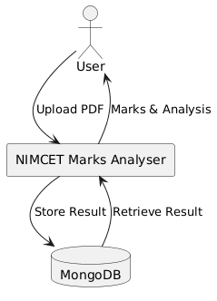
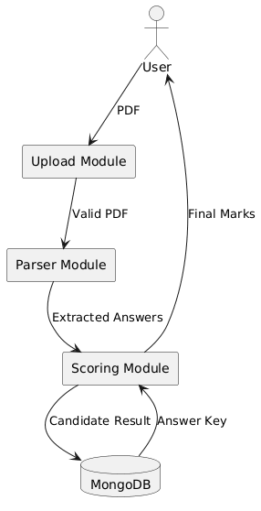
Data-Flow Design
Context and Level-1 data flow
Context view: user, system, and database
Level 1: upload, parser, scoring, storage
MARKS ANALYSER • MCA PROJECT PRESENTATION
09

Slide 10
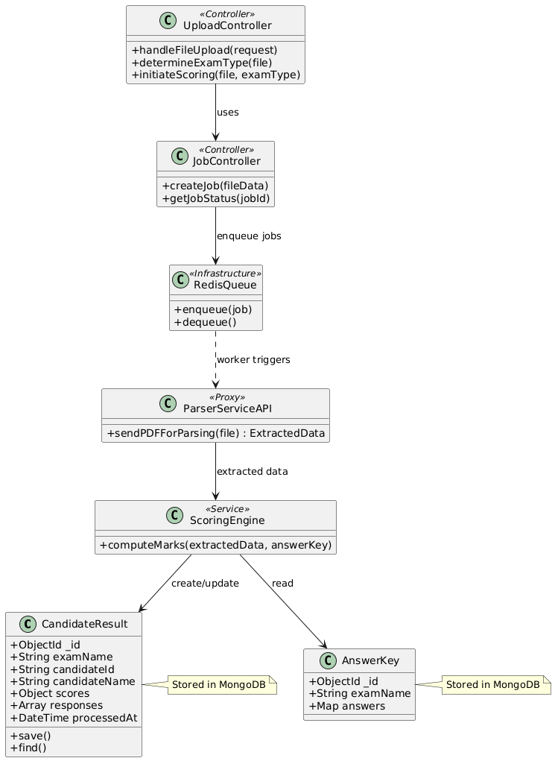
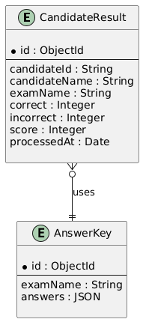
Data and Class Design
Persistent result data and application responsibilities
MARKS ANALYSER • MCA PROJECT PRESENTATION
10

Slide 11
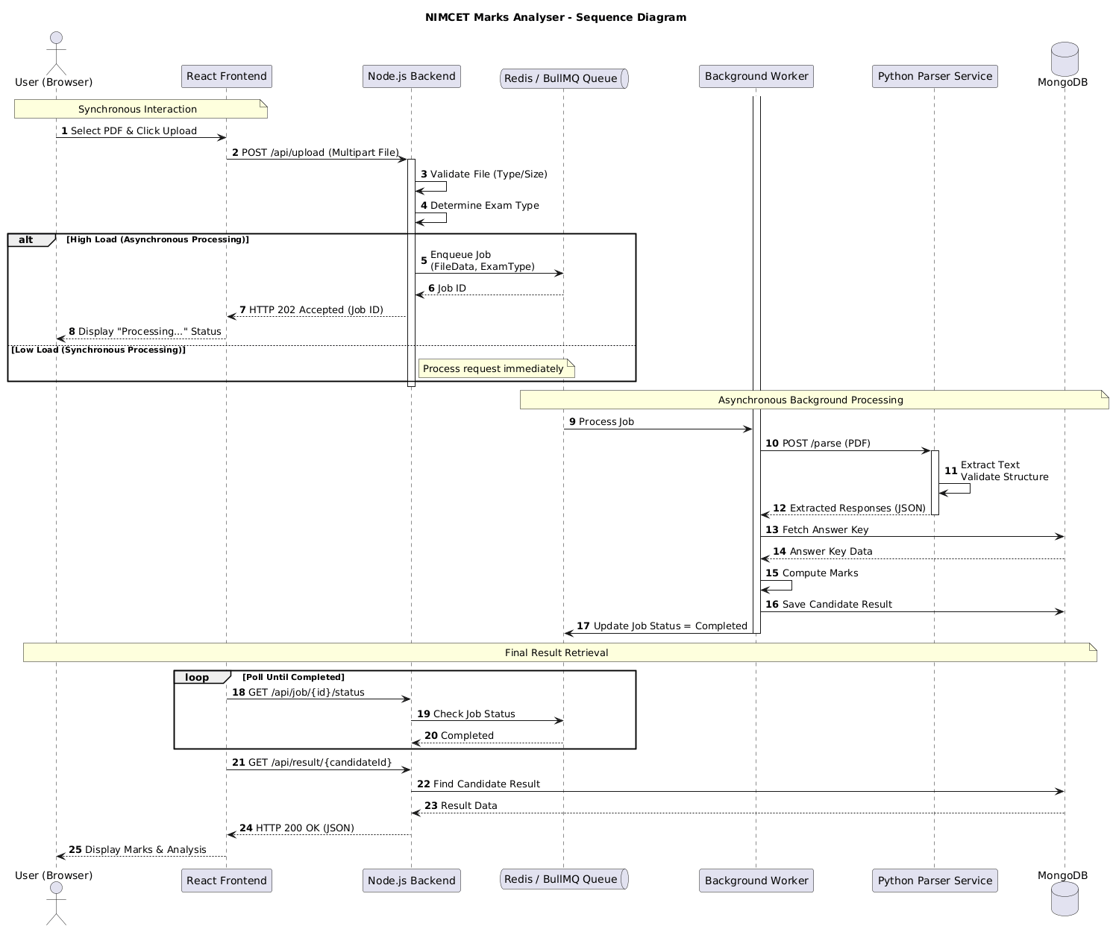
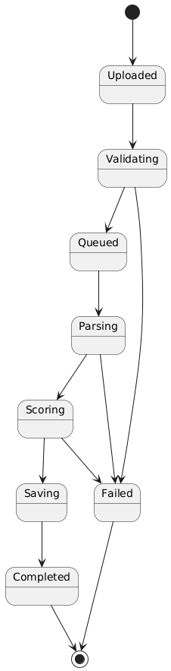
Sequence and State Models
Service collaboration and response-sheet lifecycle
MARKS ANALYSER • MCA PROJECT PRESENTATION
11

Slide 12
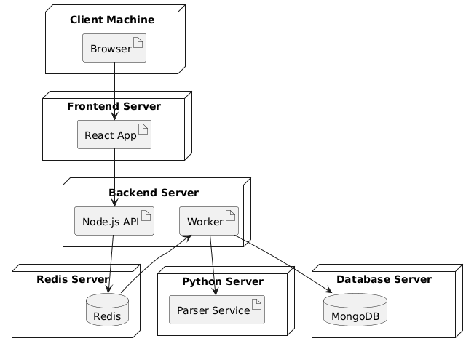
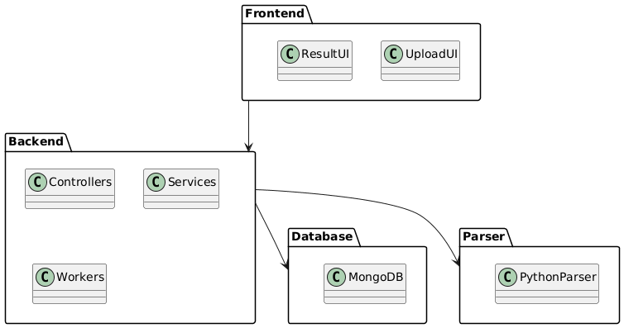
Package and Deployment Design
Logical organisation and runtime environment
Packages separate frontend, backend, parser, and data services.
Deployment separates browser, services, queue, and database.
MARKS ANALYSER • MCA PROJECT PRESENTATION
12

Slide 13
Technology Stack
Modern, modular, and extensible technologies
Application Layers
Data & Operations
Frontend: React 19, Vite, Axios, Recharts.
Backend: Node.js, Express, Mongoose, Multer.
Parser: Python, Flask, Flask-CORS.
Database: MongoDB for result persistence.
Queue: Redis, BullMQ, Bull Board.
Deployment: Docker, Docker Compose, Nginx.
Security: Helmet, CORS, rate limiting.
MARKS ANALYSER • MCA PROJECT PRESENTATION
13

Slide 14
Implementation Modules
Responsibilities by module
Frontend
Upload form, progress, result display, admin screens
Backend
Routes, validation, orchestration, authentication
Parser
PDF text extraction and exam-specific parsing
Scoring
Normalisation and marks calculation
Data services
MongoDB persistence and Redis queue processing
MARKS ANALYSER • MCA PROJECT PRESENTATION
14

Slide 15
Parser and Scoring Pipeline
Reliable transformation of PDF text into marks
1. Validate
2. Extract
3. Normalise
4. Score
5. Persist
Validate PDF type, size, and examination context.
→
→
Convert options into a consistent A–D representation.
→
→
Store traceable result and confidence information.
Detect candidate information and marked responses.
Apply answer key and marking rules.
Confidence information and structured errors support safe review of imperfect documents.
MARKS ANALYSER • MCA PROJECT PRESENTATION
15

Slide 16
Data, Queue, and Administration
Built for traceability and high-volume workloads
Result Management
Asynchronous Processing
Store exam, candidate data, responses, key, counts, and marks.
Support result retrieval and controlled recalculation.
Preserve timestamps for auditability.
BullMQ queues jobs when parsing should not block users.
Redis coordinates queued, active, completed, and failed work.
Admin pages expose results, job status, analytics, and health.
MARKS ANALYSER • MCA PROJECT PRESENTATION
16

Slide 17
Security and Reliability
Controls built into the service architecture
PDF-only upload validation and configurable file-size limits.
Helmet security headers, CORS policy, and request rate limiting.
Dedicated administrator authentication middleware.
Structured JSON errors and central exception handling.
Health checks, queue monitoring, and circuit-breaker support.
Recommended production controls: HTTPS, malware scanning, secret management, backups.
Reliability loop
Validate
Monitor
Recover
Improve
MARKS ANALYSER • MCA PROJECT PRESENTATION
17

Slide 18
Testing and Validation
Evidence-based verification
Test Coverage
Expected Quality
Valid PDF upload
Invalid file type and missing file
Unsupported examination selection
Correct scoring and answer normalisation
Parser confidence and extraction handling
Clear user-facing validation messages.
Correct marks for known test inputs.
Safe handling of service errors.
Persistent, retrievable result records.
Traceable testing evidence and regression checks.
MARKS ANALYSER • MCA PROJECT PRESENTATION
18

Slide 19
Future Enhancements
Opportunities for the next development cycle
Template-based OCR and image preprocessing for scanned sheets.
Additional examination formats and configurable marking schemes.
Bulk upload, PDF/CSV exports, and detailed dashboards.
Role-based access control and stronger administrator authentication.
Automated tests and continuous integration.
Machine-learning-assisted anomaly and answer-pattern detection.
MARKS ANALYSER • MCA PROJECT PRESENTATION
19

Slide 20
Thank You
Marks Analyser — Faster, clearer, and more traceable response-sheet analysis.
Questions & Discussion
YAMALAVALASA SRINIVAS | MCA Project Presentation

