Slide 1

Electricity Billing System
Submitted by : Atul
Id : 1911985038

Slide 2
INTRODUCTION
Online Billing System is an Executive Information System(EIS) that determines the bill of consumed power per unit time and performs computation based on the sale rate of power per unit time .
It provides an environment to maintain the consumer details.
In this system Customers are also complaint their issues just by logging into system.
It is well organized software solution for billing.

Slide 3

SCOPE OF PROJECT:
TO make the existing system more efficient.
To minimize the time.
Easy to pay the bill of electricity.
The main objective of Electricity Bill system is to manage the details of Electricity , Bill, Connections, Customer.

Slide 4
System Requirements
Windows 8 or more
Front end –Visual Studio Code for React
Backend – Intelli j for Spring Boot
Database –MY SQL

Slide 5
REQUIREMENTS
The Electricity Bill System shall be required to maintain information about its Admin and User.
It needs user credentials.
After Login, it needs New User’s data like name, Id, Password, Address, etc.
And also needs some validation.
We also need for Database to store our data.
Annual revenue growth

Slide 6
PROJECT AND OBJECTIVE:
To design a user friendly graphical user interface
It takes very less time.
We don’t have to remember the last month bill, it automatically saves in system.
User friendly and environment friendly.
We don’t need to stand in long lines.

Slide 7
Task of ADMIN:
Admin Login
Provide Reference Id to user
Add User
View all Bill
Add Bill
Show Users
Logout

Slide 8


HTML CSS JavaScript Bootstrap(React) My SQL workbench Java/Spring Boot Internet Connection
Development tools and techniques

Slide 9
Functional Requirements
Sign Up: The user should be able to sign up to setup a new account.
Login: All users should be able to login into the system.
View Bill: User should be able to view their electricity bill.
Pay Bill: User should be able to pay their electricity bill online.

Slide 10
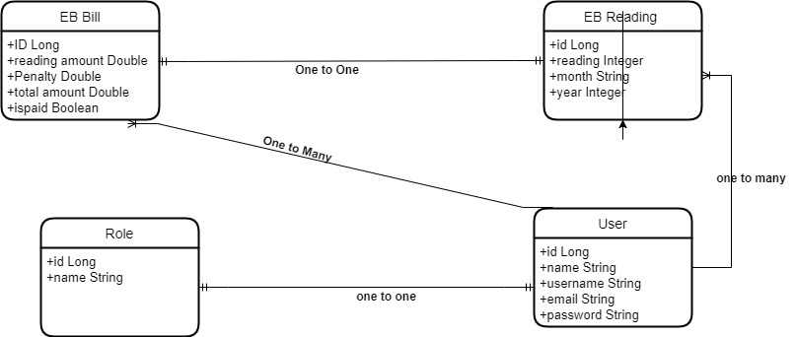
ENTITY RELATION

Slide 11
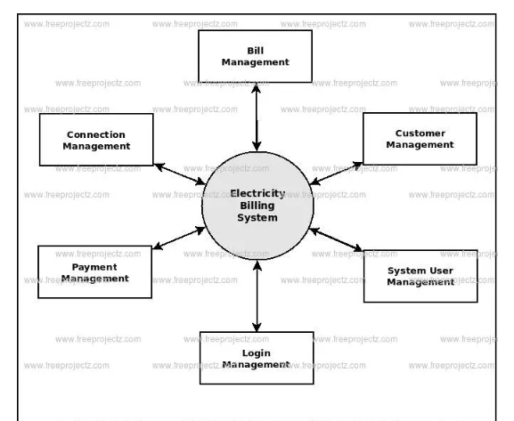
DFD DIAGRAM

Slide 12
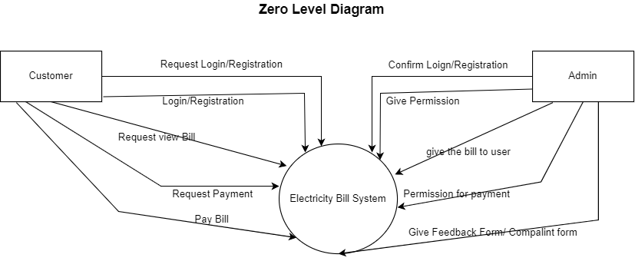

Slide 13
Non functional Requirements
Speed: The system should be fast to access and should not slow down.
Reliability: The system should be reliable to use all time.
Performance: The system should be able to perform good all times.
Security: The system should be secure to give the user of sense of security.
f

Slide 14
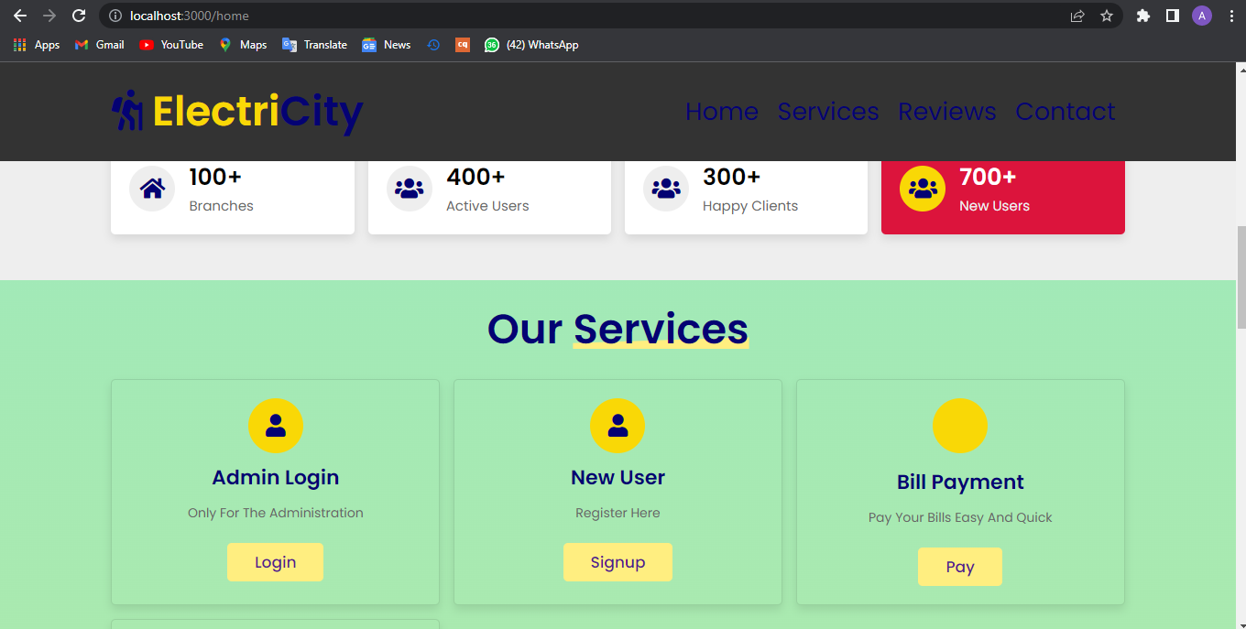
Screenshots

Slide 15
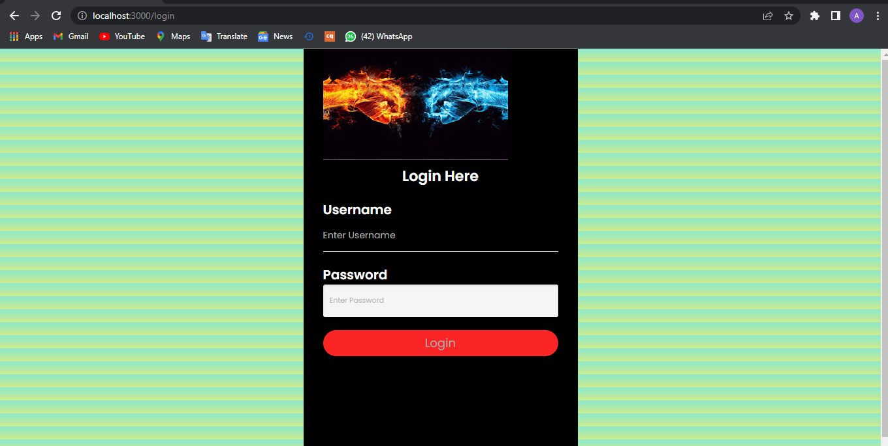

Slide 16
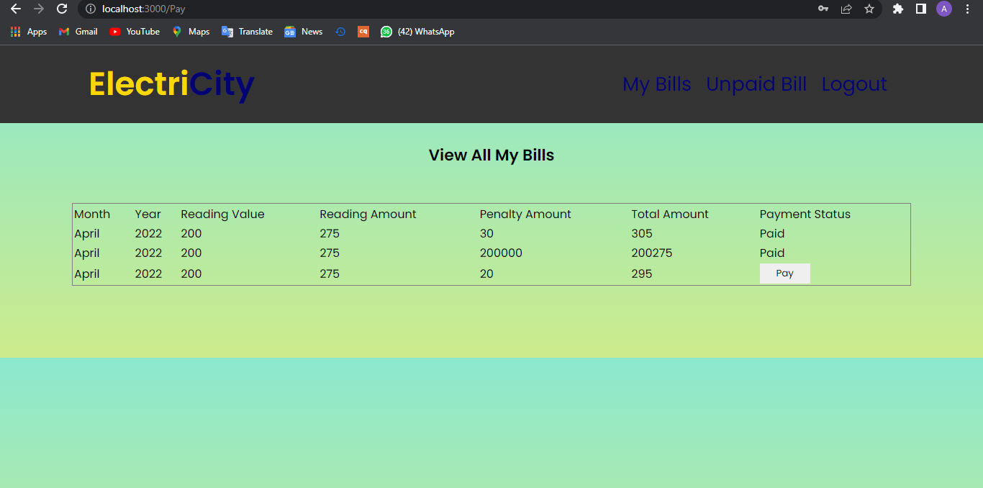

Slide 17
Future analysis
I have left very much options open so that if there is any other future requirement in the system by the user for the enhancement of the system then it is possible to implement them .
Developing Security features.
Forgot Password.
Barcode Scanning.
In the last I would like to thanks all the persons involved in the development of system directly or indirectly. I am also thankful to Chitkara University, to provide us a fruitful training.
I hope that the project will serve its purpose for which it is develop there by underlining success of process.

Slide 18


SUMMARY
The "Electricity Billing System" has been developed to override the problems prevailing in the practicing manual system. This software is supported to eliminate and in some cases reduce the hardships faced by this existing system. Moreover this system is designed for the particular need of the company to carry out operations in a smooth and effective manner.

Slide 19

THANK YOU
Atul
1911985038
atulbadole1612@gmail.com

