Slide 1
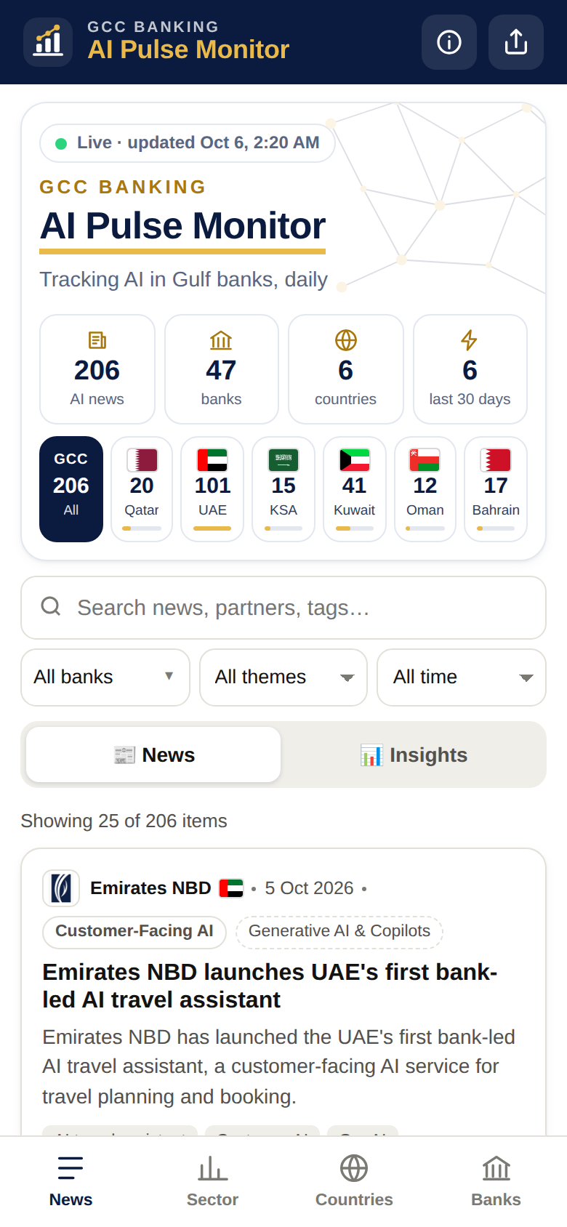
AI Pulse Monitor
GCC BANKING
Tracking AI in Gulf banks, daily
Solution overview · October 2026
atulchandorkar.github.io/gitproject
Notes:
A mobile dashboard that tracks every AI initiative announced by GCC banks, updated daily, with Telegram alerts.

Slide 2
One trusted view of AI across Gulf banking
A daily, fact-checked feed of what GCC banks are doing with AI, on any phone
206
47
6
101
verified AI items
banks with AI activity (74 tracked)
GCC countries covered
global sector insights
What
AI initiatives, investments, projects and outcomes from 74 GCC banks, plus global banking-AI studies and use cases.
Why
One reliable source for the Head of AI and leadership to benchmark peers and spot trends early.
How
An AI agent collects and fact-checks news daily; results go to a mobile dashboard and Telegram.
Notes:
Figures as of 6 October 2026 (first days of operation). Coverage grows with every daily run.

Slide 3




Why we built it
Tracking peers' AI moves by hand is slow, scattered and unreliable
Scattered sources
Noise and duplicates
No time to track
74 banks, 6 countries, English and Arabic press, bank newsrooms and annual reports.
The same story appears in many outlets; hype and fintech news blur the picture.
Leadership needs a quick, trusted view, not hours of searching every week.
The answer: an automated monitor that finds, verifies and organises every bank AI announcement, and pushes what is new.

Slide 4








What the solution does
Bank AI news
Telegram alerts
Smart filters
2-year history
74 GCC banks, English + Arabic
New items pushed daily
Country, bank, theme, period
Updated every morning
Verified
No duplicates
Annual reports
Global insights
Fact-checked, with sources
One card per story
AI highlights + PDF links
Studies, use cases, regulation
Notes:
Also: charts of AI themes, tech partners and monthly trends; designed for phones; shareable by link.

Slide 5
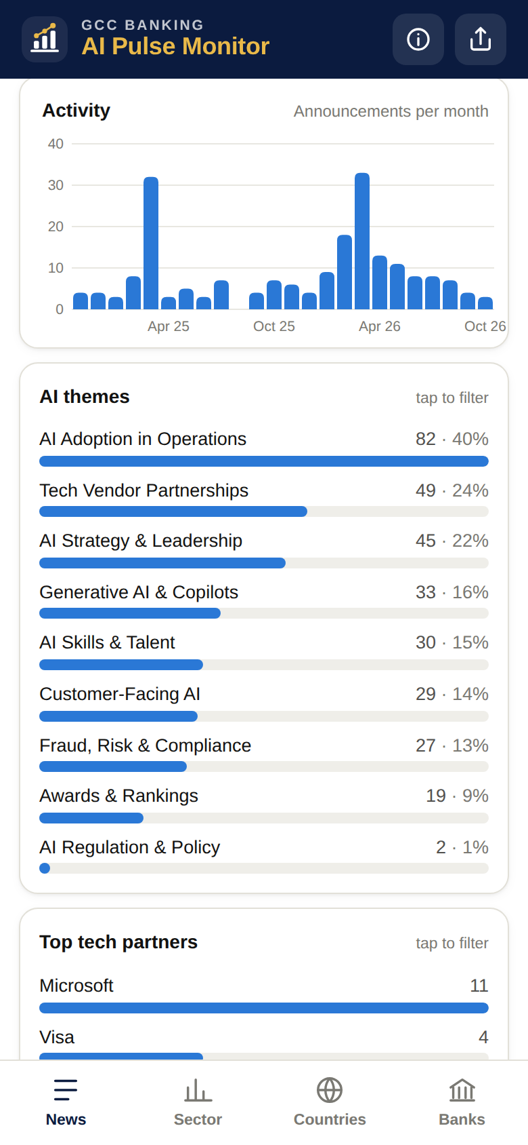
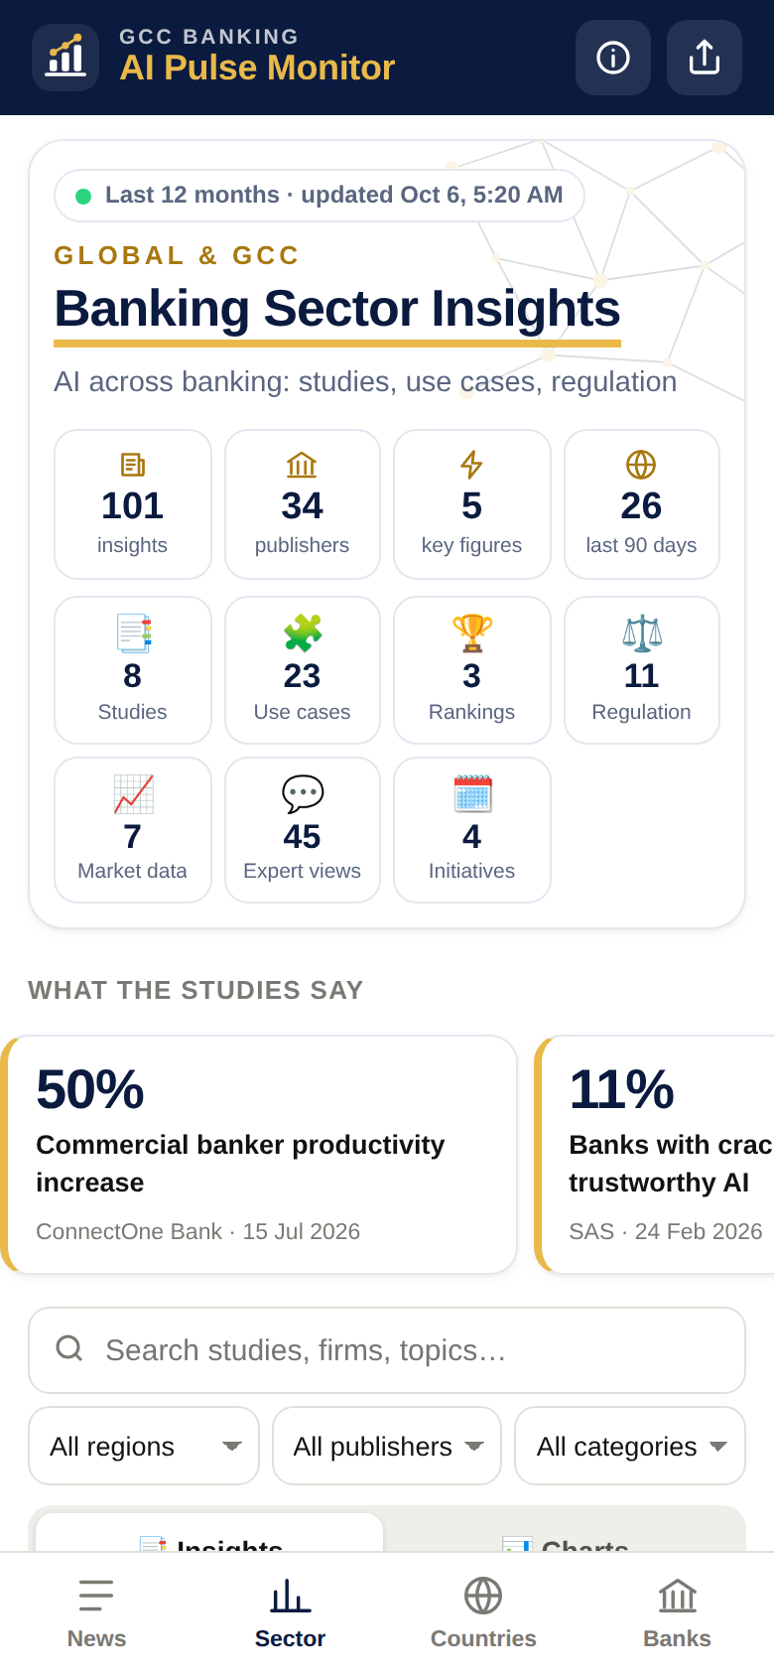
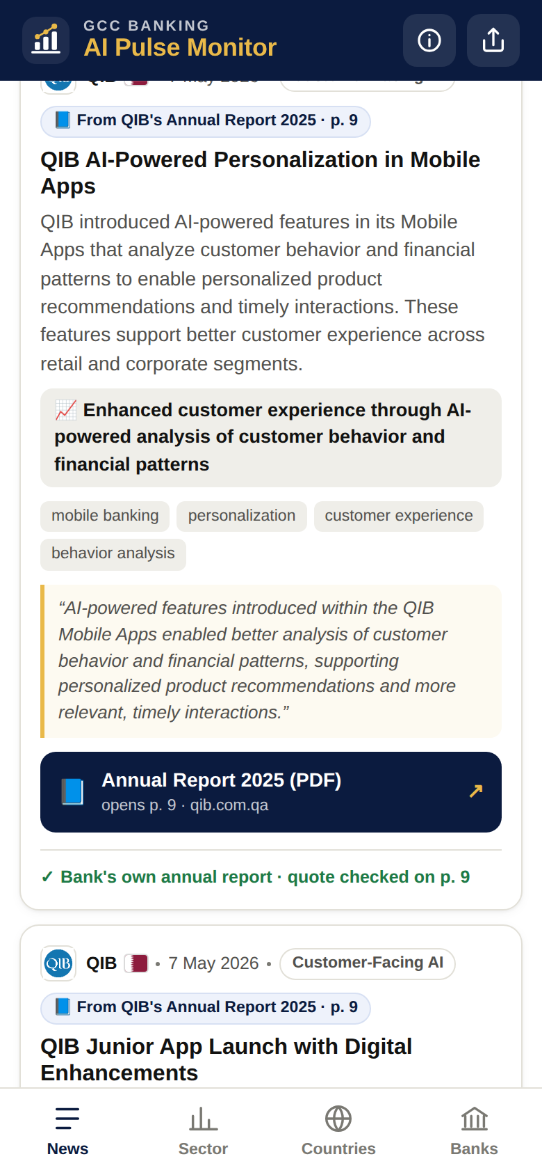
Built for the phone, shareable by link
News feed
Insights
Sector insights
Annual reports
Live KPIs, country strip and verified bank AI news
AI themes, tech partners and monthly trend
Global studies, use cases, regulation
Exact quote and link to the PDF page

Slide 6



How it works: one automated run every morning
Runs daily at 06:17 Qatar time; no manual effort
1
2
3
4
5
6
Collect
›
Screen
›
Verify
›
Merge
›
Publish
›
Alert
News feeds (EN/AR), bank newsrooms, annual reports, consultancy pages
Keyword filter, then AI keeps only bank AI items
Facts, numbers and source checked
Same story merged into one card
Dashboard refreshed with charts
New items sent to Telegram
AI is used only where judgement is needed (screening, fact-checking, summaries); everything else is free, rule-based automation.

Slide 7






Architecture: simple, serverless and low-cost
SOURCES
PROCESSING
OUTPUTS
Google News (EN + AR)
AI agent (Python)
GitHub Actions · daily 06:17 Qatar
Data store
JSON files in GitHub
Bank newsrooms
Discover
Screen
Dashboard
GitHub Pages, mobile
Bank annual reports (PDF)
Verify
De-duplicate
Annual reports
Sector insights
Telegram bot
Daily alerts
Consultancy & regulator pages
Logos
Alerts
Claude Haiku 4.5 (Anthropic API)
Screening, fact-checks, summaries
Notes:
No servers to run: GitHub Actions does the work, GitHub Pages hosts the site, data is versioned in the repository (full audit history).

Slide 8
Components at a glance
Component | What it does | Technology
Collector | Finds bank AI news daily (feeds, newsrooms) | Python, Google News RSS
AI screener & fact-checker | Keeps bank AI items, checks every claim, writes summaries | Claude Haiku 4.5
De-duplicator | Merges the same story into one card, conservatively | Word match + AI check
Annual-report reader | Extracts AI highlights from bank annual reports | pypdf + Claude
Sector insights | Global studies, use cases, regulation | Python + Claude
Scheduler | Runs everything daily at 06:17 Qatar | GitHub Actions
Data store | All items, sources and audit log, versioned | JSON in GitHub repo
Dashboard | Mobile web app, filters and charts | GitHub Pages (HTML/JS)
Alerts | Pushes new items to phones | Telegram bot

Slide 9
Built for accuracy: every item is checked
1
Real source
Links come from news feeds or bank sites, never from the AI
2
Bank named
The bank must be named in the source (English or Arabic)
One story, one card
Merged only when the AI is highly confident and a shared detail (person, product, partner) is in both stories.
3
No invented numbers
Every figure must appear in the source
4
Independent AI fact-check
A second AI pass checks each claim against the article
Annual reports: quote-checked
Shown only if the exact quote is found on that page of the bank's PDF.
5
Trusted or confirmed
Official or reputable outlet, or a second outlet confirms it
Notes:
Items that fail are logged with the reason (audit trail). Items from unknown outlets wait up to 21 days for a second source.

Slide 10
Coverage after the first days
Verified AI items by country (as of 6 Oct 2026, growing daily)
97
AI highlights from 30 annual reports
18
banks' annual reports read so far
90
global studies and use cases

Slide 11



What GCC banks are doing with AI
Share of items per theme; an item can have several themes
Operations first
Most activity is AI inside the bank: credit, KYC, back office.
Vendors matter
Microsoft is the top partner (11 items), then Visa and NVIDIA.
Leadership moves
ADIB and ADCB have appointed Chief AI Officers.

Slide 12


Low cost, no servers, no manual work
Item | Cost
GitHub hosting & automation | Free
Google News & bank sites | Free
Telegram alerts | Free
Claude Haiku 4.5 (AI checks) | ≈ $1–5 / month
One-time history load | A few dollars
Daily at 06:17 Qatar
Fully automatic; can also be run on demand
Public data only
No bank or customer data; public sources only
Shareable link
Opens on any phone; no app or login
A monthly spend limit is set in the Anthropic console; if credit runs out, the run stops safely and sends a Telegram alert.

Slide 13
Next steps
NOW
NEXT
OPTIONS
Complete coverage
Share more widely
Extend
Annual reports for all 74 banks
Proper logos for the remaining banks
Full 12 months of global insights
Roll out the link to leadership
Telegram channel for the AI team
Monthly AI benchmark summary
Private access (sign-in) if needed
Peer scorecard per bank
Arabic interface

Slide 14
AI Pulse Monitor
GCC BANKING
Open it on your phone:
atulchandorkar.github.io/gitproject

