Slide 1
Web Designing | PHP

Slide 2
What is PHP?
PHP started out as a small open source project that evolved as more and more people found out how useful it was. Rasmus Lerdorf unleashed the first version of PHP way back in 1994.
PHP is a recursive acronym for "PHP: Hypertext Preprocessor".
PHP is a server side scripting language that is embedded in HTML. It is used to manage dynamic content, databases, session tracking, even build entire ecommerce sites.
It is integrated with a number of popular databases, including MySQL, PostgreSQL, Oracle, Sybase, Informix, and Microsoft SQL Server.
PHP Syntax is C-Like.

Slide 3
Uses of Php
PHP performs system functions, i.e. from files on a system it can create, open, read, write, and close them. The other uses of PHP are:
PHP can handle forms, i.e. gather data from files, save data to a file, thru email you can send data, return data to the user.
You add, delete, modify elements within your database through PHP.
Access cookies variables and set cookies.
Using PHP, you can restrict users to access some pages of your website.
It can encrypt data.

Slide 4
Characteristics
Five important characteristics make PHP's practical nature possible:
Simplicity
Efficiency
Security
Flexibility
Familiarity

Slide 5
Example-Hello World
<html>
<head>
<title>Hello World</title>
<body>
<?php echo "Hello, World!";?>
</body>
</html>
Output : Hello, World!

Slide 6
Case Sensitive
<html>
<head>
<title>Hello World</title>
<body>
<?php
$random = 67;
echo("Variable random is $random<br>");
echo("Variable RANdom is $RANdam<br>");
?>
</body>
</html>

Slide 7
White Space Insensitive
<?php
$four = 2 + 2; // single spaces
$four <tab>=<tab2<tab>+<tab>2 ; // spaces and tabs
$four =
2+
2; // multiple lines
?>
No Effect

Slide 8
Variable Types

Slide 9
Introduction
The main way to store information in the middle of a PHP program is by using a variable.
Here are the most important things to know about variables in PHP.
All variables in PHP are denoted with a leading dollar sign ($).
The value of a variable is the value of its most recent assignment.
Variables are assigned with the = operator, with the variable on the left-hand side and the expression to be evaluated on the right.
Variables used before they are assigned have default values.
PHP does a good job of automatically converting types from one to another when necessary.

Slide 10
Continued
PHP has a total of eight data types which we use to construct our variables:
Integers: are whole numbers, without a decimal point, like 4195.
Doubles: are floating-point numbers, like 3.14159 or 49.1.
Booleans: have only two possible values either true or false.
NULL: is a special type that only has one value: NULL.
Strings: are sequences of characters, like 'PHP supports string operations.'
Arrays: are named and indexed collections of other values.
Objects: are instances of programmer-defined classes, which can package up both other kinds of values and functions that are specific to the class.
Resources: are special variables that hold references to resources external to PHP (such as database connections).

Slide 11
Variable Naming
Rules for naming a variable is:
Variable names must begin with a letter or underscore character.
A variable name can consist of numbers, letters, underscores but you cannot use characters like + , - , % , ( , ) . & , etc
There is no size limit for variables.

Slide 12
PHP Variables
Scope can be defined as the range of availability a variable has to the program in which it is declared. PHP variables can be one of four scope types:
Local variables
Function parameters
Global variables
Static variables

Slide 13
PHP Local Variable
A variable declared in a function is considered local; that is, it can be referenced solely in that function. Any assignment outside of that function will be considered to be an entirely different variable from the one contained in the function:
<?php
$x = 4;
function assignx () {
$x = 0;
print "\$x inside function is $x. <br> ";
}
assignx();
print "\$x outside of function is $x. ";
?>

Slide 14
PHP Function Parameters
A function is a small unit of program which can take some input in the form of parameters and does some processing and may return a some value.
Function parameters are declared after the function name and inside parentheses. They are declared much like a typical variable would be:
<?php
// multiply a value by 10 and return it to the caller
function multiply ($value) {
$value = $value * 10;
return $value;
}
$retval = multiply (10);
Print "Return value is $retval\n";
?>

Slide 15
PHP Global Variables
A global variable can be accessed in any part of the program. However, in order to be modified, a global variable must be explicitly declared to be global in the function in which it is to be modified.
This is accomplished, conveniently enough, by placing the keyword GLOBAL in front of the variable that should be recognized as global.
Placing this keyword in front of an already existing variable tells PHP to use the variable having that name.

Slide 16
Example
<?php
$somevar = 15;
function addit() {
GLOBAL $somevar;
$somevar++;
print "Somevar is $somevar";
}
addit();
?>

Slide 17
PHP Static Variables
The final type of variable scoping that we discuss is known as static. In contrast to the variables declared as function parameters, which are destroyed on the function's exit, a static variable will not lose its value when the function exits and will still hold that value should the function be called again.
You can declare a variable to be static simply by placing the keyword STATIC in front of the variable name.

Slide 18
Example
<?php
function keep_track() {
STATIC $count = 0;
$count++;
print $count;
print " "; }
keep_track();
keep_track();
keep_track();
keep_track();
?>

Slide 19
Constants
A constant is a name or an identifier for a simple value. A constant value cannot change during the execution of the script. By default a constant is case-sensitive. By convention, constant identifiers are always uppercase. A constant name starts with a letter or underscore, followed by any number of letters, numbers, or underscores. If you have defined a constant, it can never be changed or undefined.
To define a constant you have to use define() function and to retrieve the value of a constant, you have to simply specifying its name. Unlike with variables, you do not need to have a constant with a $. You can also use the function constant
constant() function
As indicated by the name, this function will return the value of the constant.
This is useful when you want to retrieve value of a constant, but you do not know its name, i.e. It is stored in a variable or returned by a function.
Only scalar data (boolean, integer, float and string) can be contained in constants.

Slide 20
Constant example
<html>
<head>
<title>Hello World</title>
<body>
<?php
define("MINSIZE", 50);
echo MINSIZE;
echo '<br>';
echo constant("MINSIZE"); // same thing as the previous line
?>
</body>
</html>

Slide 21
Valid & Invalid Constants
// Valid constant names
define("ONE", "first thing");
define("TWO2", "second thing");
define("THREE_3", "third thing")
// Invalid constant names
define("2TWO", "second thing");
define("__THREE__", "third value");

Slide 22
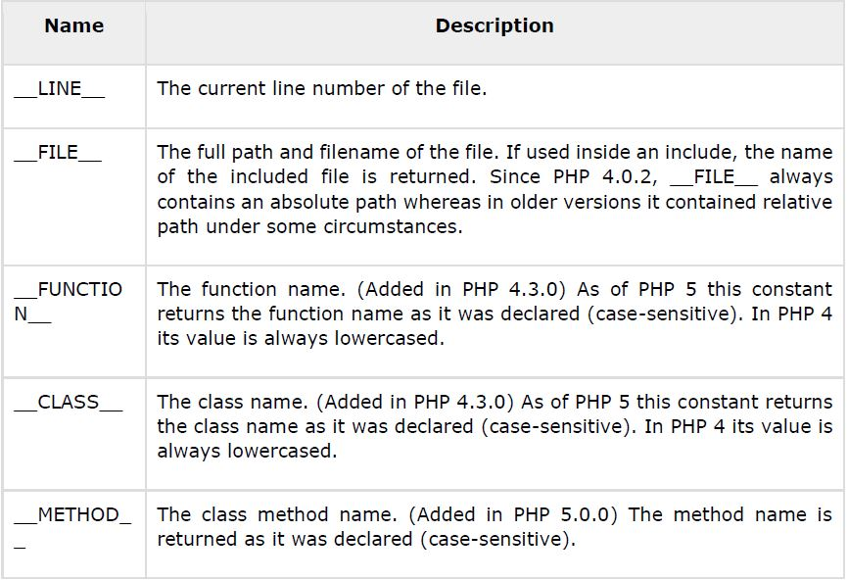
PHP Magic Constants

Slide 23
Operator Types

Slide 24
Operators
What is Operator? Simple answer can be given using expression 4 + 5 is equal to 9. Here 4 and 5 are called operands and + is called operator. PHP language supports following type of operators.
Arithmetic Operators
Comparison Operators
Logical (or Relational) Operators
Assignment Operators
Conditional (or ternary) Operators

Slide 25
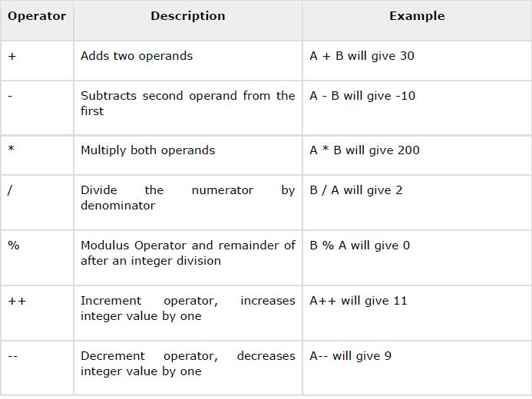
Arithmetic Operators
Assume variable A holds 10 and variable B holds 20 then:

Slide 26
Example
<?php
$a = 42;
$b = 20;
$c = $a + $b;
echo "Addition Operation Result: $c <br/>";
$c = $a - $b;
echo "Subtraction Operation Result: $c <br/>";
$c = $a * $b;
echo "Multiplication Operation Result: $c <br/>";
$c = $a / $b;
echo "Division Operation Result: $c <br/>";
$c = $a % $b;
echo "Modulus Operation Result: $c <br/>";
$c = $a++;
echo "Increment Operation Result: $c <br/>";
$c = $a--;
echo "Decrement Operation Result: $c <br/>";
?>

Slide 27
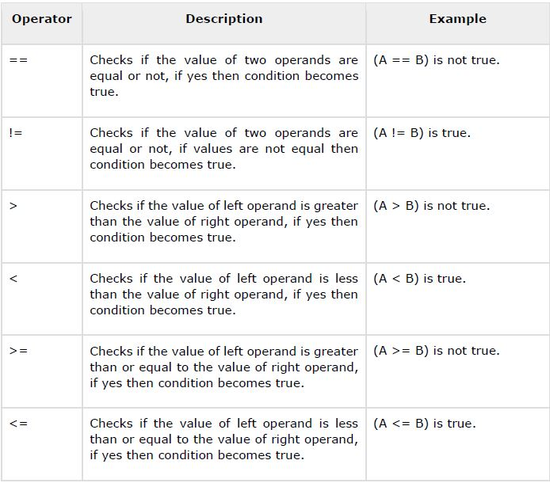
Comparison Operators
Assume variable A holds 10 and variable B holds 20 then:

Slide 28
Example
<?php
$a = 42;
$b = 20;
if( $a == $b ){
echo "TEST1 : a is equal to b<br/>";
}else{
echo "TEST1 : a is not equal to b<br/>";
}
if( $a > $b ){
echo "TEST2 : a is greater than b<br/>";
}else{
echo "TEST2 : a is not greater than b<br/>";
}
if( $a < $b ){
echo "TEST3 : a is less than b<br/>";
}else{
echo "TEST3 : a is not less than b<br/>";
}
if( $a != $b ){
echo "TEST4 : a is not equal to b<br/>";
}else{
echo "TEST4 : a is equal to b<br/>";
}
if( $a >= $b ){
echo "TEST5 : a is either greater than or equal to b<br/>";
}else{
echo "TEST5 : a is neither greater than nor equal to b<br/>";
}
if( $a <= $b ){
echo "TEST6 : a is either less than or equal to b<br/>";
}else{
echo "TEST6 : a is neither less than nor equal to b<br/>";
}
?>

Slide 29
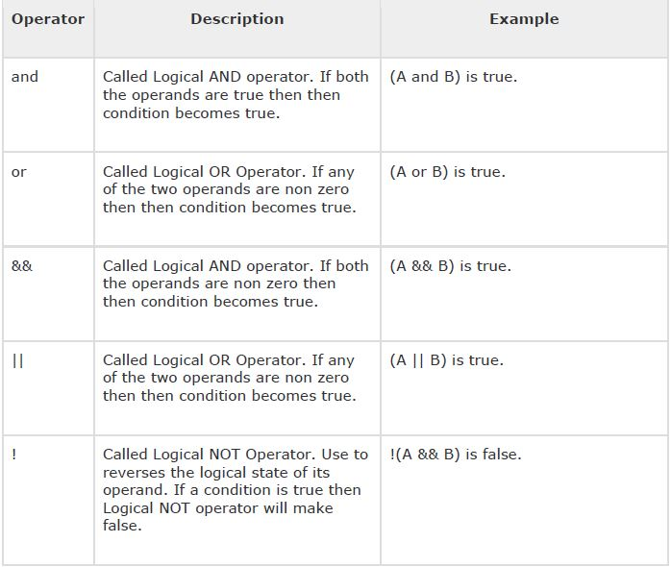
Logical Operators
Assume variable A holds 10 and variable B holds 20 then:

Slide 30
Example
<?php
$a = 42;
$b = 0;
if( $a && $b ){
echo "TEST1 : Both a and b are true<br/>";
}else{
echo "TEST1 : Either a or b is false<br/>";
}
if( $a and $b ){
echo "TEST2 : Both a and b are true<br/>";
}else{
echo "TEST2 : Either a or b is false<br/>";
}
if( $a || $b ){
echo "TEST3 : Either a or b is true<br/>";
}else{
echo "TEST3 : Both a and b are false<br/>";
}
if( $a or $b ){
echo "TEST4 : Either a or b is true<br/>";
}else{
echo "TEST4 : Both a and b are false<br/>";
}
$a = 10;
$b = 20;
if( $a ){
echo "TEST5 : a is true <br/>";
}else{
echo "TEST5 : a is false<br/>";
}

Slide 31
Example
if( $b ){
echo "TEST6 : b is true <br/>";
}else{
echo "TEST6 : b is false<br/>";
}
if( !$a ){
echo "TEST7 : a is true <br/>";
}else{
echo "TEST7 : a is false<br/>";
}
if( !$b ){
echo "TEST8 : b is true <br/>";
}else{
echo "TEST8 : b is false<br/>";
}
?>

Slide 32
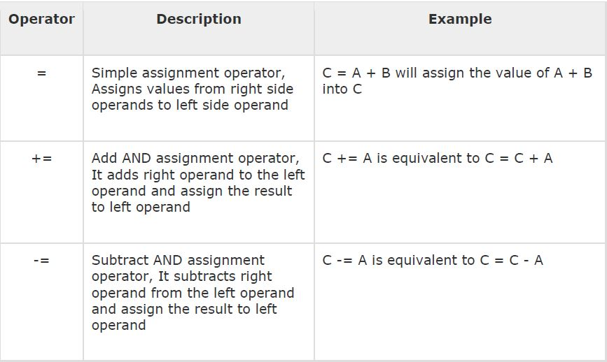
Assignment Operators

Slide 33
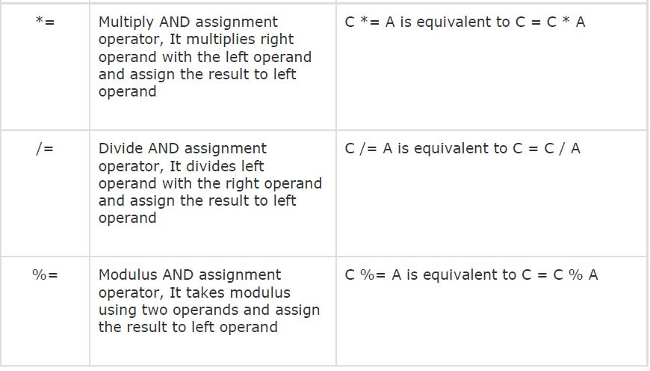
Assignment Operators

Slide 34
Example
<?php
$a = 42;
$b = 20;
$c = $a + $b; /* Assignment operator */
echo "Addition Operation Result: $c <br/>";
$c += $a; /* c value was 42 + 20 = 62 */
echo "Add AND Assignment Operation Result: $c <br/>";
$c -= $a; /* c value was 42 + 20 + 42 = 104 */
echo "Subtract AND Assignment Operation Result: $c <br/>";
$c *= $a; /* c value was 104 - 42 = 62 */
echo "Multiply AND Assignment Operation Result: $c <br/>";
$c /= $a; /* c value was 62 * 42 = 2604 */
echo "Division AND Assignment Operation Result: $c <br/>";
$c %= $a; /* c value was 2604/42 = 62*/
echo "Modulus AND Assignment Operation Result: $c <br/>";
?>

Slide 35
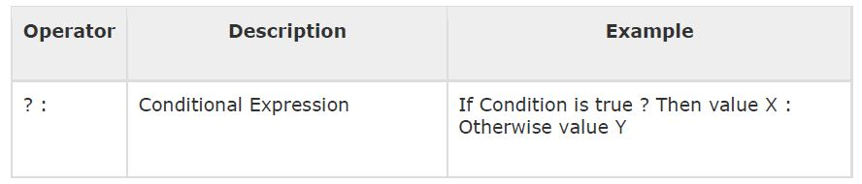
Conditional Operators

Slide 36
Example
<?php
$a = 10;
$b = 20;
/* If condition is true then assign a to result otherwise b */
$result = ($a > $b ) ? $a :$b;
echo "TEST1 : Value of result is $result<br/>";
/* If condition is true then assign a to result otherwise b */
$result = ($a < $b ) ? $a :$b;
echo "TEST2 : Value of result is $result<br/>";
?>

Slide 37
Decision Making

Slide 38
Decision Making
PHP supports following three decision making statements:
if...else statement - use this statement if you want to execute a set of code when a condition is true and another if the condition is not true
elseif statement - is used with the if...else statement to execute a set of code if one of several condition are true
switch statement - is used if you want to select one of many blocks of code to be executed, use the Switch statement. The switch statement is used to avoid long blocks of if..elseif..else code.

Slide 39
The If...Else Statement
If you want to execute some code if a condition is true and another code if a condition is false, use the if....else statement.
if (condition)
code to be executed if condition is true;
else
code to be executed if condition is false;

Slide 40
Example
<html>
<head>
<title>Hello World</title>
<body>
<?php
$d=date("D");
if ($d=="Fri")
{
echo "Hello!<br />";
echo "Have a nice weekend!";
}
else
{
echo "Be Busy";
}
?>
</body> </html>

Slide 41
The Else..If Statement
If you want to execute some code if one of the several conditions is true, then use the elseif statement.
if (condition)
code to be executed if condition is true;
elseif (condition)
code to be executed if condition is true;
else
code to be executed if condition is false;

Slide 42
Example
<html>
<body>
<?php
$d=date("D");
if ($d=="Fri")
echo "Have a nice weekend!";
elseif ($d=="Sun")
echo "Have a nice Sunday!";
else
echo "Have a nice day!";
?>
</body>
</html>

Slide 43
The Switch Statement
If you want to select one of many blocks of code to be executed, use the Switch statement.
The switch statement is used to avoid long blocks of if..elseif..else code.
switch (expression)
{
case label1:
code to be executed if expression = label1;
break;
case label2:
code to be executed if expression = label2;
break;
default:
code to be executed
if expression is different
from both label1 and label2;
}

Slide 44
Example
<html>
<body>
<?php
$d=date("D");
switch ($d)
{
case "Mon":
echo "Today is Monday";
break;
case "Tue":
echo "Today is Tuesday";
break;
case "Wed":
echo "Today is Wednesday";
break;
case "Thu":
echo "Today is Thursday";
break;
case "Fri":
echo "Today is Friday";
break;
case "Sat":
echo "Today is Saturday";
break;
case "Sun":
echo "Today is Sunday";
break;
default:
echo "Wonder which day is this ?";
}
?>
</body>
</html>

Slide 45
Loop Types

Slide 46
Loop Types
Loops in PHP are used to execute the same block of code a specified number of times. PHP supports following four loop types.
for - loops through a block of code a specified number of times.
while - loops through a block of code if and as long as a specified condition is true.
do...while - loops through a block of code once, and then repeats the loop as long as a special condition is true.
foreach - loops through a block of code for each element in an array.

Slide 47
The for loop student
The for statement is used when you know how many times you want to execute a statement or a block of statements.
for (initialization; condition; increment)
{
code to be executed;
}

Slide 48
Example
<?php
$a = 0;
$b = 0;
for( $i=0; $i<5; $i++ )
{
$a += 10;
$b += 5;
}
echo ("At the end of the loop a=$a and b=$b" );
?>

Slide 49
The while loop student
The while statement will execute a block of code if and as long as a test expression is true.
If the test expression is true then the code block will be executed. After the code has executed the test expression will again be evaluated and the loop will continue until the test expression is found to be false.
while (condition)
{
code to be executed;
}

Slide 50
Example
<?php
$i = 0;
$num = 50;
while( $i < 10)
{
$num--;
$i++;
}
echo ("Loop stopped at i = $i and num = $num" );
?>

Slide 51
The do...while loop statement
The do...while statement will execute a block of code at least once - it then will repeat the loop as long as a condition is true .
do
{
code to be executed;
}while (condition);

Slide 52
Example
<?php
$i = 0;
$num = 0;
do
{
$i++;
}while( $i < 10 );
echo ("Loop stopped at i = $i" );
?>

Slide 53
The foreach loop statement
The foreach statement is used to loop through arrays. For each pass the value of the current array element is assigned to $value and the array pointer is moved by one and in the next pass next element will be processed.
foreach (array as value)
{
code to be executed;
}

Slide 54
Example
<html>
<body>
<?php
$array = array( 1, 2, 3, 4, 5);
foreach( $array as $value )
{
echo "Value is $value <br />";
}
?>
</body>
</html>

Slide 55
Break statement
The PHP break keyword is used to terminate the execution of a loop prematurely.
The break statement is situated inside the statement block. If gives you full control and whenever you want to exit from the loop you can come out. After coming out of a loop immediate statement to the loop will be executed.

Slide 56
Example
<html>
<body>
<?php
$i = 0;
while( $i < 10)
{
$i++;
if( $i == 3 )break;
}
echo ("Loop stopped at i = $i" );
?>
</body>
</html>

Slide 57
Continue statement
The PHP continue keyword is used to halt the current iteration of a loop but it does not terminate the loop.
Just like the break statement the continue statement is situated inside the statement block containing the code that the loop executes, preceded by a conditional test. For the pass encountering continue statement, rest of the loop code is skipped and next pass starts.

Slide 58
Example
<html>
<body>
<?php
$array = array( 1, 2, 3, 4, 5);
foreach( $array as $value )
{
if( $value == 3 )continue;
echo "Value is $value <br />";
}
?>
</body>
</html>

Slide 59
Arrays

Slide 60
Arrays
An array is a data structure that stores one or more similar type of values in a single value. For example if you want to store 100 numbers then instead of defining 100 variables its easy to define an array of 100 length.
There are three different kind of arrays and each array value is accessed using an ID c which is called array index.
• Numeric array - An array with a numeric index. Values are stored and accessed in linear fashion
• Associative array - An array with strings as index. This stores element values in association with key values rather than in a strict linear index order.
• Multidimensional array - An array containing one or more arrays and values are accessed using multiple indices

Slide 61
Numeric Arrays
These arrays can store numbers, strings and any object but their index will be represented by numbers. By default, the array index starts from zero.

Slide 62
Example
<html>
<body>
<?php
/* First method to create array. */
$numbers = array( 1, 2, 3, 4, 5);
foreach( $numbers as $value )
{
echo "Value is $value <br />";
}
/* Second method to create array. */
$numbers[0] = "one";
$numbers[1] = "two";
$numbers[2] = "three";
$numbers[3] = "four";
$numbers[4] = "five";
foreach( $numbers as $value )
{
echo "Value is $value <br />";
}
?>
</body>
</html>

Slide 63
Associative Arrays
The associative arrays are very similar to numeric arrays in term of functionality but they are different in terms of their index. Associative array will have their index as string so that you can establish a strong association between key and values.
To store the salaries of employees in an array, a numerically indexed array would not be the best choice. Instead, we could use the employees names as the keys in our associative array, and the value would be their respective salary.

Slide 64
Example
<?php
$salaries = array(
"mohammad" => 2000,
"qadir" => 1000,
"zara" => 500
);
echo "Salary of mohammad is ". $salaries['mohammad'] . "<br />";
echo "Salary of qadir is ". $salaries['qadir']. "<br />";
echo "Salary of zara is ". $salaries['zara']. "<br />";
/* Second method to create array. */
$salaries['mohammad'] = "high";
$salaries['qadir'] = "medium";
$salaries['zara'] = "low";
echo "Salary of mohammad is ". $salaries['mohammad'] . "<br />";
echo "Salary of qadir is ". $salaries['qadir']. "<br />";
echo "Salary of zara is ". $salaries['zara']. "<br />";
?>

Slide 65
Multidimensional Arrays
The associative arrays are very similar to numeric arrays in term of functionality but they are different in terms of their index. Associative array will have their index as string so that you can establish a strong association between key and values.
To store the salaries of employees in an array, a numerically indexed array would not be the best choice. Instead, we could use the employees names as the keys in our associative array, and the value would be their respective salary.

Slide 66
Example
<?php
$marks = array(
"mohammad" => array
(
"physics" => 35,
"maths" => 30,
"chemistry" => 39
),
"qadir" => array
(
"physics" => 30,
"maths" => 32,
"chemistry" => 29
),
"zara" => array
(
"physics" => 31,
"maths" => 22,
"chemistry" => 39
)
);
/* Accessing multi-dimensional array values */
echo "Marks for mohammad in physics : " ;
echo $marks['mohammad']['physics'] . "<br />";
echo "Marks for qadir in maths : ";
echo $marks['qadir']['maths'] . "<br />";
echo "Marks for zara in chemistry : " ;
echo $marks['zara']['chemistry'] . "<br />";
?>

Slide 67
Using HTML Forms
<?php
if( $_POST["name"] || $_POST["age"] )
{
echo "Welcome ". $_POST['name']. "<br />";
echo "You are ". $_POST['age']. " years old.";
exit();
}
?>
<html>
<body>
<form action="<?php $_PHP_SELF ?>" method="POST">
Name: <input type="text" name="name" />
Age: <input type="text" name="age" />
<input type="submit" />
</form>
</body>
</html>
The PHP default variable $_PHP_SELF is used for the PHP script name and when you click "submit" button then same PHP script will be called and will produce following result:
• The method = "POST" is used to post user data to the server script.

Slide 68
GET AND POST METHOD

Slide 69
GET AND POST METHOD
There are two ways the browser client can send information to the web server.
• The GET Method
• The POST Method
Before the browser sends the information, it encodes it using a scheme called URL encoding. In this scheme, name/value pairs are joined with equal signs and different pairs are separated by the ampersand.
name1=value1&name2=value2&name3=value3
Spaces are removed and replaced with the + character and any other non-alphanumeric characters are replaced with a hexadecimal values. After the information is encoded it is sent to the server.

Slide 70
GET METHOD
The GET method sends the encoded user information appended to the page request. The page and the encoded information are separated by the ? character.
http://www.test.com/index.htm?name1=value1&name2=value2
• The GET method produces a long string that appears in your server logs, in the browser's Location: box.
• The GET method is restricted to send up to 1024 characters only.

Slide 71
GET METHOD
• Never use GET method if you have password or other sensitive information to be sent to the server.
• GET can't be used to send binary data, like images or word documents, to the server.
• The data sent by GET method can be accessed using QUERY_STRING environment variable.
• The PHP provides $_GET associative array to access all the sent information using GET method.

Slide 72
Example
<?php
if( $_GET["name"] || $_GET["age"] )
{
echo "Welcome ". $_GET['name']. "<br />";
echo "You are ". $_GET['age']. " years old.";
exit();
}
?>
<html>
<body>
<form action="<?php $_PHP_SELF ?>" method="GET">
Name: <input type="text" name="name" />
Age: <input type="text" name="age" />
<input type="submit" />
</form>
</body>
</html>

Slide 73
POST METHOD
The POST method transfers information via HTTP headers. The information is encoded as described in case of GET method and put into a header called QUERY_STRING.
• The POST method does not have any restriction on data size to be sent.
• The POST method can be used to send ASCII as well as binary data.
• The data sent by POST method goes through HTTP header so security depends on HTTP protocol. By using Secure HTTP you can make sure that your information is secure.
• The PHP provides $_POST associative array to access all the sent information using POST method.

Slide 74
Example
<?php
if( $_POST["name"] || $_POST["age"] )
{
echo "Welcome ". $_POST['name']. "<br />";
echo "You are ". $_POST['age']. " years old.";
exit();
}
?>
<html>
<body>
<form action="<?php $_PHP_SELF ?>" method="POST">
Name: <input type="text" name="name" />
Age: <input type="text" name="age" />
<input type="submit" />
</form>
</body>
</html>

Slide 75
The $_REQUEST variable
The PHP $_REQUEST variable contains the contents of both $_GET, $_POST, and $_COOKIE. We will discuss $_COOKIE variable when we will explain about cookies.
The PHP $_REQUEST variable can be used to get the result from form data sent with both the GET and POST methods.

Slide 76
Example
<?php
if( $_REQUEST["name"] || $_REQUEST["age"] )
{
echo "Welcome ". $_REQUEST['name']. "<br />";
echo "You are ". $_REQUEST['age']. " years old.";
exit();
}
?>
<html>
<body>
<form action="<?php $_PHP_SELF ?>" method="POST">
Name: <input type="text" name="name" />
Age: <input type="text" name="age" />
<input type="submit" />
</form>
</body>
</html>

Slide 77
File Inclusion

Slide 78
File Inclusion
You can include the content of a PHP file into another PHP file before the server executes it. There are two PHP functions which can be used to included one PHP file into another PHP file.
• The include() Function
• The require() Function
This is a strong point of PHP which helps in creating functions, headers, footers, or elements that can be reused on multiple pages. This will help developers to make it easy to change the layout of complete website with minimal effort. If there is any change required then instead of changing thousand of files just change included file.

Slide 79
The include() Function
The include() function takes all the text in a specified file and copies it into the file that uses the include function. If there is any problem in loading a file then the include() function generates a warning but the script will continue execution

Slide 80
Example
menu.php
<a href="http://www.apptronix.net">Home</a>
<a href="http://www.apptronix.net/about-us">About Us</a>
<a href="http://www.apptronix.net/technology">Technology</a>
<a href="http://www.apptronix.net/register">Register</a>
<a href="http://www.apptronix.net/contact-us/">Contact Us</a> <br />
<html>
<body>
<?php include("menu.php"); ?>
<p>This is an example to show how to include PHP file!</p>
</body>
</html>

Slide 81
The require() Function
The require() function takes all the text in a specified file and copies it into the file that uses the include function. If there is any problem in loading a file then the require() function generates a fatal error and halt the execution of the script.
So there is no difference in require() and include() except they handle error conditions. It is recommended to use the require() function instead of include(), because scripts should not continue executing if files are missing or misnamed.
<html>
<body>
<?php require("menu.php"); ?>
<p>This is an example to show how to include wrong PHP file!</p>
</body>
</html>

Slide 82
FILES & I/O
This includes :
• Opening a file
• Reading a file
• Writing a file
• Closing a file

Slide 83
Opening and Closing Files
The PHP fopen() function is used to open a file. It requires two arguments stating first the file name and then mode in which to operate. These are the following mode.
Mode | Purpose
r | Opens the file for reading only. Places the file pointer at the beginning of the file.
r+ | Opens the file for reading and writing. Places the file pointer at the beginning of the file.
w | Opens the file for writing only. Places the file pointer at the beginning of the file and truncates the file to zero length. If files does not exist then it attempts to create a file.
w+ | Opens the file for reading and writing only. Places the file pointer at the beginning of the file and truncates the file to zero length. If files does not exist then it attempts to create a file.

Slide 84
Opening and Closing Files
Mode | Purpose
a | Opens the file for writing only. Places the file pointer at the end of the file. If files does not exist then it attempts to create a file.
a+ | Opens the file for reading and writing only. Places the file pointer at the end of the file. If files does not exist then it attempts to create a file.
If an attempt to open a file fails then fopen returns a value of false otherwise it returns a file pointer which is used for further reading or writing to that file.
After making a changes to the opened file it is important to close it with the fclose()function. The fclose() function requires a file pointer as its argument and then returns true when the closure succeeds or false if it fails.

Slide 85
Reading a file
Once a file is opened using fopen() function it can be read with a function called fread(). This function requires two arguments. These must be the file pointer and the length of the file expressed in bytes.
The files's length can be found using the filesize() function which takes the file name as its argument and returns the size of the file expressed in bytes.
So here are the steps required to read a file with PHP.
• Open a file using fopen() function.
• Get the file's length using filesize() function.
• Read the file's content using fread() function.
• Close the file with fclose() function.

Slide 86
Example
<html>
<head>
<title>Reading a file using PHP</title>
</head>
<body>
<?php
$filename = "/home/user/guest/tmp.txt";
$file = fopen( $filename, "r" );
if( $file == false )
{
echo ( "Error in opening file" );
exit();
}
$filesize = filesize( $filename );
$filetext = fread( $file, $filesize );
fclose( $file );
echo ( "File size : $filesize bytes" );
echo ( "<pre>$filetext</pre>" );
?>
</body>
</html>
# home folder in C drive

Slide 87
Writing a file
A new file can be written or text can be appended to an existing file using the PHP fwrite()function. This function requires two arguments specifying a file pointer and the string of data that is to be written. Optionally a third integer argument can be included to specify the length of the data to write. If the third argument is included, writing would will stop after the specified length has been reached.
The following example creates a new text file then writes a short text heading inside it. After closing this file its existence is confirmed using file_exist() function which takes file name as an argument

Slide 88
Example
<?php
$filename = "/home/user/guest/newfile.txt";
$file = fopen( $filename, "w" );
if( $file == false )
{
echo ( "Error in opening new file" );
exit();
}
fwrite( $file, "This is a simple test\n" );
fclose( $file );
?>

Slide 89
FUNCTIONS

Slide 90
FUNCTIONS
PHP functions are similar to other programming languages. A function is a piece of code which takes one more input in the form of parameter and does some processing and returns a value.
You already have seen many functions like fopen() and fread() etc. They are built-in functions but PHP gives you option to create your own functions as well.
There are two parts which should be clear to you:
• Creating a PHP Function
• Calling a PHP Function

Slide 91
Creating PHP Function
It is very easy to create your own PHP function. Suppose you want to create a PHP function which will simply write a simple message on your browser when you will call it.
Following example creates a function called writeMessage() and then calls it just after creating it.
Note that while creating a function its name should start with keyword function and all the PHP code should be put inside { and } braces.

Slide 92
Example
<html>
<head>
<title>Writing PHP Function</title>
</head>
<body>
<?php
/* Defining a PHP Function */
function writeMessage()
{
echo "You are really a nice person, Have a nice time!";
}
/* Calling a PHP Function */
writeMessage();
?>
</body>
</html>

Slide 93
PHP Functions with Parameters
PHP gives you option to pass your parameters inside a function. You can pass as many as parameters your like. These parameters work like variables inside your function.
Following example takes two integer parameters and add them together and then print them.

Slide 94
Example
<html>
<head>
<title>Writing PHP Function with Parameters</title>
</head>
<body>
<?php
function addFunction($num1, $num2)
{
$sum = $num1 + $num2;
echo "Sum of the two numbers is : $sum";
}
addFunction(10, 20);
?>
</body>
</html>

Slide 95
Passing Arguments by Reference
It is possible to pass arguments to functions by reference. This means that a reference to the variable is manipulated by the function rather than a copy of the variable's value.
Any changes made to an argument in these cases will change the value of the original variable. You can pass an argument by reference by adding an ampersand to the variable name in either the function call or the function definition.

Slide 96
Example
<html>
<head>
<title>Passing Argument by Reference</title>
</head>
<body>
<?php
function addFive(&$num)
{
$num += 5;
}
function addSix(&$num)
{
$num += 8;
}
$orignum = 10;
addFive( $orignum );
echo "Original Value is $orignum<br />";
addSix( $orignum );
echo "Original Value is $orignum<br />";
?>
</body>
</html>

Slide 97
PHP Functions returning value
A function can return a value using the return statement in conjunction with a value or object. return stops the execution of the function and sends the value back to the calling code.
You can return more than one value from a function using return array(1,2,3,4).
Following example takes two integer parameters and add them together and then returns their sum to the calling program. Note that return keyword is used to return a value from a function.

Slide 98
Example
<html>
<head>
<title>Writing PHP Function which returns value</title>
</head>
<body>
<?php
function addFunction($num1, $num2)
{
$sum = $num1 + $num2;
return $sum;
}
$return_value = addFunction(10, 20);
echo "Returned value from the function : $return_value";
?>
</body>
</html>

Slide 99
Sending E-Mails In PHP

Slide 100
Sending E-Mails In PHP
PHP must be configured correctly in the php.ini file with the details of how your system sends email. Open php.ini file available in /etc/ directory and find the section headed [mail function].
Windows users should ensure that two directives are supplied. The first is called SMTP that defines your email server address. The second is called sendmail_from which defines your own email address.
The configuration for Windows should look something like this:
[mail function]
; For Win32 only.
SMTP = apptronix.net
; For win32 only
sendmail_from = info@apptronix.net

Slide 101
Sending plain text email
PHP makes use of mail() function to send an email. This function requires three mandatory arguments that specify the recipient's email address, the subject of the the message and the actual message additionally there are other two optional parameters.
mail( to, subject, message, headers, parameters );
As soon as the mail function is called PHP will attempt to send the email then it will return true if successful or false if it is failed.
Multiple recipients can be specified as the first argument to the mail() function in a comma separated list.

Slide 102
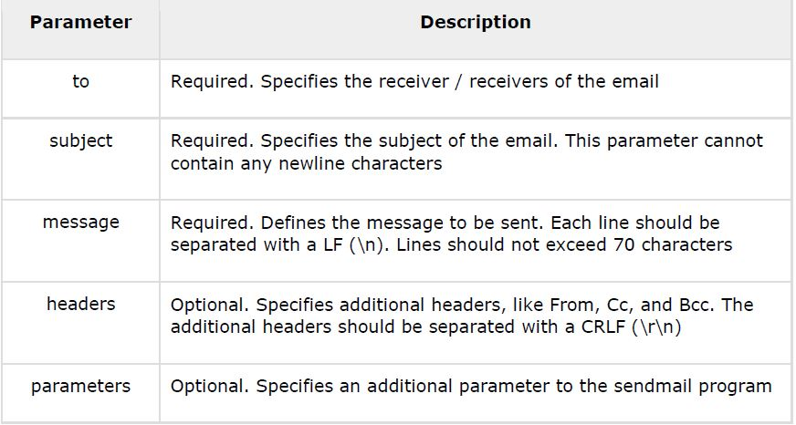
Parameters

Slide 103
Example
<?php
$to = "xyz@somedomain.com";
$subject = "This is subject";
$message = "This is simple text message.";
$header = "From:abc@somedomain.com \r\n";
$retval = mail ($to,$subject,$message,$header);
if( $retval == true )
{
echo "Message sent successfully...";
}
else
{
echo "Message could not be sent...";
}
?>

Slide 104
FILE UPLOADING

Slide 105
FILE UPLOADING
A PHP script can be used with a HTML form to allow users to upload files to the server. Initially files are uploaded into a temporary directory and then relocated to a target destination by a PHP script.
Information in the phpinfo.php page describes the temporary directory that is used for file uploads as upload_tmp_dir and the maximum permitted size of files that can be uploaded is stated as upload_max_filesize. These parameters are set into PHP configuration filephp.ini
The process of uploading a file follows these steps
• The user opens the page containing a HTML form featuring a text files, a browse button and a submit button.
• The user clicks the browse button and selects a file to upload from the local PC.
• The full path to the selected file appears in the text filed then the user clicks the submit button.

Slide 106
FILE UPLOADING
• The selected file is sent to the temporary directory on the server.
• The PHP script that was specified as the form handler in the form's action attribute checks that the file has arrived and then copies the file into an intended directory.
• The PHP script confirms the success to the user.
As usual when writing files it is necessary for both temporary and final locations to have permissions set that enable file writing. If either is set to be read-only then process will fail.
An uploaded file could be a text file or image file or any document.

Slide 107
Upload Form
<html>
<head>
<title>File Uploading Form</title>
</head>
<body>
<h3>File Upload:</h3>
Select a file to upload: <br />
<form action="b.php" method="post"
enctype="multipart/form-data">
<input type="file" name="file" size="50" />
<br />
<input type="submit" value="Upload File" />
</form>
</body>
</html>

Slide 108
Creating an upload script
There is one global PHP variable called $_FILES. This variable is an associate double dimension array and keeps all the information related to uploaded file. So if the value assigned to the input's name attribute in uploading form was file, then PHP would create following five variables:
• $_FILES['file']['tmp_name']- the uploaded file in the temporary directory on the web server.
• $_FILES['file']['name'] - the actual name of the uploaded file.
• $_FILES['file']['size'] - the size in bytes of the uploaded file.
• $_FILES['file']['type'] - the MIME type of the uploaded file.
• $_FILES['file']['error'] - the error code associated with this file upload.

Slide 109
Example
<?php
if( $_FILES['file']['name'] != "" )
{
move_uploaded_file($_FILES['file']['tmp_name'],"/home/umang1122/public_html/home/".$_FILES['file']['name']) or
die( "Could not copy file!");
}
else
{
die("No file specified!");
}
?>

Slide 110
Example
<html>
<head>
<title>Uploading Complete</title>
</head>
<body>
<h2>Uploaded File Info:</h2>
<ul>
<li>Sent file: <?php echo $_FILES['file']['name']; ?>
<li>File size: <?php echo $_FILES['file']['size']; ?> bytes
<li>File type: <?php echo $_FILES['file']['type']; ?>
</ul>
</body>
</html>

Slide 111
PHP Form Handling

Slide 112
A Simple HTML Form
<!DOCTYPE HTML> <html> <body> <form action="welcome.php" method="post"> Name: <input type="text" name="name"><br> E-mail: <input type="text" name="email"><br> <input type="submit"> </form> </body> </html>

Slide 113
welcome.php
<html> <body> Welcome <?php echo $_POST["name"]; ?><br> Your email address is: <?php echo $_POST["email"]; ?> </body> </html>

Slide 114
PHP Complete Form With Required Fields & Validation
Code

