Slide 1
Welcome

Slide 2
Stimulation & comparing parameters of Routing algorithm
Under guidance of prof. A.B.Choudhary

Slide 3
Problem Definition
For sending information from one network to other network through a subnet efficiently, one has to select a better routing technique among the several techniques available. So far no routing Algorithm is reported to be outright choice for all possible cases. So an attempt is made to provide such a routing technique which provides better results for a given configuration of the subnet in real time.
The main objective of our project is to maximize the efficiency of the routing process by suggesting the potential user a better algorithm.
Calculation of Efficiency of Subnet:
Efficiency of Routing Algorithm = ∑ ηi / n
Where
ηi is Efficiency of Router i
n is Number of Routers in the Subnet

Slide 4
Objectives of the System
The Routing Simulator has the following objectives:
The topology of the subnet should be displayed with routers designated with computer images and links with lines.
The congestion table should be printed showing the congestion on various links.
Various Statistics for the router like efficiency, average packet size are to be displayed when required.
Statistics for the link like propagation delay, buffers filled are to be displayed when congestion table is clicked.

Slide 5
When a link is down, it should be highlighted. This gives an idea of how the routing goes when a link is down.
A provision for redrawing the congestion table and network is to be provided.

Slide 6
Introduction
Routing is the act of moving information across an inter network from a source to a destination.
Routing is accomplished by means of routing protocols that establish mutually consistent routing tables in every router in the Network.
…continue

Slide 7
Algorithms Used
1.Flooding
2.Source Routing
3.Distance Vector (Bellman-Ford)
4.RIP (Routing Information Protocol)
5.Link state

Slide 8
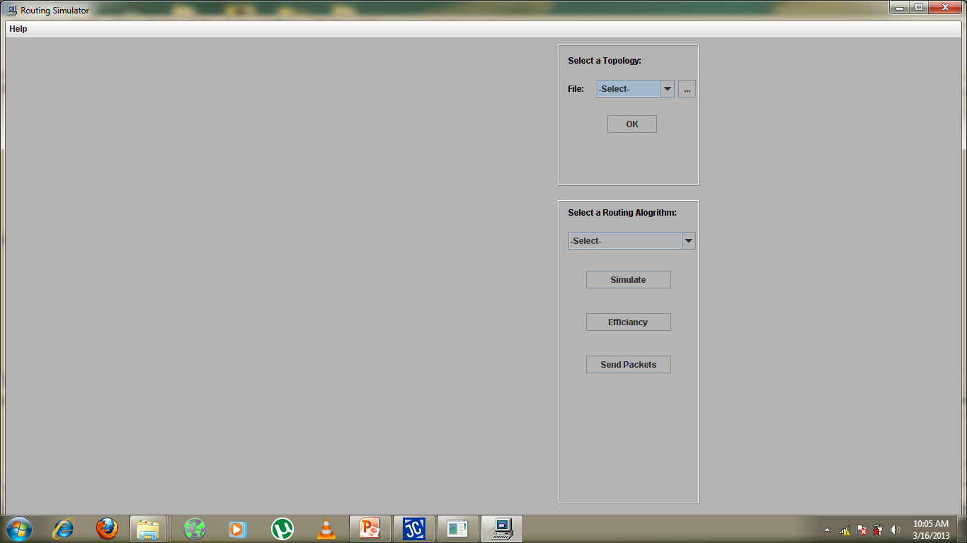
SCREENSHOTS

Slide 9
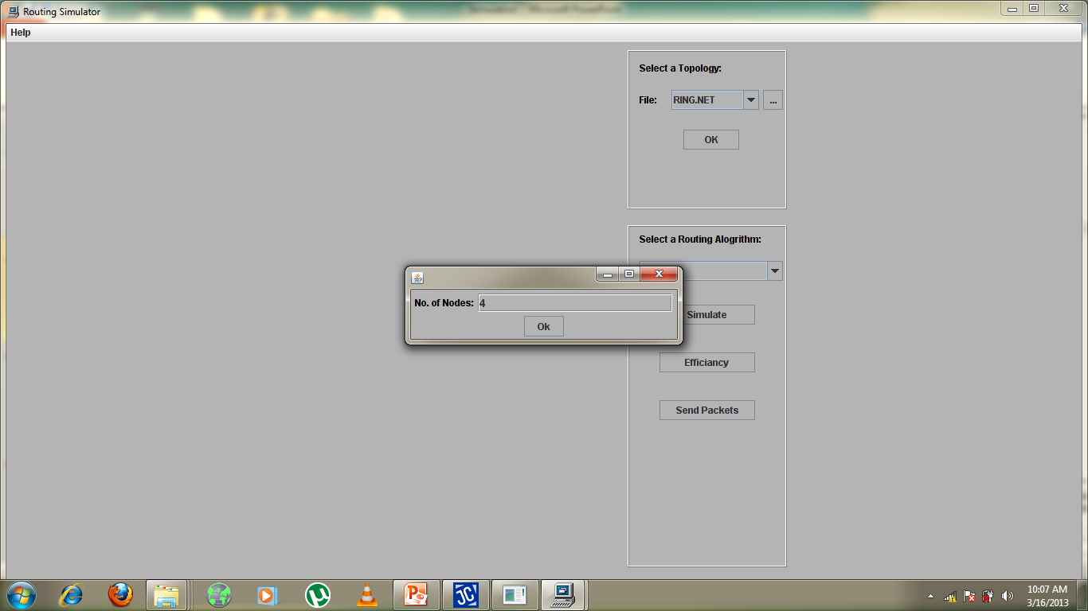

Slide 10
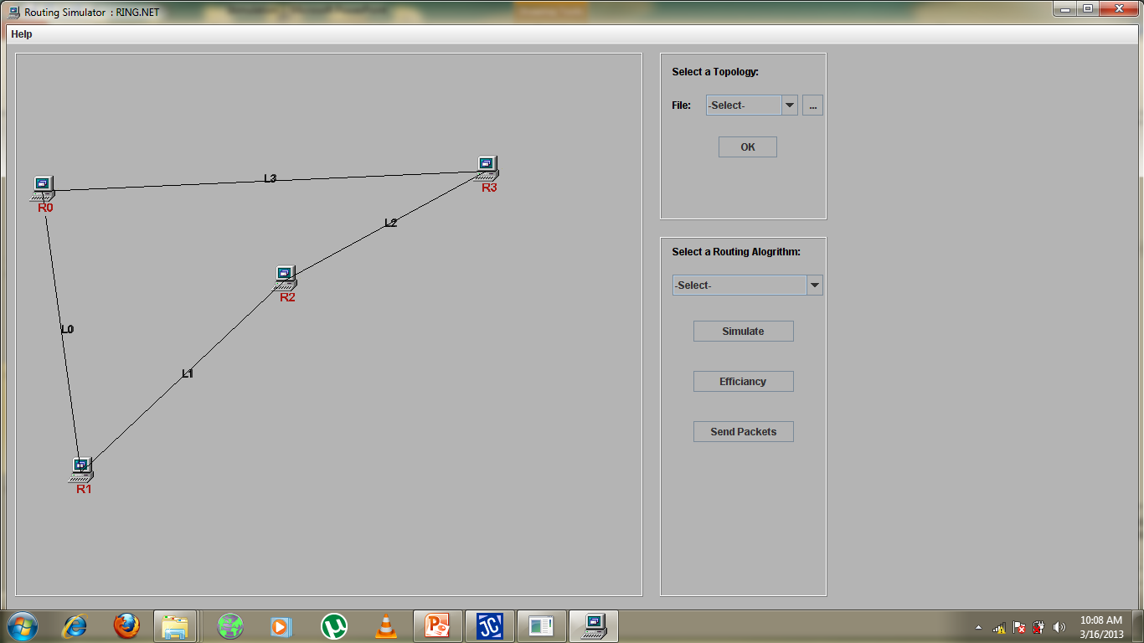

Slide 11
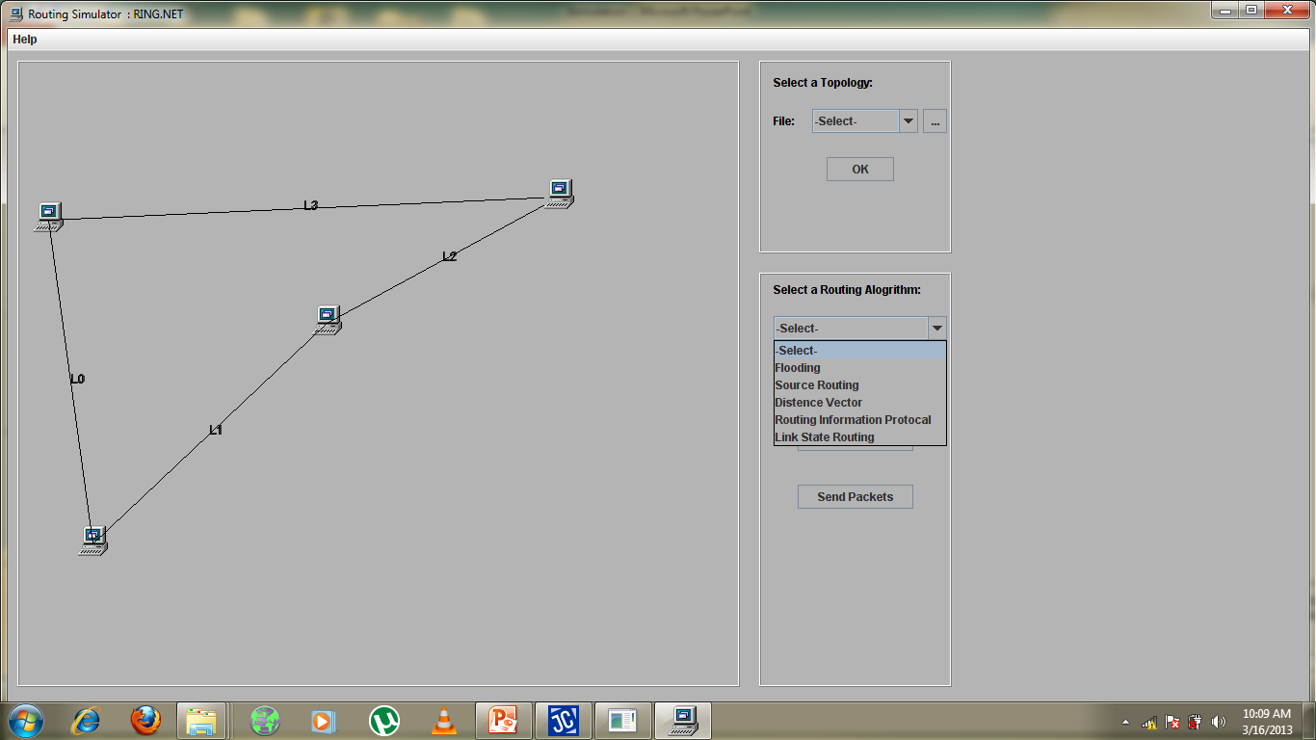

Slide 12
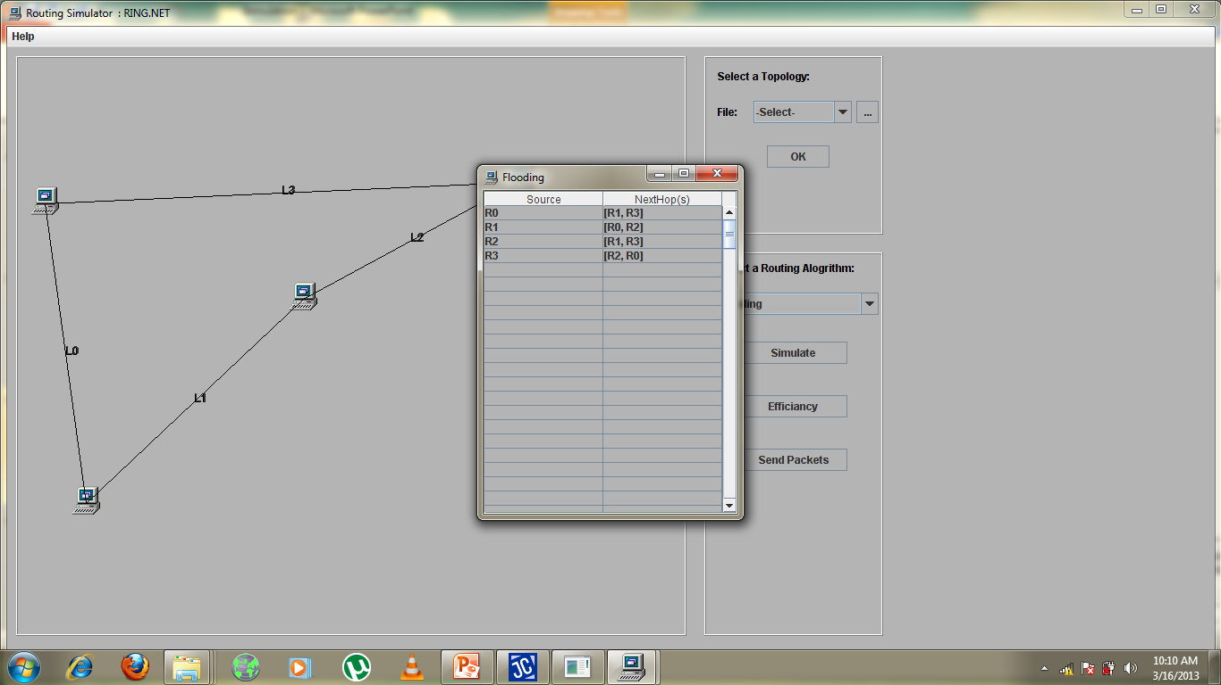

Slide 13
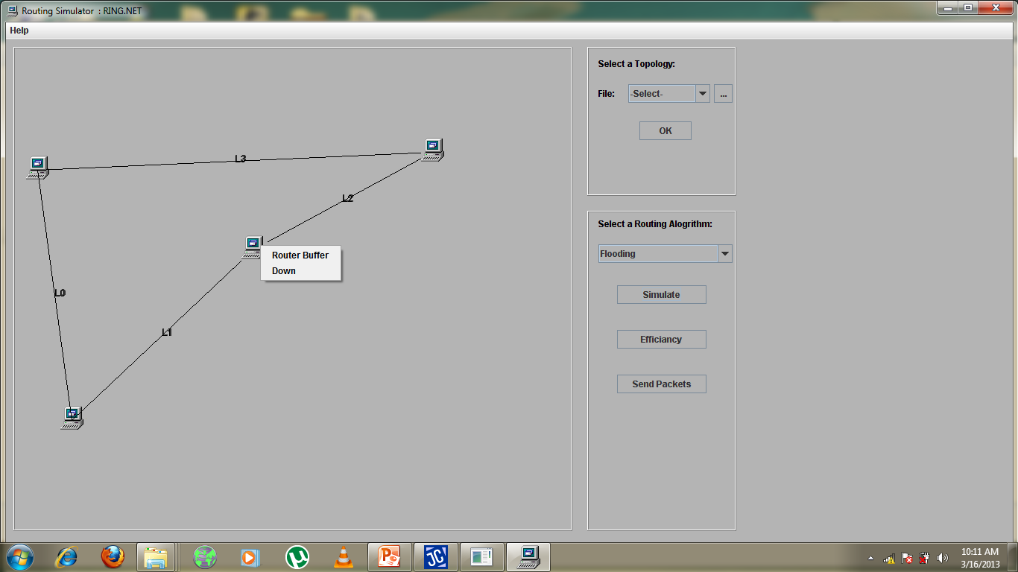

Slide 15
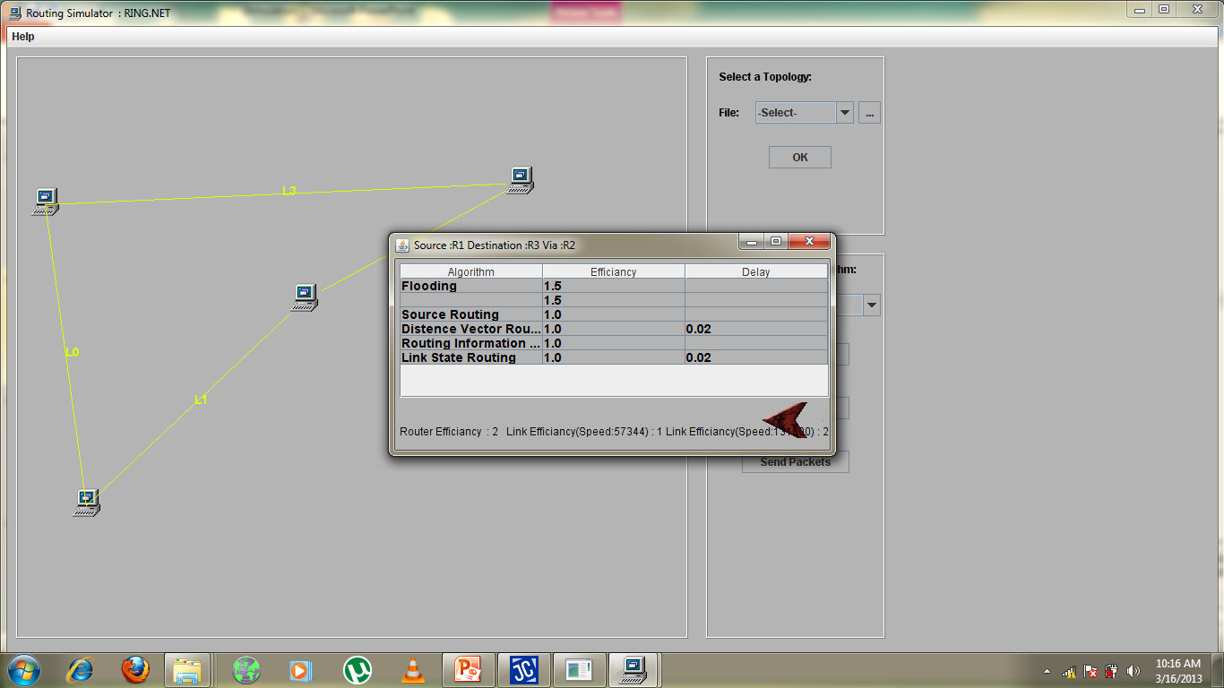

Slide 16
Implementation
JAVA Development Kit(JDK) 1.6
Java Archive Tool (jar)
JAVA Documentation Generator (javadoc)

Slide 17
Scopes
Simulator model can be made a more realistic one by considering the effects of most of the System parameters.
Tools for experimentation on design and analysis of Subnets.
Mathematical model established for efficiency of Subnet yields acceptable results.

Slide 18
Conclusion
Configurations of the subnet as Input and gives the different statistics of the routers and links.
The optimal algorithm for a particular network is obtained by analyzing the results obtained.
Simulation helps to achieve an optimal path that reduces the cost of routing.
Useful for people who provide networking services and those who design networks.

Slide 19
Thank You

