Slide 1
Welcome

Slide 2
Stimulation & comparing parameters of Routing algorithm
Under guidance of prof. A.B.Choudhary

Slide 3
Problem Definition
For sending information from one network to other network through a subnet efficiently, one has to select a better routing technique among the several techniques available. So far no routing Algorithm is reported to be outright choice for all possible cases. So an attempt is made to provide such a routing technique which provides better results for a given configuration of the subnet in real time.
The main objective of our project is to maximize the efficiency of the routing process by suggesting the potential user a better algorithm.
Calculation of Efficiency of Subnet:
Efficiency of Routing Algorithm = ∑ ηi / n
Where
ηi is Efficiency of Router i
n is Number of Routers in the Subnet

Slide 4
Objectives of the System
The Routing Simulator has the following objectives:
The topology of the subnet should be displayed with routers designated with computer images and links with lines.
The congestion table should be printed showing the congestion on various links.
Various Statistics for the router like efficiency, average packet size are to be displayed when required.
Statistics for the link like propagation delay, buffers filled are to be displayed when congestion table is clicked.

Slide 5
When a link is down, it should be highlighted. This gives an idea of how the routing goes when a link is down.
A provision for redrawing the congestion table and network is to be provided.

Slide 6
Introduction
Routing is the act of moving information across an inter network from a source to a destination.
Routing is accomplished by means of routing protocols that establish mutually consistent routing tables in every router in the Network.
…continue

Slide 7
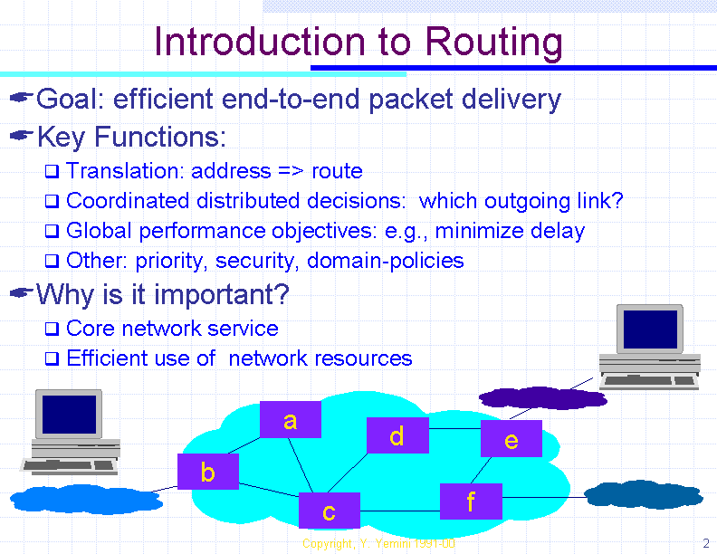

Slide 8
Concept
Packets:-
A packet has two parts-
1) Payload:- Information content.
2) Meta-data:- Information about the payload.

Slide 9
Algorithms Used
1.Flooding
2.Source Routing
3.Distance Vector (Bellman-Ford)
4.RIP (Routing Information Protocol)
5.Link state

Slide 10
Flooding
Every incoming packet is sent out on every other link by every router.
Super simple to implement, but generates lots of redundant packets.
Advantages:
Highly robust
Suitable for setting virtual circuits
Useful for broadcasting
Disadvantage:
High traffic load

Slide 11
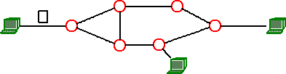
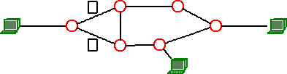
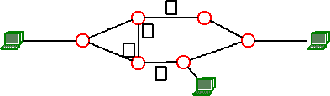
HOP 1
HOP 2
HOP 3

Slide 12
Source Routing Source Routing is a technique whereby the sender of a packet can specify the route that a packet should take through the network. As a packet travels through the network, each router will examine the "destination IP address" and choose the next hop to forward the packet to. In source routing, the "source" (i.e. the sender) makes some or all of these decisions.

Slide 13
Source routing is used for the following purposes: -Mapping the network -Troubleshooting -Performance -Hacking

Slide 14
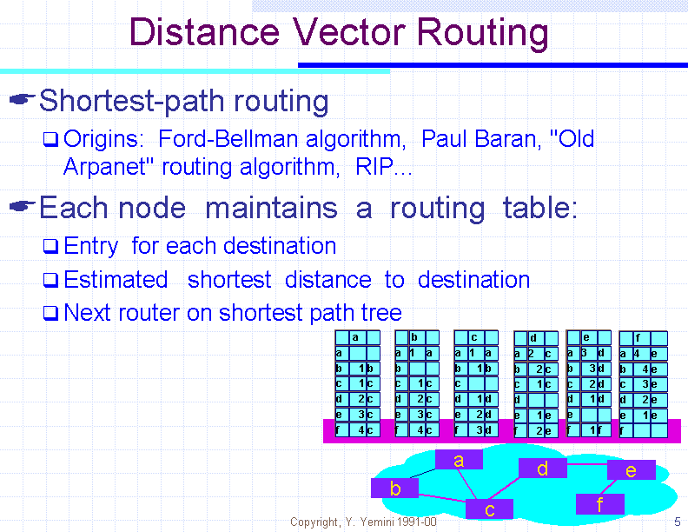

Slide 15
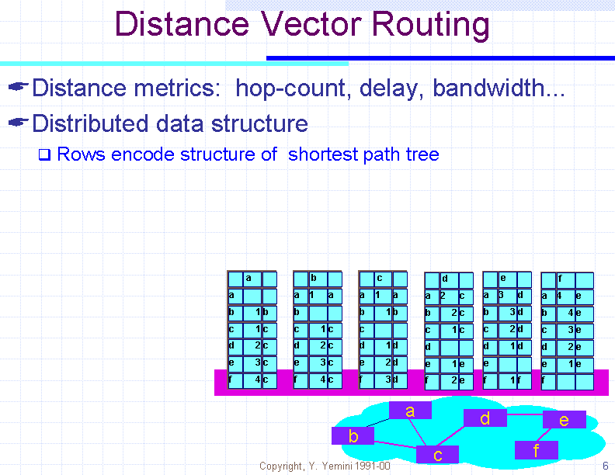

Slide 16
RIP (Routing Information Protocol)
The Routing Information Protocol (RIP) is a distance-vector protocol that uses hop count as its metric.
RIP is widely used for routing traffic in the global Internet and is an interior gateway protocol (IGP), which means that it performs routing within a single autonomous system.

Slide 17
Link-State Routing
Widely used today as OSPF in the Internet, replaced Distance Vector in the ARPANET.
Link State improves the convergence of Distance Vector by having everybody share their idea of the state of the net with everybody else (more information is available to nodes, so better routing tables can be constructed).

Slide 18
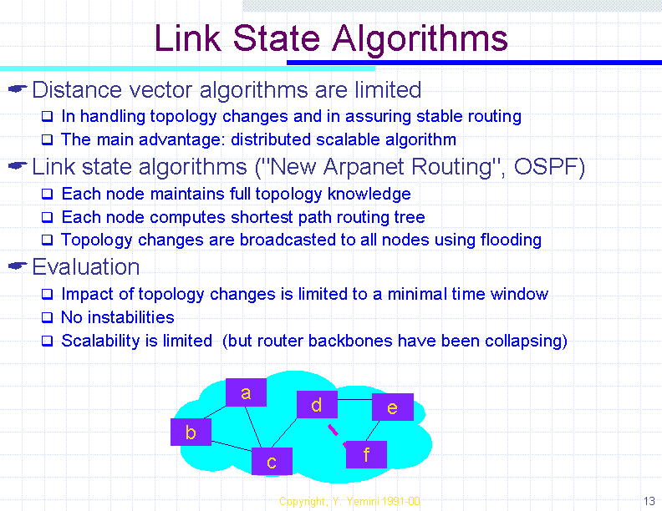

Slide 19
Routing Algorithm:-
Design goals of Routing Algorithm
1. Optimality
2. Simplicity and low overhead
3. Robustness and stability
4. Rapid convergence
5. Flexibility
Factors that decide the best path
1.Path Length
2.Reliability
3.Delay
4.Bandwidth
5.Load
6.Communication Cost

Slide 20
Factors that decide the best path
Routing algorithms have used many different metrics to determine the best route.
Path Length
Path length is the most common routing metric. Some routing protocols allow network administrators to assign arbitrary costs to each network link. In this case, path length is the sum of the costs associated with each link traversed.
Reliability
Reliability, in the context of routing algorithms, refers to the dependability (usually described in terms of the bit-error rate) of each network link.

Slide 21
delay
Routing delay refers to the length of time required to move a packet from source to destination through the internetwork.
Bandwidth
Bandwidth refers to the available traffic capacity of a link. All other things being equal, a 10-Mbps Ethernet link would be preferable to a 64-kbps leased line.
Load
Load refers to the degree to which a network resource, such as a router, is busy. Load can be calculated in a variety of ways, including CPU utilization and packets processed per second. Monitoring these parameters on a continual basis can be resource-intensive itself.
Communication Cost
Communication cost is another important metric, especially because some companies may not care about performance as much as they care about operating expenditures.

Slide 22
DATA FLOW DIAGRAM

Slide 23
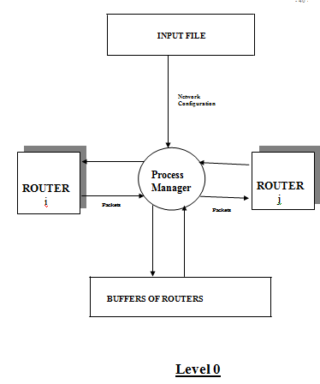

Slide 24
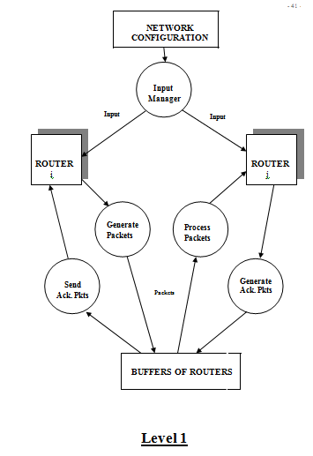

Slide 25
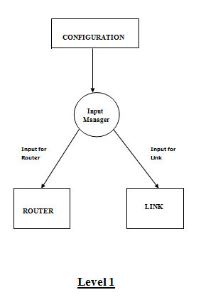

Slide 26
Implementation
JAVA Development Kit(JDK) 1.6
Java Archive Tool (jar)
JAVA Documentation Generator (javadoc)

Slide 27
Scopes
Simulator model can be made a more realistic one by considering the effects of most of the System parameters.
Tools for experimentation on design and analysis of Subnets.
Mathematical model established for efficiency of Subnet yields acceptable results.

Slide 28
Conclusion
Configurations of the subnet as Input and gives the different statistics of the routers and links.
The optimal algorithm for a particular network is obtained by analyzing the results obtained.
Simulation helps to achieve an optimal path that reduces the cost of routing.
Useful for people who provide networking services and those who design networks.

Slide 29
Thank You

