Slide 1



CAR RENTAL MANAGEMENT SYSTEM (DBMS Project)
By
Atulendra Singh Yadav
Abhay Pratap Singh Yadav
Ayush Raj

Slide 2
Introduction to the Car Rental System
Objective:
To manage car inventory, rental transactions, and customer
details efficiently.
Purpose:
Minimize manual errors.
Provide real-time car availability updates.
Key Features:
Car inventory management.
Customer data tracking.
Rental transaction records.
Cost calculations.

Slide 3
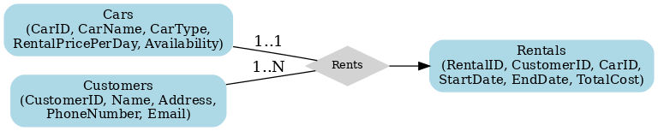
ER Diagram
Key Entities:
Cars: Tracks car details and availability.
Customers: Stores customer information.
Rentals: Manages rental transactions.
Relationships:
Customers (1) ↔ Rentals (∞)
Cars (1) ↔ Rentals (1)

Slide 4
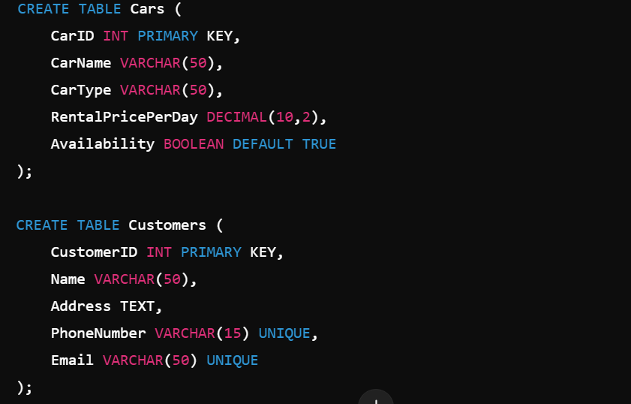
Database Schema Design
Database Tables:Cars Table: Manages car details (CarID, Name, Type, Price, Availability).
Customers Table: Tracks customer details (CustomerID, Name, Contact Info).
Rentals Table: Logs rental transactions (RentalID, CustomerID, CarID, Dates, Total Cost).

Slide 5
Features of the Car Rental System
Car Inventory Management: Add, update, and track car availability.
Customer Management: Store customer details.
Rental Transactions: Record start/end dates and calculate costs.
Data Integrity: Ensured with foreign keys and constraints.

Slide 6
THANK YOU

