Slide 1
CS 513 - Knowledge Discovery & Data Mining
Credit Score Classification

Slide 2




Members
Shubham Kulkarni
Nancy Radadia
Siddharth Prabhakaran
Atul Gupta

Slide 3
Problem Statement
The company has gathered a substantial dataset comprising basic bank details and extensive credit-related information, reflecting a deep pool of financial data.
The management aims to leverage this data to create an intelligent system. This system is intended to automatically categorize individuals into specific credit score brackets, thereby significantly reducing the need for manual classification efforts.
The key objective is to harness machine learning techniques to develop a robust predictive model that can accurately determine a person's credit score

Slide 4
More on DataSet
Source: Kaggle - Credit Score Classification Dataset.
The data set contains 28 parameters and 100k rows
It includes a wide array of features, such as 'Age', ‘Credit_Score’, 'Montly_Salary', and various other credit-related metrics.
The dataset comprises a mix of numerical and categorical data, hence necessitating different preprocessing approaches for each type.
The 'Credit_Score' column is the target variable for classification
Some anomalies are evident, such as an age value of -500, which will require data cleaning.

Slide 5
Challenges with the data
Challenge | Solution
Irrelevant columns | Dropped these columns
Numerical columns have non-numerical data | Use string operations to identify and remove these data points
Garbage values in the data | Replaced these with np.nan and removed them later
Numerical values are way out of range | Defined a range for these columns and removed values outside this range.
Type_of_Loan is a comma separated list | Wrote a custom encoder
Credit history age is expressed as a string | Converted to months
Dataset is imbalanced | Oversampled the dataset

Slide 6
Visualizing the data
To visualize the trends in the data to gain better understanding of the dataset and data cleaning.

Slide 7
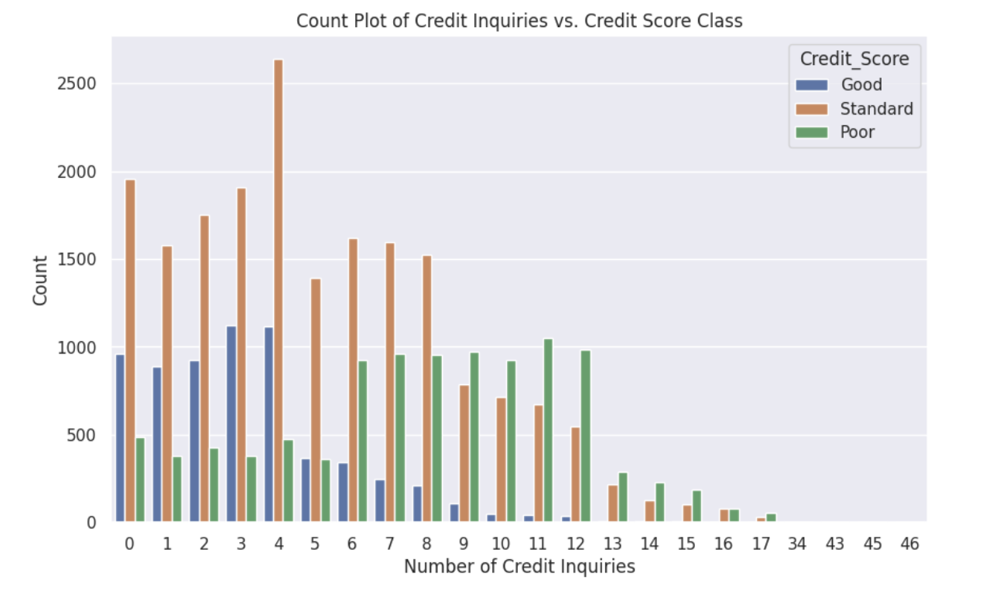
Credit inquiries vs Credit Score

Slide 8
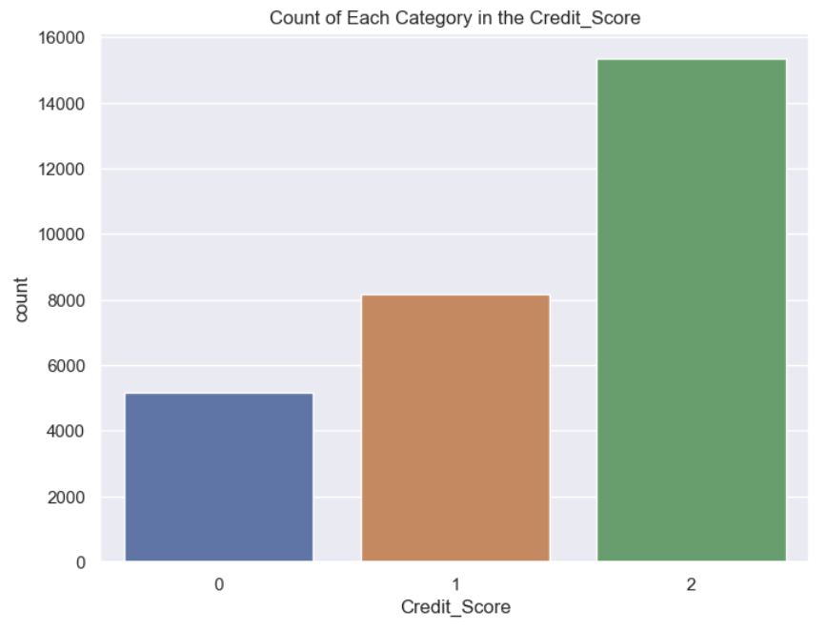
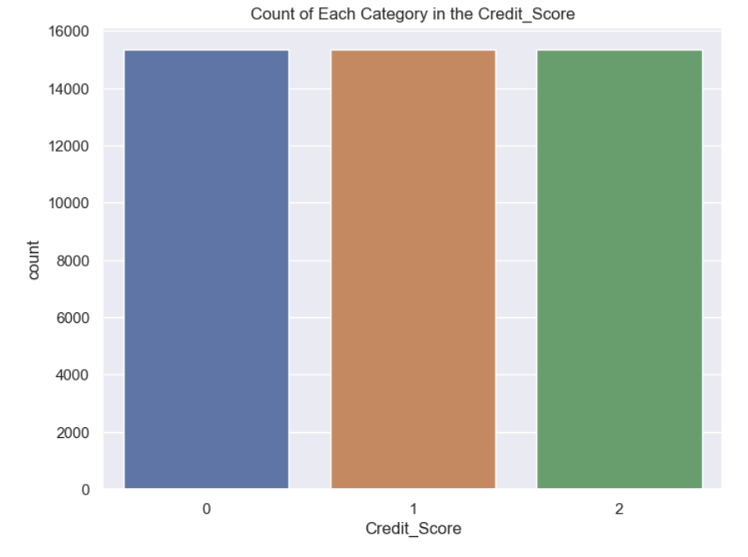
Imbalanced dataset

Slide 9
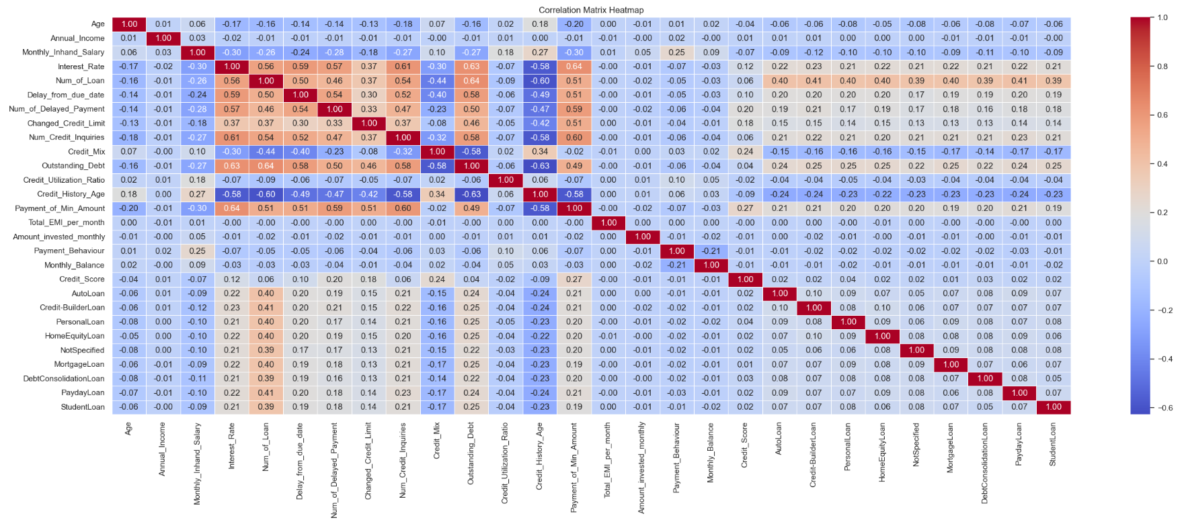
Heat Map Representation

Slide 10
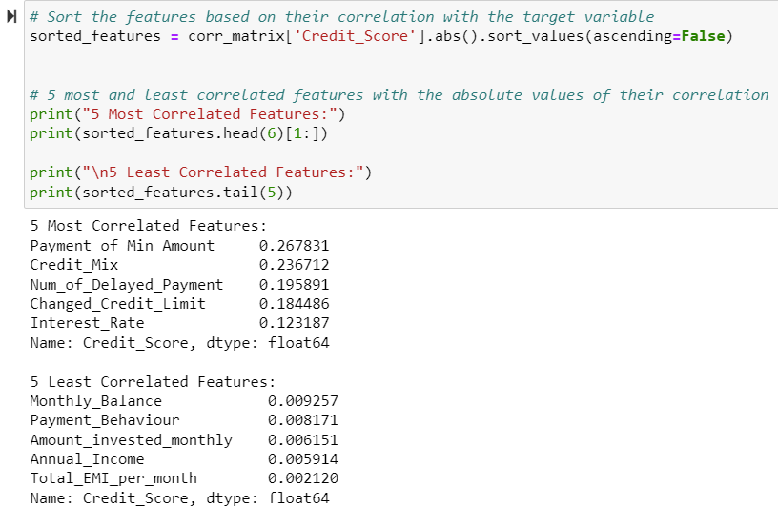
Most and least correlated features with our target variable

Slide 11
Pre-Processing and Data Cleaning

Slide 12
Anomalies Encountered
Remove Non-Essential Columns: To exclude columns like ID, Customer_ID, and Name
Clean Numerical Data: To correct non-numerical entries in numerical columns.
Standardize Missing Values: To uniformly format missing data indicators in various columns
Correct Outliers and Anomalies: Fix unrealistic data like age '5000' or interest rate '3000'.
Simplify 'Type_of_Loan' Data: Break down complex combinations in the 'Type_of_Loan' column.
Convert Time Data Format: Change 'Credit_History_Age' from string to a numerical format.
Address Data Imbalance: Implement strategies to balance the dataset for unbiased analysis.

Slide 13
Classification Algorithms Implemented
Logistic Regression
KNN
Naive Bayes
Decision Tree
Random Forest
XGBoost
AdaBoost Classifier
Bagging Classifier
Support Vector Classification

Slide 14
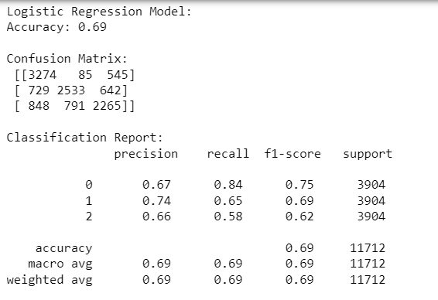
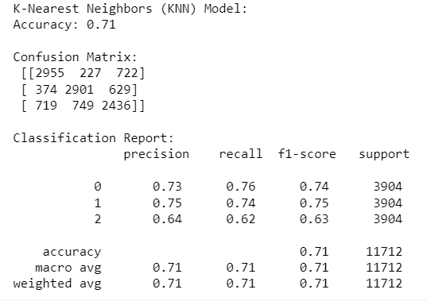
Logistic Regression
KNN

Slide 15
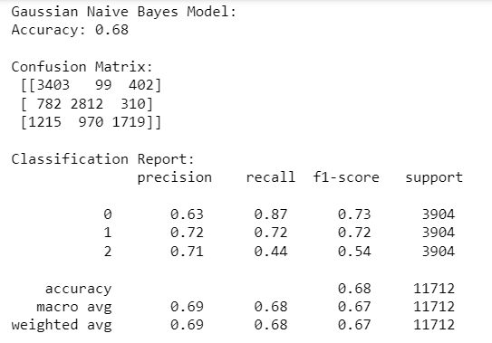
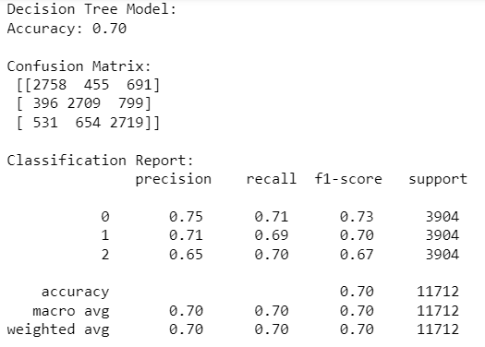
Naive Bayes
Decision Tree

Slide 16
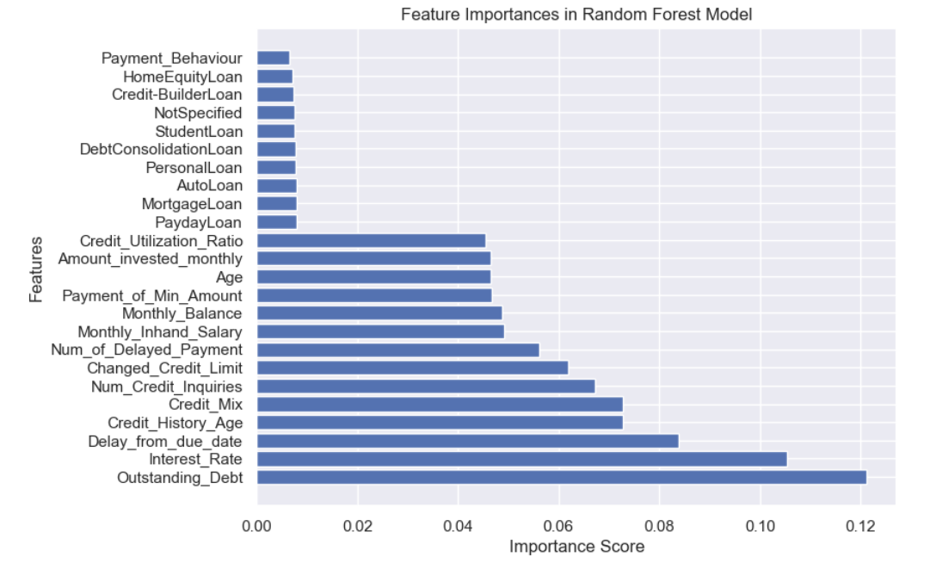

Random Forest

Slide 17
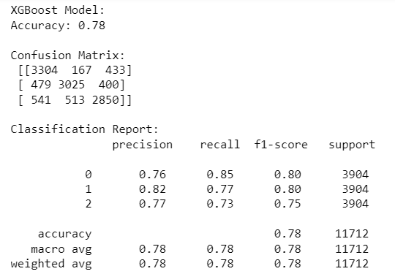
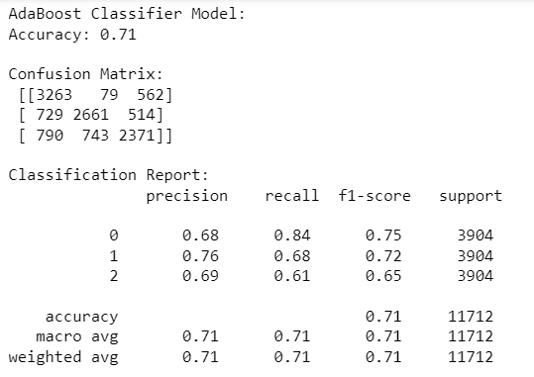
XGBoost
AdaBoost

Slide 18
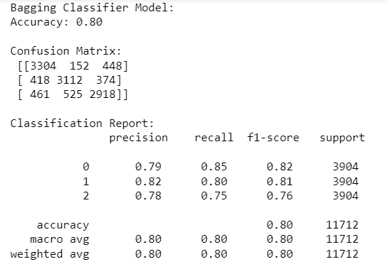
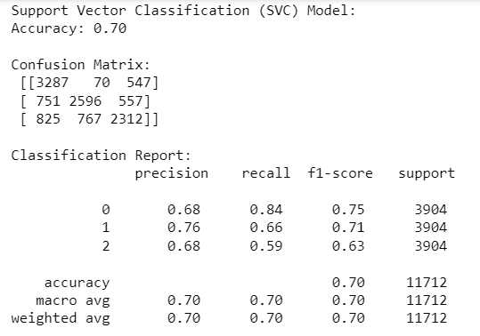
Bagging Classifier
Support Vector

Slide 19
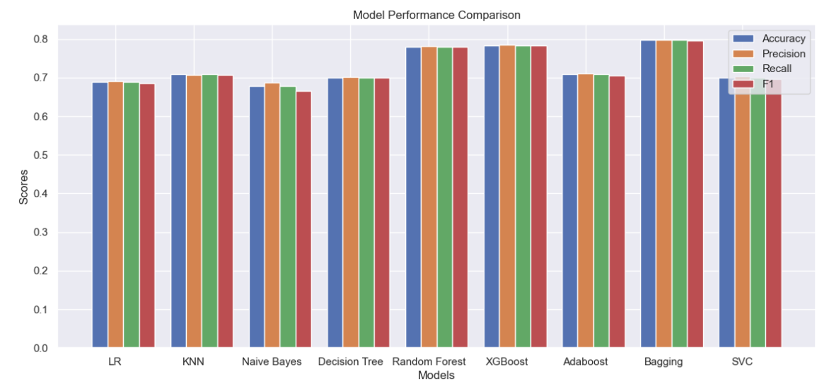
Accuracy comparison

Slide 20
Future Work
Implementing other classification algorithms, basically to improve the accuracy.
Improve the original dataset by gathering more data points.
Diving into Clustering algorithms and testing the model.
Applying Neural networks.

Slide 21
Conclusion
In summary, addressing the credit card classification problem requires a holistic approach that encompasses data preprocessing, model selection, and ongoing monitoring. Striking a balance between accuracy and interpretability, addressing imbalanced data, and adapting to evolving fraud patterns are key considerations in developing a successful credit card fraud detection system. Continuous improvement through model updates and vigilant monitoring is essential for staying ahead of emerging threats in this dynamic landscape.

Slide 22
References
https://www.kaggle.com/datasets/parisrohan/credit-score-classification

