Slide 1
MENTORMATHS
Plan · Practice · Perform
The maths coaching OS — exam plans, daily drills, revision queues, and parent alerts built by a teacher who runs real classes.
For coaching classes & serious home mentors · mentormaths.in

Slide 2
One line coaches remember
Punch lines you can put on a flyer or WhatsApp broadcast
Not another question bank.
A full coaching operating system — plan → practice → exam → revise.
Wrong answers never die quietly.
Every miss enters a revision queue until the student redoes it right.
Parents see progress without chasing you.
Email + WhatsApp when work is done — score, time, and what went wrong.
Built in the classroom, not a boardroom.
Made by a practising mentor · shipped weekly with agile changes for real batches.
TrainingPeaks for Maths.
Syllabus plan + daily workout + race day (school exam) + performance stats.
mentormaths.in · Plan · Practice · Perform
2/12

Slide 3
The coaching-class problem
Generic apps don’t run a batch the way you do
Today’s pain
With MentorMaths
• WhatsApp groups full of PDFs — no completion truth
• Excel trackers go stale every exam week
• Students “finish” but wrong sums never get redone
• Parents ask “how is he doing?” — you dig for answers
• One syllabus, many exam dates per child
• Live class dashboard: completion, score, hours, revision
• Per-student exam plan tied to chapters
• Revision queue: pending + wrong until cleared
• Auto email / WhatsApp on every submission
• Content bank: practice, test, written, FIB, formula, books
mentormaths.in · Plan · Practice · Perform
3/12

Slide 4
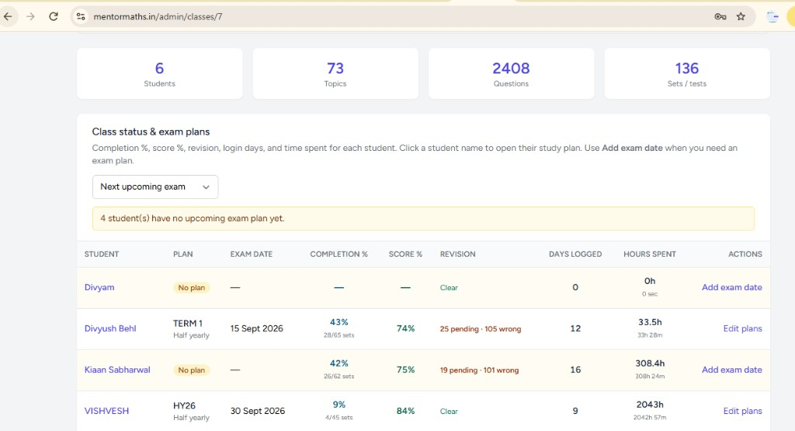
Coaching-class dashboard
Class status & exam plans — who is ready for the next paper
mentormaths.in · Plan · Practice · Perform
4/12

Slide 5
What the coach sees at a glance
From the class screen — actionable, not decorative
Completion %
Score %
Revision
Sets done vs planned for studied chapters
Average across scored attempts
Pending + wrong still to redo
Days & hours
Exam plan
Alerts
Login streak and active study time
Half-yearly / unit test date per child
“4 students have no upcoming exam plan”
mentormaths.in · Plan · Practice · Perform
5/12

Slide 6
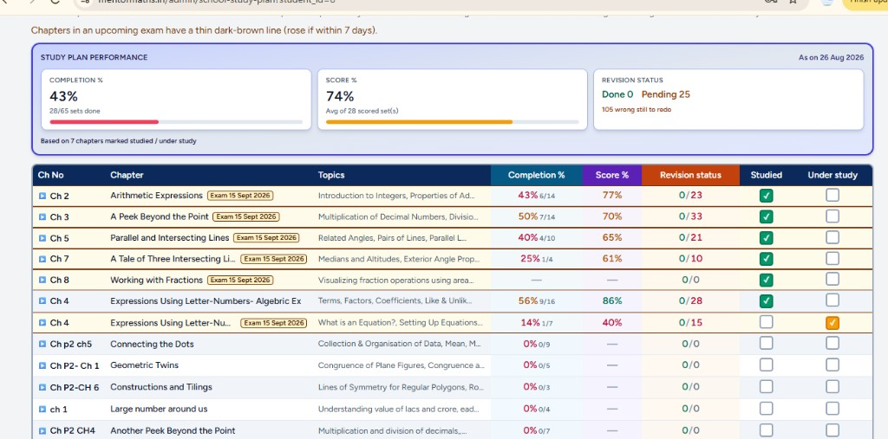
Student view — study plan performance
Same truth the coach sees · chapters tagged to exam date
mentormaths.in · Plan · Practice · Perform
6/12

Slide 7
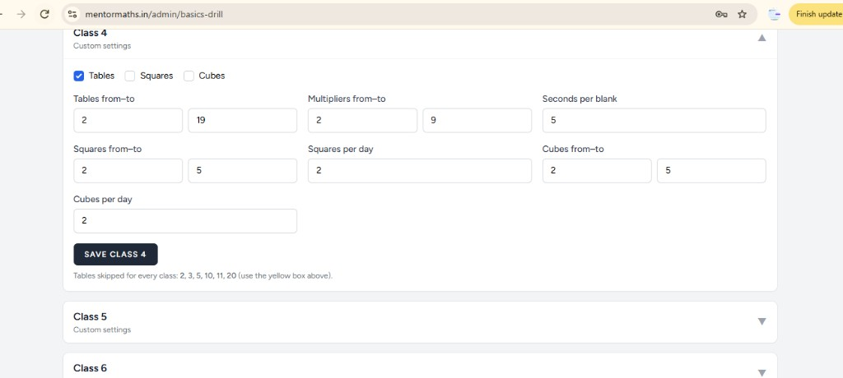
The drill concept
Mastery = finish the set + clear every wrong sum
• Guided practice: one sum at a time, hints, give-up tracked
• Learner / Achiever / Expert mixes — not one-size worksheets
• Wrong answers → revision queue (pending until redone)
• Basics drill: tables / squares / cubes with seconds-per-blank
• Formula drill: daily spaced practice from your bank
• Chapter tests autosave — WiFi drop doesn’t wipe progress
mentormaths.in · Plan · Practice · Perform
7/12

Slide 8
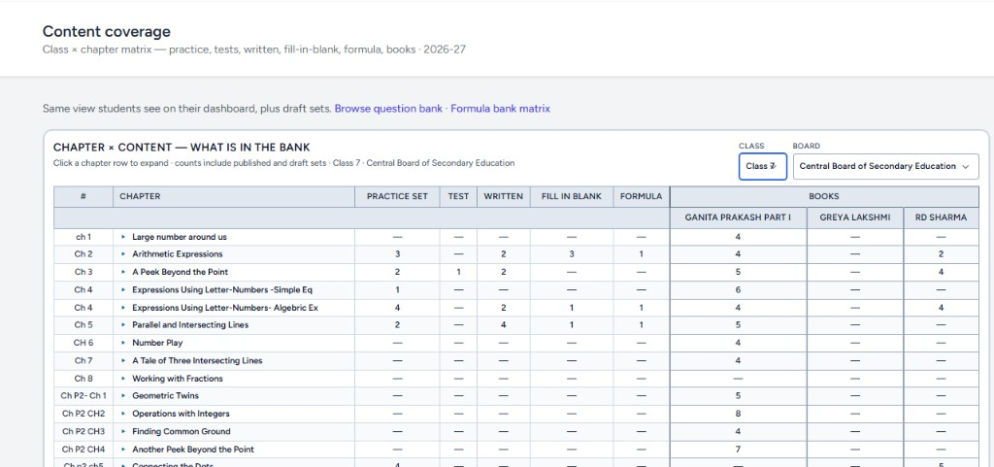
Content coverage — your bank, chapter × format
Practice · Test · Written · Fill-blank · Formula · Books
mentormaths.in · Plan · Practice · Perform
8/12

Slide 9
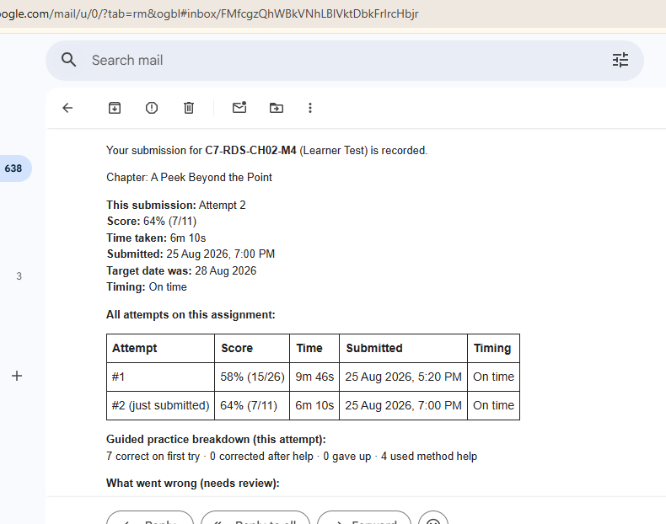
Email & WhatsApp — parents stay in the loop
Every submission: score, time, attempt history, what went wrong
In the mail
• Attempt # and score
• Time taken vs target date
• All prior attempts compared
• First-try correct / hints used
• “What went wrong” review list
• WhatsApp templates for assignments too
mentormaths.in · Plan · Practice · Perform
9/12

Slide 10
How we differ from market tools
Byju’s · EduGain · Open Door · fee CRMs — vs a coaching-class OS
Capability
Byju’s
EduGain
Open Door
Fee / tuition CRMs
MentorMaths
Exam-linked study plan
Course packs
Topic practice
Topic tests
Rare
Yes — per student
Revision of wrong sums
In-app only
Focus areas
Assessment gap
—
Auto redo queue
Basics / formula drills
General app
Worksheets
—
—
Class-tuned daily
Parent email / WhatsApp
Parent app
Limited
School reports
Fees only
On every attempt
Coach class dashboard
Consumer-led
Teacher assign
School admin
Attendance/fees
Done · score · hours
Your books + sets matrix
Their content
Generated bank
Their workbooks
—
Chapter × format
Built for YOUR batch
Big roadmap
Product SKU
School program
Vendor queue
Weekly — mentor builds
Fair positioning by typical product strength — not a full SKU audit of every plan.
mentormaths.in · Plan · Practice · Perform
10/12

Slide 11
Built by the mentor · shipped with agile speed
Not a distant SaaS — tuned for the classes that use it
Practitioner-built
Designed while teaching real CBSE batches — features come from classroom friction, not feature lists.
Agile weekly releases
Need a new drill range, exam label, or WhatsApp flow? Ship it for your class the same week.
Your syllabus, your books
Ganita Prakash, RD Sharma, Greya Lakshmi… mapped chapter-wise into one coverage matrix.
Integrity + continuity
Test protection, autosave on WiFi drops, Continue where the student left off.
mentormaths.in · Plan · Practice · Perform
11/12

Slide 12
Ready for your next batch?
Run one class on MentorMaths for one exam cycle. Watch completion, revision, and parent calm improve together.
mentormaths.in
Plan · Practice · Perform

