Slide 1
Beer Data - Presentation
By- Atul, Rahul and Bhavana

Slide 2
DATA- Sample
Week | PRICE 12PK | PRICE 18PK | PRICE 30PK | CASES 12PK | CASES 18PK | CASES 30PK
1 | 19.98 | 14.10 | 15.19 | 223.5 | 439 | 55.00
2 | 19.98 | 18.65 | 15.19 | 215.0 | 98 | 66.75
3 | 19.98 | 18.65 | 13.87 | 227.5 | 70 | 242.00
4 | 19.98 | 18.65 | 12.83 | 244.5 | 52 | 488.50
5 | 19.98 | 18.65 | 13.16 | 313.5 | 64 | 308.75
6 | 19.98 | 18.65 | 15.19 | 279.0 | 72 | 111.75
7 | 19.98 | 18.65 | 13.92 | 238.0 | 47 | 252.50
8 | 20.10 | 18.73 | 14.42 | 315.5 | 85 | 221.25
9 | 20.12 | 18.75 | 13.83 | 217.0 | 59 | 245.25
10 | 20.13 | 18.75 | 14.50 | 209.5 | 63 | 148.50

Slide 3
Weekly Prices of 12PK
PRICE 12PK
WEEK

Slide 4
Weekly Prices of 18PK
PRICE 18PK
WEEK

Slide 5
Weekly Prices of 30PK
PRICE 30PK
WEEK

Slide 6
Weekly Sales Volume of 12PK
SALES 12PK
WEEK

Slide 7
Weekly Sales Volume of 18PK
SALES 18PK
WEEK

Slide 8
Weekly Sales Volume of 30PK
SALES 30PK
WEEK

Slide 10
CORRELATION MATRIX
 | Week | PRICE 12PK | PRICE 18PK | PRICE 30PK | CASES 12PK | CASES 18PK | CASES 30PK
Week | 1.000000 | -0.365878 | -0.376522 | 0.358451 | 0.349867 | 0.426598 | -0.389701
PRICE 12PK |  | 1.000000 | -0.083596 | -0.363540 | -0.8588615 | 0.25457 | 0.32856
PRICE 18PK |  |  | 1.000000 | 0.2514 | 0.2409 | -0.86640 | 0.52133
PRICE 30PK |  |  |  | 1.000000 | 0.29976 | 0.2939 | -0.80677
CASES 12PK |  |  |  |  | 1.000000 | -0.2951 | -0.20997
CASES 18PK |  |  |  |  |  | 1.000000 | -0.4584
CASES 30PK |  |  |  |  |  |  | 1.000000
The correlation coefficient r measures the strength and direction of a linear relationship between two variables

Slide 11
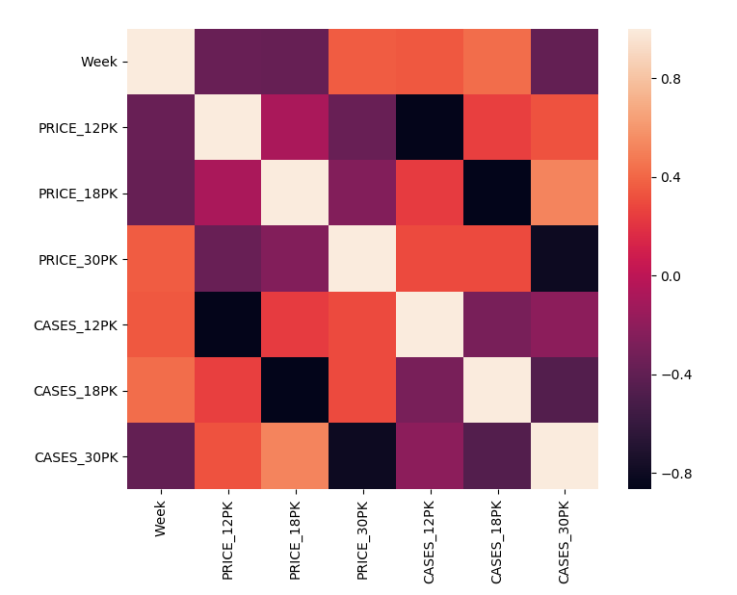

Slide 12
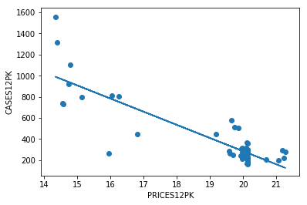
Cases12 = -124.442921 Price12 + 2774.491644

Slide 13
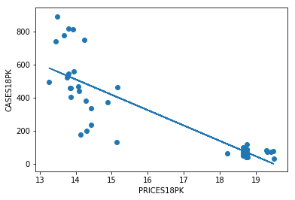
Cases18 = -93.007273 Price18 + 1812.183939

Slide 14
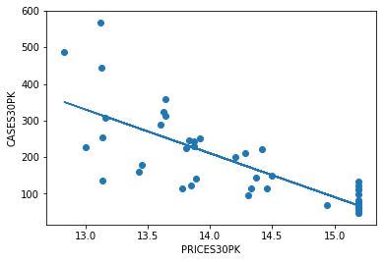
Cases30 = -119.770839 Price30 + 1887.255795

Slide 15
Sales Forecast
PRICE12PK | SALES12PK
17.50 | 596.74
18.25 | 503.40
19.20 | 385.18
19.65 | 329.18
20.25 | 254.52

Slide 16
Sales Forecast
PRICE18PK | SALES18PK
17.50 | 184.55
18.25 | 114.80
18.50 | 91.54
19.20 | 26.44
19.35 | 12.49

Slide 17
Sales Forecast
PRICE30PK | SALES30PK
12.25 | 420.06
12.45 | 396.10
13.20 | 306.28
13.60 | 258.37
14.15 | 192.50

