Slide 1
The Battle of the Neighbourhoods
-By Atul Jain

Slide 2
Business Problem
The objective is to find a place to start indoor-sports arena in the best neighborhood in the USA. It would be dependent on the following variables:
Per Capita Income
Population of locality
Areans in the given neighborhood

Slide 3
Data needed
Four square API
List of United states cities by population(Wikipedia)
List of United states counties by per capita income(Wikipedia)
IBM Watson account for Jupyter

Slide 4
Approach
The Foursquare API is then used to get the venues in each city of United States
he Wikipedia page (https://en.wikipedia.org/wiki/List_of_United_States_cities_by_population) was scraped using the BeautifulSoup library to build a pandas dataframe listing the cities, states, coordinates, area and population density. Dataframe was cleaned by dropping rows which were not needed and processed.
The Wikipedia page (https://en.wikipedia.org/wiki/List_of_United_States_counties_by_per_capita_income) was scraped using the BeautifulSoup library to build a pandas dataframe listing the cities, states and percapita income. Dataframe was cleaned by dropping rows which were not needed and processed.
The city is decided using the algorithm, then we use Four Square API to get the venues for that city and assign weights to each category
Here we cluster neighborhoods via K-means clustering method K means to cluster the venues based on the category and get the coordinates of the cluster that has maximum weight and is location to steup sports arena.

Slide 5
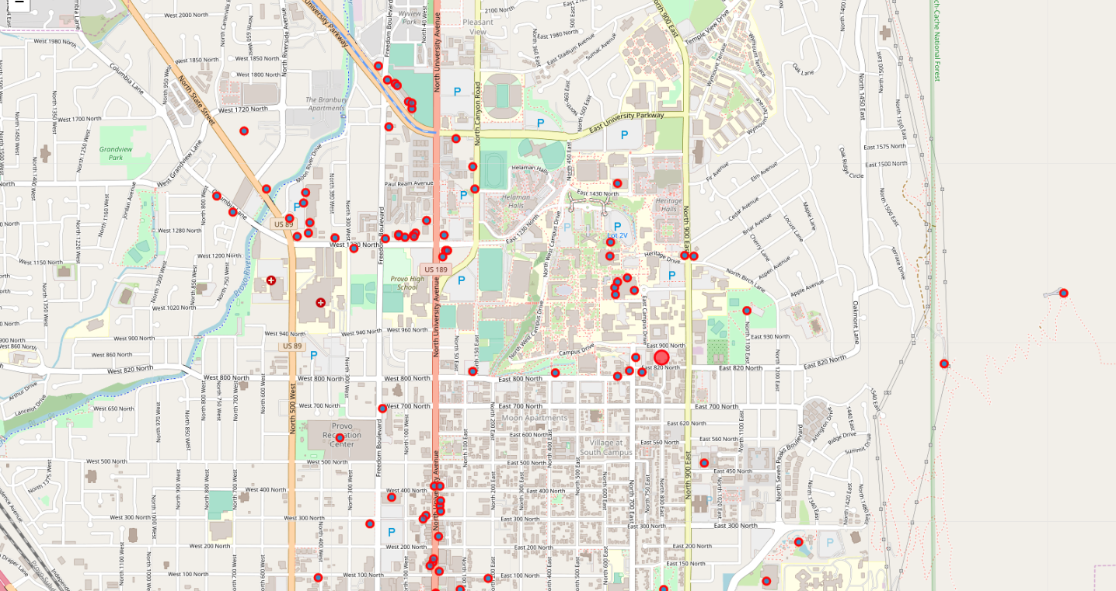
Locations in Provos,Utah

Slide 6
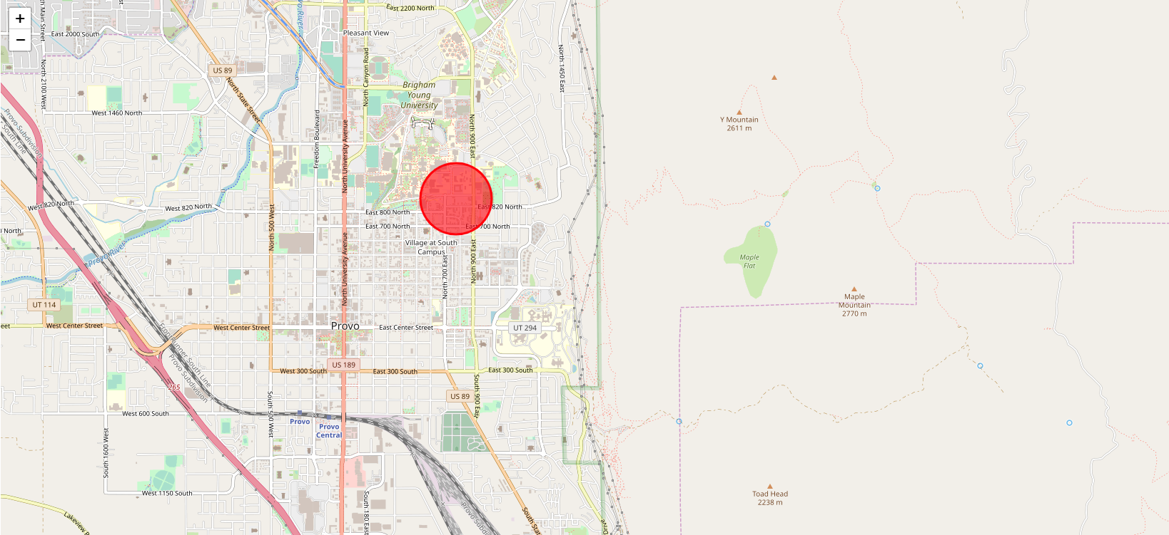
Result
Marked location is the best location to start

