Slide 1
EMG & DCSA

Slide 2
EMG (Enhanced Metadata Generator)
Neural Networks
Used by EMG to identify names of the data items which can be of any type.
The proposed metadata generator in the research paper generates descriptive metadata from the datasets itself, by harnessing information such as title, uniqueness, type of content.
Once the metadata is generated it is consumed by data context similarity analyzer to calculate the similarity between the datasets.

Slide 3
EMG (Enhanced Metadata Generator)
The EMG works on neural network.
Our dataset had a set of mixed datatypes.
After a long research it was understood that to use a neural network we need numeric values.
Dr. Crick suggested us to create a dictionary which would have key as the String value and the count as the numeric count.
So first we created the dictionary.txt which was generated by createDictionary.py.
And then we passed the numeric values for the strings to the neural network.

Slide 4
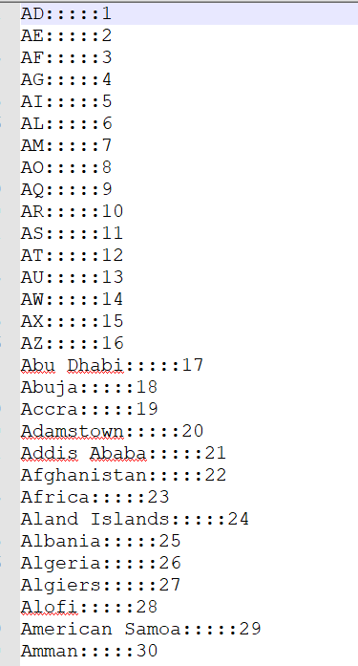
EMG (Enhanced Metadata Generator)
Dictionary.txt

Slide 5
EMG (Enhanced Metadata Generator)
How the EMG works
It extract the header names from the input dataset and use them as the expected output for the neural network.
We have implemented the neural network in two ways.
Single Model Implementation:
Divide the dataset to training and test data, 30% and 70% respectively.
Pass the training dataset to the neural network to train the model.
The input to the neural network will be the training data and the expected header names extracted from the dataset.
Once the model is trained save it and use it on test data to predict the header name.
Multiple Models Implementation:
Generate the model for each column separately and save each model in a list.
Use the models saved in the list iteratively to predict the header names.

Slide 6
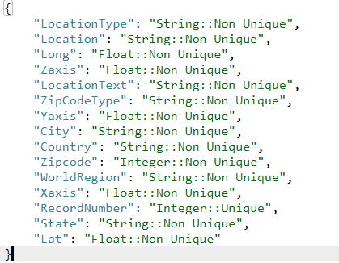
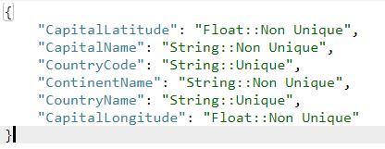
EMG (Enhanced Metadata Generator)
The EMG generates the metadata in JSON format:

Slide 7
EMG (Enhanced Metadata Generator)
The result shown above is similar for type of implementations.
The only difference between the both of them is the performance factor.
The neural network implemented using single model gave results in 49 seconds for zip-code-dataset having 15 columns.
The multi-model implementation for the same dataset took 3 minutes and 11 seconds.
If we compare both of these implementations single model implementation is almost 4 times faster then the multi-model implementation.
This ratio will only increase with the increase in number of columns in the dataset.

Slide 8
DCSA (Data Context Similarity Analyzer)
Once the metadata is generated by EMG, it is consumed by DCSA to do data association.
For data context similarity analysis following techniques are used :
Structure Matching
Constraint Matching
Linguistic Matching

Slide 9
DCSA (Data Context Similarity Analyzer)
Structure Matching
Matches data items with similar features such as names, data types.
These are obtained from metadata generated by EMG.
Structure matching similarity values lie between 0 and 1.
How it works
StructureMatching.py takes EM of two datasets generated by EMG as input.
It compares the keys from the two metadata and compares them using SequenceMatcher python library.
Once they match it checks if the datatypes of both the keys are matching, and if they both are unique or not.
Based on these three parameters we get a value between 0 and 1.

Slide 10
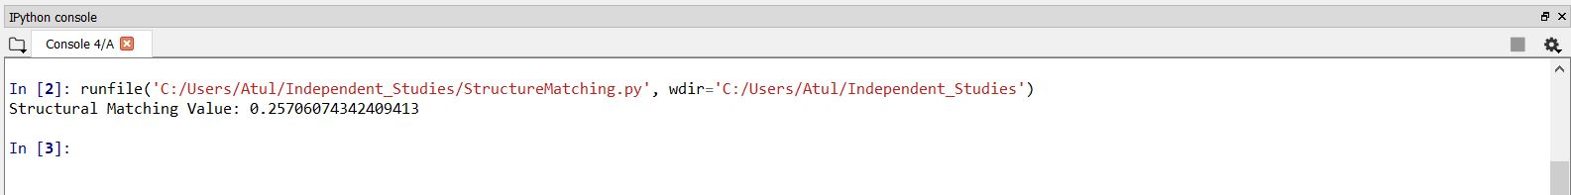
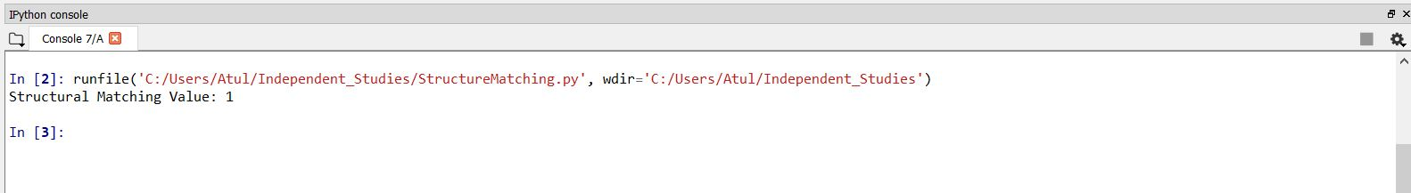
DCSA (Data Context Similarity Analyzer)
Structural Matching output for two different datasets:
Structural Matching output for the same datasets:

Slide 11
DCSA (Data Context Similarity Analyzer)
Constraint Matching
Constraint matching aims to find the similarity of constraint conditions among data items such as type, length, etc.
Similarity degree of the datasets is computed based on the relevant pairs of similar names.
Similarity degree is between 0 and 1.
How it works
Constraint matching takes the input as the two datasets.
Compares the actual values of the datasets and finds out the similarity degree based on how similar the name pairs are.
We have used SequenceMatcher library to find out the similarity probability among two similar values.

Slide 12
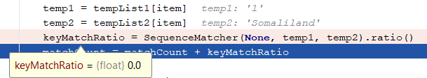
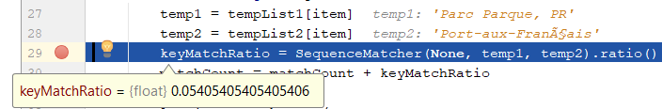
DCSA (Data Context Similarity Analyzer)
SequenceMatcher
It is an API provided by “difflib” library by python.
Takes two string values as the input and generates a similarity probablity between those two strings.
SequenceMatcher.ratio() returns a float in [0, 1], measuring the similarity of the sequences. As a rule of thumb, a ratio() value over 0.6 means the sequences are close matches:

Slide 13
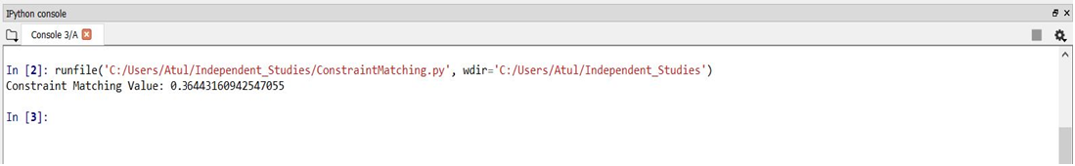
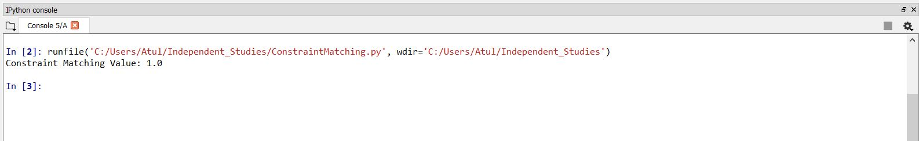
DCSA (Data Context Similarity Analyzer)
Constraint Matching output for two different datasets:
Constraint Matching output for the same datasets:

Slide 14
DCSA (Data Context Similarity Analyzer)
Linguistic Matching
Linguistic Matching attempts to match data items with similar linguistic features.
Auxiliary information file contains all relevant pairs having the same names.
The value of similarity lies between 0 to 1.
If similar linguistic features the value will be as high as 0.8 .
Threshold is considered as 0.8 .

Slide 15
DCSA (Data Context Similarity Analyzer)
Also, we thought we had already done the matching of similar names in constraint matching.
What we thought is it was unnecessary to do the same thing as in Linguistic Matching we were simply finding the similar names.
And based on that we were finding the similarity value.
The same thing was also done in constraint matching, so we didn’t work on linguistic matching.

Slide 16
Datasets Used
We have used following datasets for the testing purpose.
We got the reference to these datasets from the research papers which were provided to us.
free-zipcode-database.csv
country-capitals.csv

Slide 17
GITHUB
The complete code and the files used in this project are in github.
Here is the link for the same:
https://github.com/atuljoshi1990/Independent-Studies

Slide 18
References
https://docs.python.org/2/library/difflib.html
https://pypi.python.org/pypi/editdistance
https://machinelearningmastery.com/tutorial-first-neural-network-python-keras/
http://federalgovernmentzipcodes.us//
http://www.numpy.org/
https://keras.io/

Slide 19
THE END

