Slide 1


Encrypted Chat Room
COSC4436 F22 | Computer Networks Atul Kumar, Emma Ude, Jane Rebecca Kim

Slide 2





Chat Room Overview
Multi-user
Encrypted
Connecting first client
Connecting other clients
Client enter/exit messages

Slide 3

Connecting First Client
Run server program
Run client program
Connect client to server
Connection message
“___ entered in the chatroom at ____(time)”
“_ has entered the chat”

Slide 4

Connecting other clients
“___ entered in the chatroom at ____(time)”
Additional client launches
Connect by entering username
Connection message
“___ has entered the chat”
Will display the current users in the chat room to the new user
“___ has entered the chat”

Slide 5

Chat Room
1
2
3
Sending messages
Type message in console + ‘Enter’
Message then sent through server to all clients
Receiving messages
“X: message”
Closing connection
Client terminates program
“___ has left the chat”

Slide 6

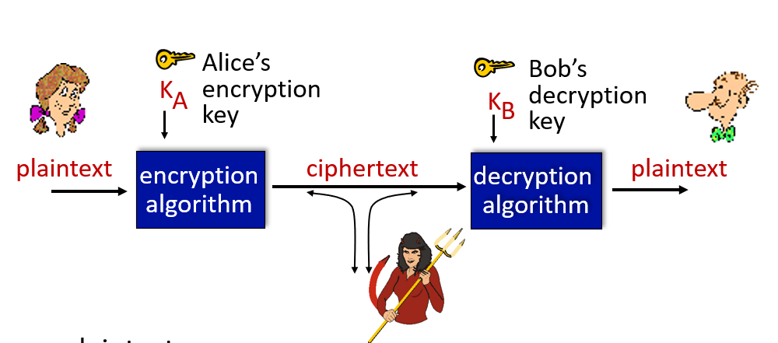
Programs
Server
Client Handler
Client
Java.net package for TCP connection
BufferedReader, BufferedWriter
Encrypted when sent & decrypted when received
Socket 1234

Slide 7
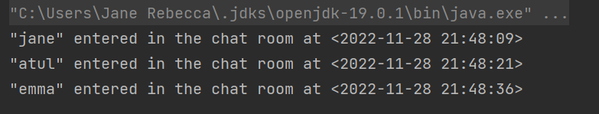
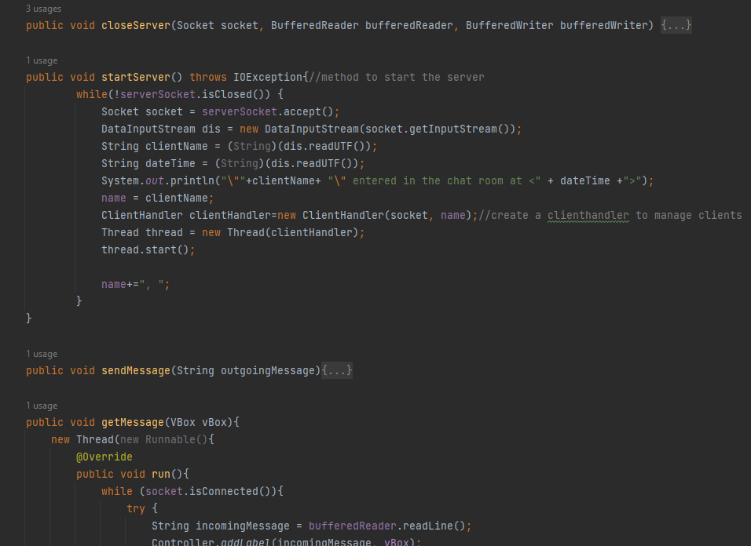
Server
Creates socket: java.net ServerSocket, Socket classes
Start & close the socket
startServer()
accept()
closeServer()
Date & time

Slide 8
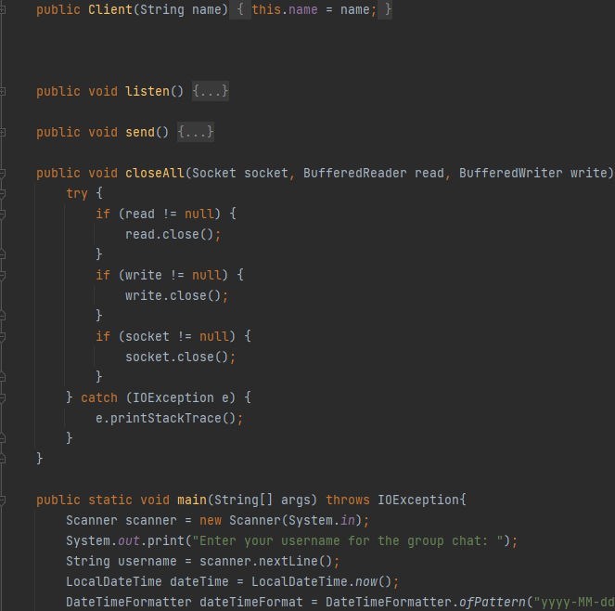
Client
Connects client to user with username
send()
BufferedWriter – encryption
listen()
BufferedReader - decryption
Welcome message

Slide 9
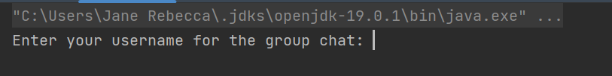
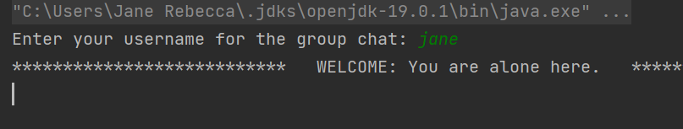
Client
Connects client to user with username
send()
BufferedWriter – encryption
listen()
BufferedReader - decryption
Welcome message

Slide 10
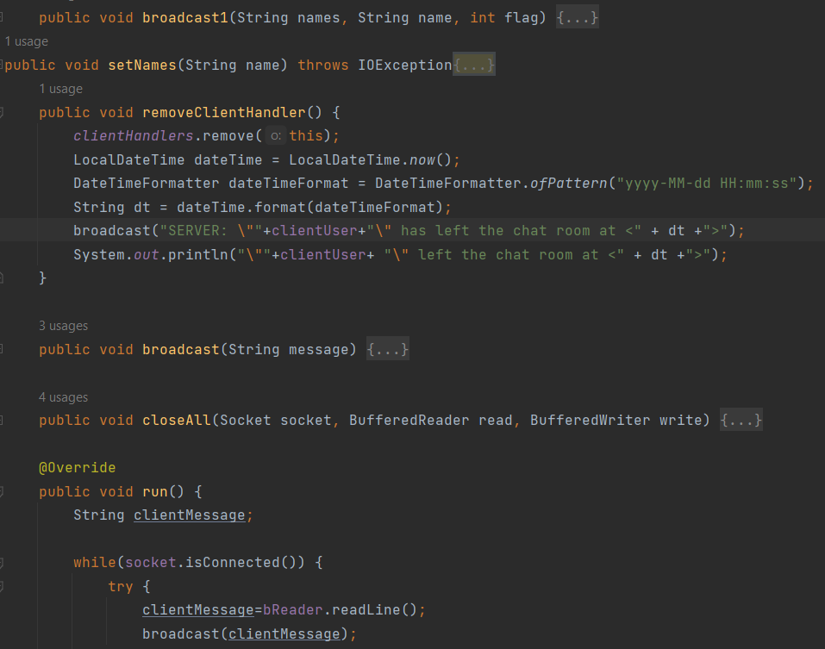
Client Handler
Manages number of clients
Informs clients’ entry/exit
broadcast()
removeClientHandler()

Slide 11

Thank you!

