Slide 1





PGP PROGRAM
OpenAI Agents SDK
Agentic AI
First agents, tools and design patterns
LangChain
Nine hands-on sessions: from your first OpenAI agent to stateful LangGraph workflows, multi-agent crews, agentic RAG and deep agents.
Chains, memory, RAG and tool-using agents
LangGraph
INSTRUCTOR
Stateful graphs, loops, human-in-the-loop
Atul Kahate
linkedin.com/in/atulkahate
CrewAI and AutoGen
COURSE REPOSITORY
Multi-agent crews, flows and teams
github.com/atulkahatecdac/agenticai
Agentic RAG and deep agents
Sessions 1–9 · Demo code: 16_PGP-Agentic/code/session_N
Smarter retrieval, reflection, memory

Slide 2
Course Map
Nine sessions, each with live demos from the course repository
S1
Agentic AI Foundations and Agent Architectures
OpenAI Agents SDK, tools, design patterns
S2
LangChain Core: Chains, Memory and RAG
LCEL, memory, vector stores, RAG pipeline
S3
LangChain Agents and Tool Use
Prompting, custom tools, SQL agents, tool chaining
S4
LangGraph: Stateful Workflows and Routing
State, nodes, edges, streaming, LangGraph Studio
S5
LangGraph: Cycles, HITL and Persistence
Loops, human approval, checkpointers, guardrails
S6
Multi-Agent Orchestration with CrewAI
Crews, flows, managers, memory, observability
S7
Multi-Agent Systems with Microsoft AutoGen
AgentChat, teams, GraphFlow, memory
S8
Agentic RAG and GraphRAG for Agents
Self-RAG, CRAG, reranking, GraphRAG, RAGAS
S9
Deep Agents: Reflection, Planning and Memory
Reflection, replanning, long-term memory

Slide 3




Agentic AI Foundations and Agent Architectures
SESSION 1
What agents are, how they are built, and the patterns behind them – using the OpenAI Agents SDK
Explain what an AI agent is
and how it differs from an LLM, a chatbot and a workflow
AGENDA
What an AI agent is and why we need one
Build agents with the OpenAI Agents SDK
instructions, tools, and the Runner that executes them
Chatbots vs workflows vs agents
Agent components and architecture
Setup and API key
Run agents sync and async
and know when concurrency pays off
OpenAI Agents SDK basics
Giving an agent tools (@function_tool)
Recognise the core design patterns
tool use, ReAct, plan-and-execute, reflection, multi-agent
Building a multi-tool agent step by step
Sync vs async agents
Agent design patterns
Agentic AI framework landscape

Slide 4



What Is an AI Agent?
A system that uses AI models to perceive, decide and act toward a goal
Perception
Reasoning
Action
Learning
Takes input from its environment
e.g. text, user queries, images, audio, sensor data
Decides what to do using rules, logic or ML
e.g. plan a route, pick the best response
Performs tasks based on its decisions
e.g. answer a question, run a command, call an API
Optional: improves over time from feedback
e.g. refine recommendations, improve accuracy
IN ONE LINE
An LLM generates text. An agent wraps an LLM with goals, tools and a loop, so it can actually get things done.
DEMO
session_1/1_1_my_first_agent.py (teaser)

Slide 5
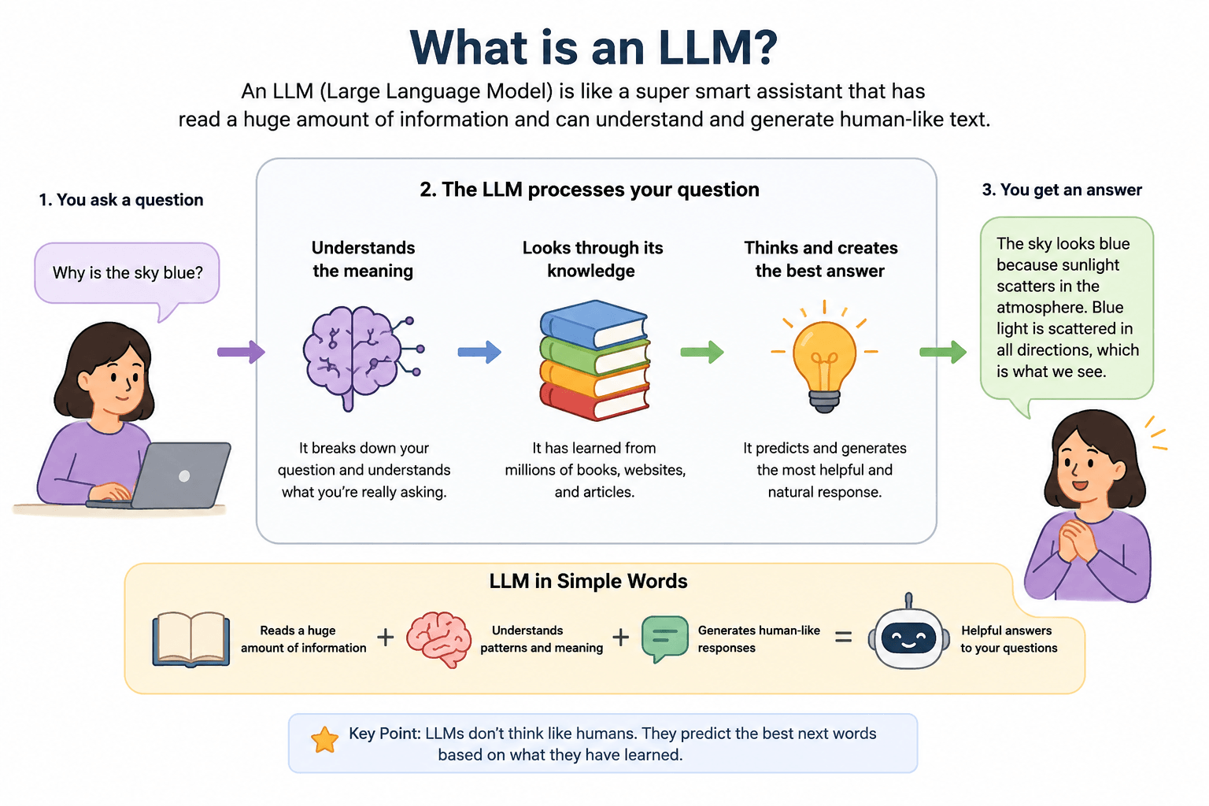
TALK
Concept slide – no code; discuss

Slide 6
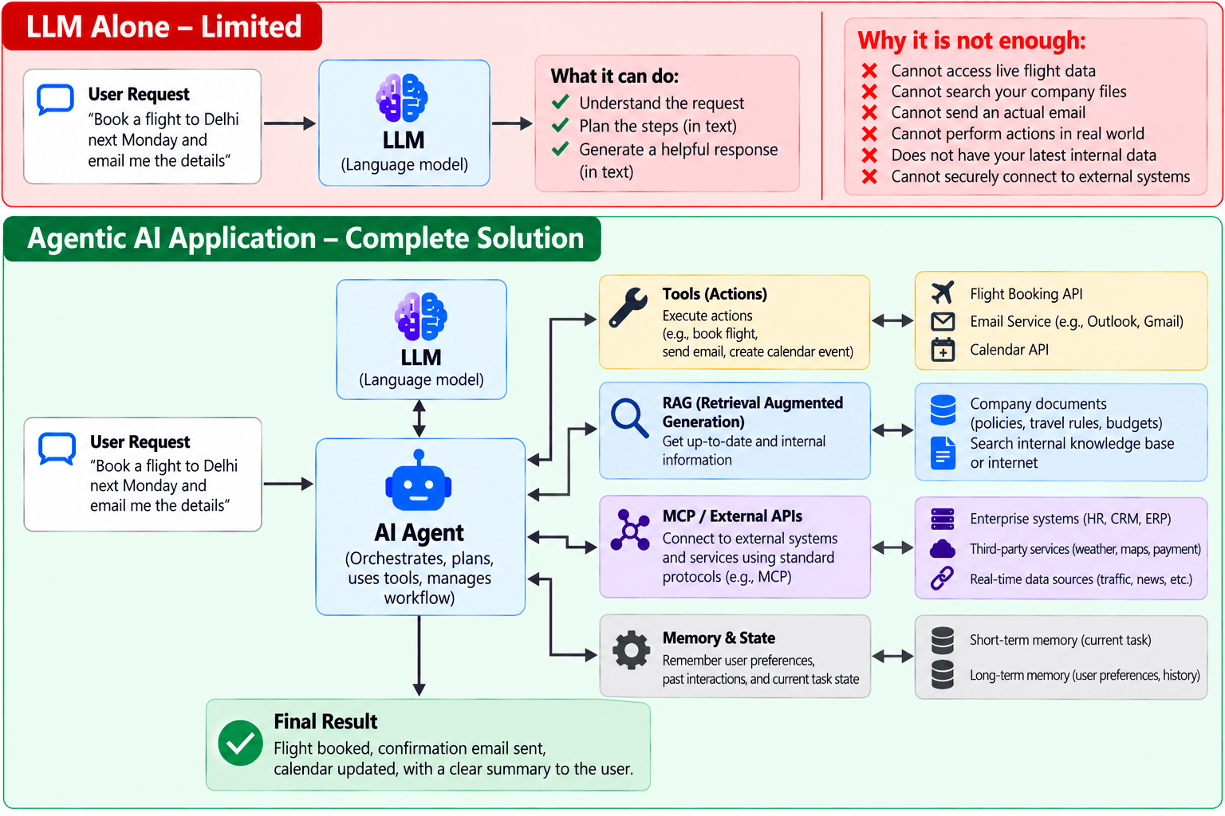
TALK
Concept slide – no code; discuss

Slide 7
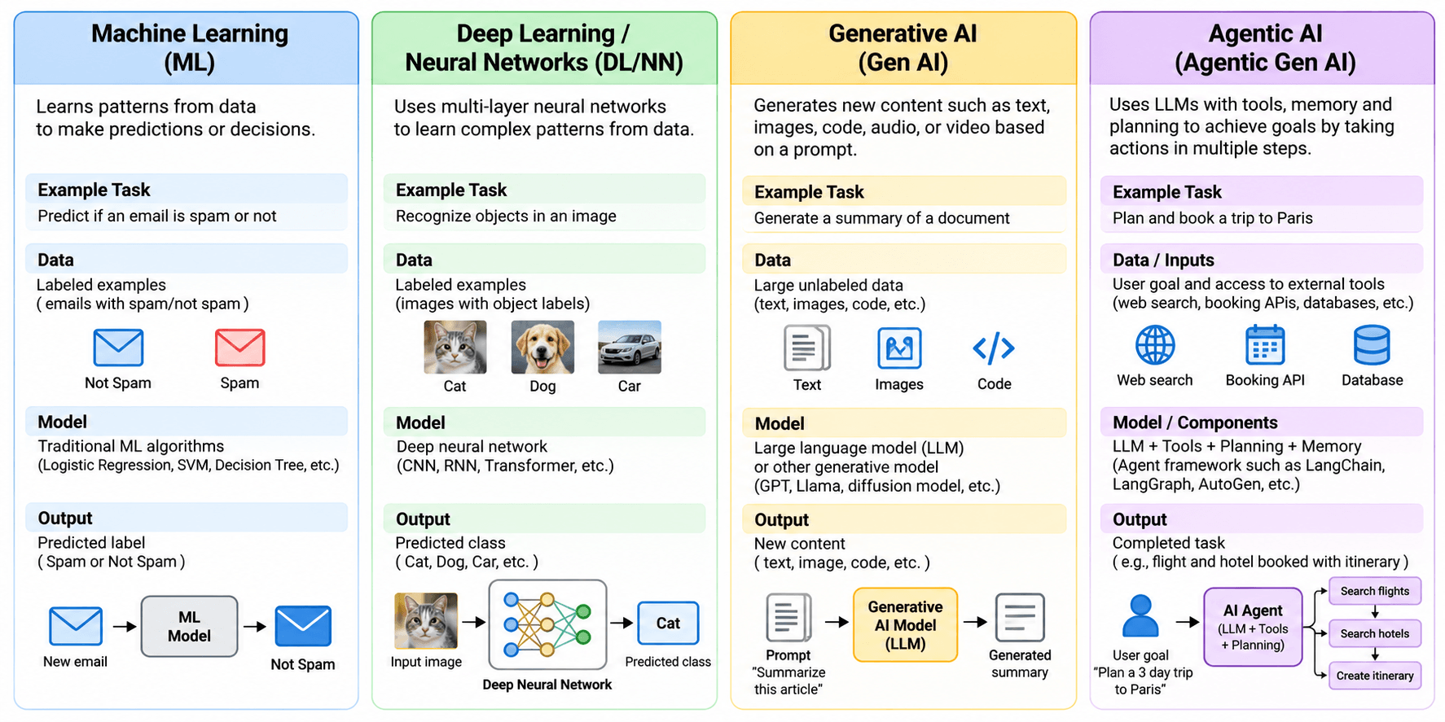
TALK
Concept slide – no code; discuss

Slide 8
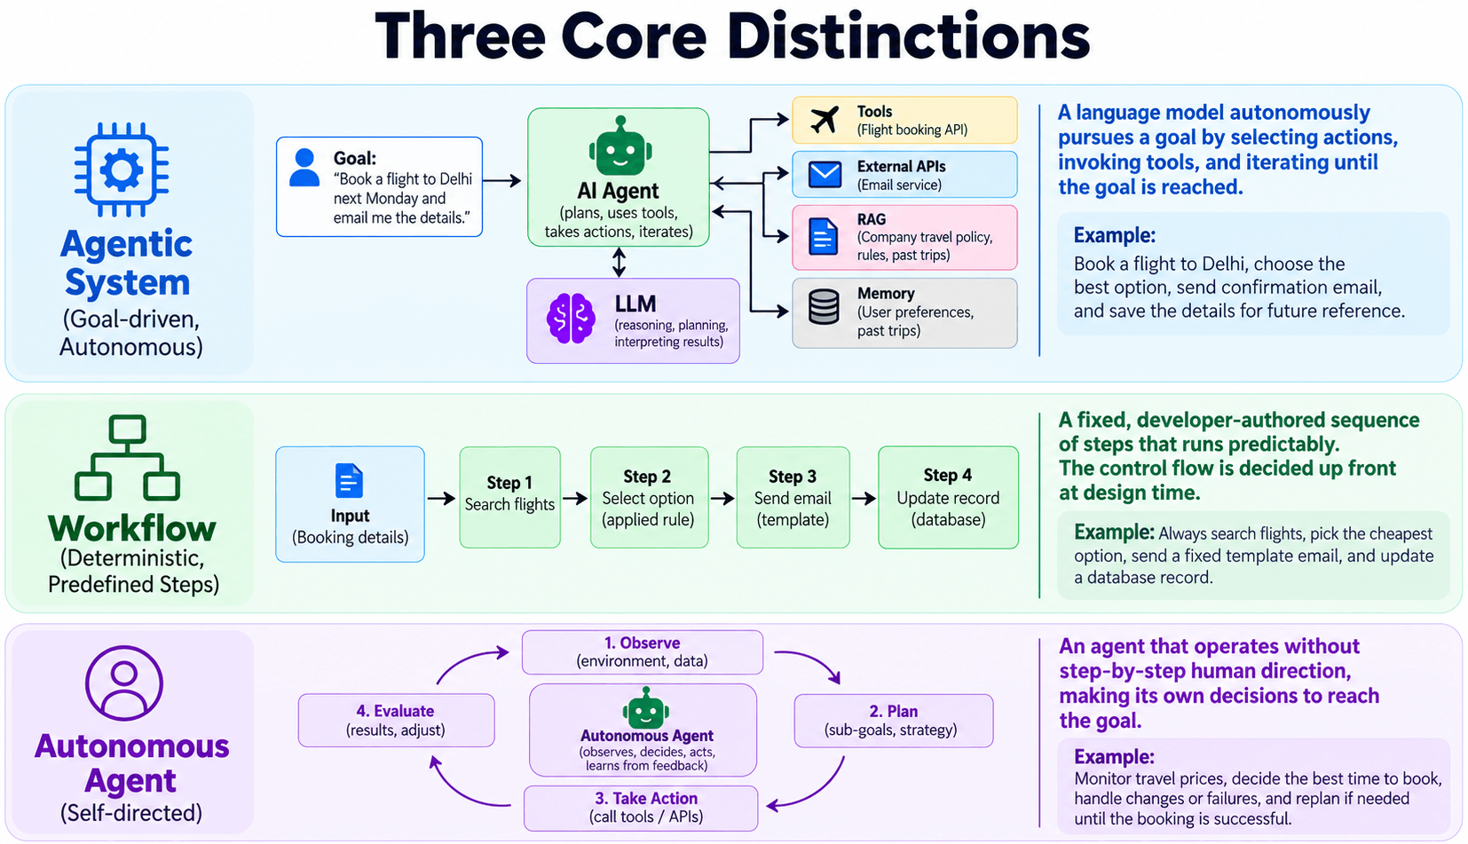
TALK
Concept slide – no code; discuss

Slide 9









The Building Blocks of Agentic AI
Every agent we build in this course combines some of these
Instructions
Goal and role in plain language
LLM
The reasoning engine
Tool calling
APIs, code, databases
Think – act – review
The agent loop
RAG
Grounding in your own documents
MCP
A standard way to plug in tools
Memory
Short-term and long-term context
Human-in-the-loop
Approval at the risky steps
Guardrails
Keep inputs and outputs safe
Multiple agents
Specialists that collaborate
Observability
Traces of every step
Evaluation
Measure answer quality
TALK
Concept slide – no code; discuss

Slide 10
Hands-on Setup
Once per laptop – every later session reuses this environment
1
Install Python 3.12, VS Code and git
Terminal
Fork the course repository
github.com/atulkahatecdac/agenticai → Fork → keep the name agenticai
cd agenticai
python -m venv myenv
# Windows (if blocked, first run:
# Set-ExecutionPolicy -Scope Process Bypass)
myenv\Scripts\activate
# macOS / Linux
source myenv/bin/activate
pip install openai openai-agents python-dotenv
# .env (in the repo root)
OPENAI_API_KEY=sk-...
2
Clone it and open it in VS Code
git clone https://github.com/YOUR-USERNAME/agenticai
3
4
Create and activate a virtual environment
VS Code: Ctrl+Shift+P → Python: Select Interpreter
5
Add your OpenAI API key to .env
platform.openai.com → API keys → copy into .env
DEMO
session_1/1_5_openai_basic.py

Slide 11



First Call: Talking to an LLM Directly
The lowest level – one request, one response, no agent
API key from .env
load_dotenv() puts OPENAI_API_KEY into the environment
1_5_openai_basic.py
from openai import OpenAI
from dotenv import load_dotenv
load_dotenv(override=True)
client = OpenAI()
response = client.chat.completions.create(
model="gpt-4o-mini",
messages=[
{"role": "system",
"content": "You are a helpful assistant"},
{"role": "user",
"content": "Explain agentic AI in one paragraph"},
],
)
print(response.choices[0].message.content)
Messages in, text out
A system message sets the role; the user message asks the question
No tools, no memory, no loop
Everything else an agent does, we would have to code ourselves
DEMO
session_1/1_5_openai_basic.py

Slide 12


SDK, API and Endpoint
Who runs where when our agent talks to the model
Our code
Agents SDK
API endpoint
LLM
Agent logic in Python
Runs on our machine; builds the requests
HTTPS URL exposed by the provider
GPT model running on OpenAI's servers
Term | Full form | Where it runs
SDK | Software Development Kit | On our client – a Python library we import
API | Application Programming Interface | On the server side – the model provider
Endpoint | The URL of one API operation | e.g. the chat completions or responses endpoint
TALK
Concept slide – no code; discuss

Slide 13


OpenAI Agents SDK
pip install openai-agents · define an agent → add tools → run it → inspect the result
Agents
Handoffs
Guardrails
Sessions
An LLM with instructions and tools
e.g. a support bot answering FAQs with function calls
An agent delegates to another agent
e.g. general support hands billing questions to a billing agent
Validate inputs and outputs
e.g. block unsafe requests, check the output is valid JSON
Keep conversation history across runs
e.g. a tutor remembers topics already covered
Also built in: tracing, MCP tools and human approval. The SDK runs the agent loop for us instead of us hand-coding it.
DEMO
session_1/1_2_openai_agent_basic.py

Slide 14


Your First Agent
Two objects: Agent describes it, Runner runs it
1_2_openai_agent_basic.py
Agent(...)
Creates, but does not run, the agent: a name, a system prompt (instructions) and a model
from dotenv import load_dotenv
from agents import Agent, Runner
load_dotenv(override=True)
agent = Agent(
name="Assistant",
instructions="You are a helpful customer support analyst.",
model="gpt-4o-mini", # optional
)
result = Runner.run_sync(agent,
"Analyze this customer feedback and suggest improvements: "
"'The product was a bit stale'")
print(result.final_output)
Runner.run_sync(...)
Sends instructions + message to the LLM and waits for the answer
result.final_output
The agent's final answer, after any tool calls
DEMO
session_1/1_2_openai_agent_basic.py

Slide 15

DEMO
session_1/1_6_openai_agent_pattern_tool.py

Slide 16



How a Tool Call Works
The LLM decides and describes the call; our code executes it
User input
Decide
Tool call
Runner executes
Final answer
"What's the temperature in Tokyo?"
Answer directly, or call a tool?
Structured call that matches the tool's schema
Runs our Python function with those arguments
LLM combines the tool result into a reply
DECIDES
DOES THE WORK
CONNECTS THEM
LLM (agent)
Tool / function
Runner
Chooses when to call a tool, using its instructions, the context and the tool schemas
Name, description (docstring) and parameters, plus the code to run
Passes the call to our function, handles async and errors, returns the result
DEMO
session_1/1_6_openai_agent_pattern_tool.py

Slide 17


Writing a Tool
A normal Python function plus a decorator – the docstring tells the agent when to use it
Step 1 – the function
@function_tool
Turns the function into a tool and generates its JSON schema from the type hints
from agents import function_tool
@function_tool
def get_temperature(city: str) -> str:
"""Returns mock temperature for a city."""
temps = {"london": "65°F", "tokyo": "78°F",
"mumbai": "85°F"}
return temps.get(city.lower(), "70°F")
The docstring matters
The agent reads it to decide if and when to call the tool – make it clear and specific
Type hints are the contract
city: str becomes a required string parameter the LLM must fill in
Step 2 – give it to the agent
agent = Agent(
name="QuickAssistant",
tools=[get_temperature, get_time, calculate],
instructions="Use tools when needed. Be concise.",
)
DEMO
session_1/1_6_openai_agent_pattern_tool.py

Slide 18
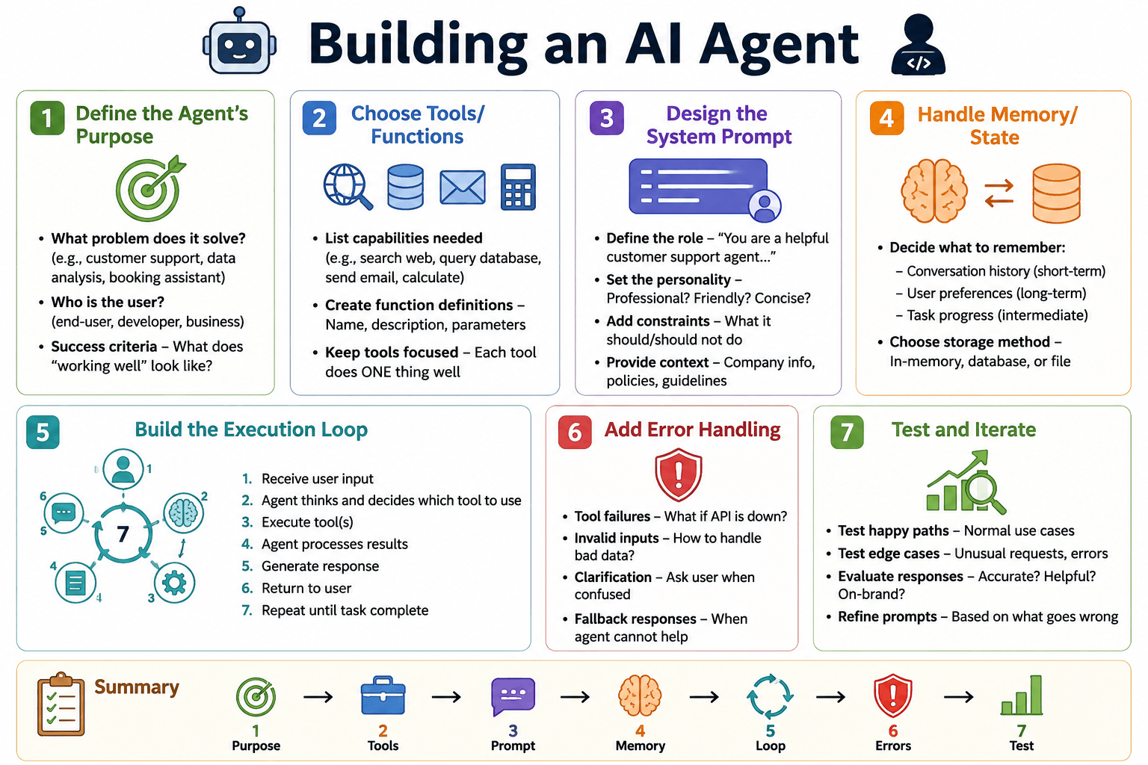
DEMO
session_1/1_1_my_first_agent.py

Slide 19
A Multi-Tool Agent, End to End
Three tools, one agent, three questions answered concurrently
1_1_my_first_agent.py (condensed)
Code | What it does
@function_tool | Makes each function callable by the agent
tools=[...] | The menu of tools the agent may choose from
queries | Plain-language questions – the agent picks the tool
Runner.run(...) | Async run; the list holds one task per query
asyncio.gather | Runs all tasks at once, waits for all
final_output | Each agent's answer after its tool calls
@function_tool
def get_temperature(city: str) -> str: ...
@function_tool
def get_time(timezone: str) -> str: ...
@function_tool
def calculate(expression: str) -> str: ...
agent = Agent(name="QuickAssistant", model="gpt-4o-mini",
tools=[get_temperature, get_time, calculate],
instructions="Use tools when needed. Be concise.")
async def run_agent():
queries = ["What's the temperature in Tokyo?",
"Calculate 25 * 4 + 10",
"What time is it in New York timezone?"]
tasks = [Runner.run(agent, q) for q in queries]
results = await asyncio.gather(*tasks)
for q, r in zip(queries, results):
print(f"Q: {q}\nA: {r.final_output}")
DEMO
session_1/1_1_my_first_agent.py

Slide 20
Sync or Async?
Same agent, two ways to run it
Synchronous – Runner.run_sync(...)
Asynchronous – await Runner.run(...)
Blocking: one call at a time, each waits for the previous
Simple to write – no async / await
Best for scripts, one-off calls, debugging
Slower when there are many requests
Non-blocking: many LLM or tool calls in parallel
Needs asyncio and await
Best for production apps, web servers, many sessions
Higher throughput; errors via gather, timeouts, cancellation
result = Runner.run_sync(agent, msg)
print(result.final_output)
async def main():
result = await Runner.run(agent, msg)
asyncio.run(main())
DEMO
session_1/1_7_openai_agent_sync.py, 1_8_openai_agent_async.py

Slide 21
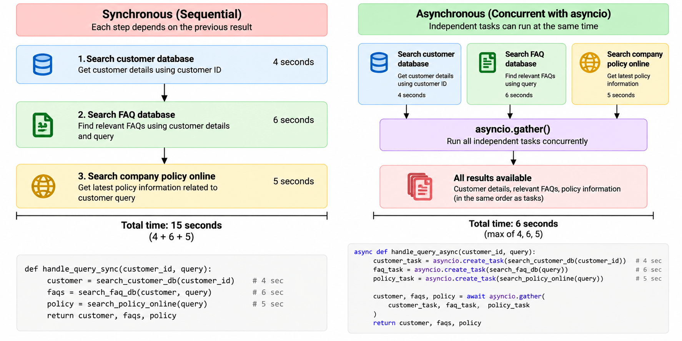
DEMO
session_1/1_7_openai_agent_sync.py, 1_8_openai_agent_async.py

Slide 22
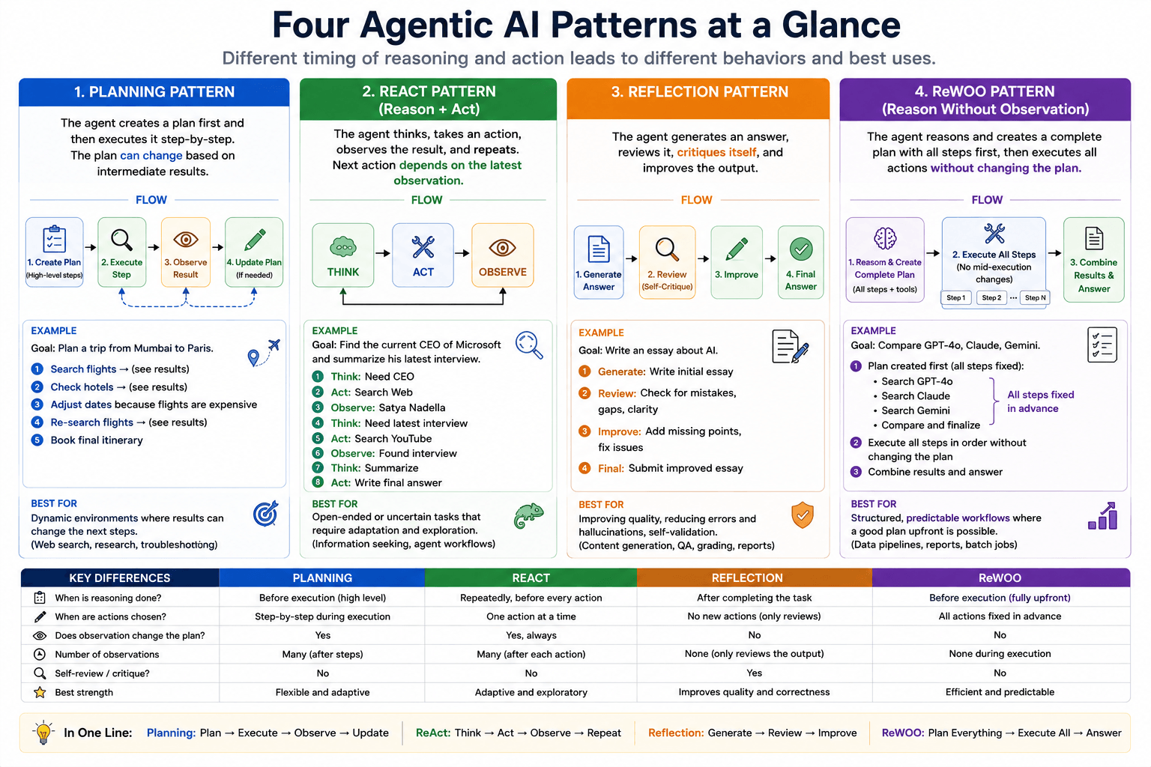
DEMO
session_1/1_9_openai_agent_pattern_plan.py, 1_4_…_react.py, 1_10_…_reflection.py, 1_3_…_rewoo.py

Slide 23





Pattern: Tool Use
The agent decides when and how to call external tools instead of doing everything itself
Analyse
Choose
Call
Receive
Integrate
Understand the task
Pick a suitable tool
Send structured input
Get the tool's output
Fold it into the answer
Modular
Each tool is a specialist
Scalable
Add tools, not code paths
Auditable
Clear trace of who did what
Efficient
Offload work to optimised tools
DEMO
session_1/1_6_openai_agent_pattern_tool.py

Slide 24

Pattern: ReAct (Reason + Act)
Think, act, look at the result, think again – until the goal is reached
Thought
Action
Observation
Answer
What do I need next?
Call the right tool
Read the tool's result
Stop when the goal is met
repeat until the goal is achieved
WHY IT WORKS
The next step is chosen from the latest observation, so the agent adapts as it learns more – ideal when the path to the answer is not known up front.
DEMO
session_1/1_4_openai_agent_pattern_react.py

Slide 25



Pattern: Plan-and-Execute
Plan the whole job first, then carry out the steps
Goal
Planner
Execution plan
Executor
Step 1
Step 2
Step 3
Final answer
Planning
Execution
vs ReAct
Create a complete plan to reach the goal before doing anything
Carry out each step in order; each step can be a small ReAct loop of its own
ReAct decides after every observation; plan-and-execute commits to a strategy first
DEMO
session_1/1_9_openai_agent_pattern_plan.py

Slide 26



Pattern: Multi-Agent
Specialised agents collaborate on one problem, coordinated by an orchestrator
Request
Decompose
Assign
Execute
Aggregate
Arrives at the orchestrator
Split into sub-tasks
Each sub-task to a specialist
In parallel or in sequence
Combine and validate
Specialisation
Each agent does one thing well
Scalability
Add or swap agents freely
Parallelism
Agents work concurrently
Robustness
One failure doesn't sink the rest
In 1_11, three agents run in sequence for each candidate: extractor → evaluator → decider.
DEMO
session_1/1_11_openai_agent_pattern_multi_agent.py

Slide 27
From FAQ Bot to RAG: The Code Ladder
Each script adds one capability to the previous one
# | What changes | Pattern / feature | Script
1 | FAQ bot with a hardcoded knowledge base, keyword match | Function calling | 1_12_openai_agent_tool_hardcoded_knowledge.py
2 | Search by meaning instead of keywords | Semantic search (embeddings) | 1_13_openai_agent_hardcoded_semantic.py
3 | Local Chroma store with OpenAI embeddings | Basic RAG | 1_14_openai_agent_openai_vectorstore.py
4 | FAQs in SQLite, vectorised locally | Basic RAG | 1_15_…_create_faq_db.py → 1_16_…_faq_db_vectorized.py
5 | Chat UI in the browser | Separate the UI (Flask) | 1_17_openai_agent_flask.py
6 | Answers from an insurance PDF | RAG over a document | 1_18_openai_agent_insurance_flask.py
7 | Block balance questions before the agent answers | Input guardrail | 1_19_openai_agent_guardrails.py
8 | Traditional vs agentic RAG | Agentic RAG | 1_20_… vs 1_21_…_agentic_rag.py
9 | Agents used as tools by a manager agent | Agents as tools | 1_22_openai_agent_agent_as_tool.py
10 | Remember earlier turns | Short-term memory | 1_23_openai_agent_short_term_memory.py
DEMO
session_1/1_12_* … 1_23_*

Slide 28
The Agentic AI Framework Landscape
From raw API calls to full multi-agent frameworks – the order we cover them in
 | Tool / framework | Role | Why it fits here
1 | OpenAI SDK | Base API / SDK | Lowest level – call LLMs and embeddings; everything else builds on it
2 | OpenAI Agents SDK | Structured agents | Adds agents, tools, handoffs, guardrails and sessions
3 | LangChain / LangGraph | Chains and agent graphs | Compose workflows as graphs: predictable flows, loops, multi-agent
4 | CrewAI | Multi-agent crews | Role-based agents collaborating on tasks; built for autonomy
5 | AutoGen | Conversational multi-agent | Agents that talk to each other: debate, negotiate, review
6 | MCP | Protocol | Standard agent ↔ tool connection that makes all of the above interoperable
7 | No-code / low-code | Visual builders | Drag-and-drop agents with many connectors (n8n, OpenAI Agent Builder)
TALK
Concept slide – no code; discuss

Slide 29
Session 1 Summary
What you built today
1_2
A first agent
KEY TAKEAWAYS
Agent + Runner.run_sync, with instructions and a model
An agent = LLM + instructions + tools + a loop
The LLM only describes a tool call – our code runs it
Docstrings and type hints are how the agent understands a tool
Use async when calls are independent; sync when each step needs the last
Pick a pattern by how predictable the path to the answer is
1_6
Tools
@function_tool functions the agent decides to call
1_1
Multi-tool async agent
Three tools, three queries, run concurrently with asyncio.gather
1_4
Design patterns
ReAct, plan-and-execute, reflection, ReWOO, multi-agent
1_12+
FAQ bot → RAG ladder
NEXT
Semantic search, vector stores, guardrails, memory
Session 2: LangChain Core – Chains, Memory and RAG

Slide 30

LangChain Core: Chains, Memory and RAG
SESSION 2
Compose LLM apps from small parts, give them memory, and ground them in your own documents
Compose chains with LCEL
prompt | llm | parser, and the Runnables behind the pipe
AGENDA
LangChain overview and architecture
Add conversation memory
buffer, summary and vector-store memory; persistence
LCEL and Runnables
Prompt templates and output parsers
Conversation memory (session and persistent)
Store and search embeddings
ChromaDB and FAISS, similarity metrics, metadata filters
Embeddings and vector databases (Chroma, FAISS)
Document loaders, text splitters and chunking
Building a RAG pipeline with retrievers
Build a RAG pipeline end to end
load, split, embed, retrieve, generate – and a PDF Q&A bot
Hands-on: Q&A bot over PDFs

Slide 31
LangChain at a Glance
An open-source framework for building applications on top of LLMs
Building blocks
Models, prompts, output parsers, retrievers, tools – all interchangeable
How LangChain evolved
Provider-agnostic
Swap OpenAI, Gemini or a local Ollama model without rewriting the app
Generation | Architecture | Status
Early | LLMChain | Legacy
Intermediate | SequentialChain | Legacy
Modern | LCEL (Runnables) | Recommended
Agentic | LangGraph | Complex workflows
LCEL
Connect the blocks with |, then run any chain with .invoke(), .batch() or .stream()
DEMO
session_2/2_1_langchain_lcel.py

Slide 32
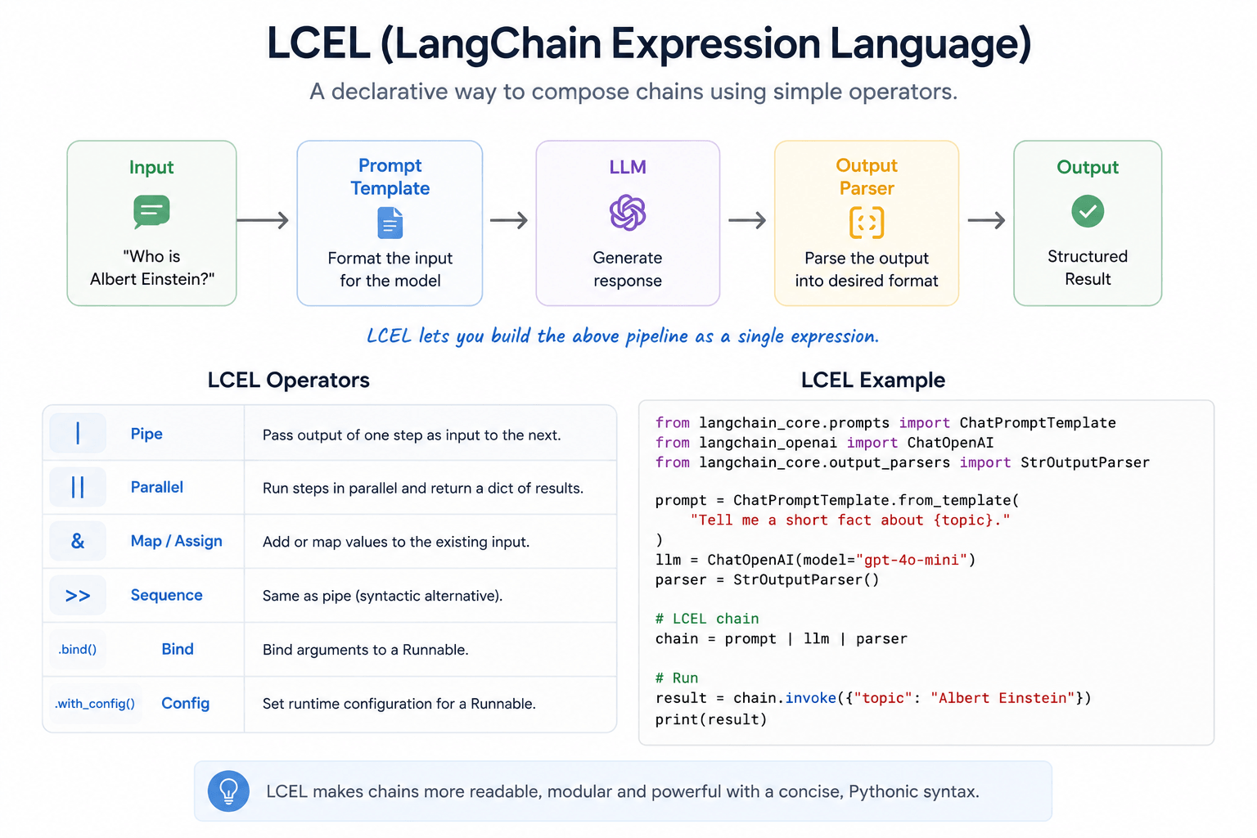
DEMO
session_2/2_1_langchain_lcel.py, 2_2_langchain_lcel_ollama.py

Slide 33
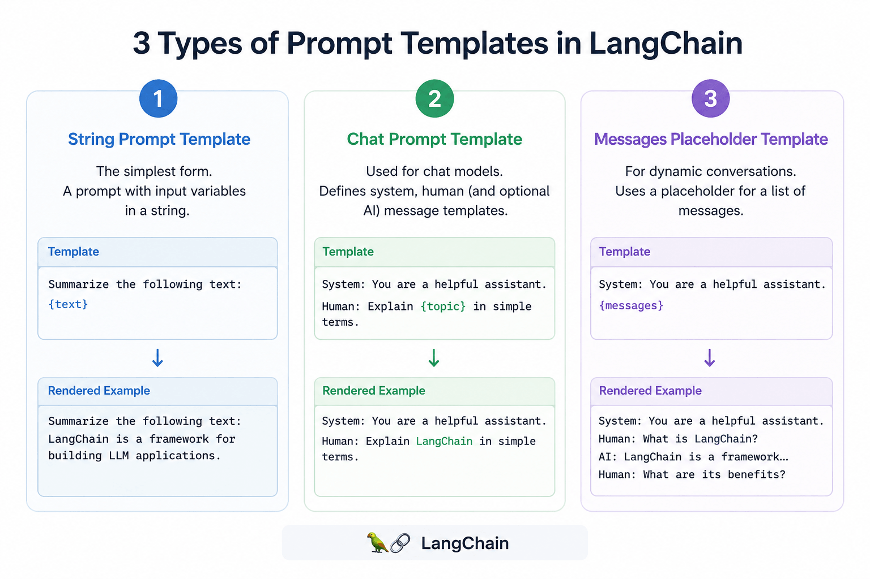
DEMO
session_2/2_3_prompt_templates.py (chat, MessagesPlaceholder and partial templates)

Slide 34
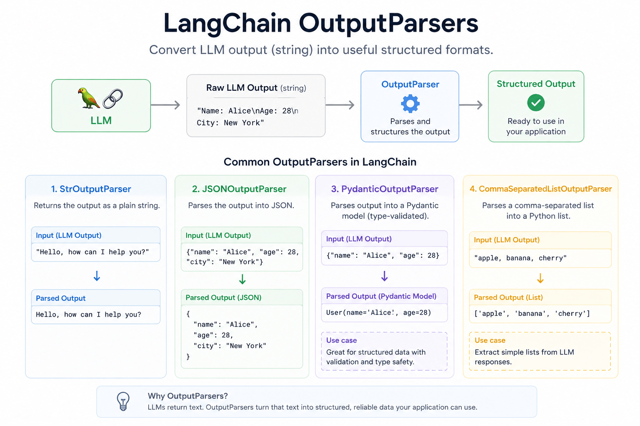
DEMO
session_2/2_4_output_parsers.py (Str, JSON and Pydantic parsers)

Slide 35


Conversation Memory Types
Three ways to remember a customer-support chat – each trades detail for size
STORES EVERYTHING
STORES A SUMMARY
STORES MEANING
Buffer memory
Summary memory
Vector-store memory
Sends every past turn, word for word, to the LLM every time
Simple, but grows without limit
An LLM rewrites the chat into a running summary: "Customer's blender arrived damaged; a replacement ships in 3 days."
Compact, loses detail
Six turns about a laptop; "My battery drains fast" → retrieves the battery turn (turn 3) – the most relevant, not the most recent
Scales to long histories
DEMO
session_2/2_5_memory_types.py

Slide 36

Persistent Memory
Session memory lives only while the app runs; persistent memory survives restarts
System instruction
Previous conversation
Current question
LLM
Save the turn
Who the assistant is
Loaded from the database
This turn's input
Answers with full context
Written back for next time
Session memory
Persistent memory
Kept in RAM
Lost when the program stops
Fine for a single chat
Kept in a database (e.g. SQLite)
Survives restarts – multi-turn across days
Needed for real assistants
DEMO
session_2/2_6_persistent_chatbot.py

Slide 37
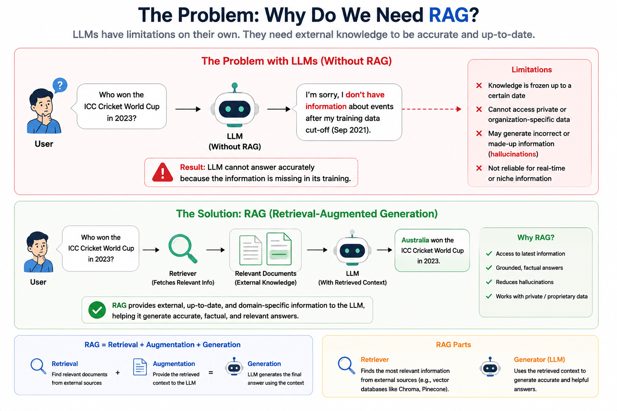
DEMO
session_2/2_7_chroma_db_basic.py

Slide 38
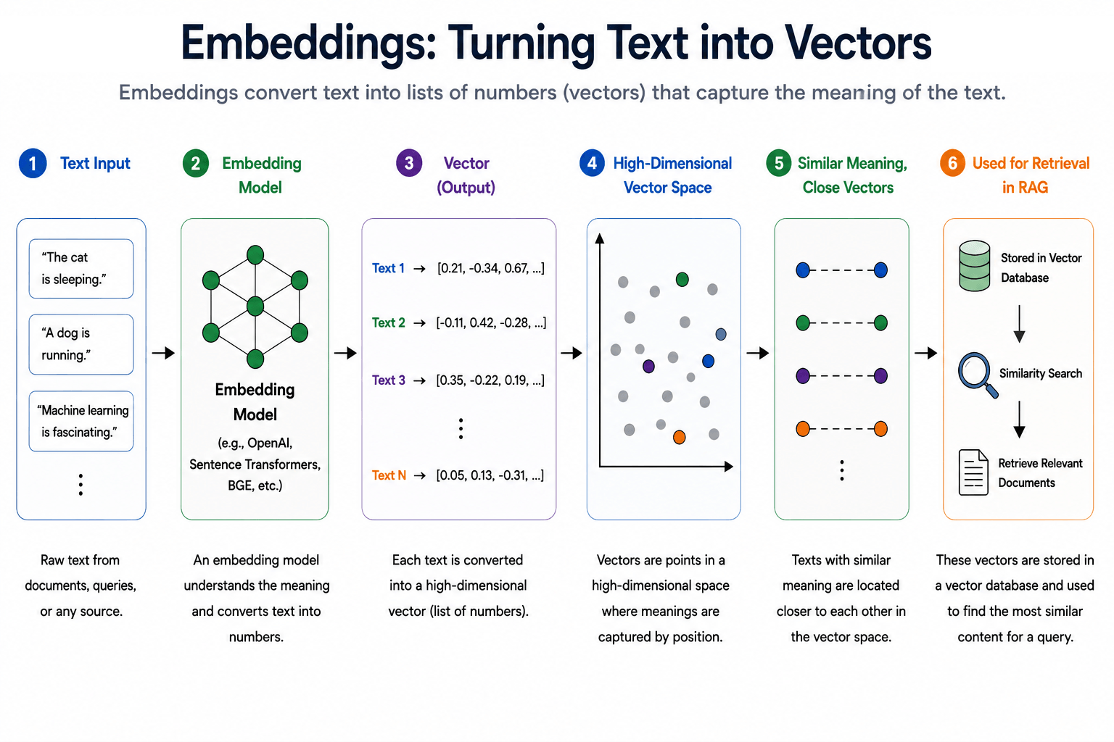
DEMO
session_2/2_7_chroma_db_basic.py, 2_8_rag_cosine_euclidean.py

Slide 39



Measuring Similarity
Nearest-neighbour retrieval ranks stored vectors by how close they are to the query vector
Cosine similarity
L2 (Euclidean) distance
Dot product
Angle between two vectors – ignores length
Larger is better (1 = same direction)
Straight-line distance between two points
Smaller is better (0 = identical)
Alignment and magnitude together
Larger is better; equals cosine for normalised vectors
Not in the demo
RETRIEVAL IN ONE LINE
Embed the question, score it against every stored vector, keep the top-k closest – those chunks go to the LLM.
DEMO
session_2/2_8_rag_cosine_euclidean.py

Slide 40

DEMO
session_2/2_9_chroma_db_adding_metadata.py

Slide 41


ChromaDB: Meaning plus Metadata
A local, persistent vector database – documents, embeddings and metadata together
Documents
The text you store – here, FAQ questions
Search by meaning, filter by metadata
results = collection.query(
query_texts=["can i use cash?"],
n_results=1,
where={"category": "returns"},
)
Embeddings
Created for you by Chroma's built-in model, or one you choose
Metadata
Key–value tags on each item: category, priority, the answer text
ORDER OF WORK
where narrows the candidates by metadata first; similarity then ranks what is left.
DEMO
session_2/2_7_chroma_db_basic.py, 2_9_chroma_db_adding_metadata.py

Slide 42
Vector Databases Compared
Same idea – store vectors, find the nearest ones – different trade-offs
Database | Type | Best for | Pros | Cons
ChromaDB | Local / embedded | Small–medium apps, notebooks | Easy, local persistence, Python-first | Not ideal at very large scale
FAISS | Library, not a DB | Fast in-process search | Very fast, offline, optimised | No metadata store or server
Pinecone | Managed cloud | Production, large scale | Scalable, highly available, no infra | Paid, cloud-only
Qdrant | Open source + cloud | Production with filters | Fast filtering, simple API | Heavier to self-host
DEMO
session_2/2_7_chroma_db_basic.py, 2_10_faiss_search.py

Slide 43
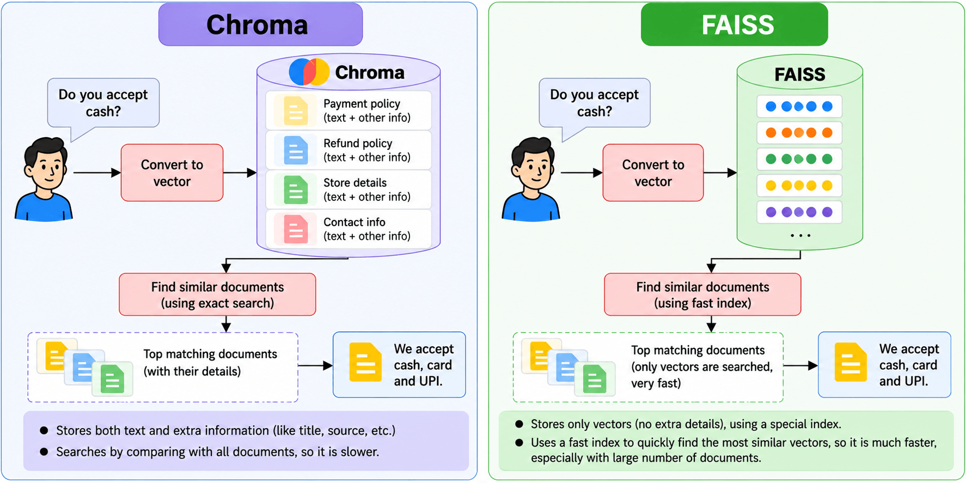
DEMO
session_2/2_7_chroma_db_basic.py, 2_10_faiss_search.py

Slide 44
FAISS: Search Without Comparing Everything
Facebook AI Similarity Search – Meta's library for fast similarity search over dense vectors
Imagine one million documents (the demo has ten), and the user asks "What is artificial intelligence?"
Without FAISS – linear scan
With FAISS – an index
Embed the query
Compare with document 1, then 2, then 3 …
… all the way to document 1,000,000
Slow, and gets slower as data grows
Embed the query
Search the FAISS index
Get the top-k results (top_k=3 in the demo)
IndexFlatL2 in the demo still compares all; IndexHNSW skips most
DEMO
session_2/2_10_faiss_search.py

Slide 45



Loading and Chunking Documents
Turn files into Document objects, then into chunks small enough to embed and retrieve
Loaders
One per format – PDF, CSV, web, Notion; a PDF loads as one Document per page
Strategy | How it splits | Best for
Fixed-size | Every N characters, with overlap so ideas are not cut in half | Quick prototypes (not in the demo)
Recursive | Paragraph → sentence → word until each chunk fits | General RAG (most common)
Semantic | Where the topic changes, judged with embeddings | High-quality RAG
Why chunk: context window
Whole documents do not fit, and tokens cost money
Why chunk: better retrieval
Small focused chunks match questions better
DEMO
session_2/2_11_document_loaders.py, 2_12_text_splitters.py

Slide 46


The RAG Pipeline, End to End
Index once, then answer many questions
Indexing – done once, or when documents change
Documents
Loader
Splitter
Embeddings
Vector DB
PDF, Word, web, CSV, DB
→ Document objects
→ small chunks
→ vectors
Chroma, FAISS, Pinecone
Answering – for every user question
Question
Embed it
Retriever
Prompt
LLM
From the user
Same embedding model
Top-k similar chunks
Context + question
Grounded answer
DEMO
session_2/2_13_rag_pipeline.py

Slide 47

Retrievers
The bridge between the vector database and the LLM – only the relevant chunks reach the prompt
THE DEFAULT
REPHRASE
TRIM
VectorStoreRetriever
MultiQueryRetriever
ContextualCompression
Embeds the question and returns the most similar chunks
Fast, but only as good as the question's wording
An LLM writes several versions of the question, retrieves for each, merges the results
Catches chunks a single wording misses
Retrieves candidates, then an LLM keeps only the parts that answer the question
Less noise in the prompt
BEYOND THESE THREE
Self-query, parent-document and ensemble retrievers (not demoed in this course) build on the same idea – they change how a question becomes the final chunks.
DEMO
session_2/2_14_retrievers.py

Slide 48
Hands-on: Q&A Bot over PDFs
A LangServe app that answers questions about an insurance PDF
1
Run the Chroma version
2_15_langchain_qand_a_bot_chroma.py
Chroma
FAISS
2
Open the playground
http://localhost:8000/ask/playground/
Manages a directory of files for us
Persists automatically
A single .index file + .pkl of documents
save_local / load_local
3
Ask about the policy
Answers come only from the retrieved chunks
Swap in FAISS
2_16_langchain_qanda_bot_faiss.py – same app, different store
4
DEMO
session_2/2_15_langchain_qand_a_bot_chroma.py, 2_16_langchain_qanda_bot_faiss.py

Slide 49
Session 2 Summary
What you built today
2_1
LCEL chains
KEY TAKEAWAYS
prompt | llm | parser, with OpenAI and with local Ollama models
In modern LangChain, everything is a Runnable joined with |
Pick memory by what you can afford to send: all, a summary, or what is relevant
Embeddings turn meaning into geometry; retrieval is nearest-neighbour search
Chunking strategy often matters more than the choice of vector DB
The retriever decides what the LLM gets to see
2_5
Memory
Buffer, summary and vector-store memory; a persistent chatbot
2_7
Vector stores
ChromaDB search with metadata filters; FAISS indexes
2_13
A RAG pipeline
Load → split → embed → store → retrieve → generate
2_15
PDF Q&A bot
NEXT
A LangServe app over an insurance document
Session 3: LangChain Agents and Tool Use

Slide 50

LangChain Agents and Tool Use
SESSION 3
Prompting techniques that drive agents, custom tools, and agents connected to real systems
Write prompts that steer agents
personas, few-shot examples, chain-of-thought, ReAct
AGENDA
Agent fundamentals (recap)
Create and bind custom tools
@tool, bind_tools, and Pydantic schemas
Prompting techniques that drive agents
Creating custom tools and binding them to an LLM
Connect agents to real systems
SQL databases, chained tools and web research
Tools with Pydantic schemas
SQL database agents
Multi-step reasoning and tool chaining
Tool-augmented research agent

Slide 51


Agent Fundamentals: A Quick Recap
Unlike a chatbot, an agent makes decisions and performs tasks until the goal is reached
Perceive
Reason
Decide
Act
Observe
Read the environment
Think about the problem
Choose the next action
Execute it with a tool
Look at the result
continue until the goal is achieved
THIS SESSION
The same loop, built with LangChain: prompts steer the Reason step, tools power the Act step, and a short loop in our own code ties them together.
TALK
Concept slide – no code; discuss

Slide 52
System Prompts for Domain-Expert Personas
Set the role, expertise, rules and style before any user interaction
Component | Purpose
Role | The assistant's expertise
Goal | The primary objective
Knowledge scope | Domain or information sources
Instructions | How to generate answers
Constraints | What to avoid
Output format | Shape of the response
Tone | Formal, friendly, technical …
Template
You are an expert <ROLE>.
Your goal is to <OBJECTIVE>.
Use your expertise in <DOMAIN>.
When answering:
- Explain concepts clearly.
- Ask clarifying questions if information is missing.
- Do not make up facts. If uncertain, say so.
Respond in a professional and concise manner.
Example from the demo (REACT_INSTRUCTIONS)
You are a customer-support assistant that decides
refund eligibility using ReAct-style reasoning.
You do NOT know order details in advance -
you must look them up.
DEMO
session_3/3_1_prompting_techniques.py

Slide 53
Zero-Shot, One-Shot and Few-Shot Prompting
The same refund decision for order A1002, with examples or with none at all
POLICY AND CASE ONLY
ONE EXAMPLE
THREE EXAMPLES HERE
0
Zero-shot
1
One-shot
2+
Few-shot
Best for: QA, summaries, translation, simple classification
Watch out: inconsistent on complex tasks
Best for: teaching a format or style
Watch out: one example rarely covers every case
Best for: complex classification, extraction, structured output
Watch out: longer prompts cost tokens and time
Headphones, 42 days, opened,
undamaged. Eligible for a
refund? Yes/No and amount.
Desk Lamp, 10 days, unopened
→ Yes, refund of $19.99
Headphones, 42 days…
→ ?
Desk Lamp, unopened → Yes
Coffee Mug, damaged → No
Yoga Mat, 35 days → No
Headphones, 42 days… → ?
DEMO
session_3/3_1_prompting_techniques.py

Slide 54
Chain-of-Thought and Tree-of-Thought Prompting
Ask the model to reason step by step, or to compare several lines of reasoning
Case: "I'd like to return order A1002. Can I get a refund?" Bluetooth Headphones, delivered 42 days ago, opened but undamaged. The policy allows returns within 30 days.
Zero-shot: answer directly
CoT: "Think through the policy step by step"
"No, this order is not eligible."
Plausible – but we cannot see or check the reasoning
First the window: 42 days is past the 30-day limit
Then the condition: opened but undamaged is acceptable
Final Decision: not eligible, because of the window
TREE-OF-THOUGHT
Three separate calls each explore one line of reasoning (temperature 0.9); a final call evaluates them against the policy and gives one decision.
DEMO
session_3/3_1_prompting_techniques.py

Slide 55
ReAct Prompting
Reason + Act: alternate thinking with tool calls, and use each result to decide the next step
We have discussed this in Section 1, earlier; but now want to see the inside working of the loop
User: I'd like to return order A1003. Can I get a refund?
T
Thought: I don't know this order yet, so I must look it up
A
Action: lookup_order[A1003]
Question
Thought
Action
O
Observation: Laptop Stand, 6 days since delivery, opened, damaged, $34.5
Observation
Thought
Answer
T
Thought: within 30 days, but the policy excludes opened and damaged items
✓
Final Answer: No, this order is not eligible for a refund
DEMO
session_3/3_1_prompting_techniques.py

Slide 56
Tool Calling: The LLM Asks, the App Acts
On its own, an LLM cannot query an API, send an email, read a database or run a function
User
LLM decides
Tool call
App executes
Answer
"Most downloaded Jane Austen book on Project Gutenberg?"
"I need the book catalogue"
search_gutenberg_books("Jane Austen")
Our code runs the function
LLM reads the result and replies
KEY POINT
The LLM never executes anything. It only generates a structured request; the application decides whether and how to run it.
DEMO
session_3/3_2_tool_calling.py

Slide 57
Tools in LangChain
Define with @tool, attach with bind_tools, and constrain inputs with Pydantic
Define a tool and bind it to the LLM
Pydantic in, Pydantic out (3_3)
from langchain_core.tools import tool
@tool
def search_gutenberg_books(query: str) -> str:
"""Search Project Gutenberg books."""
...
llm_with_tools = llm.bind_tools(
[search_gutenberg_books])
class SearchGutenbergInput(BaseModel):
query: str = Field(description="Title, author or subject")
@tool("search_gutenberg_books",
args_schema=SearchGutenbergInput)
def search_gutenberg_books(query: str) -> str: ...
class BookAnswer(BaseModel):
title: str
author: str
download_count: int
structured_llm = llm.with_structured_output(BookAnswer)
Pydantic makes sure what goes to and from the LLM matches a schema – wrong types fail fast.
DEMO
session_3/3_2_tool_calling.py, 3_3_tool_calling_pydantic.py

Slide 58

Talking to Databases: SQLDatabaseToolkit
Natural language → SQL query → answer
"Which product generated the highest total revenue?" – the agent inspects the schema, writes the SQL, runs it and explains the result. 3_6 asks the same kind of question with one hand-written run_sql tool on the OpenAI Agents SDK.
sql_db_list_tables
Which tables exist?
sql_db_schema
Columns of the chosen tables
sql_db_query
Run a SQL query
sql_db_query_checker
Check a query before running it
PRODUCTION TIP
Give the agent a read-only database user – an LLM that can write SQL can also write DELETE.
DEMO
session_3/3_4_create_sales_db.py → 3_5_sql_database_toolkit_agent.py, 3_6_sales_db_agent.py

Slide 59
The Agent Loop, in Our Own Code
The bind_tools idea from 3_2, repeated until the LLM stops asking for tools
run_agent() from 3_5 (prints and try/except left out)
1
Ask the LLM
It sees the question and all results so far
def run_agent(question, max_steps=8):
messages = [SystemMessage(SYSTEM_PROMPT),
HumanMessage(question)]
for _ in range(max_steps):
ai_message = llm_with_tools.invoke(messages)
messages.append(ai_message)
if not ai_message.tool_calls:
return ai_message.content
for tool_call in ai_message.tool_calls:
tool = tools_by_name[tool_call["name"]]
result = tool.invoke(tool_call["args"])
messages.append(ToolMessage(
content=str(result),
tool_call_id=tool_call["id"]))
2
No tool calls?
Then this is the final answer, so stop
3
Run the tools
Our code runs them, not the LLM
Feed the results back
Each ToolMessage goes into the history; loop again
4
Limit the steps
max_steps stops a confused agent from looping forever
5
DEMO
session_3/3_5_sql_database_toolkit_agent.py, 3_7_chaining_tool_outputs.py

Slide 60





Multi-Step Reasoning: Chaining Tools
"What should I wear outside today in Tokyo?" – no single tool can answer that
User city
geocode_city()
get_current_weather()
recommend_clothing()
find_nearby_places()
Input
→ latitude / longitude
uses the coordinates
uses the weather
uses the coordinates
TWO WAYS
3_7 runs this twice: first the agent decides each next tool, then the same chain is hardcoded with no LLM. The Flask app (3_8) puts a UI on the hardcoded version.
DEMO
session_3/3_7_chaining_tool_outputs.py, 3_8_chaining_tool_outputs_flask.py

Slide 61


Tool-Augmented Research Agent
Search the web, dig deeper where needed, and save a report of what it found
get_current_date()
web_search()
fetch_page_content()
save_report()
When the topic depends on recency
Tavily (3_9) or SerpAPI (3_10)
BeautifulSoup reads promising pages
Markdown file with sources
DIFFERENT FRAMEWORK
These two demos use the OpenAI Agents SDK from Session 1, not LangChain. The agent decides the tool order, and the script then checks that the report file really exists.
DEMO
session_3/3_9_research_agent_tools.py, 3_10_research_agent_tools_serp.py

Slide 62
Session 3 Summary
What you built today
3_1
Prompting techniques
KEY TAKEAWAYS
Few-shot, chain-of-thought, tree-of-thought and ReAct
Prompts are the agent's operating manual – structure them
The LLM requests tool calls; your code runs them
A clear docstring and schema are what make a tool usable
Chain tools when one output is the next one's input
Restrict what tools can do (read-only DB, allow-lists)
3_2
Custom tools
@tool, bind_tools and Pydantic input schemas
3_5
SQL agent
Natural-language questions, with our own agent loop
3_7
Tool chaining
One tool's output becomes the next tool's input
3_9
Research agent
Search, scrape and summarise
NEXT
Session 4: LangGraph – Stateful Workflows and Routing

Slide 63


LangGraph: Stateful Workflows and Routing
SESSION 4
Model an LLM application as a graph: shared state, nodes that update it, and edges that decide what runs next
Know when to reach for LangGraph
and how it differs from plain LangChain chains
AGENDA
Why LangGraph (LangChain vs LangGraph)
Build graphs from state, nodes and edges
TypedDict state, StateGraph, conditional edges
Core components: state, nodes, edges
Building the first graph
Conditional edges
Stream and debug
streaming output and LangGraph Studio
Streaming
Multi-node pipelines and LangGraph Studio

Slide 64
Three Ways to Work with LLMs
More structure at each level: plain Python, a LangChain chain, and a LangGraph graph
LOW ABSTRACTION
MEDIUM ABSTRACTION
HIGH ABSTRACTION
Plain Python (OOP)
LangChain (LCEL)
LangGraph
Direct API calls; we write the flow, state and error handling ourselves
Fits: one-off calls, prototypes
A declarative pipeline: prompt → LLM → parser → tool
Mostly linear; built-in retries and fallbacks
Fits: standard pipelines
Nodes and edges over an explicit, persistent state
Branches, loops, parallel paths, conditional routing
Fits: stateful, multi-step, multi-agent work
TALK
Concept slide – no code; discuss

Slide 65
LangChain vs LangGraph
LangGraph builds on LangChain; it doesn't replace it
Aspect | LangChain | LangGraph
Purpose | Use LLMs with tools, retrievers and parsers | Complex, stateful, multi-agent applications
Workflow | Simple, single-step or short chains | Multi-step, long-running, with loops
State | Minimal; memory handled outside | Built-in shared state across every step
Control flow | Mostly predefined steps | Dynamic branching and runtime decisions
Best for | Chatbots, document Q&A, calculators | Automation, multi-agent orchestration
Learning curve | Easier | Steeper: state, nodes, edges, coordination
TALK
Concept slide – no code; discuss

Slide 66


LangGraph: Four Key Components
A simple greeting graph: ask for a name, then greet the user
State
The data that flows through the graph and is updated at each step
START
Node
One step: takes the current state, returns an updated state
step_1 (ask_name)
step_2 (greet_user)
Edge
Connects two nodes and decides how control flows between them
END
Graph
The overall structure that organises nodes and edges
DEMO
session_4/4_1_langgraph_basic.py

Slide 67
Shared State with TypedDict
Nodes don't pass many variables to each other – they read and update one shared state
Every node now knows which fields exist
 | TypedDict | Pydantic BaseModel
Purpose | Type hints for dicts | Validation and parsing
At runtime | Not enforced | Enforced, with type conversion
Defaults | Not supported | Supported
Nested models | Plain nested dicts | Fully supported
Speed | Faster – no checks | Slower – validates
Use when | You just need structure | You need validation (e.g. API input)
class InputState(TypedDict):
name: str
greeting: str
PARTIAL UPDATES
A node can return only the fields it changed: classify_mood in 4_2 returns just {"mood": ...}, and LangGraph merges it in.
DEMO
session_4/4_1_langgraph_basic.py, 4_2_greeter_graph.py

Slide 68
Your First Graph
Ask for a name, then greet the user – two nodes over a shared state
4_1_langgraph_basic.py (condensed)
START
step_1
step_2
END
class InputState(TypedDict):
name: str
greeting: str
def ask_name(state):
user_name = input("Bot: What's your name? ")
return {"name": user_name, "greeting": ""}
def greet_user(state):
name = state.get("name") or "there"
greeting = f"Hello {name}, nice to meet you!"
return {"name": name, "greeting": greeting}
graph = StateGraph(InputState)
graph.add_node("step_1", ask_name)
graph.add_node("step_2", greet_user)
graph.add_edge(START, "step_1")
graph.add_edge("step_1", "step_2")
graph.add_edge("step_2", END)
app = graph.compile()
app.invoke({"name": "", "greeting": ""})
State
A shared clipboard every node reads and writes
Nodes
Plain functions: state in, updated fields out
Edges
START → step_1 → step_2 → END
compile() and invoke()
Build the runnable graph, then run it from an initial state
DEMO
session_4/4_1_langgraph_basic.py

Slide 69
Conditional Edges: Choosing the Next Node
A plain edge always goes to the same node; a conditional edge picks one from the current state
From 4_2_greeter_graph.py
START
def route_by_mood(state):
return state["mood"] # "happy" or "sad"
graph.add_conditional_edges(
"classify_mood", # after this node
route_by_mood, # call this function
{"happy": "cheerful_reply", # label -> next node
"sad": "sympathetic_reply"},
)
classify_mood
cheerful_reply
sympathetic_reply
END
4_4 uses only plain edges. 4_5 adds one conditional edge: positive news goes to invest_summary, negative to alternatives_summary.
DEMO
session_4/4_2_greeter_graph.py, 4_4_stock_price_graph.py, 4_5_stock_news_sentiment_graph.py

Slide 70
Streaming and LangGraph Studio
See progress while the graph runs, and see the graph itself while you build it
Streaming
LangGraph Studio – a visual IDE for graphs
Normally the graph runs every node, then returns
stream_mode="updates": each node's output as soon as it completes
stream_mode="messages": the LLM's answer token by token
Users see progress instead of waiting
uv pip install "langgraph-cli[inmem]"
langgraph dev --tunnel # opens Studio
# "domain not allowed"? Advanced settings →
# Allowed domains: *.trycloudflare.com
# pick stock_news, input: hdfcbank
# Ctrl+C to stop
DEMO
session_4/4_3_streaming_stock_recommendation.py, langgraph.json, 4_5_stock_news_sentiment_graph.py

Slide 71
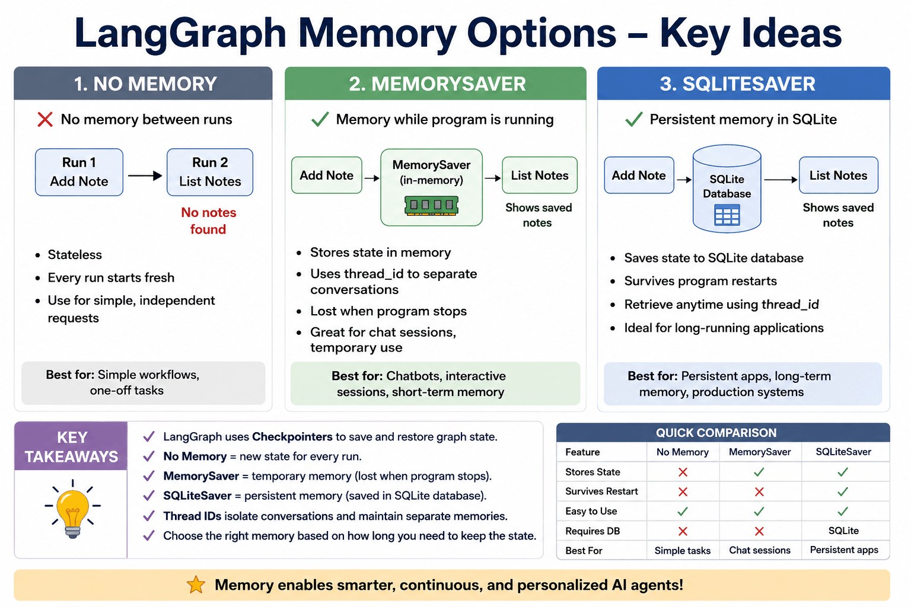
DEMO
session_5/5_4_langgraph_memory.py (covered in Session 5)

Slide 72
More LangGraph Examples
Bigger demos that combine everything so far – several continue into Session 5
Example | What it shows | Code
News summariser | External API + conditional logic on news sentiment | 4_6 (4_7 Ollama, 4_8 Gemini)
Company sector outlook | Multi-node research pipeline | 4_9
Code security reviewer | A planner agent decides the review steps | 4_10
Bank chatbot (real data) | Kaggle FAQs in ChromaDB, ntfy.sh and Gmail, Flask UI | session_5/5_7
Guardrails | Build from a Hugging Face dataset, apply to the bank bot | session_5/5_8 → 5_9
Short-term memory + RAG | Answer from memory first, else the vector DB | session_5/5_10
DEMO
session_4/4_6_…_news_summarizer.py (+4_7/4_8), 4_9_…_sector_outlook.py, 4_10_…_planner_agent.py

Slide 73
Setup: Sending Email from Code
The notification demos send mail through Gmail with an app password
1
Open your Google Account
Security and sign-in
2
Turn on 2-step verification
App passwords are only available with it enabled
3
Create an app password
Use the "App passwords" option, or go to myaccount.google.com/apppasswords
4
Put it in .env
Copy the 16-character password without spaces into GMAIL_APP_PASSWORD
DEMO
session_5/5_7_langgraph_bank_ntfy_email_flask.py

Slide 74
Session 4 Summary
What you built today
4_1
First graph
KEY TAKEAWAYS
State, two nodes, edges, compile and invoke
Use LangGraph when you need state, branches or loops
State is the contract between nodes – design it first
Nodes return partial updates; LangGraph merges them into the state
Conditional edges let the state choose the next node
Stream for responsiveness; use Studio to see and debug the graph
4_2
Mood greeter
State, nodes and a conditional edge
4_3
Streaming
Node by node, and token by token
4_5
LangGraph Studio
See and debug the stock news graph
4_6
News summariser
An API-driven graph with sentiment-based branches
NEXT
Session 5: LangGraph – Cycles, Human-in-the-Loop and Persistence

Slide 75

LangGraph: Cycles, Human-in-the-Loop and Persistence
SESSION 5
Graphs that loop until the work is good enough, pause for a human, and survive a crash
Build loops with a safe exit
conditional edges back to an earlier node, with a limit
AGENDA
Cycles and loops
Pause for human approval
interrupt() and resume with Command(resume=…)
Human-in-the-loop (HITL)
Checkpointers and persistence
Persist and recover state
checkpointers, thread IDs, SQLite crash recovery
State schema design
Subgraphs
Stateful banking chatbot
Structure and protect the graph
state schema design, subgraphs, guardrails
Guardrails in LangGraph

Slide 76


Loops in LangGraph
A node can run more than once – here, an answer is refined until the evaluator is satisfied
The loop is just a conditional edge
class AgentState(TypedDict):
question: str
answer: str
history: List[str]
iterations: int
decision: str # "continue" | "stop"
builder.add_conditional_edges(
"evaluate",
should_continue,
{"continue": "answer", # LOOP
"stop": END}, # EXIT
)
answer
evaluate
should_continue
Ask the LLM to answer or improve; iterations + 1
Ask the LLM: continue or stop?
Stop if iterations ≥ 3, else use the decision
continue → back to answer
DEMO
session_5/5_1_langgraph_looping_agents.py

Slide 77


Retry Loops in a Workflow
An order-processing state machine: approve, retry the payment, or give up
Routing after payment
approved
Continue to ship_order
graph.add_conditional_edges(
"process_payment", # source node
route_after_payment, # routing function
{
"approved": "ship_order",
"retry": "process_payment", # loop
"give_up": "fail_order",
},
)
retry
Go back to process_payment – this is the cycle
give_up
Stop at fail_order after too many attempts
ALWAYS
Give every loop an exit: an attempt counter, a quality threshold, or both.
DEMO
session_5/5_2_order_processing_state_machine.py

Slide 78


Human-in-the-Loop
Pause the graph at a risky step so a person can approve, edit or reject before it continues
Where it's needed: loan approvals, large transfers, medical recommendations, legal documents, contract signing
evaluate_expense
human_approval
Resume
LLM assesses the claim
interrupt(…) pauses here
invoke(Command(resume=decision))
A GOOD HITL SCREEN SHOWS
The AI's recommendation · supporting evidence and retrieved documents · a confidence score · a short reasoning summary · clear action buttons
interrupt() returns control to the caller with a payload to show the human
The state is saved by the checkpointer – a checkpointer is required
Static alternative: interrupt_before / interrupt_after a named node
DEMO
session_5/5_3_human_approval_gate.py

Slide 79



Checkpointers
Save the graph's state so execution can continue later instead of starting over
Graph state
All current field values
Current node
Where execution stopped
Conversation history
Messages so far
Thread ID
Which run this state belongs to
Pending interrupts
What the human must answer
Variables
Counters, flags, results
Without persistence
With persistence
Graph → state → RAM → program ends → lost
Graph → state → SQLite → program ends → retained
Checkpointer ≠ memory. A checkpointer answers "where was the agent?"; memory answers "what does the agent know?"
DEMO
session_5/5_4_langgraph_memory.py, 5_5_sqlite_checkpointing_crash_recovery.py

Slide 80


Crash Recovery with a SQLite Checkpointer
A bank transfer that crashes half-way, then resumes exactly where it stopped
START
debit_account
Checkpoint
credit_account
thread_id = "transfer-1"
$250 debited
Saved to SQLite
Deliberate crash on attempt 1
Run 2 – resume from disk
What the checkpoint holds for transfer-1
app.invoke(None, config) – None means "don't start fresh; resume this thread"
LangGraph finds transfer-1 with debit_account already completed
It runs only credit_account – the second attempt succeeds, and the debit is not repeated
{
"amount": 250.00,
"completed_steps": ["debit_account"]
}
# next node to run: credit_account
DEMO
session_5/5_5_sqlite_checkpointing_crash_recovery.py

Slide 81
Designing the State Schema
State is everything the agent needs while it works – each node reads it and adds to it
Field | Holds
messages | Conversation history
user_query | The current request
retrieved_docs | Knowledge found by retrieval
tool_results | Results returned by tools
reasoning | Intermediate reasoning
final_answer | The response
user_profile | Preferences and profile
status | Where the workflow is
"Am I eligible for a ₹50 lakh home loan?" – the state fills up as the graph runs:
1
Initial
messages, user_query
2
After retrieval
+ retrieved_docs
3
After tool execution
+ tool_results
4
After reasoning
+ reasoning
5
Final
+ final_answer
TALK
Concept slide – no code; discuss

Slide 82

Subgraphs
A graph inside a graph – split one huge workflow into smaller, reusable pieces
In parallel: medical_history + lab_analysis (subgraphs) + analyze_xray
diagnosis
prescription
In 5_6, each subgraph has its own state and nodes – e.g. lab_analysis runs load_lab_results → flag_abnormal_results → summarize_labs – and is called from one node of the main graph.
One responsibility each
A subgraph does one well-defined job
Reusable
Plug the same subgraph into other graphs
Easier to test
Debug a piece without running everything
DEMO
session_5/5_6_medical_diagnosis_subgraphs.py

Slide 83


The Stateful Banking Chatbot
The bank assistant grows feature by feature across these scripts
5_7 RAG + notifications
5_8 Build a guardrail
5_9 Guarded bot
5_10 STM + RAG
Bank FAQs in ChromaDB; ntfy for account opening, Gmail for loans
Harmful examples from a Hugging Face dataset
Unsafe questions are blocked; an LLM explains why
Check short-term memory first, then the vector DB
TRY IT, IN THIS ORDER
5_7 builds the FAQ store that 5_9 reads: ask about opening an account (ntfy) or a loan (Gmail). Then run 5_8 and 5_9 and try an off-topic or unsafe question.
DEMO
session_5/5_7_…_email_flask.py, 5_8_…_guardrails.py, 5_9_…_bank_flask.py, 5_10_…_RAG_chatbot.py

Slide 84

DEMO
session_5/5_8_langgraph_create_guardrails.py, 5_9_langgraph_guardrails_bank_flask.py

Slide 85



Types of Guardrails
Controls that keep a model within limits: safe, on-topic, accurate and within policy
Keyword blocking
Block restricted words
Input validation
Max length, no URLs or code
Allow-listed topics
Only product questions, say
Semantic safety
Embedding similarity to harmful intent
Prompt guardrails
"Use the context only"
Output filtering
Strip sensitive data, profanity
Tool-use limits
No web search for medical queries
Rate and abuse control
Throttling, authentication
Grounding
Retrieval-only answers with citations
The demos build a semantic guardrail from a Hugging Face dataset (5_8), then put it in front of the bank chatbot (5_9).
DEMO
session_5/5_8_langgraph_create_guardrails.py, 5_9_langgraph_guardrails_bank_flask.py

Slide 86
Session 5 Summary
What you built today
5_1
A self-refining loop
KEY TAKEAWAYS
answer → evaluate → continue or stop, capped at 3 rounds
A loop is a conditional edge pointing backwards – always add an exit
Human-in-the-loop needs a checkpointer to pause and resume
thread_id is how you pick which saved run to continue
Design state fields before writing nodes
Guardrails belong on input, output and tool use
5_3
Human approval gate
interrupt() and Command(resume=…) for expense claims
5_5
Crash recovery
A SQLite checkpointer resumes a half-done transfer
5_6
Subgraphs
A medical-diagnosis flow built from smaller graphs
5_9
Guarded bank bot
NEXT
Semantic guardrails in front of RAG
Session 6: Multi-Agent Orchestration with CrewAI

Slide 87
Multi-Agent Orchestration with CrewAI
SESSION 6
Teams of role-playing agents (crews) and the event-driven flows that control them
Build crews from agents and tasks
roles, goals, backstories, tools and processes
AGENDA
CrewAI concepts: agents, tasks, crews, process
Control execution with Flows
@start, @listen, @router and shared state
Building crews for real tasks
Crew vs Flow, and conditional routing
Hierarchical crews and manager agents
Delegate with managers and humans
hierarchical crews, levels of autonomy
Human-in-the-loop and controlled autonomy
Memory and knowledge
Make crews reliable and observable
memory, structured output, guardrails, LangSmith
Structured outputs and agent-to-agent communication
Guardrails, error handling and reliability
Observability for crews
End-to-end crew application

Slide 88
What Is CrewAI?
A Python framework where AI agents with different roles collaborate on complex tasks
TEAM MEMBERS
ASSIGNMENTS
TEAM LEAD
UTILITIES
Agents
Tasks
Crew
Tools
Role: what they do
Goal: what they aim for
Backstory: context that sharpens them
Tools: what they can call
Description: what to do
Expected output: format and content
Agent: who does it
e.g. "Fetch the current financial snapshot for {ticker}"
Delegates tasks
Coordinates the agents
Runs the process
Combines the results
File readers, web search, APIs, databases
Custom tools for your domain
DEMO
session_6/6_1_crewai_basics.py

Slide 89
From a Basic Crew to an Advanced One
A simple crew runs tasks in order; advanced applications also need orchestration, state and control
Financial Data Analyst
Investment Writer
Crew
Fetches a stock snapshot with a tool
Turns it into a plain-English brief
Runs the two tasks in order
Agent
Task
Crew
ADVANCED CREWS MUST ANSWER
Agent
Orchestration
State
Control
What should happen next? · Which agent should act? · What carries forward? · What if the result is poor? · Where should a human step in?
DEMO
session_6/6_1_crewai_basics.py

Slide 90
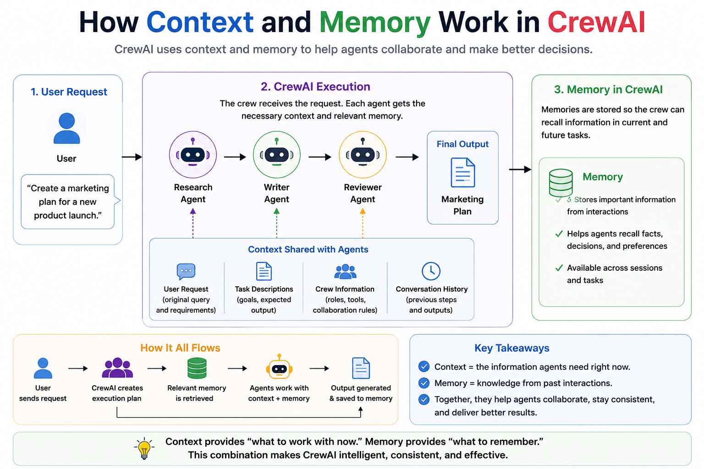
DEMO
session_6/6_2_crewai_document_generator.py

Slide 91
CrewAI Examples
Real crews to run and adapt
Crew | What it does | Script
Document generator | Researches a technology and writes documentation | 6_2_crewai_document_generator.py
Log analyser | Parses, analyses and summarises system logs | 6_3_crewai_log_analyzer.py
Cloud bill analysis | Finds cost drivers in a GCP billing export | 6_4_crewai_cloud_bill.py
Stock analysis | Market data (marketaux.com key) with a Flask UI | 6_5_crewai_stock_analysis_flask.py
Code reviewer | Quality review, without and with agent memory | 6_11 vs 6_10
Observability | The same crew traced in LangSmith | 6_14_crewai_observability.py
Customer service bot | Vector search, then low → reply, medium → email, high → ntfy alert | 6_15 (embeddings) → 6_16
DEMO
session_6/6_2 … 6_5, 6_10/6_11, 6_14, 6_15 → 6_16

Slide 92
Crew vs Flow
Crew = who does the work. Flow = how the application runs.
Crew
Flow
A team of agents working together
Focus: collaboration
Agents perform the tasks
Good for multi-agent work
Controls the overall application
Focus: orchestration
Decides what happens next
Good for complex, branching workflows
START
Fetch snapshot
Route on confidence
Good → Crew analysis → Report
Retry → Explain why not → Report
DEMO
session_6/6_6_crew_vs_flow.py

Slide 93

Flow Building Blocks
Four decorators plus a shared state
@start
Where the flow begins (there can be several)
@listen
Run when another step's output arrives
@router
Choose which path to take
State
Read → update → pass forward
Routing on confidence
Listeners subscribe to the route labels: @listen("good") and @listen("retry")
Branches can converge again with or_(…)
No hard-coded sequence – the flow decides at run time
@router(fetch_snapshot)
def route_on_confidence(self):
if self.state.confidence >= 0.8:
return "good"
return "retry"
DEMO
session_6/6_6_crew_vs_flow.py

Slide 94
Building a Flow: Stock Research
Fetch a live snapshot, judge its quality, then analyse it with a crew – or explain why not
6_6_crew_vs_flow.py (condensed)
1
State
A Pydantic model shared by every step
class ResearchState(BaseModel):
ticker: str = "AAPL"
snapshot: str = ""
confidence: float = 0.0
report: str = ""
class StockResearchFlow(Flow[ResearchState]):
@start()
def fetch_snapshot(self): ... # yfinance
@router(fetch_snapshot)
def route_on_confidence(self): ... # good | retry
@listen("retry")
def handle_low_confidence(self): ...
@listen("good")
def analyze_with_crew(self): ... # Crew.kickoff()
@listen(or_(handle_low_confidence,
analyze_with_crew))
def finalize_report(self): ...
@start
Fetch the stock snapshot; confidence = share of fields present
2
3
@router
≥ 0.8 → "good", otherwise "retry"
4
@listen("good")
An equity-analyst crew writes the take
5
or_(…)
Both branches converge in finalize_report
DEMO
session_6/6_6_crew_vs_flow.py

Slide 95
Hierarchical Crews and Manager Agents
Instead of a fixed researcher → analyst → writer chain, a manager decides who does what
Research Manager
Understands the overall objective
Delegates work to specialists
Reviews their results
Decides what needs more work
Coordinates the final output
Fundamentals
News & Sentiment
Valuation
Final output
USE IT ONLY WHEN NEEDED
If the workflow is straightforward and not agentic, a sequential crew is simpler and cheaper than a manager agent.
DEMO
session_6/6_7_hierarchical_crew.py

Slide 96
Human-in-the-Loop and Controlled Autonomy
Decide how much the crew may do on its own
Level | Agent behaviour | Example
Human-in-the-loop | A human approves each action | Approve a trade recommendation (this demo)
Human-on-the-loop | A human supervises | A review dashboard
Human-out-of-the-loop | Fully autonomous | The snapshot summary in 6_1
Agent
Recommendation
Human review
Approve → Execute
Reject → Revise
DEMO
session_6/6_8_human_in_the_loop.py

Slide 97
Memory, Knowledge and Structured Output
What agents know, what they remember – and how they hand results to each other reliably
Knowledge
"What information do I need to know?" – documents given up front
Agent
Structured output
Validated schema
Next agent
Memory
"What do I remember from earlier work?" – retrieved when needed
6_12_structured_outputs.py
class ResearchFinding(BaseModel):
company: str
revenue_growth: float # 0.12 = 12%
risk_level: str # low | medium | high
confidence: float # 0-1
evidence: list[str]
Flow state ≠ memory
State is this run's temporary context; memory outlives it
DEMO
session_6/6_9_memory_and_knowledge.py, 6_10 vs 6_11, 6_12_structured_outputs.py

Slide 98
Guardrails, Error Handling and Reliability
Agents fail – plan for it
Why agents fail
What a guardrail checks
Hallucinate
Return incomplete information
Call the wrong tool
Produce invalid output
Get stuck in a loop
Depend on a service that is down
In the demo: states buy, hold or sell
In the demo: gives reasoning, not one word
In the demo: any claimed price is near the real one
Also common: required fields, evidence, confidence
Also common: read-only SQL, allowed value ranges
Format
Content
Quality
Safety / policy
DEMO
session_6/6_13_guardrails_and_reliability.py

Slide 99
Observability with LangSmith
See every agent step, prompt, tool call and token count
1
Sign up at smith.langchain.com
.env
Create a tracing project
Tracing → New → market-research-crew
LANGSMITH_TRACING="true"
LANGSMITH_ENDPOINT="https://api.smith.langchain.com"
LANGSMITH_API_KEY="your api key"
LANGSMITH_PROJECT="market-research-crew"
2
3
Add the settings to .env
4
Run the crew and open the trace
DEMO
session_6/6_14_crewai_observability.py

Slide 100
Session 6 Summary
What you built today
6_1
A first crew
KEY TAKEAWAYS
Agents, tasks and a crew that combines their work
A crew is about who works; a flow is about what happens next
Clear roles, goals and expected outputs make agents dependable
Use a manager agent only when the work really needs judgement
Pass structured data between agents, not free text
Trace everything – multi-agent bugs are hard to see otherwise
6_6
A Flow
@start, @router and @listen around a stock-analysis crew
6_7
Hierarchical crew
A manager agent delegating to specialists
6_12
Reliable hand-offs
Pydantic outputs and guardrails between agents
6_16
Customer service bot
Vector search plus priority-based escalation
NEXT
Session 7: Multi-Agent Systems with Microsoft AutoGen

Slide 101
Multi-Agent Systems with Microsoft AutoGen
SESSION 7
Agents that cooperate by talking to each other – in teams, group chats and graphs
Build AssistantAgents with tools
model clients, messages, streaming
AGENDA
AutoGen overview
Run agents sync and async
and get structured, multimodal output
AssistantAgent and tools
Synchronous vs asynchronous agents
Organise agents into teams
round-robin, selector and Magentic-One group chats
Structured output
Multimodal messages
Control the conversation as a graph
GraphFlow with parallel branches and joins; memory
Teams / group chats: round-robin, selector, magentic
GraphFlow (including parallel join)
Memory

Slide 102
AutoGen at a Glance
Microsoft's open-source framework for agents that cooperate – fully asynchronous since v0.4
NO-CODE UI
WHAT WE USE
LOW LEVEL
AutoGen Studio
AgentChat
Core
Web UI to prototype agents by drag and drop and watch them interact
Use when: demoing ideas or validating a workflow before coding
High-level Python API for single- and multi-agent conversational apps
Use when: dialogue and turn-taking matter most
Event-driven runtime: agents, messages, handlers at scale
Use when: many agents coordinate beyond simple chats
IN THIS SESSION
Every demo uses AgentChat (packages autogen-agentchat and autogen-ext) with an OpenAI model client – except 7_5, which uses Anthropic Claude.
DEMO
session_7/7_1_autogen_basic.py

Slide 103
The AutoGen Demos
One concept per script, building up from a single agent to teams and graphs
What it adds | Script
Basic AssistantAgent syntax | 7_1
Calls a live forex API as a tool | 7_2
Sends a TextMessage instead of a plain task | 7_3
Two agents, run one after the other | 7_4
Two agents in parallel – Claude + Yahoo Finance | 7_5
Structured output (OpenAI models) | 7_6
MultiModalMessage – text plus an image | 7_7
What it adds | Script
Round-robin group chat | 7_8
Selector group chat | 7_9
Magentic-One group chat | 7_10
Fact-check: "India never faced a recession in 30 years" | 7_11
GraphFlow | 7_12
GraphFlow with a parallel join | 7_13
Memory | 7_14
DEMO
session_7/7_1_* … 7_14_*

Slide 104
AssistantAgent
An LLM-backed agent that can call Python functions as tools
7_2_autogen_forex_api.py
Parameter | What it does
name | Identifies the agent among many
model_client | The LLM backend that powers it
tools | Python functions – converted to FunctionTools with a schema automatically
system_message | Role, tone and purpose
reflect_on_tool_use | Adds a self-check after tool calls
model_client_stream | Streams tokens as they arrive
agent = AssistantAgent(
name="forex_agent",
model_client=OpenAIChatCompletionClient(
model="gpt-4o-mini"),
tools=[get_forex_rate],
)
async def main():
await Console(agent.run_stream(
task="What is the current forex rate of USD to INR?"))
asyncio.run(main())
DEMO
session_7/7_2_autogen_forex_api.py, 7_3_autogen_forex_api_text_message.py

Slide 105
How a TextMessage Travels
From the user to the model and back, wrapped in message objects
Create
Receive
Convert
Model
Wrap
TextMessage(content=…, source="User")
agent.run_stream(task=text_message.content)
to_model_message() – automatic
The model client generates a reply
TextMessage(content="1 USD = 83.12 INR", source="forex_agent")
WHY BOTHER
Message objects carry who sent what – essential once several agents are talking in the same conversation.
DEMO
session_7/7_3_autogen_forex_api_text_message.py

Slide 106
Synchronous vs Asynchronous Agents
The Session 1 idea again, now with AutoGen agents
Sequential
Concurrent
Each agent finishes before the next starts
Use when later steps need earlier outputs
Simple to reason about; slower on I/O
Independent agents run together
Use when tasks don't depend on each other
Faster; shared state is harder to manage
desc = await desc_agent.on_messages([...])
ctx = await context_agent.on_messages([...])
stock_task = asyncio.create_task(
stock_return_agent.on_messages(...))
index_task = asyncio.create_task(
index_return_agent.on_messages(...))
await asyncio.gather(stock_task, index_task)
DEMO
session_7/7_4_autogen_synchronous_agents.py, 7_5_autogen_asynchronous_agents.py

Slide 107
Structured Output
Make the model return JSON that matches a schema, ready for the next step
5 job postings
Extraction agent
Pydantic schema
JSON out
Unstructured description text (Kaggle LinkedIn jobs)
Reads each description
company_name, role, location
Consistent, easy to parse
Currently supported with OpenAI models. The schema guarantees the downstream code always gets the same keys.
DEMO
session_7/7_6_autogen_structured_output.py

Slide 108


Teams: Agents Talking to Agents
Who speaks next is what distinguishes the team types
Round-robin
Selector
Magentic-One
Swarm
Agents take turns in a fixed order; everyone sees everything
e.g. primary and critic refine a text until the critic says STOP
An LLM picks the next speaker after each message
e.g. Reviewer, Coder and Tester – whoever is needed next
A general-purpose team for open-ended tasks over web and files
e.g. extract, summarise, analyse and review a PDF
Agents hand off control with HandoffMessage
e.g. a DataCollector passes results to a DataAnalyzer (no demo)
DEMO
session_7/7_8_…_round_robin_group_chat.py, 7_9_…_selector_….py, 7_10_…_magentic_….py

Slide 109

GraphFlow: Conversations as a Directed Graph
Like LangGraph, for AutoGen teams – sequential, parallel and conditional paths
Nodes are agents
Edges are the allowed transitions, optionally conditional
7_13: two editors in parallel, one reviewer
builder = DiGraphBuilder()
builder.add_node(writer).add_node(editor1) \
.add_node(editor2).add_node(final_reviewer)
builder.add_edge("writer", "editor1")
builder.add_edge("writer", "editor2")
builder.add_edge("editor1", "final_reviewer")
builder.add_edge("editor2", "final_reviewer")
flow = GraphFlow(participants=builder.get_participants(),
graph=builder.build())
Branches, loops, joins
Fan out to parallel agents, then join
Explicit termination
Max turns, a stop signal, or graph completion
Still experimental
Expect API changes; design termination carefully
DEMO
session_7/7_12_autogen_graphflow.py, 7_13_autogen_graphflow_parallel_join.py

Slide 110
Memory in AutoGen
Store facts and inject the relevant ones into the agent's context
7_14_autogen_memory.py (condensed)
Piece | What it does
add() | Store a fact
query() | Retrieve relevant facts
update_context() | Inject them into the agent's context
clear() / close() | Start fresh / release resources
ListMemory | Simple chronological list – demos, small tasks
Vector memory | Semantic search in a vector DB – RAG-style
user_memory = ListMemory()
assistant_agent = AssistantAgent(
name="multilingual_assistant",
model_client=client,
memory=[user_memory],
)
preferred_language = input("...preferred language...")
await user_memory.add(MemoryContent(
content=f"The user prefers replies in {preferred_language}.",
mime_type=MemoryMimeType.TEXT))
DEMO
session_7/7_14_autogen_memory.py

Slide 111
Session 7 Summary
What you built today
7_2
A tool-using agent
KEY TAKEAWAYS
AssistantAgent calling a live forex API
AutoGen models collaboration as conversation between agents
Everything is async – use it to run independent agents together
Team type = the rule for who speaks next
GraphFlow brings explicit, graph-shaped control to teams
Memory is just context the framework injects for you
7_5
Parallel agents
Claude and Yahoo Finance agents run concurrently
7_6
Structured extraction
Job postings → JSON via a Pydantic schema
7_8
Group chats
Round-robin, selector and Magentic-One teams
7_13
GraphFlow
Parallel editors joined by a final reviewer
NEXT
Session 8: Agentic RAG and GraphRAG for Agents

Slide 112


Agentic RAG and GraphRAG for Agents
SESSION 8
When simple retrieve-then-generate is not enough: smarter retrieval, self-checking, graphs – and how to measure it
Diagnose why RAG fails
missed retrieval, noise, hallucination, fragmentation
AGENDA
RAG failure modes and advanced approaches
Let an agent drive retrieval
adaptive strategies, Self-RAG, corrective RAG
Traditional RAG vs agentic RAG
Retrieval + reasoning
Self-RAG
Improve what reaches the LLM
reranking and hybrid keyword + semantic search
Corrective RAG (CRAG)
Re-ranking retrieved chunks
Connect facts and measure quality
GraphRAG, multi-hop reasoning, RAGAS metrics
Hybrid search
GraphRAG
Multi-hop reasoning
Evaluating RAG with RAGAS

Slide 113
How RAG Fails
Five failure modes to recognise before reaching for a fix
Failure | What happens | Common causes | Example
Missed retrieval | The answer is in the knowledge base but isn't retrieved | Poor query wording, weak embeddings, top-k too small | Policy has the ATM withdrawal limit; unrelated card-security chunks come back
Irrelevant context | Retrieved chunks aren't relevant enough | Low retrieval precision, too much top-k, no reranking | Refund question; shipping and warranty chunks retrieved
Hallucination | The LLM states facts the context doesn't support | Missing information, model assumptions, overconfidence | Context: refunds in 5 business days. LLM: "…and you'll receive an email confirmation"
Lost in the middle | The right chunk is retrieved but buried among others | Too much context, poor ordering | The key clause sits at position 7 of 10 and is ignored
Fragmentation | The answer is split across chunks | Naive fixed-size chunking, no overlap | A rule and its exception land in different chunks
DEMO
session_8/8_1_rag_hallucination_eval.py

Slide 114



The Advanced-RAG Toolbox
Common techniques, each aimed at a specific weakness – this session demos most of them
Agentic RAG
An agent decides what, how and when to retrieve
Self-RAG
Checks its draft answer; regenerates if unsupported
Corrective RAG
Falls back to web search when local fails
Reranking
A stronger model re-orders the chunks
HyDE
Embed a hypothetical answer, search with it
Query expansion
Several rewrites of the question
GraphRAG
Entities and relationships as a graph
Hybrid RAG
Combine keyword and vector search
Multi-hop
Chain several facts to one answer
Retrieval + reasoning
Compute and decide on retrieved facts
RAGAS
Measure retrieval and answer quality
Grounding checks
Every claim backed by context
TALK
Concept slide – no code; discuss

Slide 115
Traditional RAG vs Agentic RAG
A fixed pipeline vs an agent that plans its retrieval
Traditional RAG
Agentic RAG
Fixed retrieval pipeline
Retrieves once
One LLM call
No planning; follows a predefined sequence
Simple architecture
Best for straightforward Q&A
Intelligent, dynamic workflow
Retrieves as many times as needed
Several reasoning steps
Plans, then chooses the best path
Multi-step agent architecture
Best for complex problem solving
DEMO
session_8/8_3_…_vs_agentic_rag.py, 8_4_…_serp.py, 8_5_…_traditional_rag.py vs 8_6_…_agentic_rag.py

Slide 116
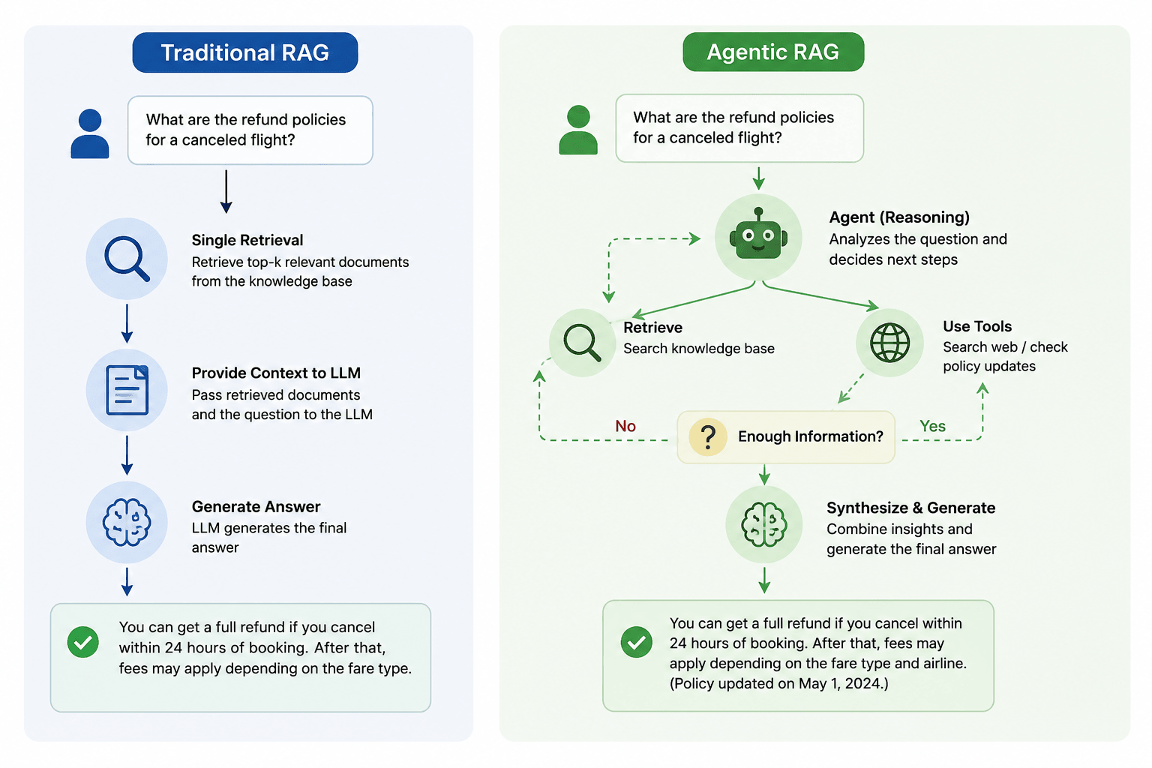
DEMO
session_8/8_3_traditional_vs_agentic_rag.py (FAQ index from 8_2_support_ticketing_agent_hitl.py)

Slide 117


Adaptive Retrieval Strategies
An agentic system picks how to retrieve – including not retrieving at all
Skip retrieval
Answer directly when existing knowledge is enough
Single retrieval
Retrieve once for simple factual questions
Iterative retrieval
Fetch more when the first pass isn't enough
Query reformulation
Rewrite the question for better search
Multi-source
Combine the FAQ knowledge base, web search and a calculator
Tool-based
Pick the right tool for the request
DEMO
session_8/8_7_adaptive_retrieval_strategies.py, 8_8_adaptive_retrieval_strategies_serp.py

Slide 118
Retrieval + Reasoning
Retrieval supplies the facts; reasoning uses them to solve the user's problem
THE QUESTION
"Can I get a ₹50 lakh home loan? My salary is ₹18 lakh a year, I already have a car loan, and my credit score is 760."
Retrieval finds
Reasoning does
Loan eligibility policy
Current interest rates
Customer profile and existing loans
Credit-score rules, RBI lending rules
Calculates the debt-to-income ratio
Checks credit-score eligibility
Applies the policy rules
Works out the maximum amount and suitable options
DEMO
session_8/8_9_loan_eligibility_rag_reasoning.py

Slide 119
A Cohere RAG Pipeline
Embed, rerank and generate – with grounding built into the chat endpoint
embed()
rerank()
chat()
Text → 1536-dim vectors (embed-v4.0)
324 FAQs → the top 3 for the query (rerank-v3.5)
Answer with the reranked FAQs passed as documents=
NOTICE
"How do I get my money back for an order?" – reranking correctly surfaces the three refund FAQs. Cohere's chat endpoint grounds the answer itself; with OpenAI you build that prompt yourself.
DEMO
session_8/8_10_cohere_rag_pipeline.py

Slide 120
Self-RAG: Don't Trust the First Draft
Retrieve → draft → critique the draft → regenerate if needed → answer
Question
Retrieve
Draft
Critique
Regenerate
Covered after 3 years? Can I switch insurer?
Chunks from the insurance policy KB
A first answer from those chunks
Every claim backed? Question fully answered?
Stricter grounding or a follow-up retrieval
draft not supported → regenerate, at most 2 more times
This catches what grading documents cannot: the chunks were relevant, but the answer still overreached beyond them.
DEMO
session_8/8_11_self_rag.py

Slide 121
Corrective RAG (CRAG)
When local knowledge fails, fall back to the web instead of guessing
Question
Plain RAG answers from whatever it retrieved – even the wrong thing
CRAG grades the retrieved chunks first
Some relevant: refine them, then add a web search. None: rewrite the query and use the web only
The answer comes from the best evidence available
Retrieve from the vector DB
Grade the documents
SELF-RAG VS CRAG
how many are relevant?
Self-RAG grades the generated answer; CRAG grades the retrieved documents and can change source.
All: KB only
Some: KB + web
None: web only
Generate the answer
DEMO
session_8/8_12_corrective_rag.py

Slide 122
Reranking Retrieved Chunks
The most similar chunk is not always the most relevant one
Query
Vector search
Top 10 chunks
Reranker
Best 3
LLM
"Documents for a cashless health insurance claim?" (illustrative scores) | Vector score | Reranked
A – Submit the claim form, original bills and discharge summary | 0.82 | 0.97 ✓
B – Premiums must be paid within the grace period | 0.79 | 0.18 ✗
C – Required documents include prescription and diagnostic reports | 0.76 | 0.94 ✓
A cross-encoder reranker reads the query and each chunk together. B was only "about health insurance"; A and C go to the LLM.
DEMO
session_8/8_13_cohere_reranking.py

Slide 123
Hybrid Search
Combine methods so each one covers the other's blind spot
TF-IDF + embeddings (8_14)
BM25 + dense vectors (8_15)
Keyword
Semantic
Favours BM25: "What is the IRDAI mandated claim settlement timeline…?" – an exact acronym
Favours vectors: "If my mom already had a health condition…" – avoids the policy's own wording
Reciprocal Rank Fusion lifts a document ranked highly by either retriever
Exact words
"SIP investment plan"
Meaning
"put money away for old age"
Two ways to combine: a weighted average, or Reciprocal Rank Fusion.
DEMO
session_8/8_14_hybrid_search.py, 8_15_agentic_hybrid_search.py

Slide 124
GraphRAG: Connecting Facts Across Documents
Extract entities and relationships into a knowledge graph instead of treating chunks as isolated
"If I switch insurer through portability, do I keep credit for the waiting period already completed?"
One triple as a graph
Cashless Claim
Extract once
An LLM pulls (subject, relation, object) triples from the policy chunks
1
processed_by
2
Build the graph
Those triples become a networkx graph
TPA
3
Find the entities
Match what the question mentions to graph nodes
4
Walk outward
Collect every connected fact in one traversal
DEMO
session_8/8_16_graph_rag.py

Slide 125
Multi-Hop Reasoning
Follow several facts to reach an answer no single chunk contains
QUESTION
"I'm on a Family Floater Gold plan and intimated the insurer 20 hours after an emergency admission. Will a cashless claim be accepted, who processes it, and how long will settlement take?"
Retrieve
Decide
next_hop_query
Answer
Vector search for the current query
What is still missing?
A new search for the missing fact
From everything collected
at most 4 hops
The demo compares this with a single search (k=3). Unlike GraphRAG, it chains facts with repeated vector searches and no stored graph.
DEMO
session_8/8_17_multi_hop_reasoning.py

Slide 126
Evaluating RAG with RAGAS
Retrieval-Augmented Generation Assessment – scores retrieval and generation, no manual labelling
ACCURACY
RELEVANCE
USEFULNESS
COMPLETENESS
Faithfulness
Answer relevancy
Context precision
Context recall
Did the LLM make things up?
Every claim must be backed by the context
Did the LLM answer the question that was asked?
Was most of what we retrieved actually useful?
Did we retrieve everything the answer needed?
DEMO
session_8/8_18_ragas_evaluation.py, 8_19_ragas_evaluation_customer_support.py

Slide 127
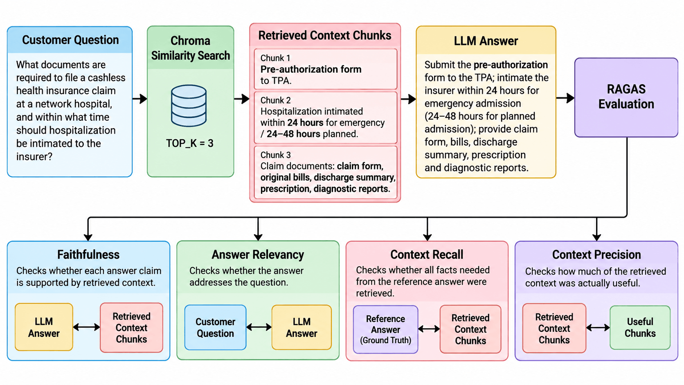
DEMO
session_8/8_18_ragas_evaluation.py, 8_19_ragas_evaluation_customer_support.py

Slide 128
RAGAS Metrics, Worked Through
One cashless-claim question, scored four ways (illustrative numbers – run the demos for real scores)
Faithfulness 0.67
Relevancy 0.95 vs 0.30
Precision 0.60
Recall 0.75
The answer makes 3 claims; the context backs 2
"Intimate within 12 hours" – the context says 24
Score = 2 / 3
Questions are guessed back from the answer and compared with the original
On-topic answer → 0.95
Answer about waiting periods → 0.30
5 chunks retrieved: 3 useful, 2 not (grace period, waiting period)
Score = 3 / 5
4 facts needed; the TPA's role in settlement was never retrieved
Score = 3 / 4
DEMO
session_8/8_18_ragas_evaluation.py, 8_19_ragas_evaluation_customer_support.py

Slide 129
Session 8 Summary
What you built today
8_3
Traditional vs agentic RAG
KEY TAKEAWAYS
The same question through both pipelines
Name the failure mode before choosing a fix
Agentic RAG decides when, what and how often to retrieve
Rerank – similar is not the same as relevant
Graphs answer questions that span documents
Measure with RAGAS before and after every change
8_11
Self-RAG and CRAG
Grade the answer or the documents; regenerate or use the web
8_13
Reranking and hybrid search
Cohere reranker; keyword + semantic with rank fusion
8_16
GraphRAG and multi-hop
An insurance-policy knowledge graph; chained searches
8_18
RAGAS evaluation
Four metrics on an insurance Q&A system
NEXT
Session 9: Deep Agents – Reflection, Planning and Long-Term Memory

Slide 130
Deep Agents: Reflection, Planning and Memory
SESSION 9
Agents that check their own work, plan and re-plan, remember, and get better from their mistakes
Add self-reflection
generate, critique and revise until a quality bar is met
AGENDA
What makes an agent "deep"
Self-reflection loops
Plan, execute and re-plan
plans that change when new facts arrive
Multi-turn reflection with a quality threshold
Plan-and-Execute
Give agents long-term memory
episodic, semantic and procedural – plus consolidation
Replanning
Long-term memory types
Episodic memory
Combine it all
context management, self-improvement, one unified architecture
Memory consolidation
Context propagation and trimming
Self-improvement from failures
Unified architecture: reflection + planning + memory

Slide 131
What Makes an Agent "Deep"
It doesn't just produce an answer – it evaluates its own process and adapts
Basic agent
User
LLM
Tool
Answer
Deeper agent
User
Think about the task
Plan
Act
Observe
Evaluate
Revise strategy
Answer
Normal reasoning
Meta-cognition
"How do I solve this?"
"Is my way of solving this working?"
TALK
Concept slide – no code; discuss

Slide 132

Self-Reflection: Generate → Critique → Revise
"Write a customer-facing outage update"
draft
reflection
revised_answer
A first customer message
Critique it against a checklist
Rewrite using the critique
Clear for non-technical users
Accountable without blaming individuals
Honest about impact
Specific about next steps and prevention
ONE PASS
One agent returns all three as JSON. The next demo loops until a score is high enough.
DEMO
session_9/9_1_openai_agent_pattern_reflection.py

Slide 133



Multi-Turn Reflection
A meal plan: iterate until a quality threshold is met – with an upper limit on rounds
generate
verify: score < 9
revise
verify: score ≥ 9
STOP
Real arithmetic
Python computes the targets and sums the plan's totals
Grounded critique
The LLM grades using those totals, not its own opinion
Stopping rule
Score 9+ or 4 iterations, whichever comes first
Runs as a Streamlit app: streamlit run 9_2_meal_plan_reflection.py.
DEMO
session_9/9_2_meal_plan_reflection.py

Slide 134
Plan-and-Execute, Revisited
Planning decides what to do (strategy); execution does it (action)
Turn a 25-module curriculum PDF into a 4-week study plan for a working professional.
Planner
Writes the numbered plan
Executor
A plain LLM call – no tools are needed here
1
extract_curriculum
Read the PDF text into the task
2
plan_step
Commit to a full ordered plan up front
Replanner
Re-examines the plan after every step
3
execute_step
Work one step at a time, e.g. "draft week 1"
4
replan_step
Shorten, extend or reorder what remains, or finish
DEMO
session_9/9_3_study_plan_plan_execute.py

Slide 135




Replanning
Update the plan when new information arrives – during execution the agent may discover that…
A resource is unavailable
A tool fails
Facts contradict an assumption
New information changes things
A task is already done
A dependency is missing
The approach is too slow or costly
In the demo
A pathology report changes the plan
DEMO
session_9/9_4_pathology_report_replanning.py

Slide 136
Memory Types
Keep context, remember preferences, recall past work – and stop asking the same questions
Memory type | Purpose | Lifetime | Example
Short-term (working) | The current conversation | Minutes / session | Previous chat messages
Long-term | Persistent user knowledge | Days to years | Preferences, profile
External | Stored outside the agent | Persistent | ChromaDB, SQL, Redis
Semantic | Facts and knowledge | Persistent | "Python is your preferred language"
Episodic | Past interactions | Persistent | Earlier support sessions
Procedural | Learned procedures | Persistent | How to deploy an application
DEMO
session_9/9_5_agent_memory_short_term_langgraph.py → 9_6, 9_7, 9_8

Slide 137
Memory Demos, in Order
Each script adds one memory capability
1
Short-term memory
9_5_agent_memory_short_term_langgraph.py
2
Session ID from the user
9_6_agent_memory_dynamic_session_id_langgraph.py – the user ID becomes the session ID
3
Short-term → long-term
9_7_…_short_to_long_term_langgraph.py and 9_8_…_short_to_external_sqlite_langgraph.py
4
The three long-term types
9_9_…_semantic, 9_10_…_procedural and 9_12_…_episodic_langgraph.py
DEMO
session_9/9_5 → 9_12

Slide 138
Long-Term Memory: Three Kinds
Episodic = experiences. Semantic = knowledge. Procedural = skills.
WHAT HAPPENED?
WHAT DO I KNOW?
HOW DO I DO IT?
Episodic
Semantic
Procedural
"We discussed Project X last Tuesday."
"Project X uses PostgreSQL."
"Deploy Project X using this procedure."
DEMO
session_9/9_9_agent_memory_semantic_langgraph.py, 9_10_agent_memory_procedural_langgraph.py

Slide 139
Episodic Memory in Practice
Store specific past episodes outside the model and recall them when a similar case arrives
Seed
recall()
Prompt
Answer
remember()
324 past support tickets, one text blob each
Find the 2 most similar episodes
"Use these similar PAST resolved cases"
Grounded in past resolutions
Store this Q and A as a new episode
Each episode
"Customer asked: Why was my payment declined? | Resolution: ..."
DEMO
session_9/9_11_episodic_memory_store.py, 9_12_agent_memory_episodic_langgraph.py

Slide 140
Memory Consolidation
Summarise and compress old episodes before they pile up
Without consolidation
With consolidation
Day 1 → episode 1 … day 100 → episode 100
Large, redundant, expensive to search
Hard to reason over
Find common patterns across episodes
Replace each group with one dense summary
Swap the summaries into the vector store
8 episodes
3 patterns: 2FA issue · card declined · subscription cancellation
3 summaries
DEMO
session_9/9_13_memory_consolidation.py

Slide 141
Context Propagation and Trimming
Pass the right information forward – and keep it within the context window
The same 16-message support chat, trimmed five ways:
Trimming strategy | How | Best for
Sliding window | Keep only the latest N messages | Chatbots
Summarisation | Replace older turns with a summary | Long conversations
Semantic retrieval | Pull back only relevant memories | Long-term memory
Token-based | Drop the oldest content at a token limit | Production
Priority-based | Always keep critical facts, drop details | Enterprise agents
1
Message 0 states order #ORD-88213
2
15 later messages bury it
3
The follow-up asks for that order number
4
Sliding window is expected to lose it
DEMO
session_9/9_14_context_management_strategies.py

Slide 142
Self-Improvement from Failures
Learn corrected facts from mistakes – good answers leave no trace, mistakes leave a lesson
recall_lessons
respond
evaluate
maybe_store_lesson
Any past lessons relevant to this query?
Answer, guided by recalled lessons
An LLM judge grades against the real policy; 7+ only for the specific correct fact
Only if score < 7: store the corrected fact, not the bad answer
This is semantic memory (facts), not episodic: who asked and when are stripped away.
DEMO
session_9/9_15_self_improving_agent.py

Slide 143
One Unified Deep-Agent Architecture
Memory informs planning → planning guides execution → reflection evaluates it → replanning adapts
Memory
Planning
Execution
Reflection
Replanning
What do I know?
What should I do?
How do I act?
Is it working?
What should change?
the cycle repeats as the agent works
IN THE DEMO
A voice assistant (Whisper + LangChain memory + GPT + TTS) that recalls facts across turns. It shows the memory part; putting all five stages together is your exercise.
DEMO
session_9/9_16_personal_memory_assistant.py

Slide 144
Session 9 and Course Summary
What you built today – and across the course
9_1
Reflection loops
KEY TAKEAWAYS
Generate, critique and revise to a quality bar
Deep agents evaluate how they are doing, not just what to do
Reflection needs a rubric and a stopping rule
Plan up front for long tasks; replan when facts change
Choose the memory type by what must be remembered
Trim context deliberately – the window is a budget
9_4
Replanning
A plan that changes when a report says so
9_11
Episodic memory
Support tickets recalled and consolidated
9_15
Self-improving agent
Lessons stored only when the agent was wrong
S1–9
The full journey
SDK agents → LangChain → LangGraph → crews and teams → agentic RAG → deep agents
NEXT
Thank you! Keep building – the code is at github.com/atulkahatecdac/agenticai

